Slide 1
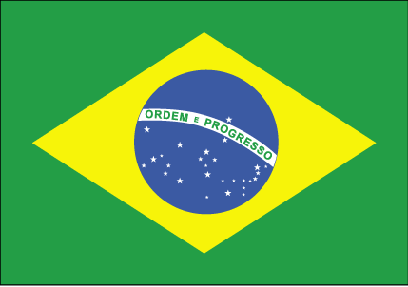
Welcome to 7LE’s assembly!

Slide 2
Flag, location and climate maps
Brazil is the largest country in Latin America and one of the largest in the world.
The river Amazon is largest in the world with a total river flow greater than the next to largest rivers combined.
The Amazon accounts for approximately one fifth of the worlds total river flow.

Slide 3

Brazilian culture !
Brazil is the largest catholic county in the world.
Brazil was a colony of Portugal for 3 centuries.
Brazilian culture is very diverse.
The religion of most Brazilians is Catholicism.
Black Africans who were brought to brazil also played a role in the formation of the culture.

Slide 4
History of Brazil
Brazil was discovered on the 22nd April 1500, by Pedro Alrares Cabral.
In 1578 the King of Portugal died.
Brazil was named after “brazil wood” a tree which is found along the Brazilian coastline.
Portugal remained under the rule of King Philip II from 1580 to 1640.

Slide 5
Geography
Brazils natural resources:
Bauxite
Gold
Iron ore
Manganese
Nickel
Phosphates
Platinum
Tin
Petrol
Hydropower
Timber
The most prominent geographical features of brazil are the Brazilian highlands or the Brazilian plateau and the basin of the Amazon river.
Serra means mountains.
The basin of the Amazon river takes up almost 1/3 of brazil!

Slide 6
Brasilia
Brasilia is the capital City of Brazil
There were 2,606,885 people living in Brasilia in 2009

Slide 7
Language
Hello= Ola
Good morning= Bomdia
Good afternoon= Boatarde
How are you?= Como voce esta?
Good= Bom
Bad= Ruim
Bye Bye= Tchau Tchau

Slide 8
Brazilian Food
Here are a few popular food dishes: Barreado, Carangueijada, Carura, Cozido and Feijoada which is their national dish. All of these include meat, vegetables or both.
Some good food places in Brazil are snack bars, pizzerias and steak houses.

Slide 9
Music and typical dances
Brazilian dance is made up from a mix of African and Portuguese parts this reflects the origins of the people of the country. The Samba is the national dance of brazil. The Samba has been danced in Brazil since it’s beginning in the late 19th century.
Brazilian music is full of passion and joy. It is a mix of Indian, Portuguese and African music. Popular music includes instruments like: cucas, tambouranies, frying pans, guitars and the piano.

Slide 10
World records and accruement
FIFA WORLD CUP:
Winners (5) :1958, 1962, 1970, 1994, 2002
Runners up (2) : 1950,1998
3rd place (2) : 1938, 1978
4th place (1) : 1974
The oldest football player is Tercio mariano de Rezende (born 31st December 1921) is currently the world’s oldest regular football player. He is a right winner in Brazil.

Slide 11
National sports
The national sport of brazil if football. Brazil have the most successful football team in the world many great players come from Brazil.
Sailing, swimming, judo and athletics are traditional sports in Brazil which have earn them Olympic medals in the past.
Currently Brazil is the most successful country at Volleyball. Capoeira is an afro Brazilian Martial arts.

Slide 12

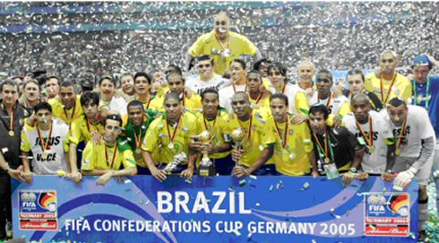
National football heroes and performance
Brazil have won the world cup 5 times.
Some of brazils football heroes are Kaka, Ronaldinho, The Ronaldo and pele.
Brazils top scorer is pele he has scored 77 goals.
They won the world cup in 1958 in Sweeden, 1962in Chile, 1970 in Mexico, 1994 in the U.S.A and 2002 in Japan and south korea.
There fifa rating is number 1 in the world.

Slide 13
Thanks for listening!!

