Slide 1
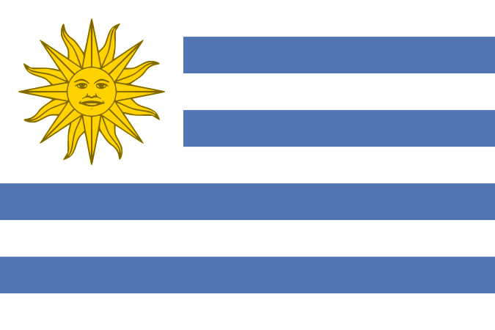
11AH WORLD CUP 2010
URUGUAY

Slide 2
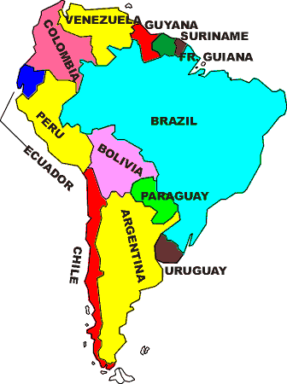
Uruguay (English pronunciation: is a country located in the southeastern part of South America. It is home to some 3.3 million people, of whom 1.1 million, live in the capital Montevideo and its metropolitan area. An estimated 88% of the population are of European descent.
URUGUAY

Slide 3
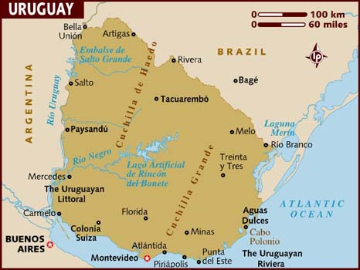
Uruguay's only land border is with Rio Grande do Sul, Brazil, to the north. To the west lies the Uruguay River, to the southwest lies the estuary of Río de la Plata, with Argentina only a short commute across the banks of either of these bodies of water, while to the southeast lies the South Atlantic Ocean. Uruguay is the second smallest country in South America, being larger only than Suriname.

Slide 4
One of Uruguay's oldest European settlements, was founded by the Portuguese in 1680. Montevideo was founded by the Spanish in the early 18th century as a military stronghold. Uruguay won its independence in 1825–1828 following a three-way struggle among Spain, Argentina and Brazil. It is a constitutional democracy, where the president fulfils the roles of both head of state and head of government.

Slide 5
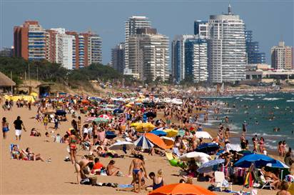
Uruguay is one of the most economically developed countries in South America, with a high GDP per capita and the 47th highest quality of life in the world.

Slide 6
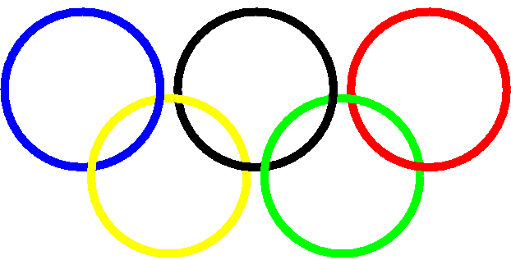
OLYMPIC EFFORT
The main sport in Uruguay is Football(soccer). In 1924, Uruguay sent its
national team to the Olympics in Paris, the first South American nation to
compete in Europe. They won gold at the competition, as well as at the next
Olympics in Amsterdam in 1928.

Slide 7
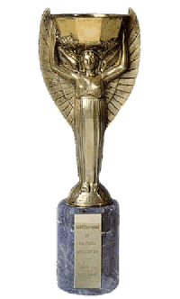
LITTLE BELTER
In 1930, Uruguay hosted the first ever World Cup and went on to win the competition, defeating Argentina 4–2 in the final. Uruguay won the 1950 FIFA World Cup famously defeating the favoured hosts, Brazil, 2–1 in the last game of the final series.
Uruguay is by far the smallest country, population wise, to win a World Cup.
In fact, only six nations with population smaller than Uruguay have ever participated in any World Cup.

Slide 8
2 OF A KIND
In addition, the Uruguay national football team is one of only
five nations to win the FIFA World Cup on two or more occasions.

Slide 9
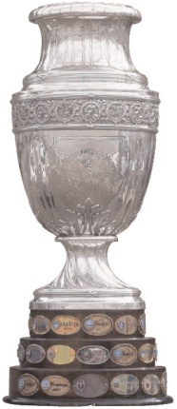
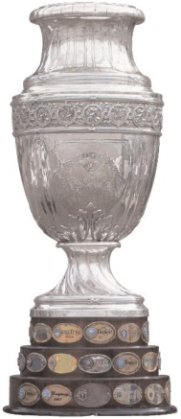
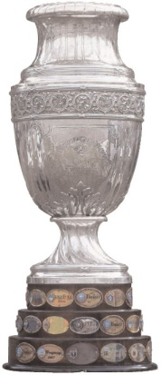

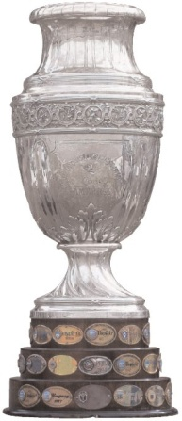


Uruguay is also the smallest member nation of CONMEBOL, South American Football Association. Nevertheless, the Uruguayan national team has won the Copa América 14 times, a record it shares with Argentina.

Slide 10


The most popular football teams in Uruguay are:
Club Nacional de Football (Three times World champions, three times Copa Libertadores de América champions, two times Copa Interamericana champions, one time Recopa Sudamericana champions)
Club Atlético Peñarol (Three times World champions, five times Copa Libertadores de América champions).
Those two, are followed by, Defensor Sporting Club, Danubio, Montevideo Wanderers, and other popular teams like Cerro and Rampla Juniors.

Slide 11
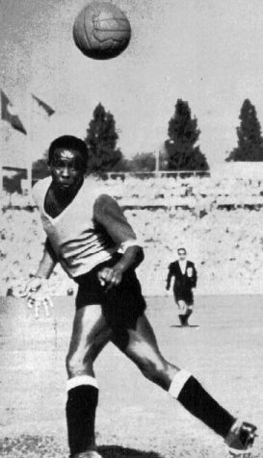
Jose Leandro Andrade
‘The Black Marvel’ never faked injury and
was a great right half (right midfield) and
attacked as a winger due to his great speed.
Fair minded on the pitch and a magician
with the ball. Arguably the best player of the
1930 World Cup he injured his eye hitting
the goal post playing against Italy. Revered
in Europe as the footballer with the Golden
Feet!
Also won 2 Olympic Gold Medals, 3 South
American Championships and 4 National
Championships.

Slide 12
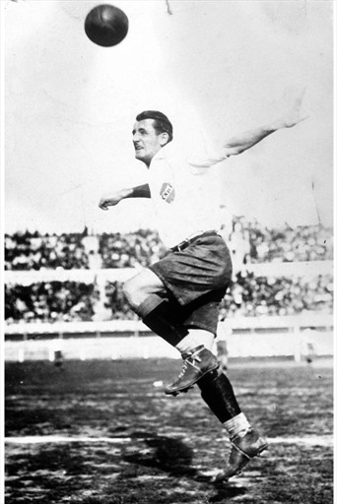
Jose Nasazzi
Captain of the1930 World Cup
Champions.
2-time Olympic Gold
Medal Winner with Uruguay 1924,
1928.
Copa America MVP in 1926 and
1935.
El Kapitan was perhaps the
Greatest Uruguayan Footballer ever!

Slide 13
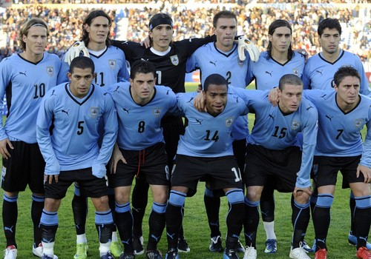
PRESENT URUGUAY TEAM

Slide 14
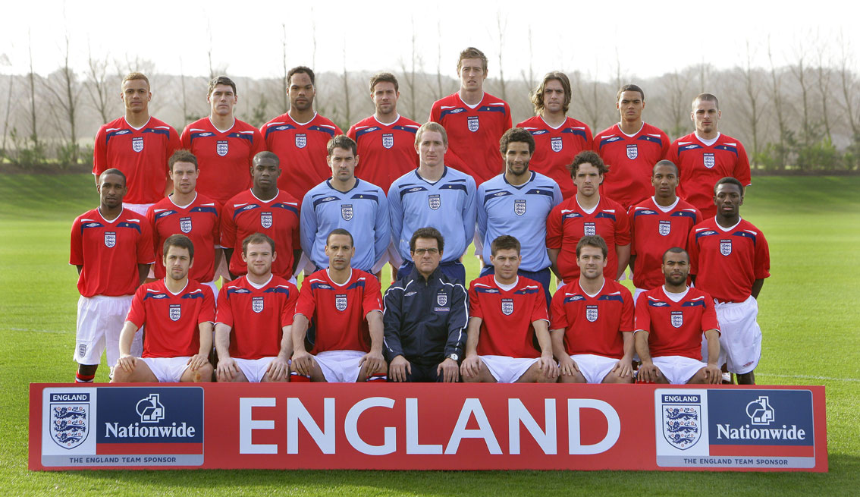
ENGLAND’S DREAMING...READ EM AND WEEP LOSERS....!

Slide 15
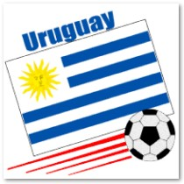
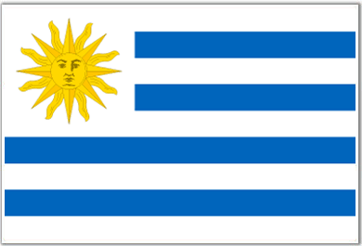
Come on you.. Uruguay...!!!

