Slide 1
HOME SWEET HOME
AKANKSHA MANRO’S V B

Slide 2
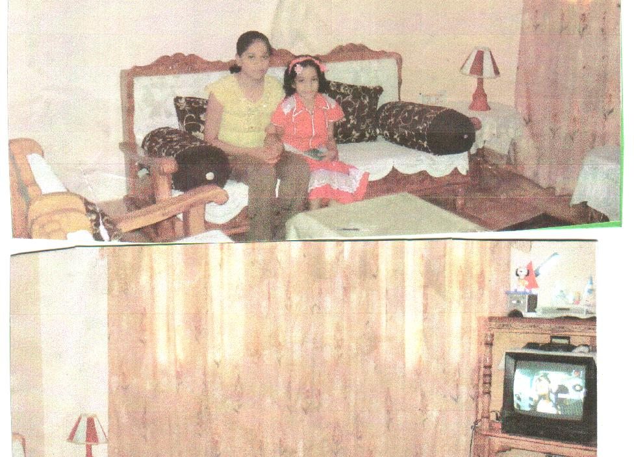
LIVING
ROOM

Slide 3
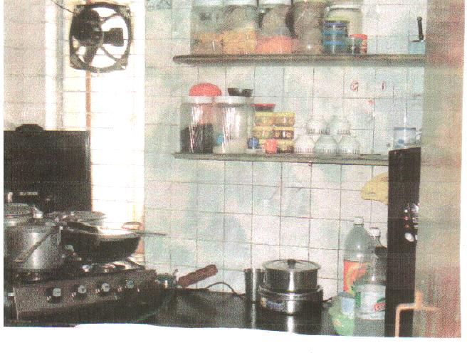
KITCHEN

Slide 4
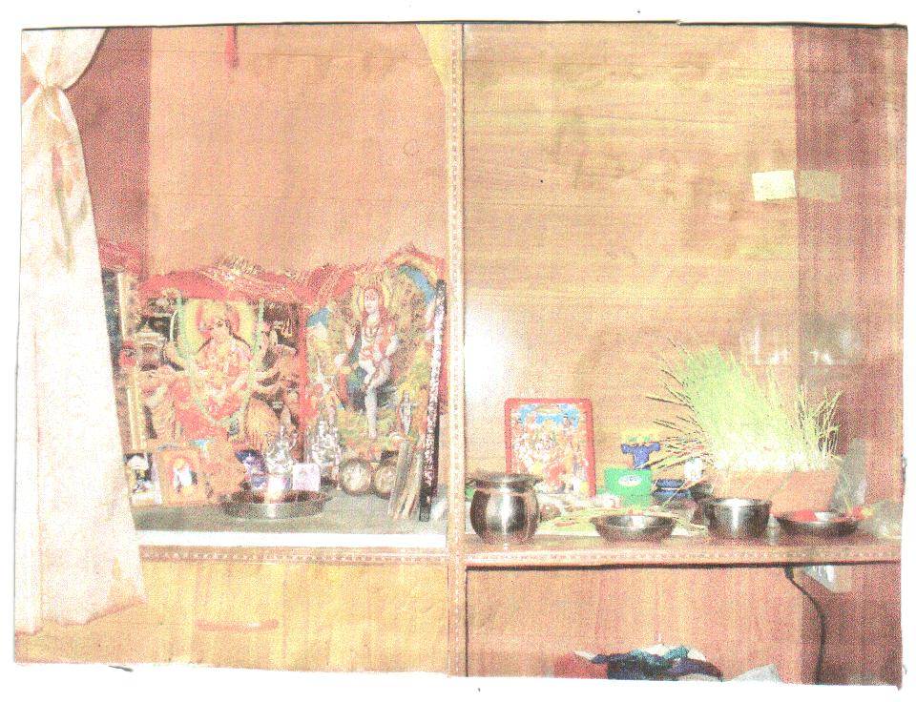
POOJA GHAR
PLACE
OF
WORSHIP

Slide 5
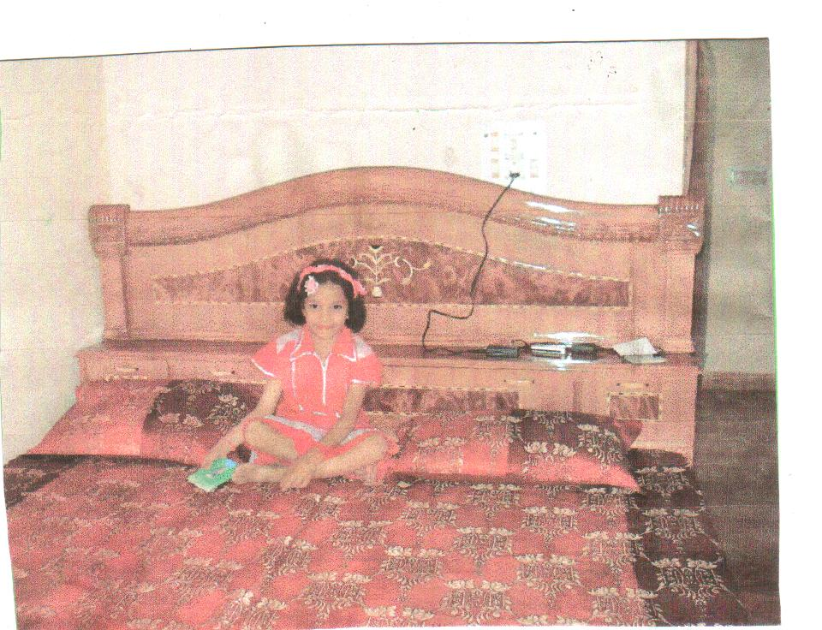
BEDROOM

Slide 6
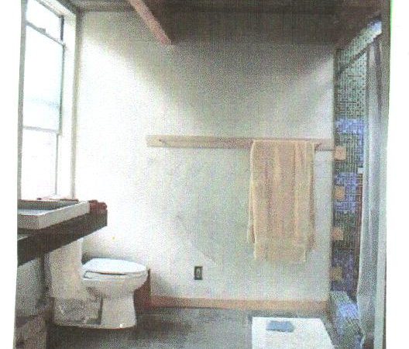
WASHROOM

