Slide 1
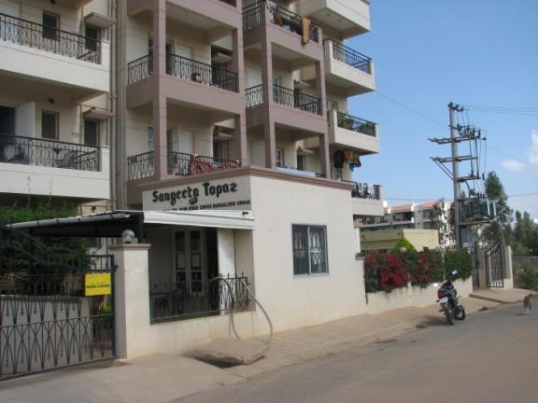
Sangeeta Topaz Apartments
TAISHA’S APARTMENTS

Slide 2
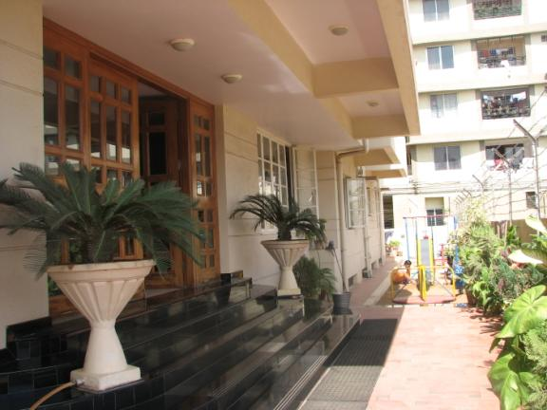
Lobby entrance

Slide 3
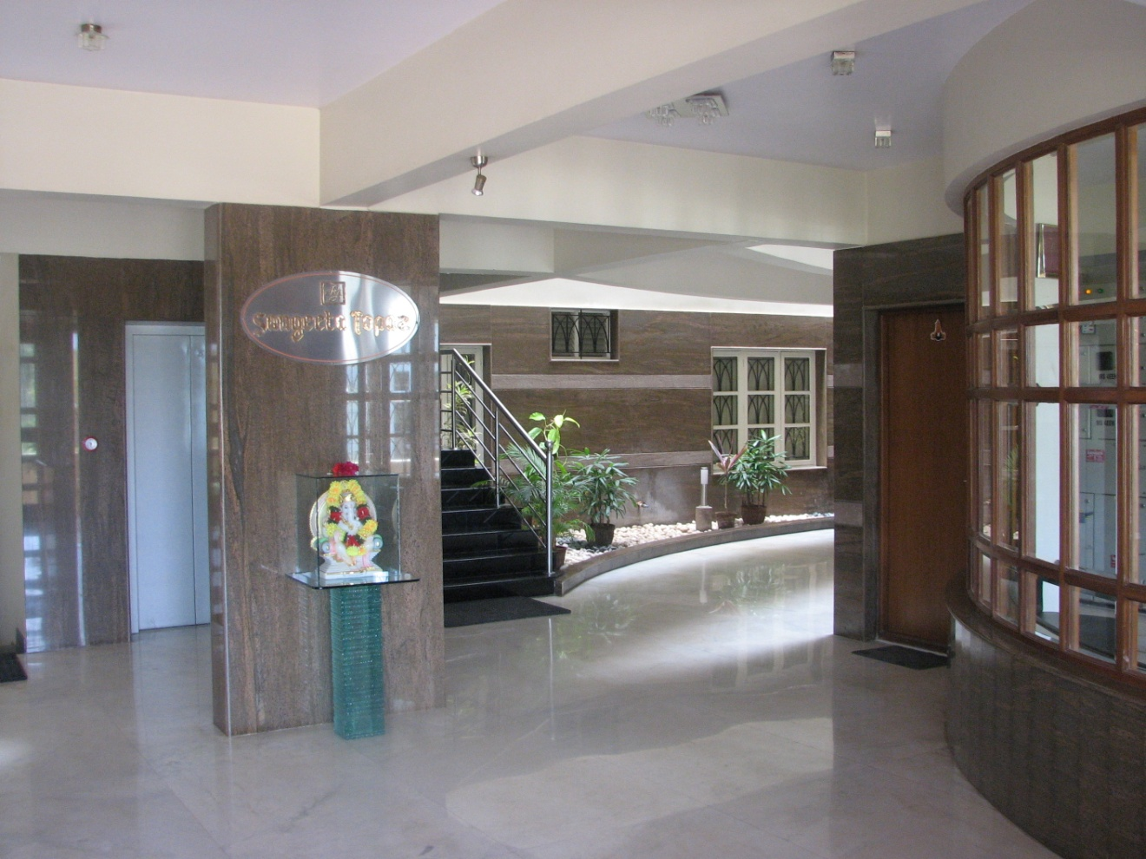
Lobby Area
LOBBY AREA

Slide 4
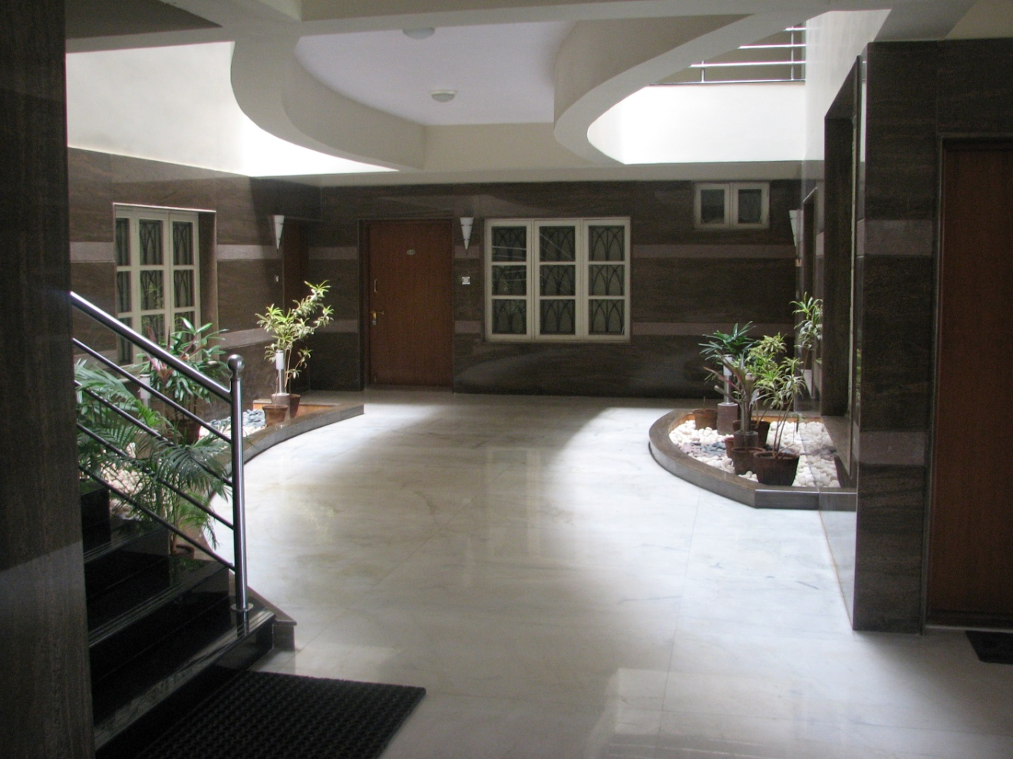
Lobby Area Continued
LOBBY AREA

Slide 5
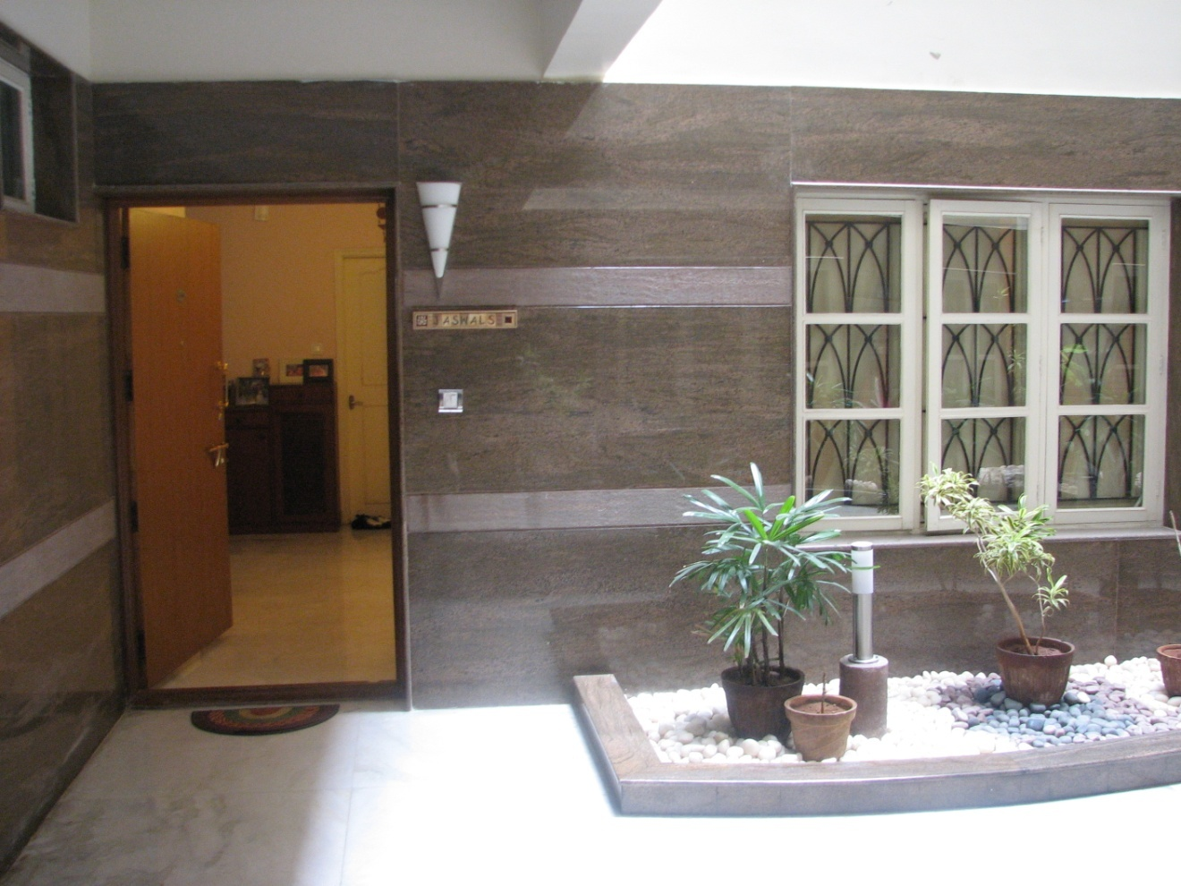
Apartment Entrance
APARTMENT ENTRANCE

Slide 6
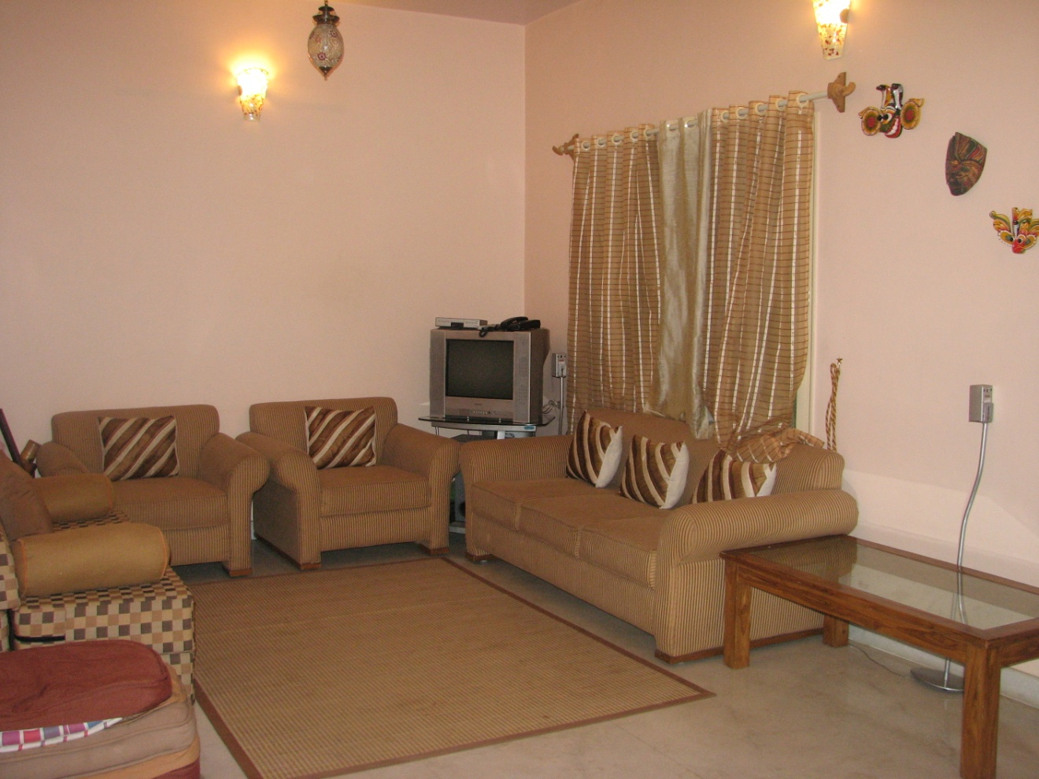
Drawing Room
LIVING ROOM

Slide 7
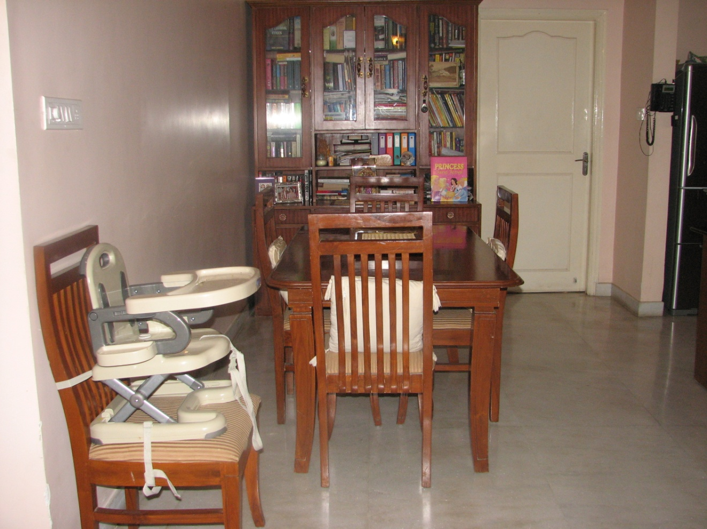
Dining Room
DINING ROOM

Slide 8
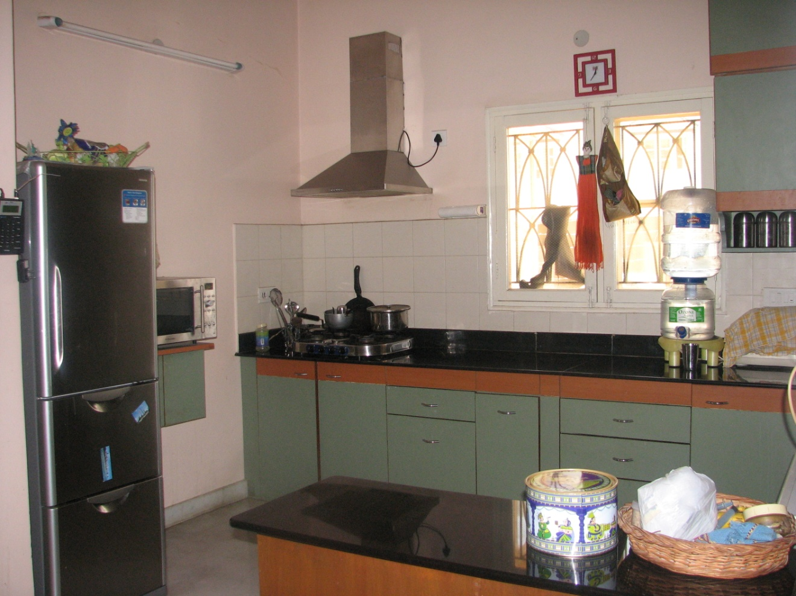
Kitchen 1
KITCHEN 1

Slide 9
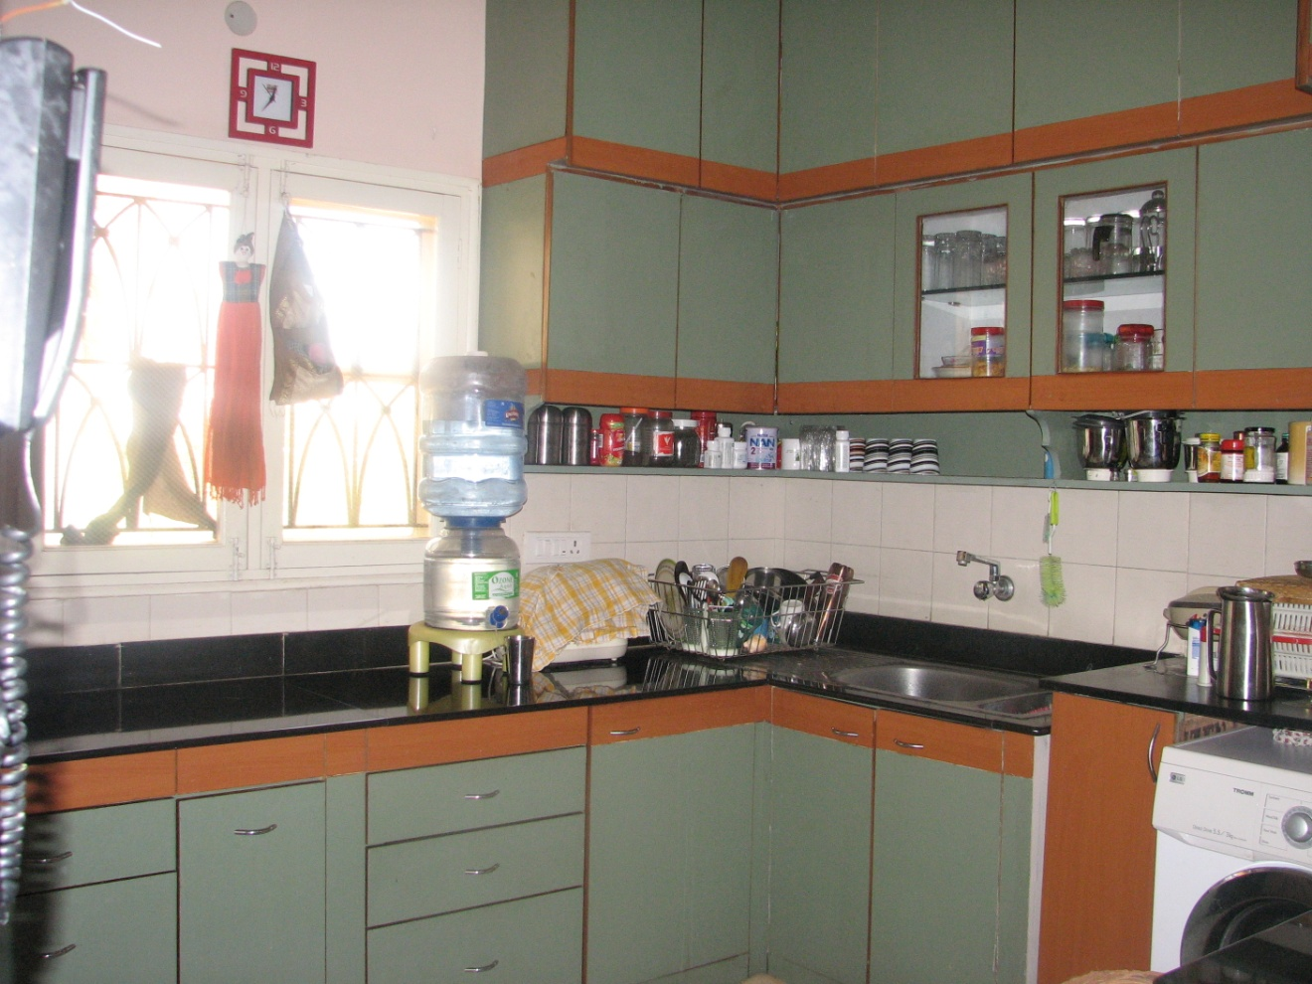
Kitchen 2
KITCHEN 2

Slide 10
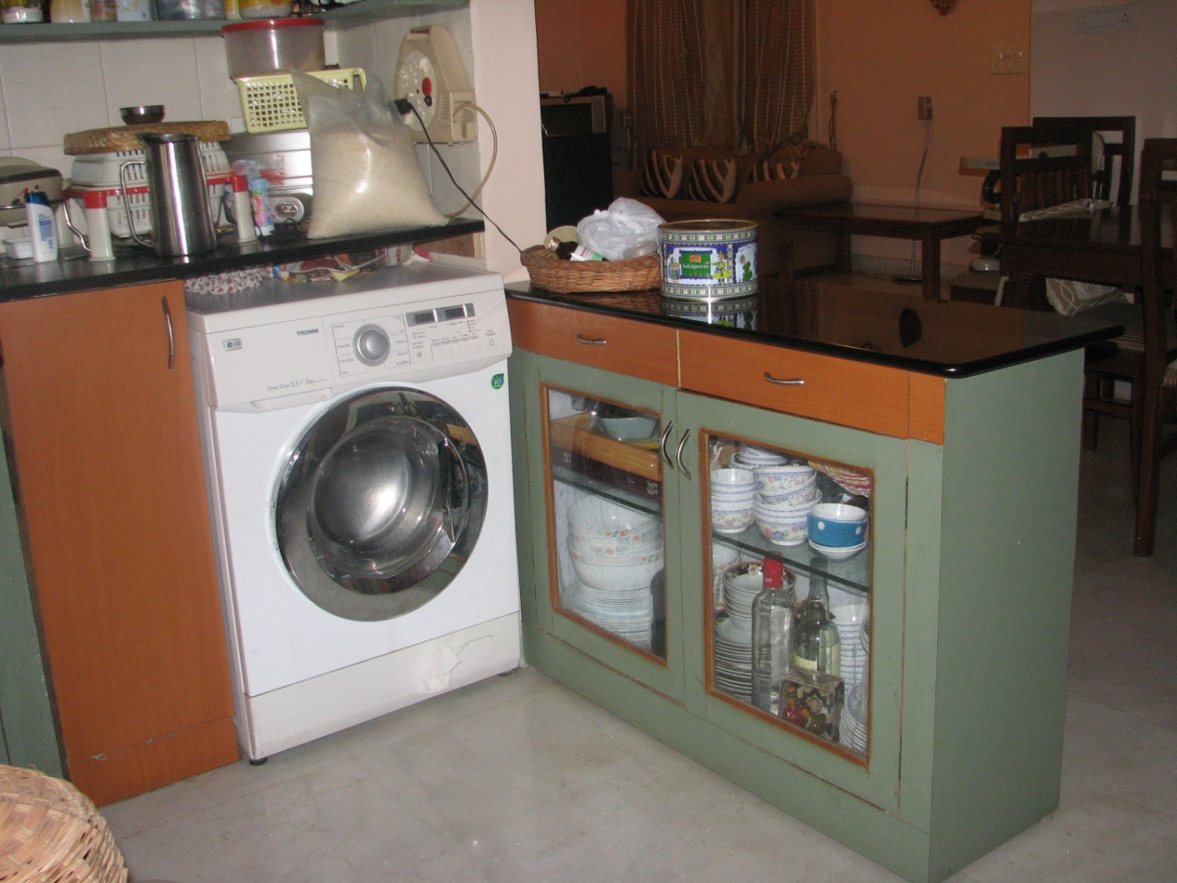
Kitchen 3
KITCHEN 3

Slide 11
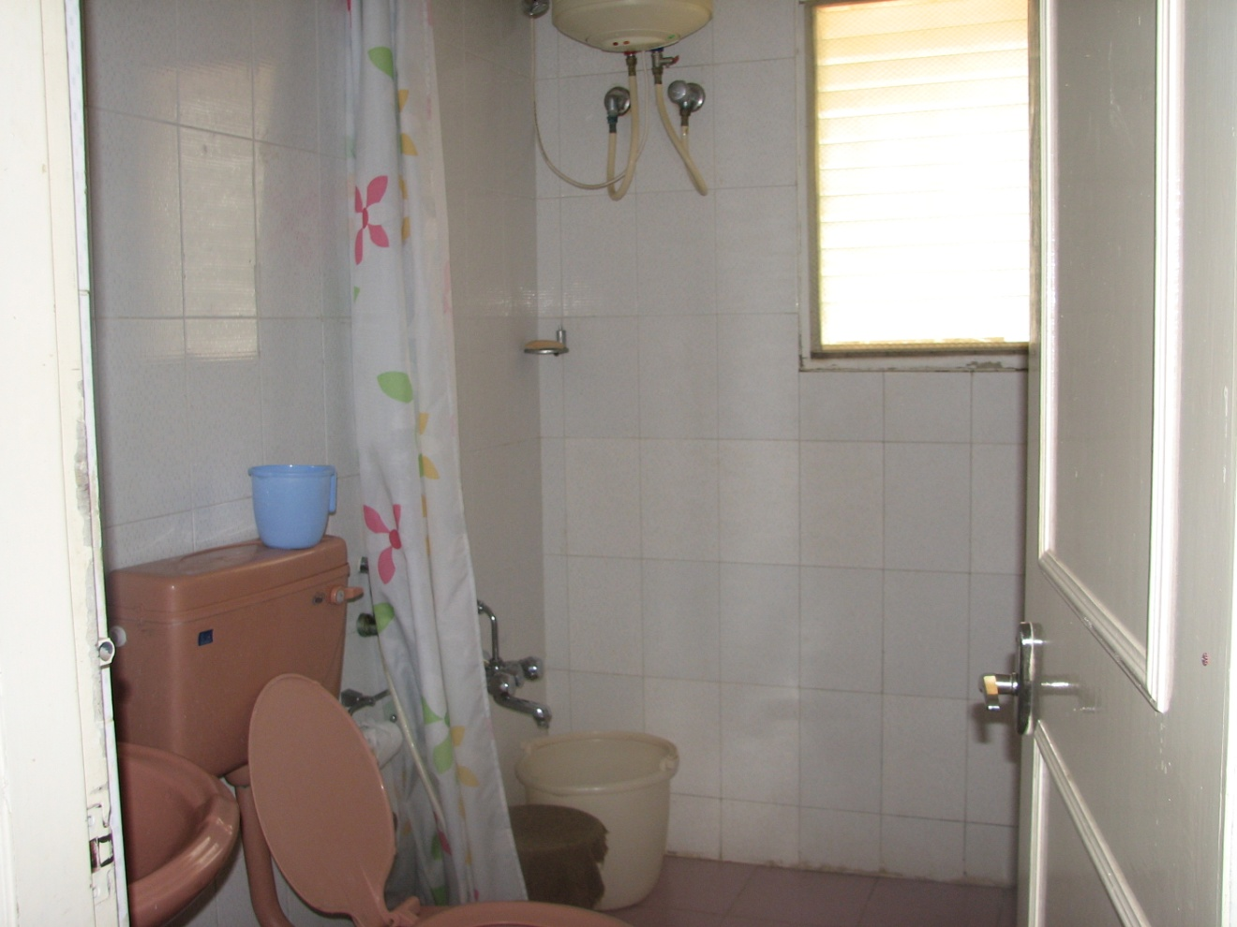
Common Bathroom
COMMON WASHROOM

Slide 12
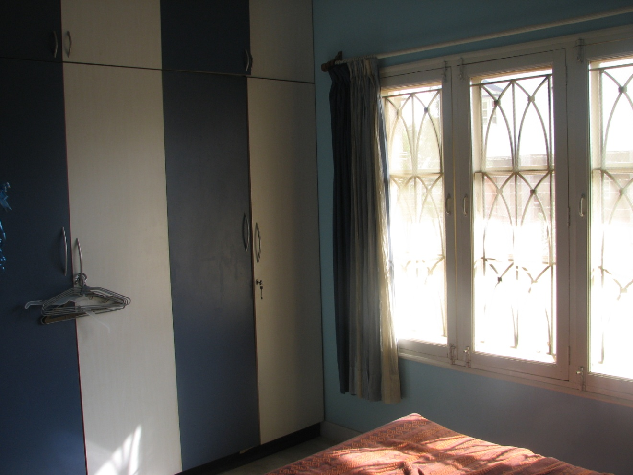
Guest Bedroom
GUEST BEDROOM 1

Slide 13
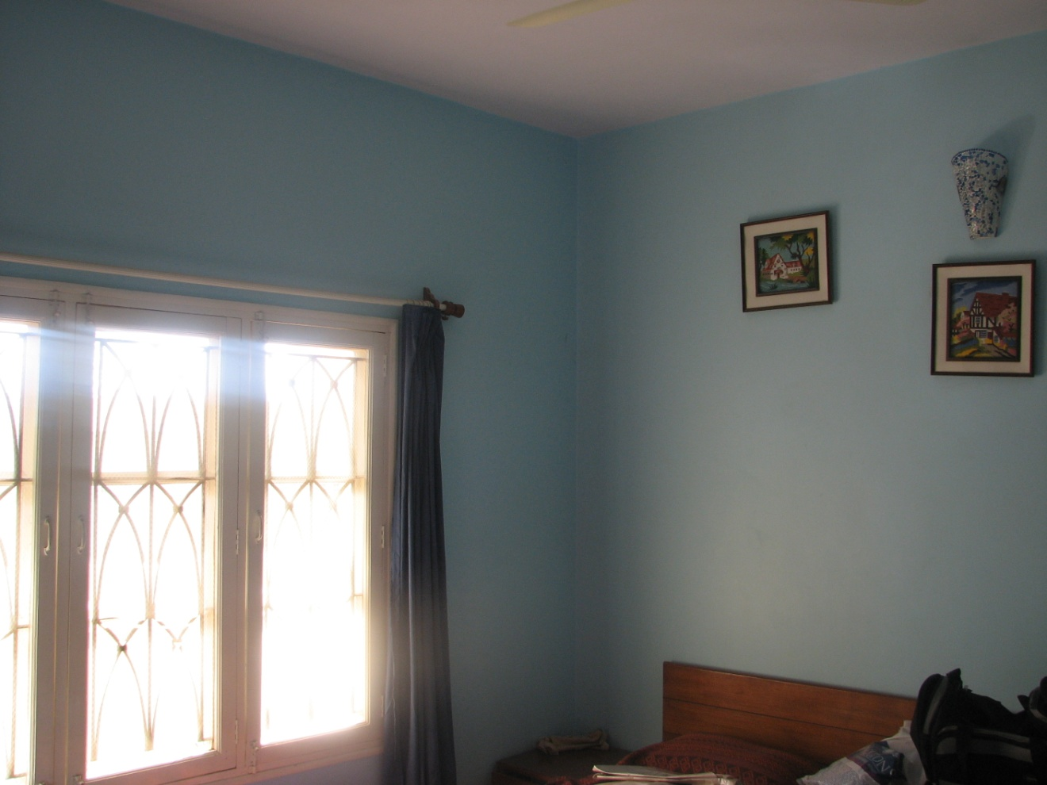
Guest Bedroom 2
GUEST BEDROOM 2

Slide 14
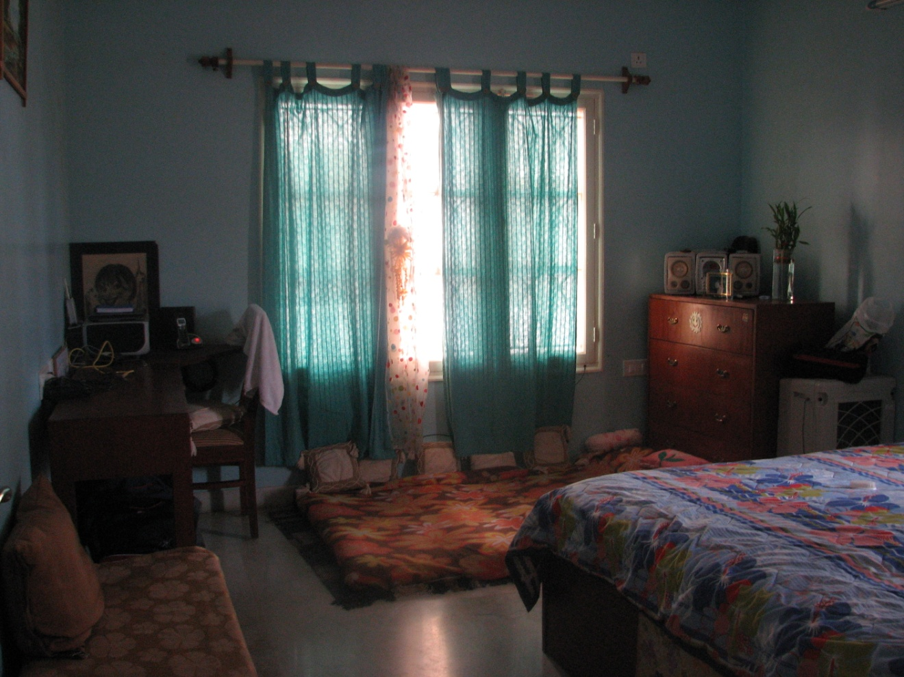
Master Bedroom
MASTER BEDROOM

Slide 15
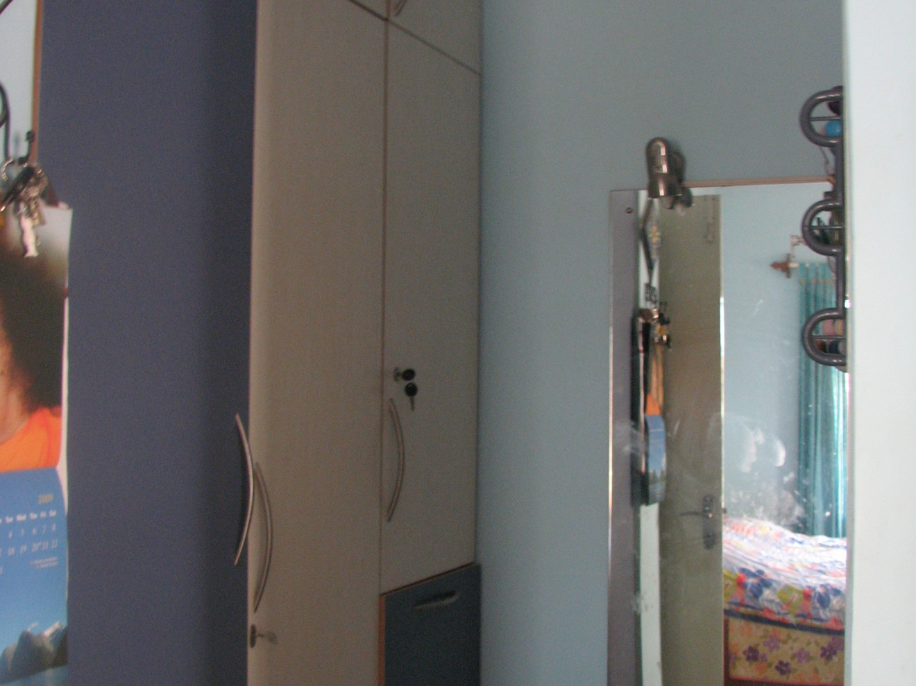
Master Bedroom – Dressing Area
MASTER BEDROOM
– DRESSING AREA

Slide 16
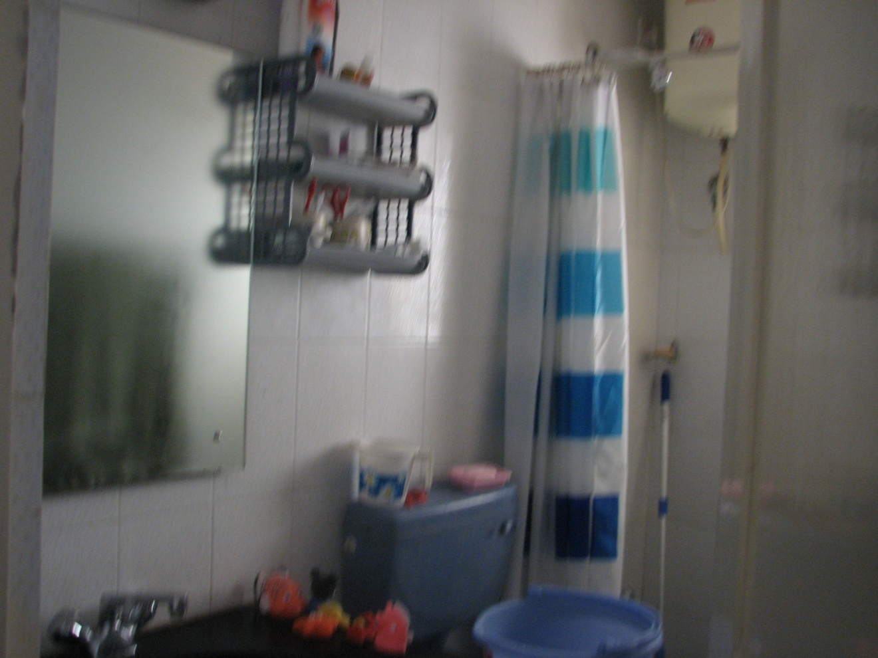
Attached bath with Master bedroom
ATTACHED BATH with MASTER BEDROOM

