Slide 1

3 r’s to save environment

Slide 2

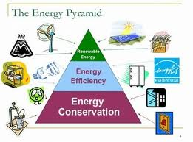

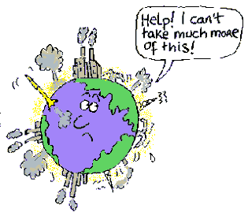

Slide 3

Save earth save your self.

Slide 4
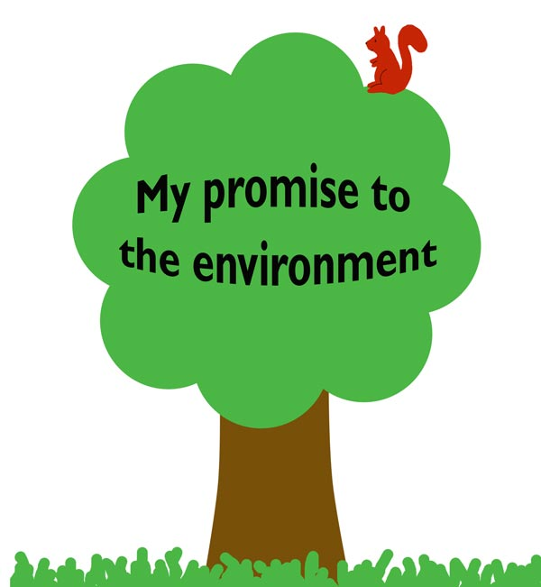
Abhya
Sindhi
V-A

