Slide 1
WAYS TO REDUCE POLLUTION

Slide 2
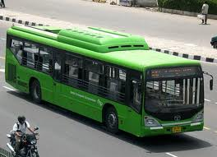
USE OF CNG AND LPG VEHICLES SHOULD BE PROMOTED

Slide 3

SAY NO TO PLASTIC BAGS

Slide 4
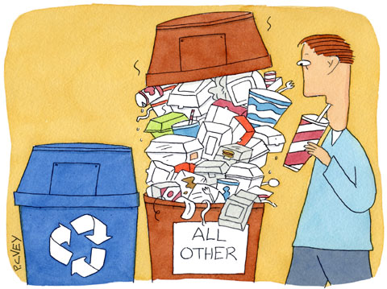
RECYCLING OF WASTE MATERIAL

Slide 5
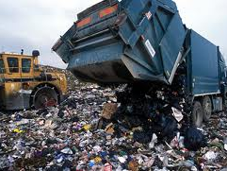
TREATMENT OF WASTE BEFORE DISPOSAL

Slide 6
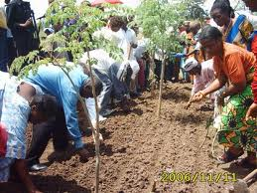
AFFORESTATION

Slide 7
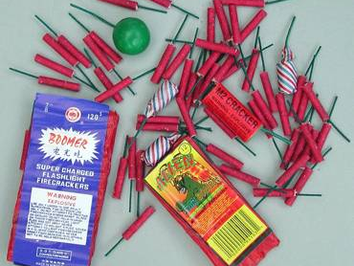
SAY NO TO CRACKERS

Slide 8
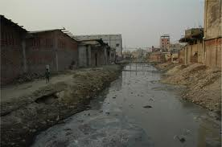
PUT A STOP TO PUTTING ASHES OF DEAD IN RIVERS

Slide 9
SHIFT INDUSTRIES TO REMOTE AREAS

