Slide 1
Christmas in Georgia
We Georgians celebrate Christmas on the 7th of January. It is traditional in Georgia to go on “Alilo” (a modified pronunciation of alleluia) a mass walk in the streets dressed in special clothing to celebrate and Congratulate each other. Most members of the Alilo march are children and they are given sweets by the adults. The alilo carols vary across the provinces of Georgia. In most songs these words are used: “on the 25th of December Chirst was born in Bathlehem.” A local variant of the Christmas tree, called “Chichilaki” is made of soft wooden material with Curled branches. Sometimes it is hazelnut branch which is Curved in to a tree of life-like shape and decorated with fruits and sweets. The western custom of a Christmas tree is also popular and has been imported from Russia. The Georgian equivalent of “Santa Claus” is known as “Tovlis Papa” literally meaning ”Snow Grandfather” and is traditionally portrayed with long white beard, dressed in national Costume “Chokha” and wearing a fur cloak called “Nabadi”

Slide 2
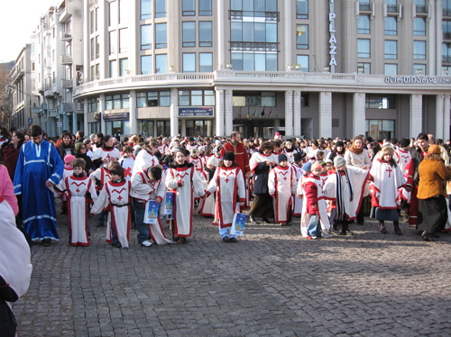
Christmas “Alilo”

Slide 3
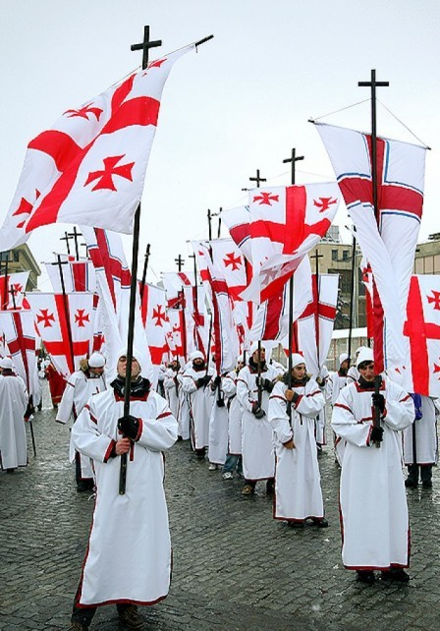
Alilo

Slide 4
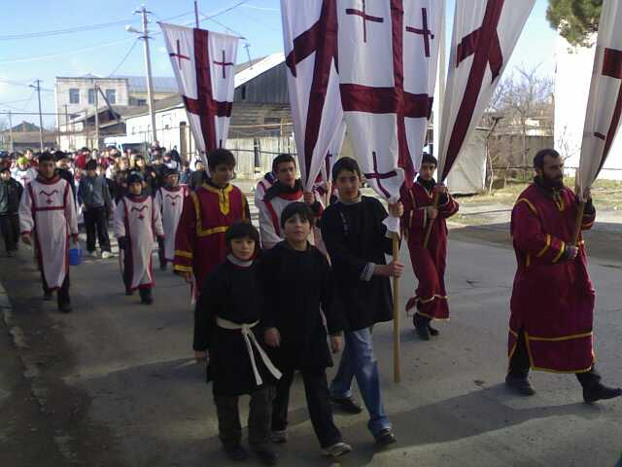
Alilo walk

Slide 5
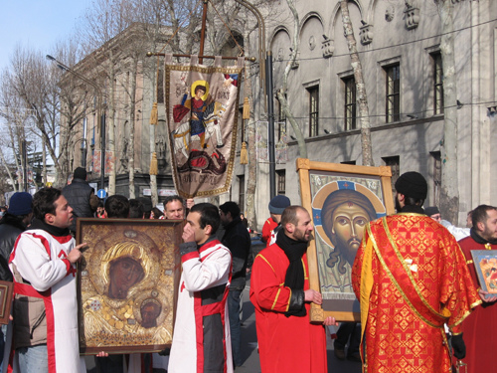
Alilo in Tbilisi

Slide 6
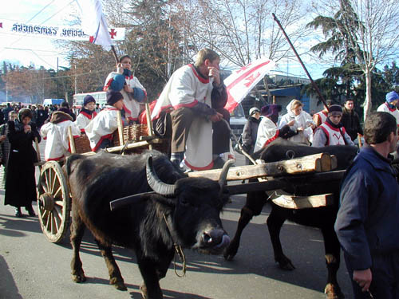
Christmas

Slide 7
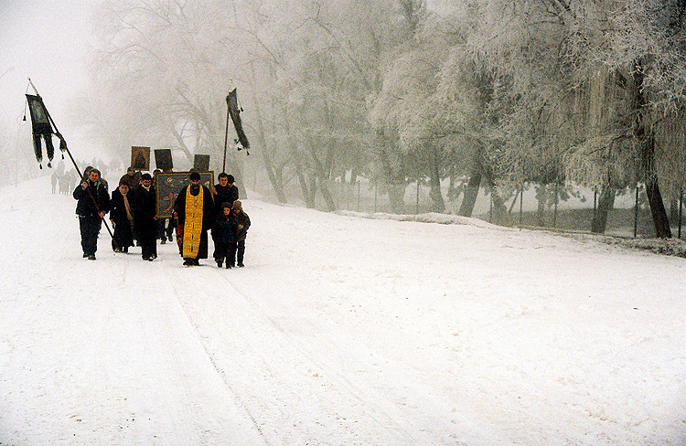
Christmas in kakheti

Slide 8
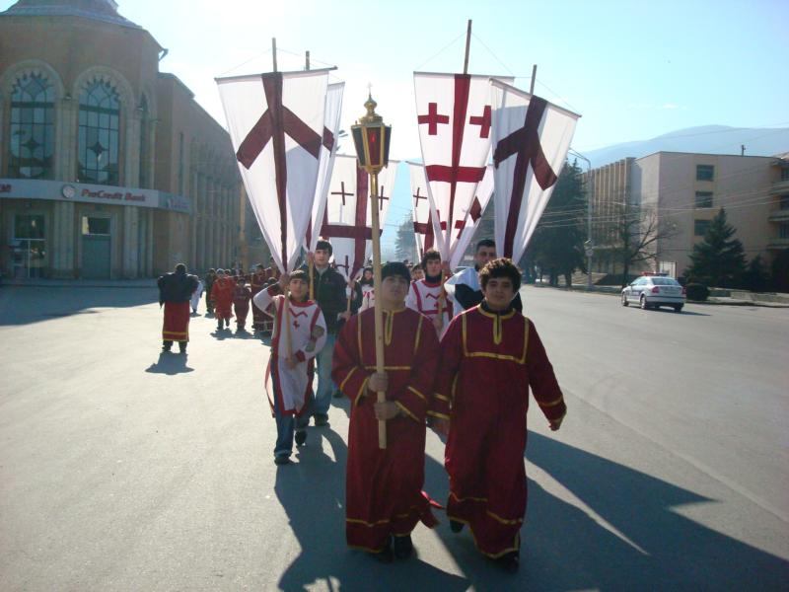
Christmas-Alilo

