Slide 1

Healthy eating is about getting the right amounts of vitamins, minerals, protein and carbohydrates, as well as the right types of fats and sugars.

Slide 2

Young adults' bodies have very demanding nutritional requirements because of physical and mental development that they go through from about the age of 12. At this age they also have much more control over what they eat than as a child.

Slide 3

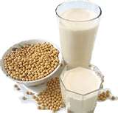

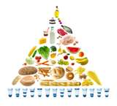

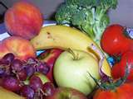

HEALTHY HABBITS…

Slide 4
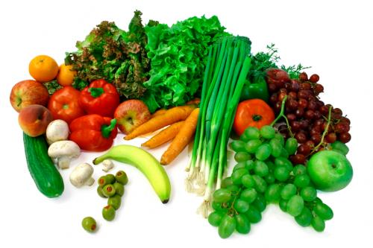
Some health diets are:-
Increase the amount of cereals and starchy foods such as whole meal bread, rice, noodles, cereals, potatoes and pasta.
Increase the amount of fruit and vegetables, i.e., eat five portions or more a day.
Eat more regular, smaller meals rather than snacking.

Slide 5

Reduce the amount of foods containing fat.
Reduce the amount of foods and drinks containing sugar.
Reduce the amount of foods containing salt.
Have 4-5 liters of water everyday.

Slide 6
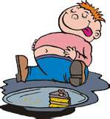

.Scientific evidence shows that a healthy diet can help you avoid diet-related diseases. These are diseases that usually develop when people are over the age of 40. For example:
Heart disease
High cholesterol
High blood pressure

Slide 7

Strokes (brain damage due to blood supply problems)
Adult-onset diabetes (the most common form of diabetes)
Some cancers
Osteoporosis (thinning of the bones).

Slide 8
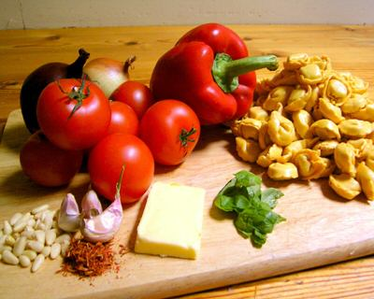
There are some effects of healthy eating:-
Help to keep a healthy body weight.
Give more energy to enjoy all kinds of physical activity, like surfing, football, netball or dancing.
Support body while growing and developing to reach full physical potential.

Slide 9

Healthy eating guidelines for young people:-

Slide 10

Eat plenty of cereals (including breads, rice, pasta and noodles), preferably wholegrain.
Include lean meat, fish, poultry and/or alternatives.
Include milks, yoghurts, cheese and/or alternatives. Choose reduced-fat varieties.
Choose water as a drink. Alcohol is not recommended.

Slide 11
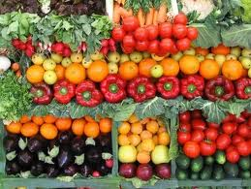
Care should be taken to:
Limit saturated fat and have a moderate total fat intake.
Choose foods low in salt.
Consume only moderate amounts of sugars and foods containing added sugars.

Slide 12


