Slide 1
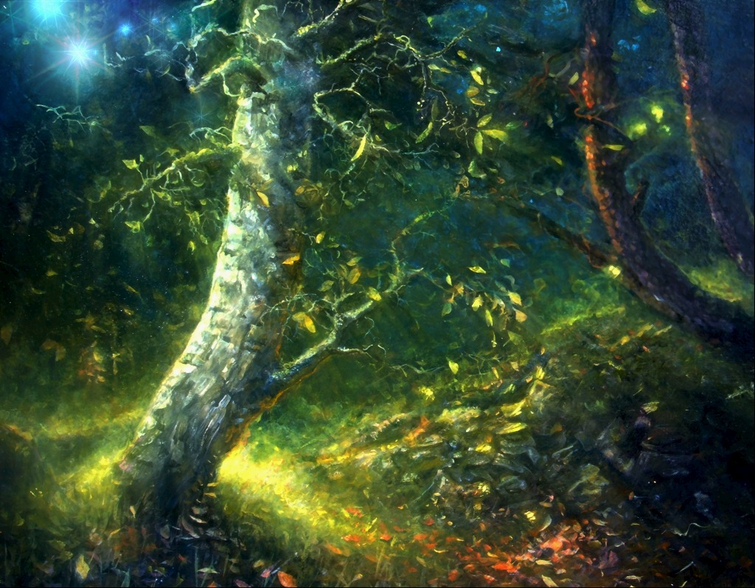
Paint earth GREEN PROTECT FOREST
Presented by- pulkit kapoor v b

Slide 2
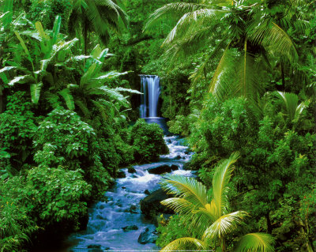
Keeping in view the green theme we like to inform you about the Indian states which have the highest area under forest cover.

Slide 3
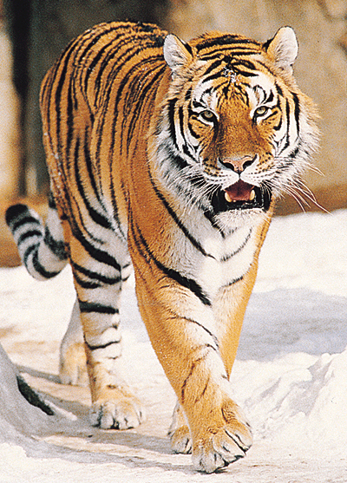
ARUNACHAL PRADESH
Forests constitute a total of 51,540 sq km area of this state. It is perhaps India’s only state that has four major big cats – the tigers, leopard, clouded leopard and snow leopard. Plants include Acores, dioscorea, oroxylum and withania.

Slide 4
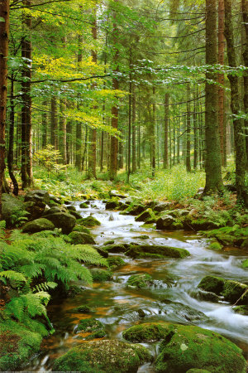
ORISSA
The state has a green cover of 58,136 km- Ten national parks and 18 wildlife sanctuaries.
The Gahirmatha Sanctuary is a mangrove system where the famous Olive Ridley turtles nestle in large numbers.

