Slide 1

Presented by –
Gaurav Aggarwal
V B

Slide 2
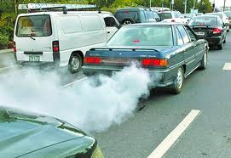
POLLUTENESS
“ Every time you step on the accelerator,
just imagine the air we are going”

Slide 3

SAVE ELECTRICITY
“Don’t let the day happen when the dusk remains a dusk,
and remains a dusk forever. Because the sun will go down one day , forever.”

Slide 4
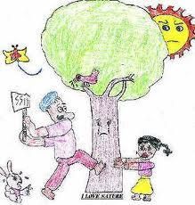
DON’T CUT TREES
“ Don’t cut it – good planets are hard to find.”

Slide 5

STOP INDUSTRIAL POLLUTION
“Brush your teeth with the best toothpaste ,
Then rinse your mouth with industrial waste?
Because what you get out is what you have put in.”

Slide 6

RECYCLE
“ REMEMBER tomorrow , RECYCLE today.”

Slide 7
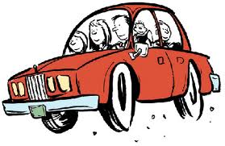
CAR POOL
“If you don’t want to think in terms of conservation , think ,
that you’re going to have a driver for some of those days when its not you turn?

Slide 8
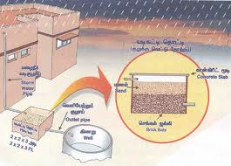
WATER HARVESTING
“We forget that the water cycle and the life cycle are one.”

Slide 9
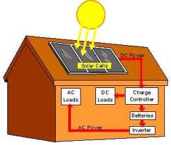
SOLAR ENERGY SYSTEMS
“ Most energy conservation measures cannot only save us money both in the short and long run , but also the future of ours , our children , and our grandchildren and the generation to come.”

Slide 10

SAVE WATER
“ All the water that will ever be is , right now.”

Slide 11
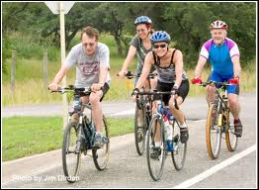
RIDE A BICYCLE
“ Every time one sees an adult on a bicycle , you no longer despair for the future of the human race.”

Slide 12
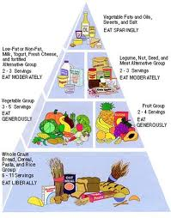
BE VEGETARIAN
“Animals are my friends… and I don’t eat my friends.”

Slide 13

PLANT MORE TREES
“ The best time to plant a tree is twenty years ago.
The second best time is now.”

