Slide 1


PROTECT WILDLIFE
SAVE FOREST
Presented By
GAURAV AGGARWAL
V B

Slide 2
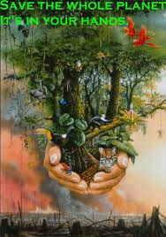

Slide 3
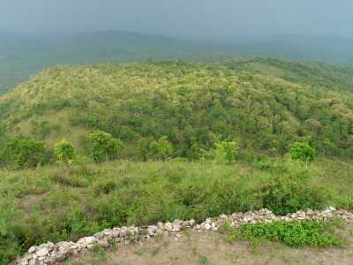
KARNATAKA
The state has forest cover of 38,284 sq km.
The lotus is the state flower.

Slide 4
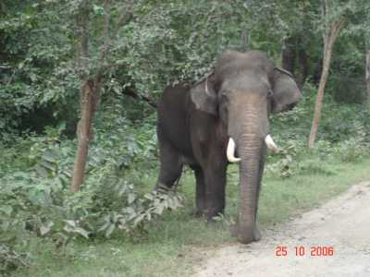
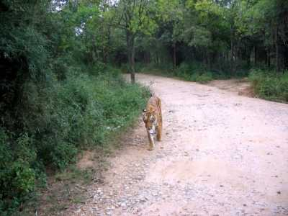
These forests support 25 % of India's elephant population and 15 % of its tiger population.

Slide 5

MAHARASHTRA
The state has 61,939 sq km of forests with Tropical dry and moist deciduous trees.

Slide 6
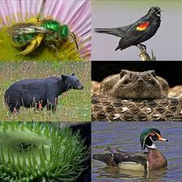
Six national parks , 35 wildlife sanctuaries : the main are Melghat , Tadoba - Andheri , and the Pench Tiger Reserve. Animals include tigers , panthers , bison and antelopes

Slide 7
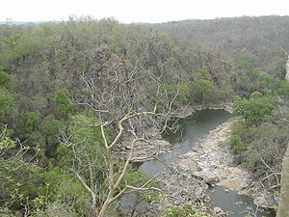
MADHYA PRADESH
The total area forest is 94,689 sq km . Teak and Sal are the prominent trees.

Slide 8
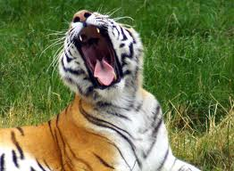
Has nine national parks , 25 sanctuaries .
Madhya Pradesh is also known as the ‘tiger state’ as it is home to 19% of India’s tiger population and 10% of the world’s tiger population .

Slide 9
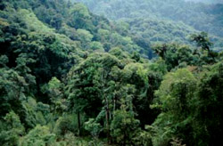
ASSAM
Forests cover 26,832 sq km of the state’s area.

Slide 10

Bird species include rosy pelican , painted stork and parakeets.
Animals species include monocellate cobra , rat snake and copper – headed trinket.

Slide 11
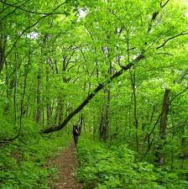
JHARKHAND
The state has 23,605 sq km of forests.

Slide 12

Common animals include: tigers, leopards, elephants, barking deer, cheetals, sambhar, chausingha and common langurs.

