Slide 1
THINGS THAT HARM OUR ENVIRONMENT
COMPILED BY
NISHKARSH SHARMA
IV B

Slide 2
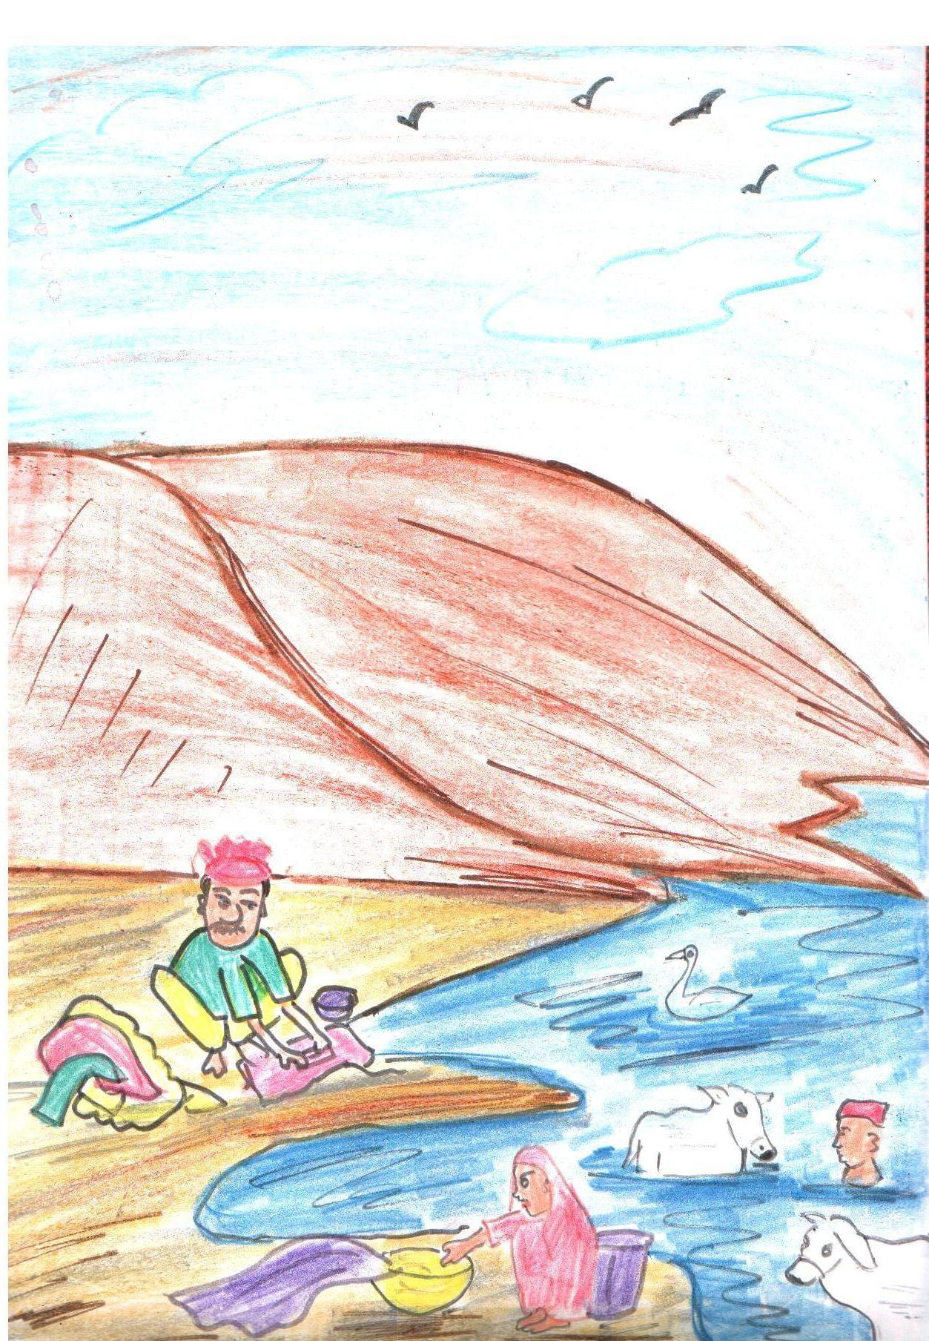
BATHING AND WASHING IN RIVERS

Slide 3
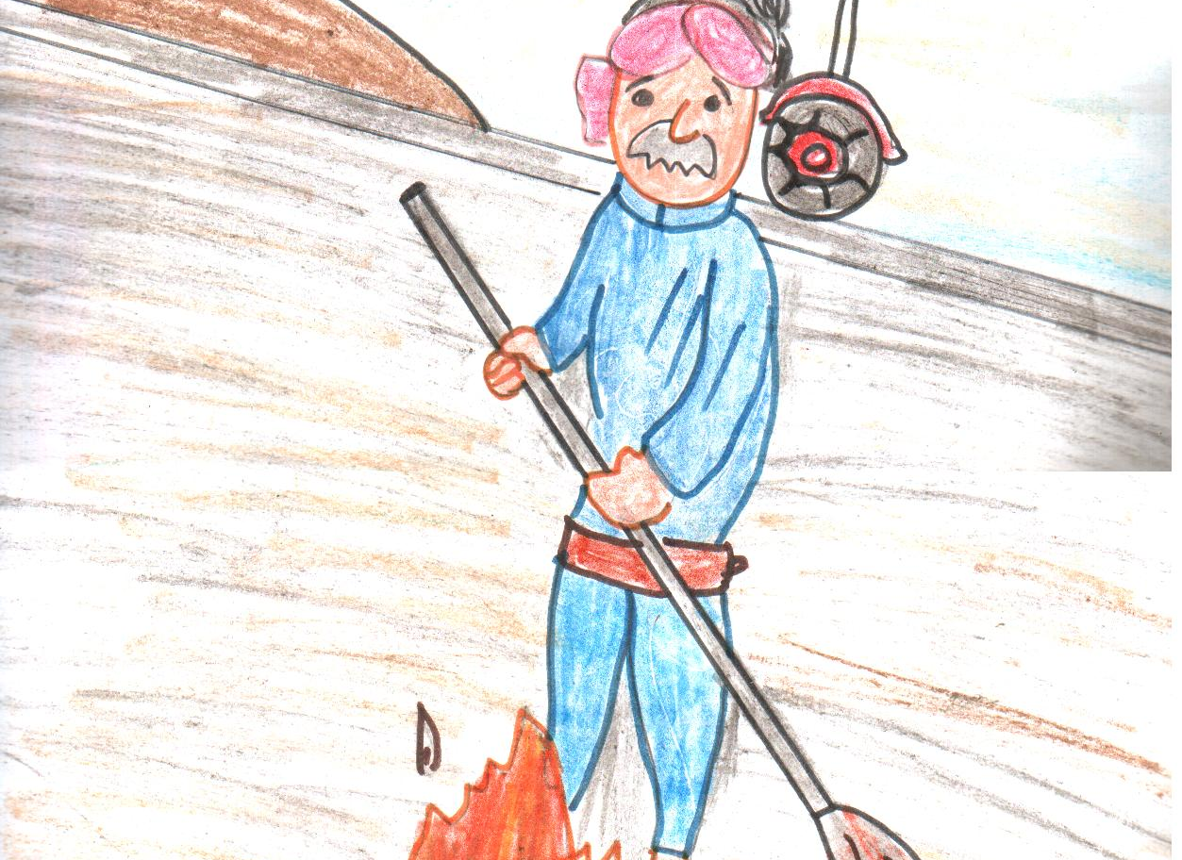
LIGHTING FIRE - COLLECTED GARBAGE

Slide 4
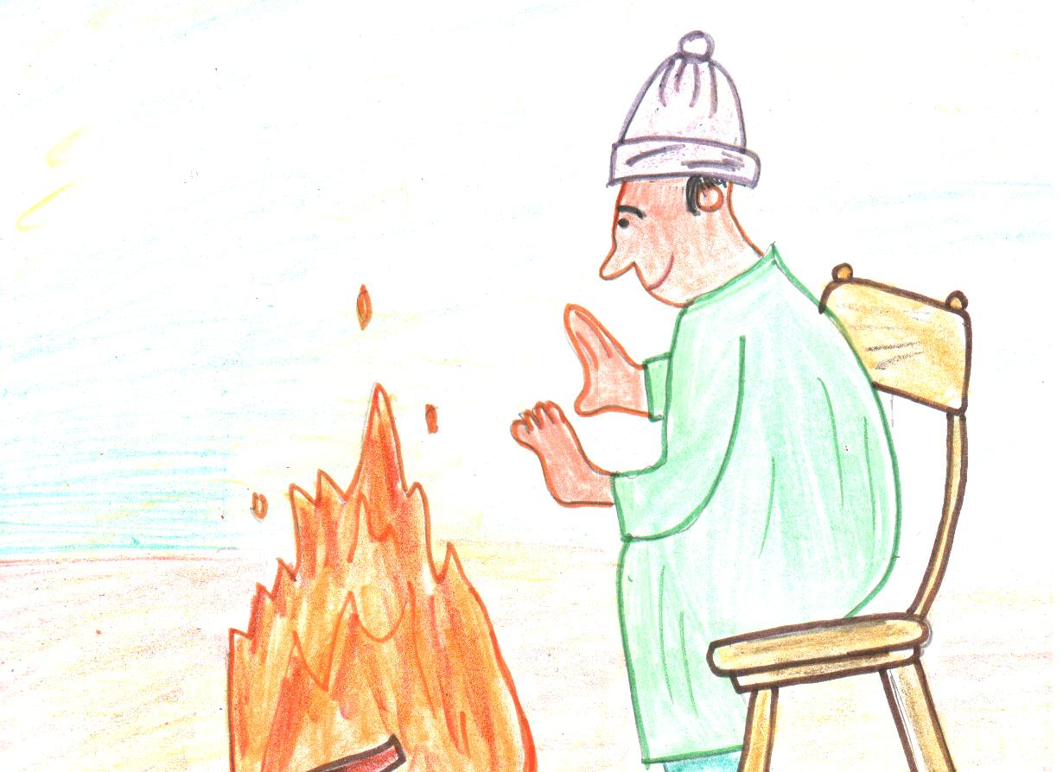
LIGHTING FIRE - WINTERS

Slide 5
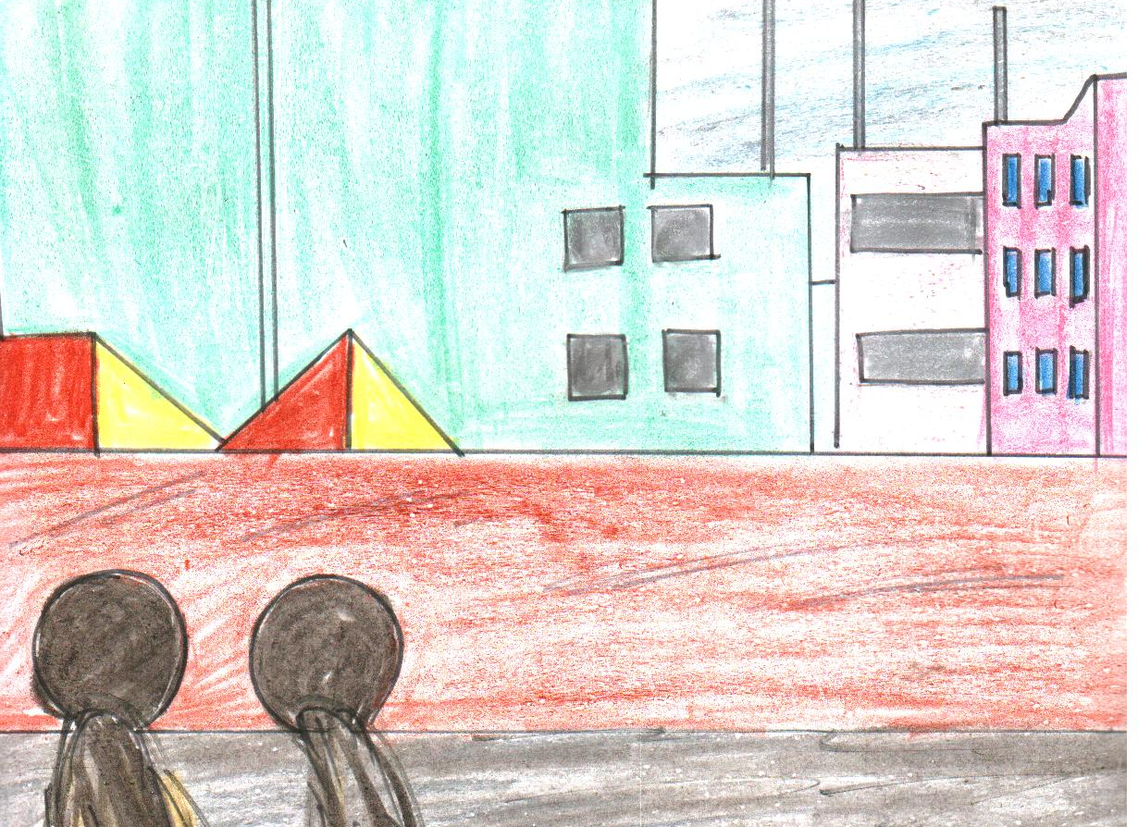
WASTES FROM FACTORIES AND INDUSTRIES

Slide 6
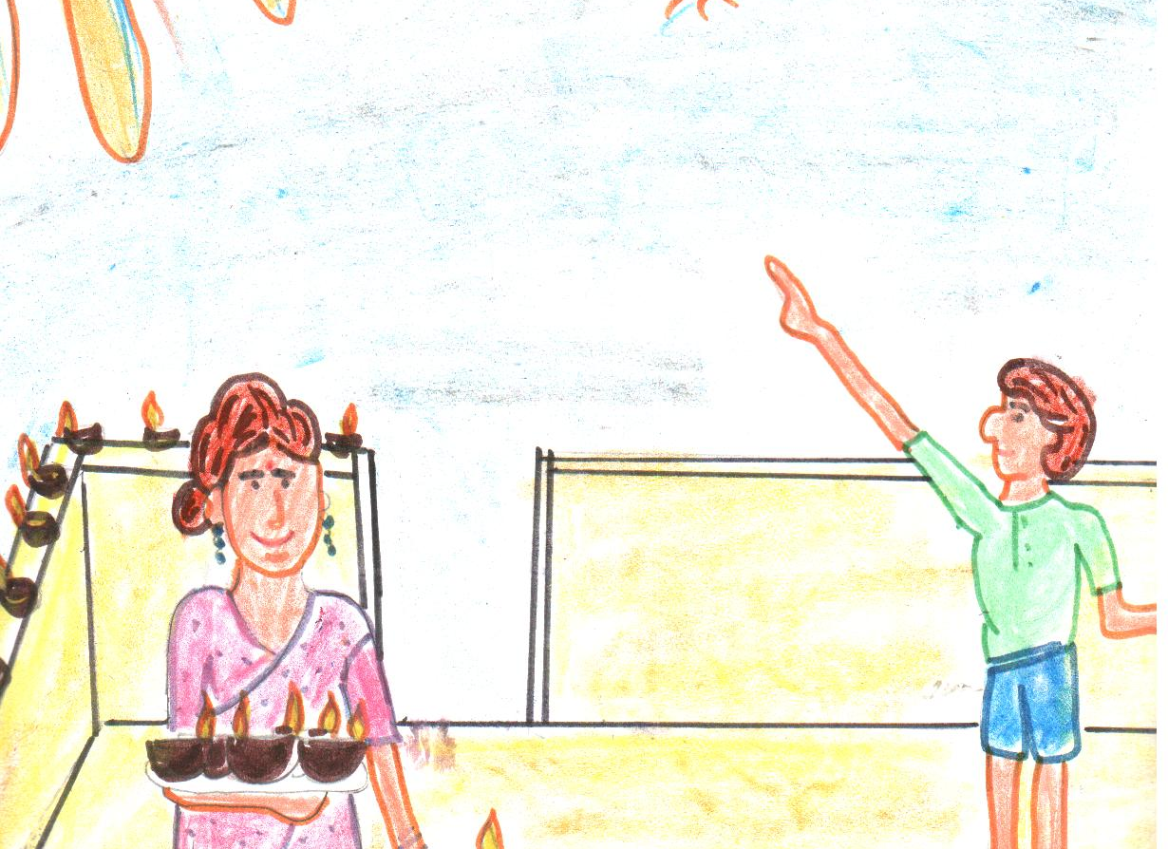
BURSTING CRACKERS

Slide 7
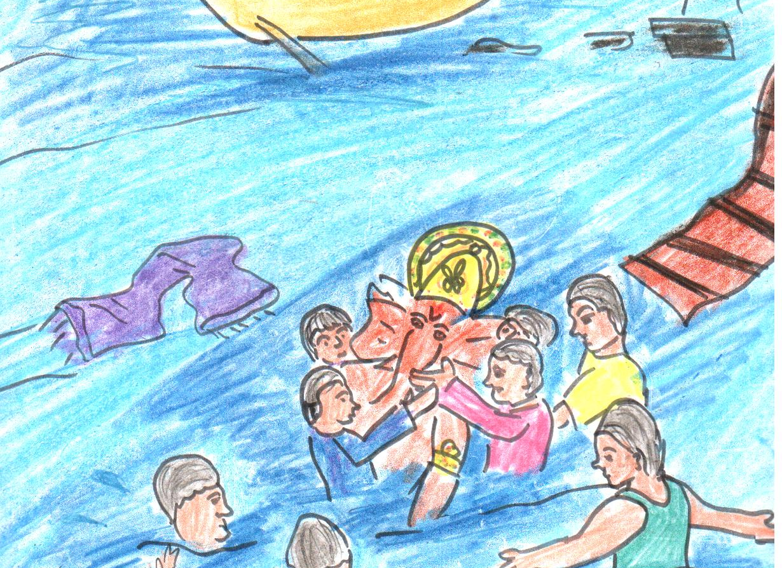
IMMERSION OF RELIGIOUS IDOLS

Slide 8
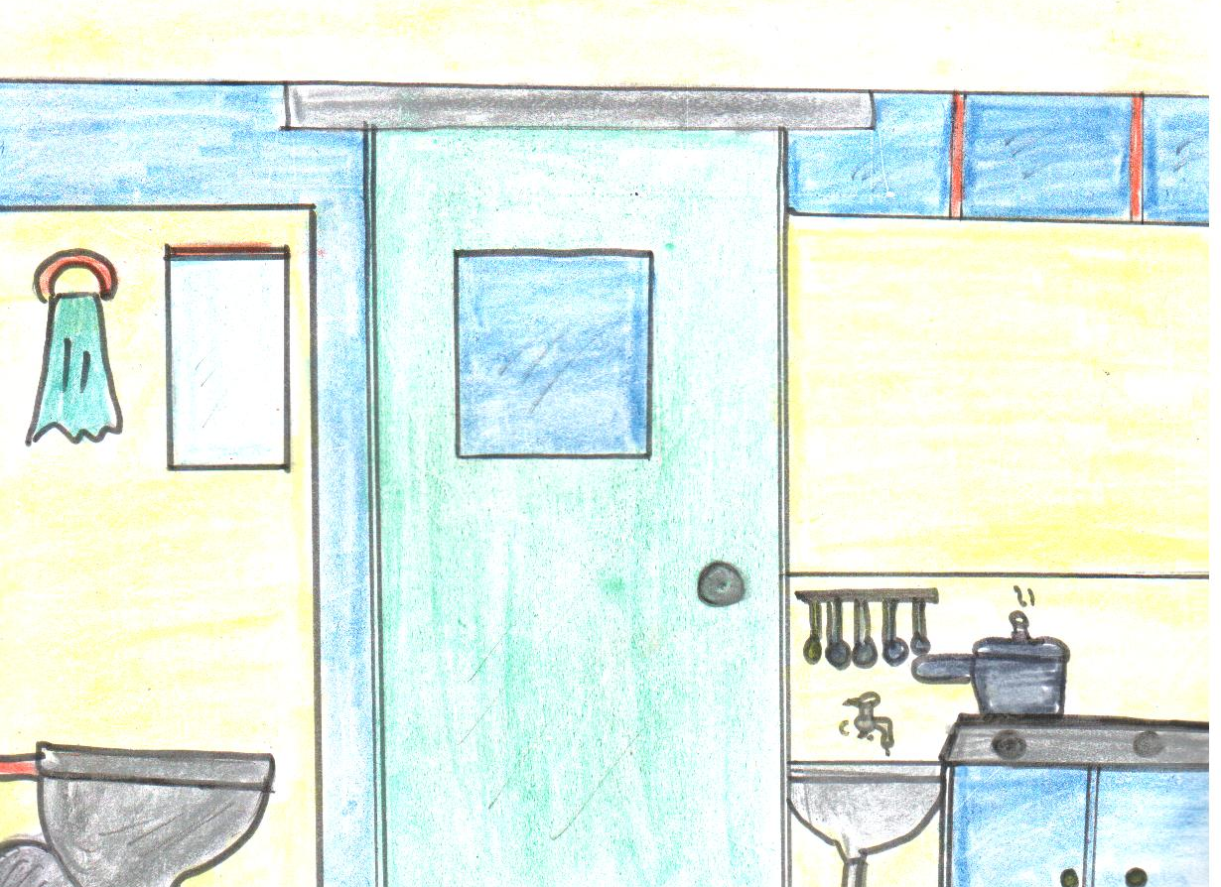
WASTING WATER AND FUEL

Slide 9
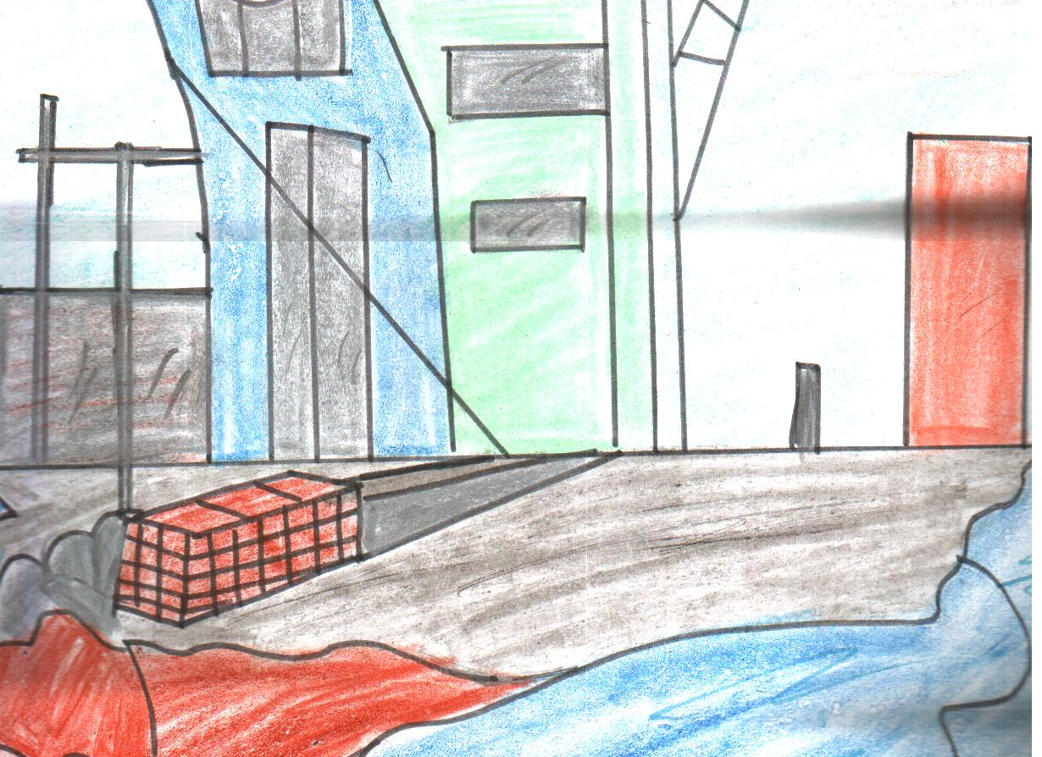
WASTES FROM FACTORIES AND INDUSTRIES

Slide 10
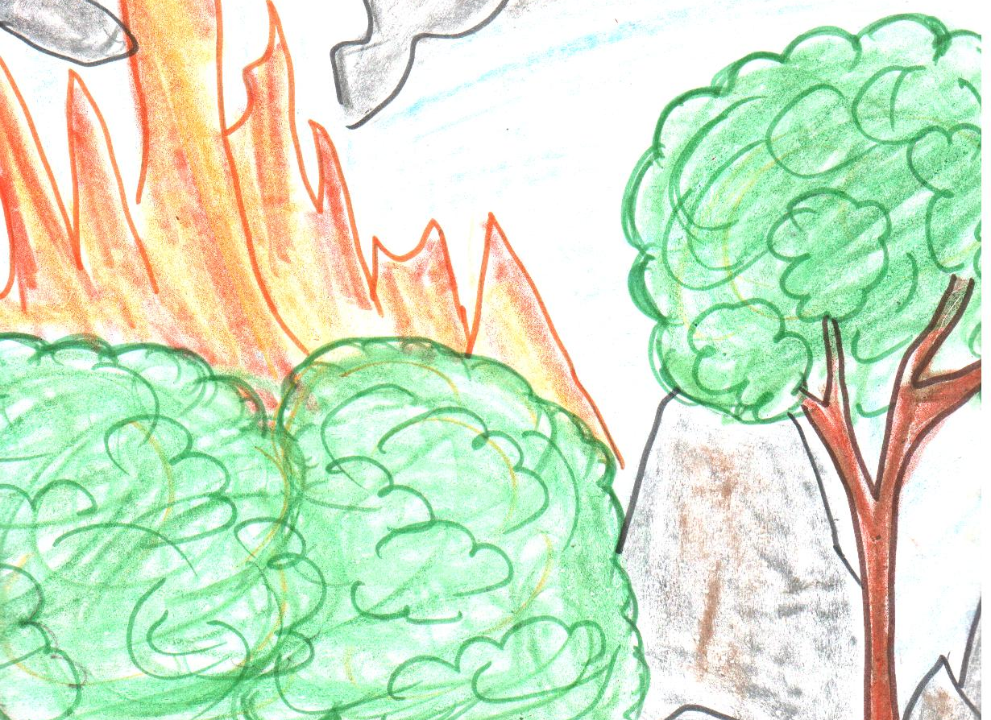
DESTROYING FORESTS

Slide 11
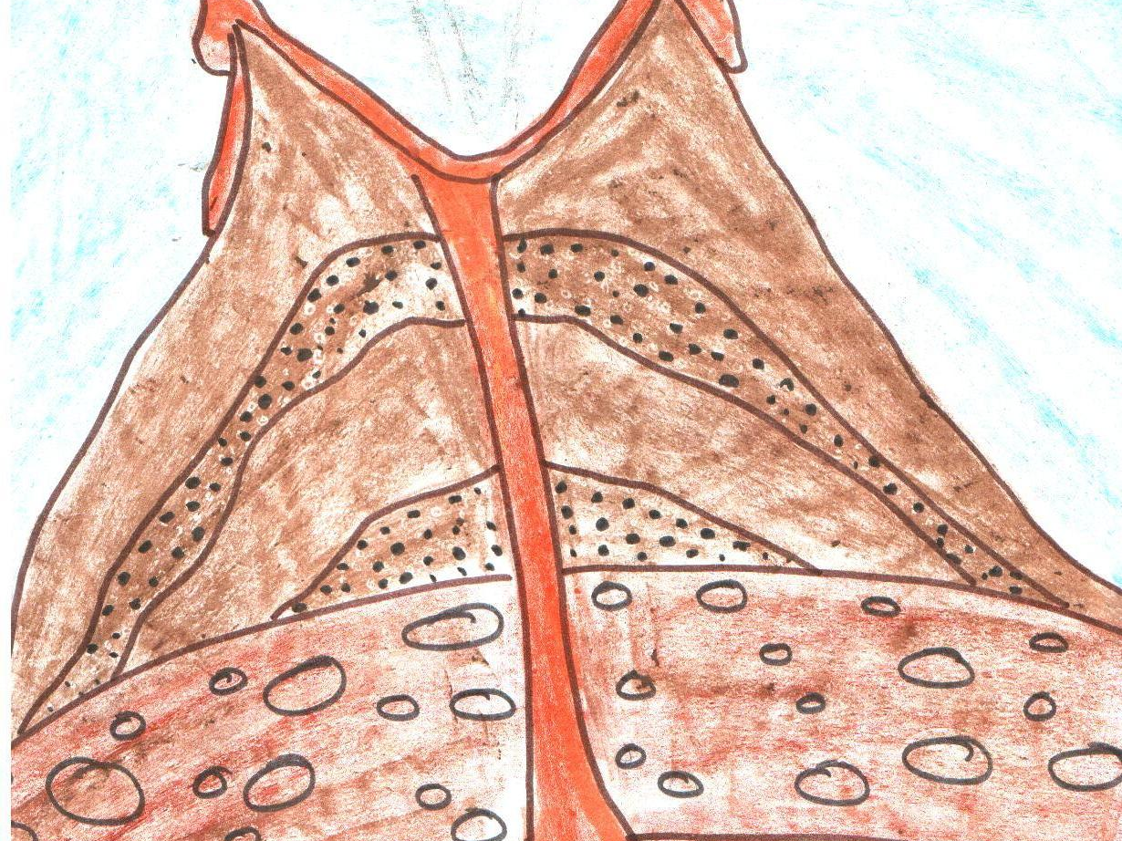
ERUPTION OF VOLCANOES

Slide 12
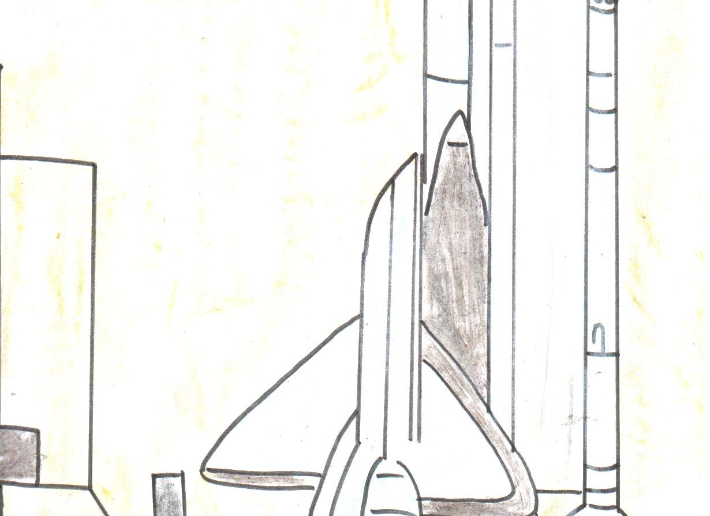
EMISSION FROM ROCKETS & SATELLITES

Slide 13
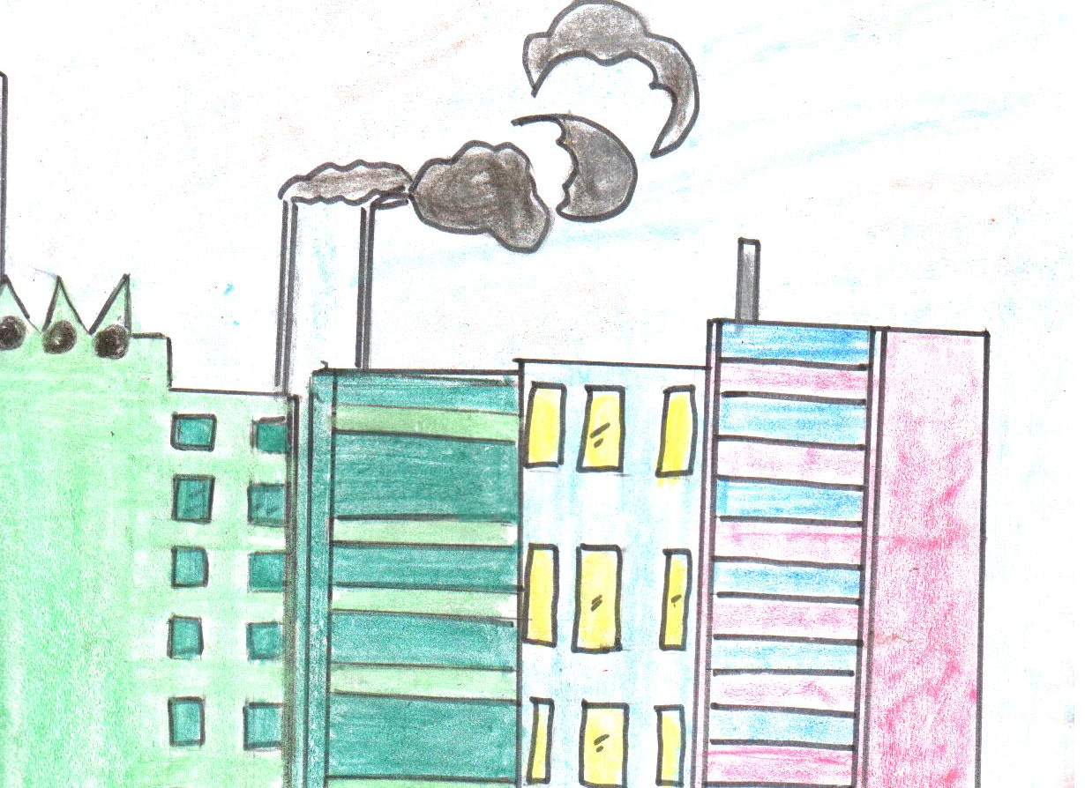
SMOKE FROM FACTORIES

