Slide 1
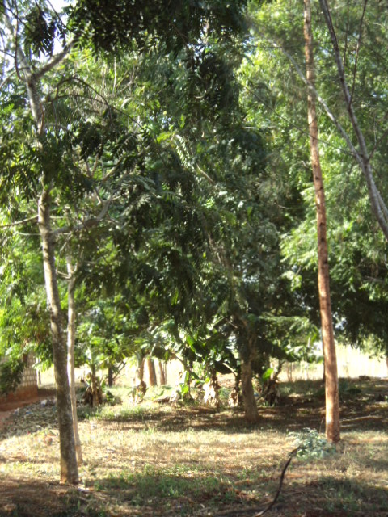
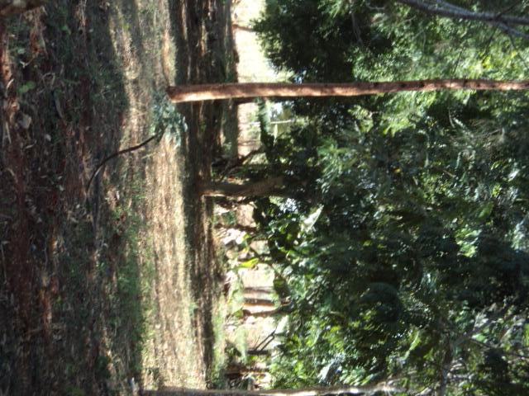
Once the world was..green

Slide 2
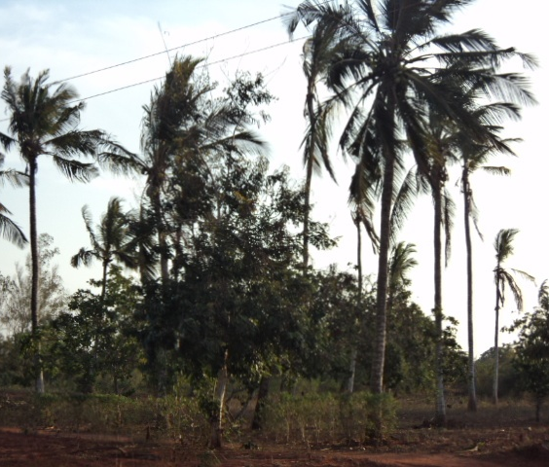
It was a good place where you could relax and enjoy the surrounding

Slide 3
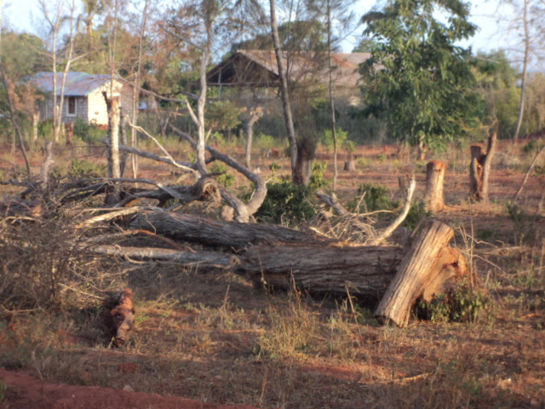
But what has happened to our world?
Time is ticking…. The world is still not conscious of what is to come!!!!

Slide 4
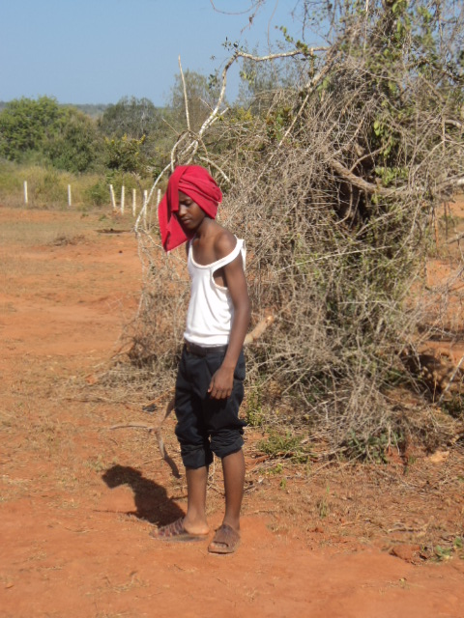
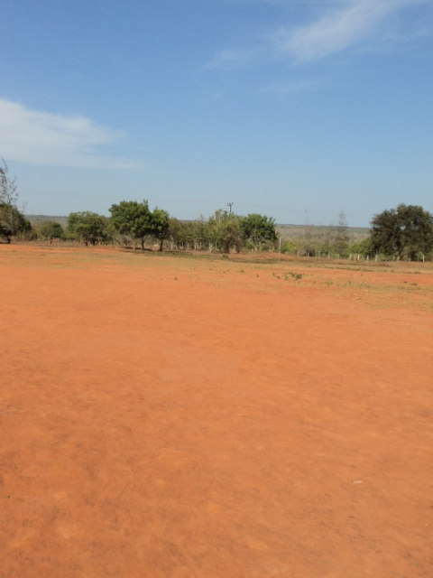
Is this what people want…?
OR

Slide 5
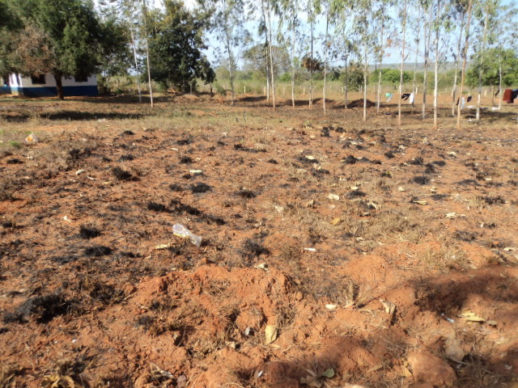
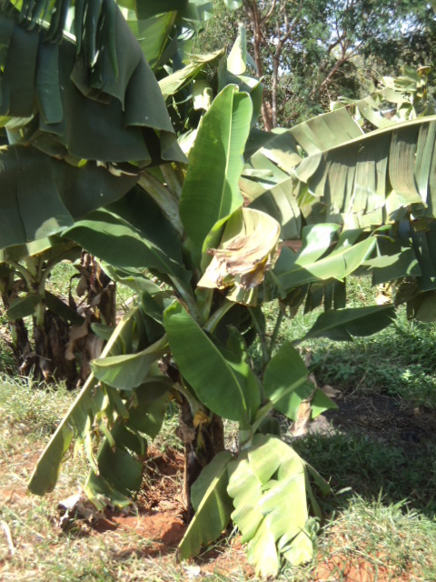
Choose between
OR ………..
THIS

Slide 6
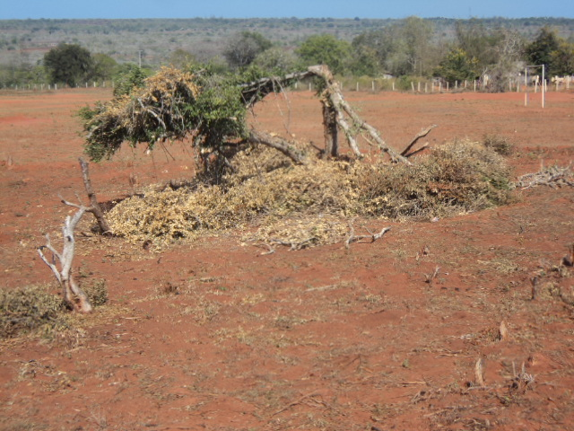
Why don’t we give the trees a chance to show their usefulness…?
They don’t deserve
this…!!!!

Slide 7
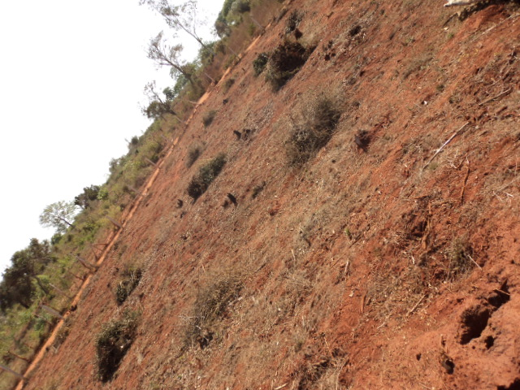
Let us join hands to fight for a green world.

Slide 8
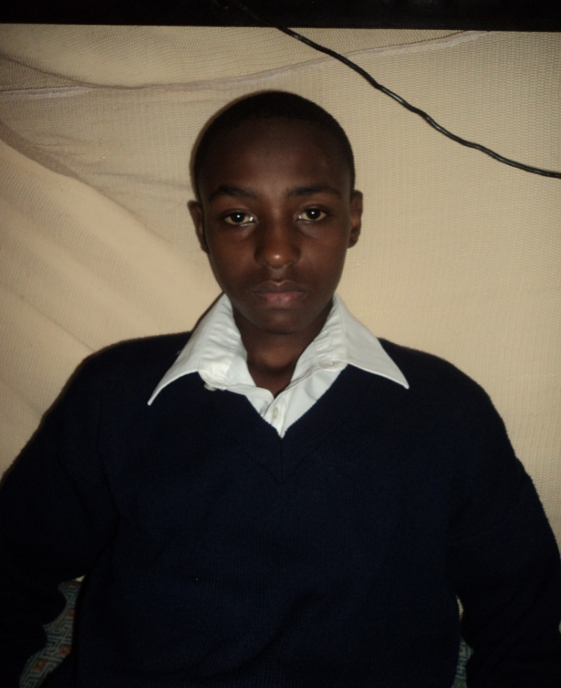
Presentation by:
SHAKO .K. GARVEY Form2 – 2011

