Slide 1
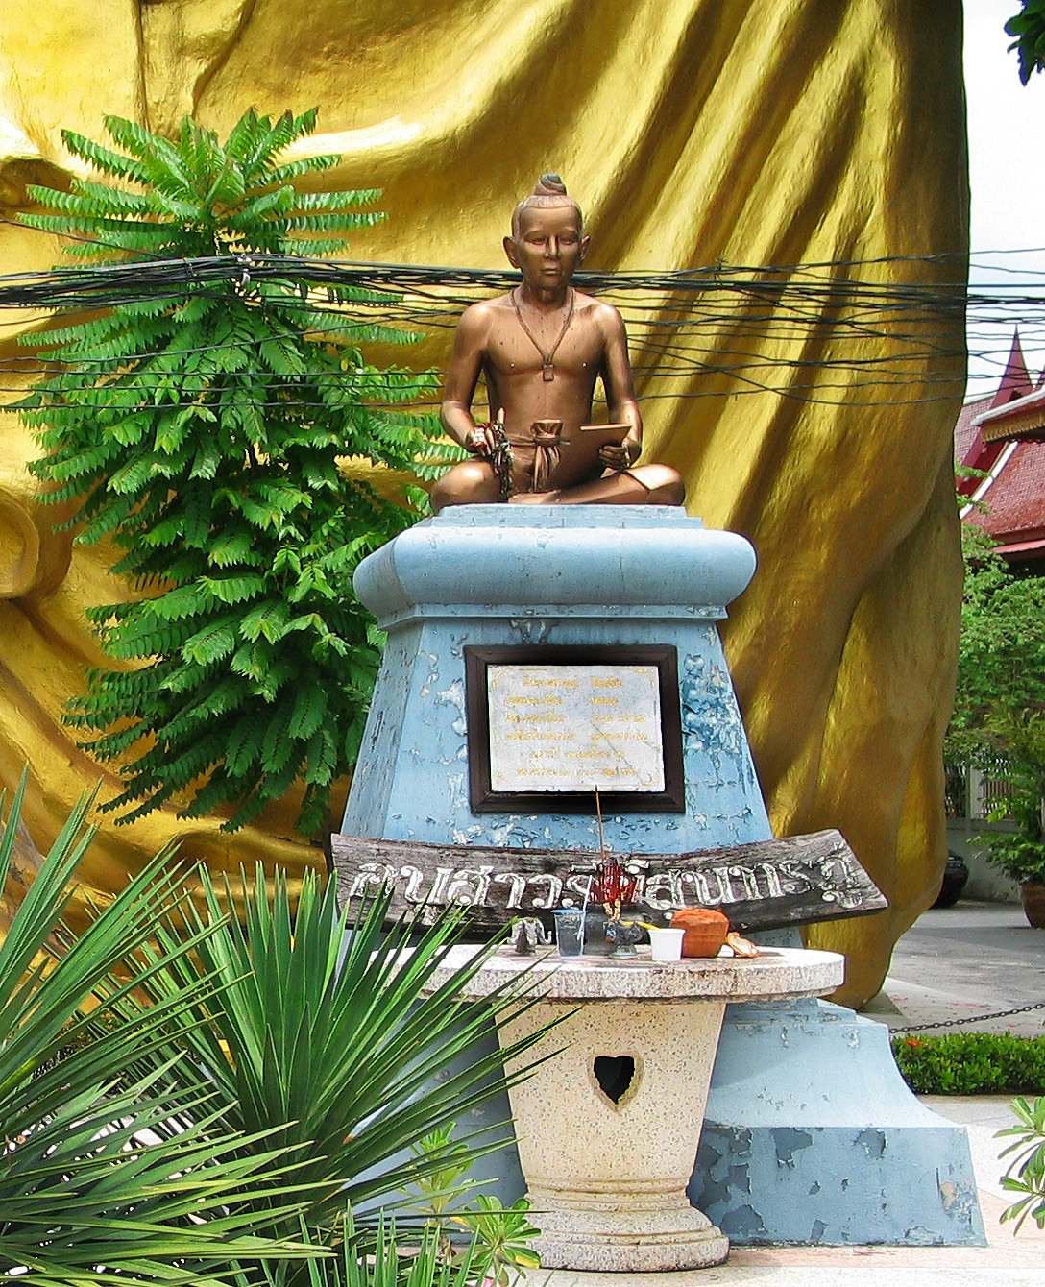
Phra Sunthorn Vohara, known as Sunthorn Phu,

Slide 2
Phra Sunthorn Vohara, known as Sunthorn Phu, (26 June 1786–1855) is Thailand’s best-known royal poet. He was active in the Rattanakosin era.
Phu's career as a royal poet began in the reign of King Rama II, and when the king died, he resigned from the role and became a monk. Twenty years later, in the reign of King Rama III, he returned to court as a royal scribe, where he remained for the rest of his life.
Phu was especially renowned for composing verse, and his conventions in epic poetry are popular in Thailand to the present day. His canonical works include Nirat Phukaothong (a collection of poems depicting his journey to the Golden Mountain), Nirat Suphan (depicting his journey to Suphanburi Province), and the Phra Aphai Mani saga.

Slide 3
Biography
Memorial in Wat Sri Sudaram, Bangkok
Sunthorn Phu was born in the reign of King Rama I, on June 26 1786. His family's house was located behind the royal palace, near the location of present day Bangkok Noi train station. His father was from Klaeng District in Rayong province. At the time the poet was born, Bangkok had been established as the Thai capital just four years earlier, founding the Rattanakosin era which continues to the present day.

Slide 4
His father and mother divorced, with his father becoming a monk at Bangrum temple; and his mother becoming a wet nurse for the Royal family. Phu had an opportunity to work in the palace with his mother, where he eventually fell in love with a lady in the palace named Jun, who was related to the Royal family. The couple were arrested and punished because their relationship violated the traditional social order, but they were pardoned on the king's death.
Phu later returned to Rayong to visit his father, and wrote a poem about the journey called “Nirat Muang Grang" which became one of his most famous poems. He wrote the poem for his fiancé, Jun. After he returned to the palace in Bangkok he married Jun, and they had a son named Pat. It was at this time that King Rama II appointed him court poet. However, the couple were not married long, divorcing after Phu had an affair with another woman. This was the first of many marriages ending in divorce, although he later professed that the wife he had loved the most was Jun. Phu became an alcoholic, and, around 1821, was jailed after a fight.

Slide 5
He began the epic poem, Phra Aphai Mani in prison, and published it in installments over the next twenty years. The epic tale follows the title character, Prince Aphai Mani, a Byronic hero, in his romantic adventures throughout ancient Thailand.
King Rama II was so pleased with Phu's poetry that he awarded him the title of "Khun". During the reign of King Rama III, however, Phu made made the grave mistake of publicly correcting one of the king's poems, and was stripped of his title as punishment. After this disgrace, he initially entered the Buddhist priesthood, but later became a merchant.
King Rama IV's daughter read his unfinished work Phra Aphai Mani, and asked the poet to complete it. King Rama IV appointed Phu as Director of Royal Scribes, and awarded him the title of "Phra". He spent the rest of life at peace until he died in 1855.

Slide 6
Legacy
Phu left behind a legacy of poems that have become famous over time because of their description of Thai history. In 1986, the 200th anniversary of his birth, Phu was honored by UNESCO as a great world poet. His Phra Aphai Mani poems describe a fantastical world, where people of all races and religions live and interact together in harmony.
Recently, his literary works have been adapted in various media such as comics, films and songs. Thai cinema's first and only cel-animated cartoon feature film, The Adventure of Sudsakorn (1979), was based on a character from Phra Aphai Mani. It was directed by Payut Ngaokrachang. A live-action version of the tale was made in 2006, titled Legend of Sudsakorn.
A statue of Phu was erected in Klaeng District, Rayong Province, the birthplace of his father. His birthday, June 26, is celebrated in Thailand as Sunthorn Phu day.

