Slide 1
THAI FAMOUS PEOPLE
Thailand has a rich tradition of honoring its heroes of the past and throughout Thailand one will find numerous bronze statues to these famous Thai people.

Slide 2
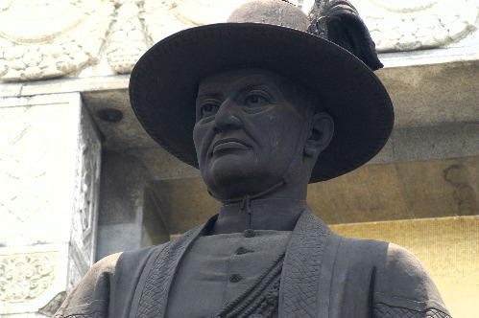
Chao Phraya Chakri Buddha Yodfa Chulaloke [ Rama 1 ]

Slide 3
Chao Phraya Chakri Buddha Yodfa Chulaloke [ Rama 1 ]
King Rama 1 was born as Thong Duang in March 1737. His father was a Mon and a noble man in the Kingdom of Ayutthaya. His mother was part Chinese and Tai. His father later was appointed to Phitsanulok and named Chao Phraya Chakri Phitsanulok. Rama 1 was sent to serve King Uthumphon in Ayutthaya and here befriended Tak Sin [ later King Taksin The Great ].
After the destruction of Ayutthaya by the Burmese, Taksin and his two close generals, Phraya Pichai and Chao Phraya Chakri retook Siam back for the Tai from the Burmese and established the Kingdom of Taksin. During this period Taksin sent Chao Phraya Chakri to conquer Laos and sack Vientiane [ Viang Chang ]. There he took the famous Emerald Buddha which to this day resides in the Emerald Buddha Temple constructed at his direction in Bangkok.
The two were good friends and battle colleges so the subsequent execution of Taksin and his replacement as King by Rama 1 is something never properly explained today. [ Taksin and others were ''executed ''. It is suggested Taksin became '' mentally ill '' and was clubbed to death in the Royal form of execution. His friend and General, Phraya Pichai, was also executed as was his family and others.
Rama I lived in savage times.

Slide 4
The entire population of the City of Ayutthaya [ over 1 million people ] was slaughtered, enslaved or routed by the Burmese in 1767, the ensuing battles to oust the Burmese from all over Siam were equally ruthless, the sacking of Vientiane in Laos and the enslavement of the Lao survivors and the forced migration of the survivors into North East Thailand [ I san ] to this day explains the ethnic diversity of this part of Thailand.
Similarly it was not all good news for the Siamese. In 1784 Rama I was encouraged by the survivor of the Nguyen Dynasty in Vietnam to send 50,000 Siamese troops and 300 battle ships to invade Vietnam and conquer the Tay Son. The resulting battle in January 1785 resulted in a total destruction of all 300 ships and the destruction of 49,000 Siamese troops.
Rama 1 is equally admired for his cultural and intellectual legacies. He created the new fortified City of Rattannakosin, he wrote the Thai Ramakian which is the Thai interpretation of the Indian epic The Ramayana, he created a new legal system entitled the Book of Three Seals and his Wat Phrao Kaew is still Thailand's greatest treasure.
Chao Phraya Chakri was given the name Buddha Yodfa Chulaloke posthumously. He had more than 40 children and was succeeded by his son.

