Slide 1


A poem on Children

Slide 2


Slide 3
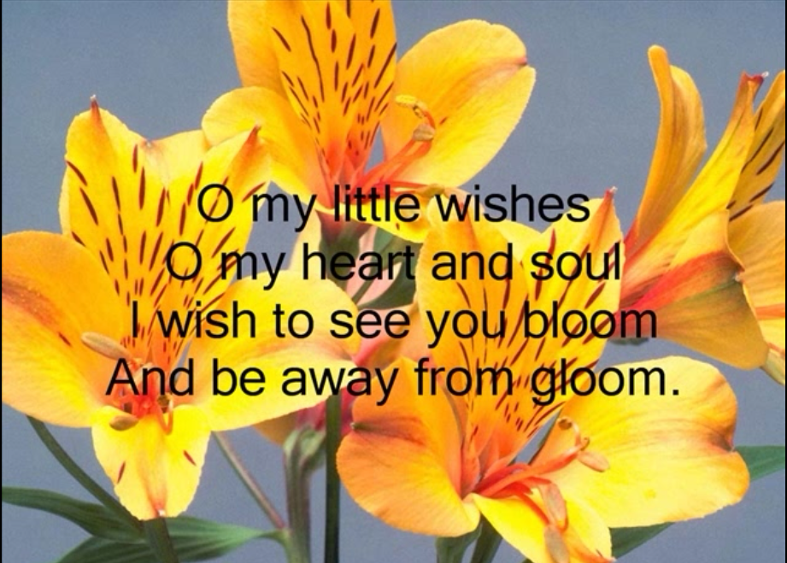

Slide 4


Slide 5


Slide 6
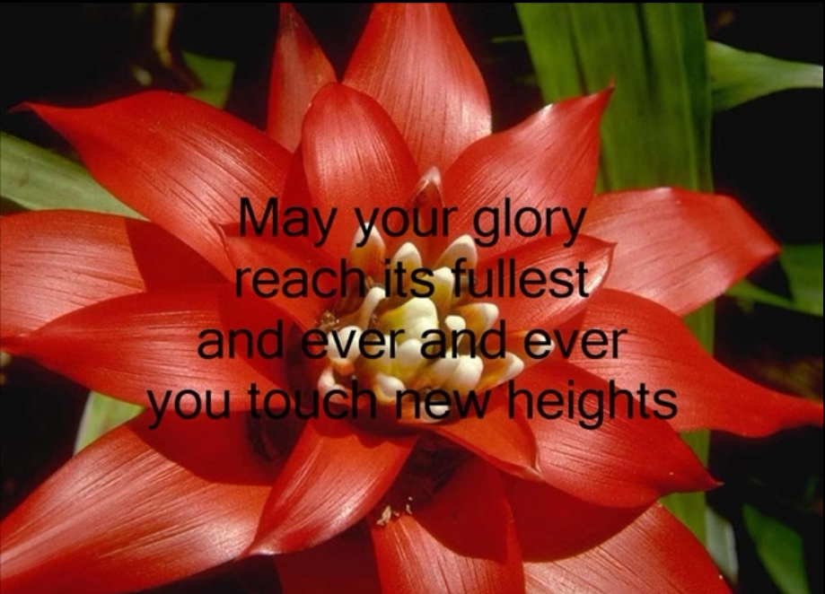

Slide 7


Slide 8
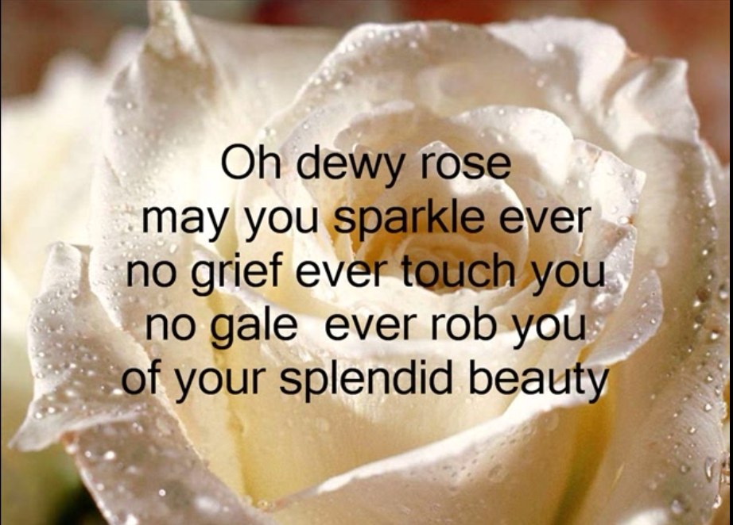

Slide 9
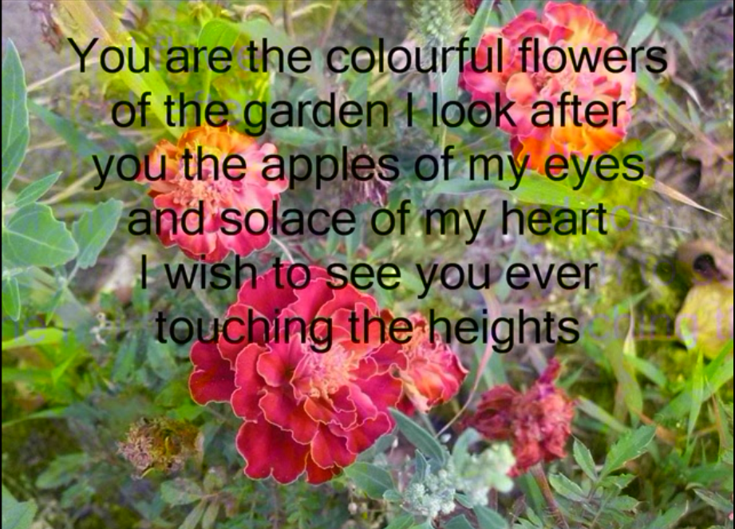

Slide 10
Why God Made Teachers ?
God understood our thirst for knowledge, and our need to be led by someone wiser;
He needed a heart of compassion, of encouragement, and patience;
Someone who would accept the challenge regardless of the opposition;
Someone who could see potential and believe in the best in others . . .
So He made Teachers.

Slide 11
Misbehavior…..?
For some students, misbehaving is the only way of gaining attention.
Most commonly, these students are the ones who speak out without permission,
arrive late for class, or make strange noises which force class or teacher attention.

Slide 12
Mistakes: Common misjudgements and errors

Slide 13
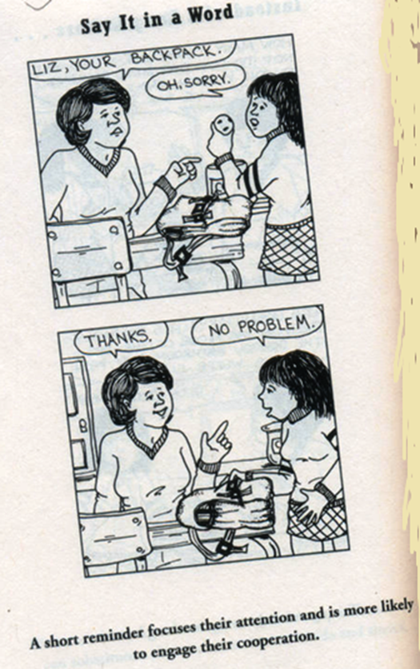
Point…Do NOT Accuse

Slide 14
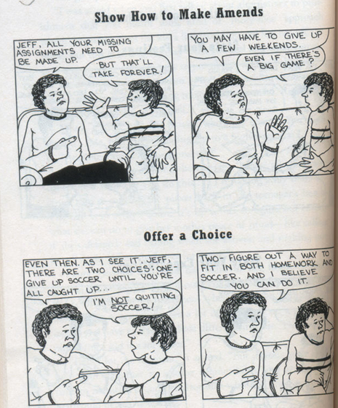
Offer a CHOICE !

Slide 15
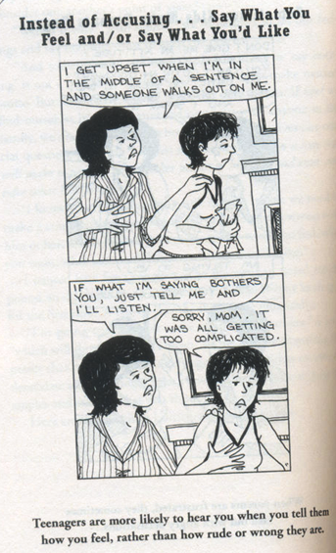
Share Feelings

Slide 16
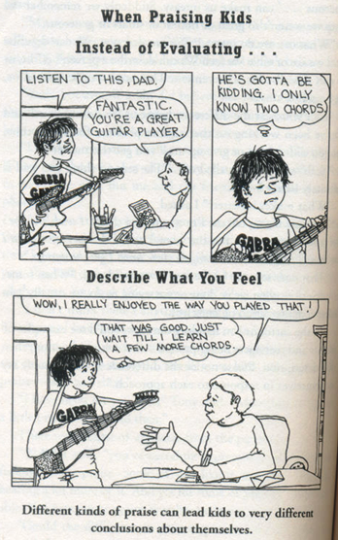
Be honest even in praising !

Slide 17
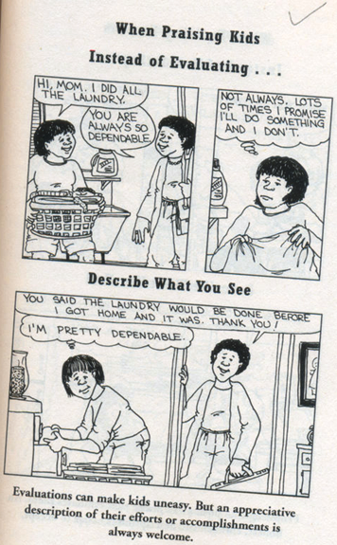
Appreciate honestly

Slide 18
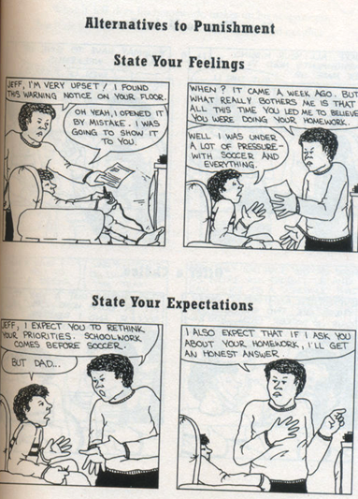
Corrective measures

Slide 19

Adolescents love choices and challenges

Slide 20

Children will quiet down when the teacher is quiet and waiting for their attention

Slide 21

Try to find at least one thing you can respect each student for - even if it's just showing up at school

Slide 22

It's not what you teach, but how you teach it that makes all the difference

Slide 23

Have a good balance of discipline and humour with the children

Slide 24
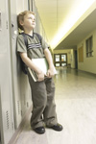
Never get into a power struggle with your students

Slide 25
How we can help ?
More than being a director, assertive teachers build positive, trusting relationships with their students and teach appropriate classroom behaviour (via direct instruction...describing, modelling, practicing, reviewing, encouraging and rewarding) to those who don't show it at present

