Slide 1
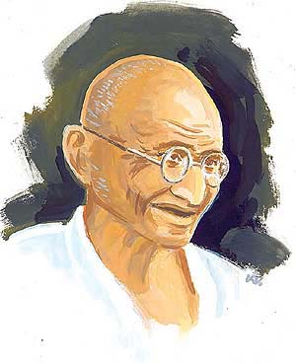
The person I am inspired by -
Mohandas karamchand gandhi

Slide 2
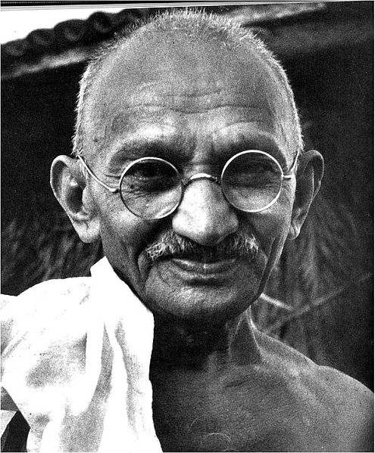
Mohandas Karamchand Gandhi
Gandhi first employed civil disobedience while an expatriate lawyer in South Africa, during the resident Indian community's struggle for civil rights. After his return to India in 1915, he organized protests by peasants, farmers, and urban laborers concerning excessive land-tax and discrimination. After assuming leadership of the Indian National Congress in 1921, Gandhi led nationwide campaigns to ease poverty, expand women's rights, build religious and ethnic amity, end untouchability, and increase economic self-reliance. Above all, he aimed to achieve Swaraj or the independence of India from foreign domination. Gandhi famously led his followers in the Non-cooperation movement that protested the British-imposed salt tax with the 400 km (240 mi) Dandi Salt March in 1930. He launched the Quit India Movement in 1942, demanding immediate independence for India. Gandhi spent a number of years in jail in both South Africa and India.

Slide 3
Early life and background
Mohandas Karamchand Gandhi^{[3]} was born on 2 October 1869 in Porbandar a coastal town which was then part of the Bombay Presidency British India. His father, Karamchand Gandhi (1822–1885), who belonged to the Hindu Modhcommunity, served as the diwan(a high official) of Porbander state, a small princely statein the Kathiawar Agency of British India His grandfather was Uttamchand Gandhi, fondly called Utta Gandhi. His mother, Putlibai, who came from the Hindu Pranami Vaishnava community, was Karamchand's fourth wife, the first three wives having apparently died in childbirth. Growing up with a devout mother and the Jain traditions of the region, the young Mohandas absorbed early the influences that would play an important role in his adult life; these included compassion for sentient beings, vegetarianism, fasting for self-purification, and mutual tolerance among individuals of different creeds.[
The Indian classics, especially the stories of Shravana and Maharaja Harishchandra, had a great impact on Gandhi in his childhood. Gandhi, in his autobiography, admits that it left an indelible impression on his mind. He writes: "It haunted me and I must have acted Harishchandra to myself times without number." Gandhi's early self-identification with Truth and Love as supreme values is traceable to these epic characters.

Slide 4
Civil rights movement in South Africa (1893–1914)
n South Africa, Gandhi faced the discrimination directed at Indians. He was thrown off a train at Pietermaritzburg after refusing to move from the first class to a third-class coach while holding a valid first-class ticket.Travelling farther on by stagecoach he was beaten by a driver for refusing to travel on the foot board to make room for a European passenger.He suffered other hardships on the journey as well, including being barred from several hotels. In another incident, the magistrate of a Durban court ordered Gandhi to remove his turban which he refused to do.These events were a turning point in his life, awakening him to social injustice and influencing his subsequent social activism. It was through witnessing firsthand the racism prejudice and injustice against Indians in South Africa that Gandhi started to question his people's status within the British Empire, and his own place in society.
Gandhi extended his original period of stay in South Africa to assist Indians in opposing a bill to deny them the right to vote. Though unable to halt the bill's passage, his campaign was successful in drawing attention to the grievances of Indians in South Africa. He helped found the Natal Indian Congress in 1894,

Slide 5
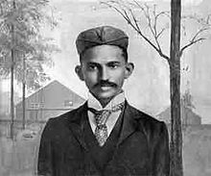
Racism and controversy
Some of Gandhi's early South African articles are controversial. On 7 March 1908, Gandhi wrote in the Indian Opinion of his time in a South African prison: "Kaffirs are as a rule uncivilised—the convicts even more so. They are troublesome, very dirty and live almost like animals." Writing on the subject of immigration in 1903, Gandhi commented: "We believe as much in the purity of race as we think they do... We believe also that the white race in South Africa should be the predominating race." During his time in South Africa, Gandhi protested repeatedly about the social classification of blacks with Indians, whom he described as "undoubtedly infinitely superior to the Kaffirs". Remarks such as these have led some to accuse Gandhi of racism. It is worth noting though that the word Kaffir had a different connotation in Gandhi's time than its current day meaning..

Slide 6
Role in Zulu War of 1906
In 1906, after the British introduced a new poll-tax, Zulus in South Africa killed two British officers. In response, the British declared war against the Zulus. Gandhi actively encouraged the British to recruit Indians. He argued that Indians should support the war efforts in order to legitimise their claims to full citizenship. The British, however, refused to commission Indians as army officers. Nonetheless, they accepted Gandhi's offer to let a detachment of Indians volunteer as a stretcher-bearer corps to treat wounded British soldiers. This corps was commanded by Gandhi. On 21 July 1906, Gandhi wrote in Indian Opinion: "The corps had been formed at the instance of the Natal Government by way of experiment, in connection with the operations against the Natives consists of twenty three Indians". Gandhi urged the Indian population in South Africa to join the war through his columns in Indian Opinion: “If the Government only realised what reserve force is being wasted, they would make use of it and give Indians the opportunity of a thorough training for actual warfare.”
In Gandhi's opinion, the Draft Ordinance of 1906 brought the status of Indians below the level of Natives. He therefore urged Indians to resist the Ordinance along the lines of satyagraha by taking the example of "Kaffirs". In his words, "Even the half-castes and kaffirs, who are less advanced than we, have resisted the government. The pass law applies to them as well, but they do not take out passes."
In 1927 Gandhi wrote of the event: "The Boer War had not brought home to me the horrors of war with anything like the vividness that the [Zulu] 'rebellion' did. This was no war but a man-hunt, not only in my opinion, but also in that of many Englishmen with whom I had occasion to talk."[

Slide 7
Partition of India
While the Indian National Congress and Gandhi called for the British to quit India, the Muslim League passed a resolution for them to divide and quit, in 1943. The Mahatma is believed to have been opposed to the partition during independence and suggested an agreement which required the Congress and Muslim League to cooperate and attain independence under a provisional government, thereafter, the question of partition could be resolved by a plebiscite in the districts with a Muslim majority. When Jinnah called for Direct Action, on 16 August 1946, Gandhi was infuriated and visited the most riot prone areas to stop the massacres, personally.He made strong efforts to unite the Indian Hindus, Muslims and Christians and struggled for the emancipation of the "untouchables" in Hindu society.
On the 14th and 15th of August, 1947 the Indian Independence Act was invoked and the following carnage witnessed a displacement of up to 12.5 million people in the former British Indian Empire with an estimated loss of life varying from several hundred thousand to a million. But for his teachings, the efforts of his followers, and his own presence, there would have been much more bloodshed during the partition, according to prominent Norwegian historian, Jens Arup Seip.

Slide 8
Assassination
On 30 January 1948, Gandhi was shot while he was walking to a platform from which he was to address a prayer meeting. The assassin, Nathuram Godse, was a Hindu nationalist with links to the extremist Hindu Mahasabha who held Gandhi responsible for weakening India by insisting upon a payment to Pakistan.Godse and his co-conspirator Narayan Apte were later tried and convicted; they were executed on 15 November 1949. Gandhi's memorial (or Samādhi) at Rāj Ghāt, New Delhi, bears the epigraph "Hē Ram", (Devanagari: हे ! राम or, He Rām), which may be translated as "Oh God". These are widely believed to be Gandhi's last words after he was shot, though the veracity of this statement has been disputed.

