Slide 1
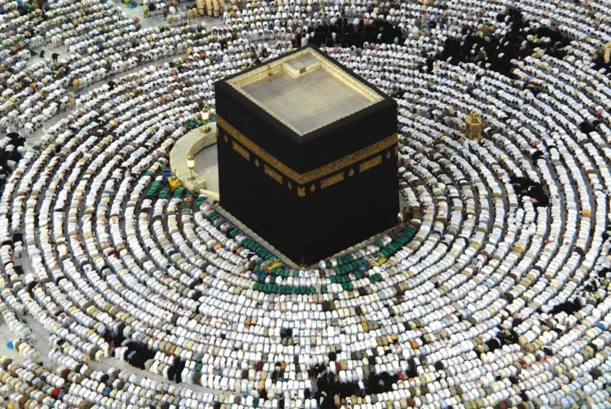
Islam
By: Youssef Zaidouh

Slide 2
Islam
Islam is one of the Abrahamic religions. The general meaning of the word Islam is peace and submission to Allah.

Slide 3
Muslims believe that Islam is the last of the divine messages, and it abrogates all previous religions; as Muslims believe that Muhammad is the Messenger of Allah, and the last of the Prophets and Messengers sent to all humanity.

Slide 4
Among the foundations of the Islamic faith the belief in the existence of one God and the belief in all prophets and messengers sent to humanity before Muhammad like prophet Abraham, Joseph, Moses and Jesus son of Mary and many others who are mentioned in the Quran. Muslims also believe in angels and the doomsday.

Slide 5
Thank you

