Slide 1


Slide 2
By Intissar Daadi

Slide 3
BRITICH COUNCIL
CONNECTING CLASS ROOMS
OUADI EDDAHAB MIDDLE SCHOOL
2011/2012
TADLA AZILAL CLUSTER
MOROCCO
Hello everyone. My name is INTISSAR DAADI I am 15years old. My school name is Oued Eddahab Middle School. I am a member of British Council Connecting Classrooms. I am happy to share with you this project about Eid Al-Adha

Slide 4
EID AL - ADHA IN MOROCCO
Eid Al-Adha is a holiday at the end of the Hajj, the annual Muslim pilgrimage to Mecca which is one of the greatest religious observance in Islam. At the end of the Hajj (annual pilgrimage to Mecca), Muslims throughout the world celebrate the holiday of Eid al-Adha (Festival of Sacrifice).
EID AL ADHA DEFINITION

Slide 5
EID AL- ADHA IN MOROCCO
During the Hajj, Muslims remember and commemorate the trials and triumphs of the Prophet Abraham. The Qur'an describes Abraham as follows:
"Surely Abraham was an example, obedient to Allah, by nature upright, and he was not of the polytheists. He was grateful for Our bounties. We chose him and guided him onto a right path. We gave him good in this world, and in the next he will most surely be among the righteous." (Qur'an 16:120-121)

Slide 6
EID AL - ADHA IN MOROCCO
One of Abraham's main trials was to face the command of Allah to kill his only son. Upon hearing this command, he prepared to submit to Allah's will. When he was all prepared to do it, Allah revealed to him that his "sacrifice" had already been fulfilled. He had shown that his love for his Lord superceded all others, that he would lay down his own life or the lives of those dear to him in order to submit to God.

Slide 7
Why do Muslims sacrifice an animal on this day?
During the celebration of Eid al-Adha, Muslims commemorate and remember Abraham's trials, by themselves slaughtering an animal such as a sheep, camel, or goat. This action is very often misunderstood by other people.

Slide 8
Why do Muslims sacrifice an animal on this day?
Allah has given us power over animals and allowed us to eat meat. Muslims slaughter animals in the same way throughout the year. By saying the name of Allah at the time of slaughter, we are reminded that life is sacred.

Slide 9
Why do Muslims sacrifice an animal on this day?
The meat from the sacrifice of Eid al-Adha is mostly given away to others. One-third is eaten by immediate family and relatives, one-third is given away to friends, and one-third is donated to the poor. The act symbolizes our willingness to give up things that are of benefit to us or close to our hearts, in order to follow Allah's commands. It also symbolizes our willingness to give up some of our own bounties, in order to strengthen ties of friendship and help those who are in need. We recognize that all blessings come from Allah, and we should open our hearts and share with others.

Slide 10
Why do Muslims sacrifice an animal on this day?
It is very important to understand that the sacrifice itself, as practiced by Muslims, has nothing to do with atoning for our sins or using the blood to wash ourselves from sin.
The symbolism is in the attitude - a willingness to make sacrifices in our lives in order to stay on the Straight Path. Each of us makes small sacrifices, giving up things that are fun or important to us. A true Muslim, one who submits his or herself completely to the Lord, is willing to follow Allah's commands completely and obediently. It is this strength of heart, purity in faith, and willing obedience that our Lord desires from us.

Slide 11
Why do Muslims sacrifice an animal on this day?
On the first morning of Eid al-Adha, Muslims around the world attend morning prayers at their local mosques. Prayers are followed by visits with family and friends, and the exchange of greetings and gifts. At some point, members of the family will make arrangements for the slaughter of an animal. The meat is distributed during the days of the holiday or shortly thereafter

Slide 12
LET us share some Eid pictures

Slide 14
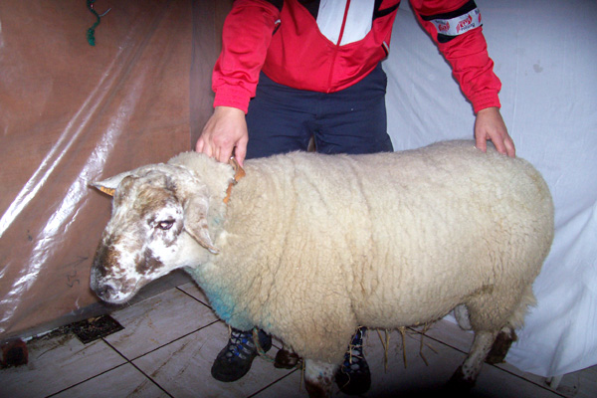

Slide 15
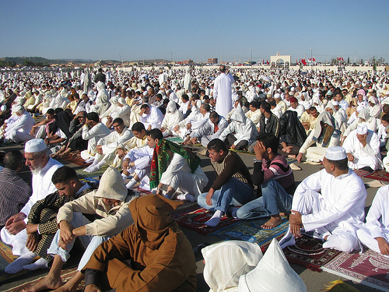

Slide 16
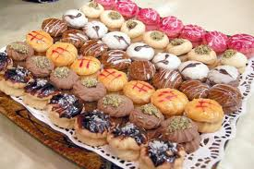

Slide 17
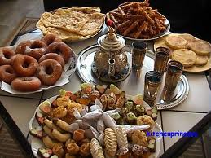

Slide 18


