Slide 1
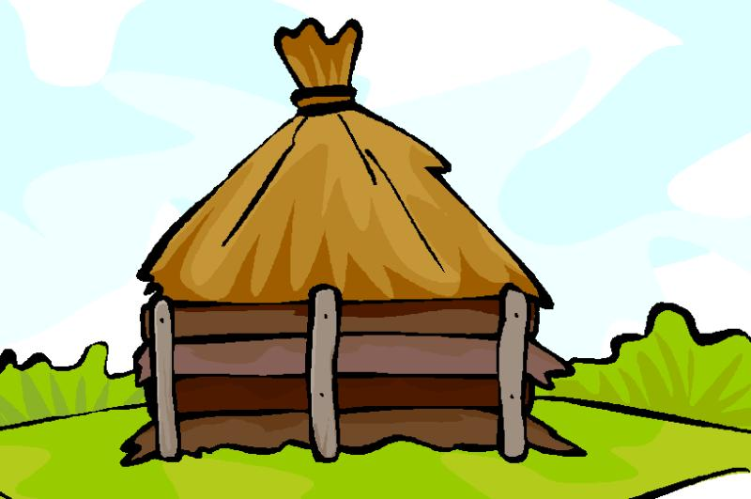
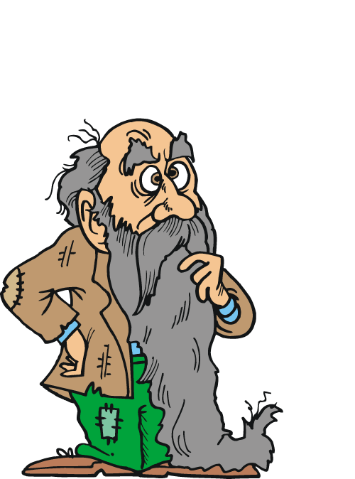
Dhilu was a poor farmer and had five children. He couldn’t earn much to fill their stomachs. He was always worried about ways
to earn more money. Once he thought it would be better to send his sons to work too. He consulted his wife and she also agreed.

Slide 2
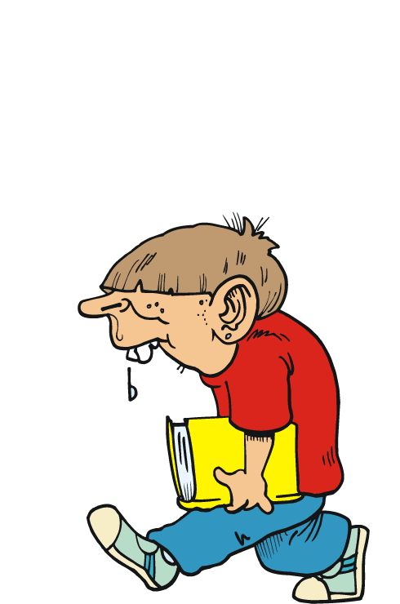
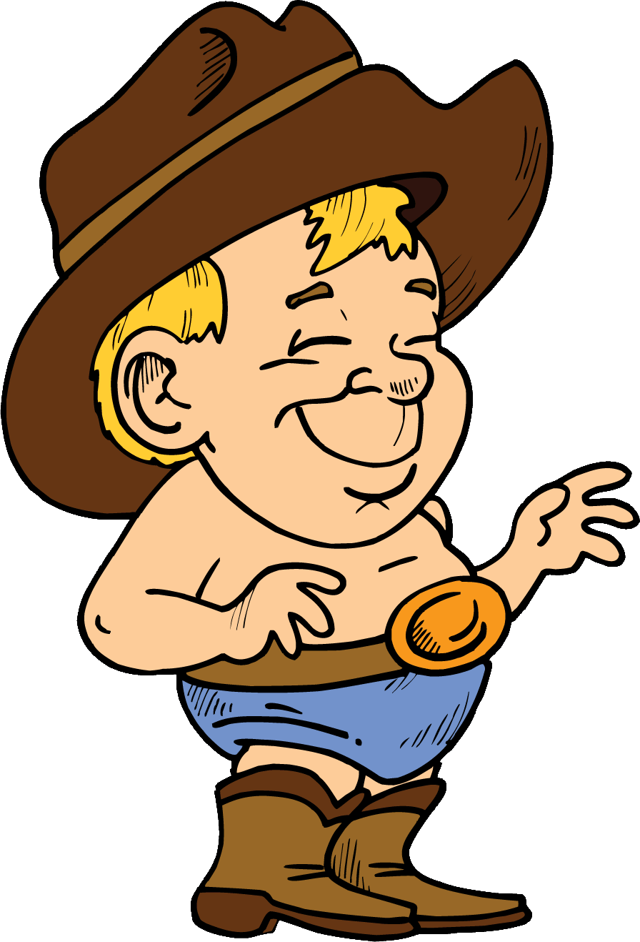
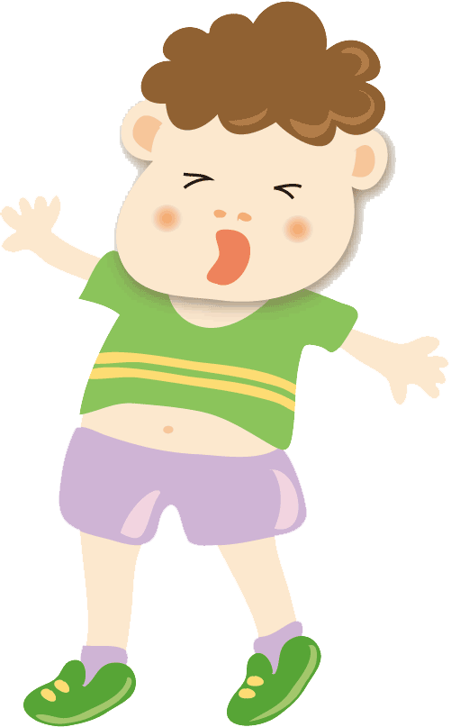
Three of the sons were asked to assist their father in earning money. They had to help in farms, work in shops or cut wood. Two of the sons who disliked studying agreed at once. But the eldest son loved to go to school , he wished to continue his study . But his father refused to send him to school. After day work, the eldest son attended night classes.

Slide 3
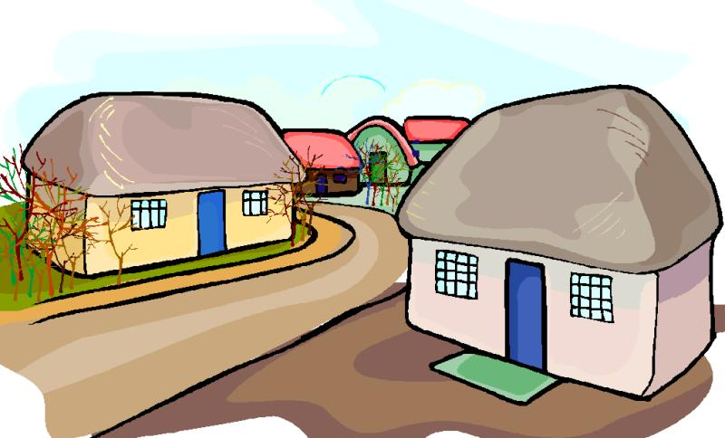


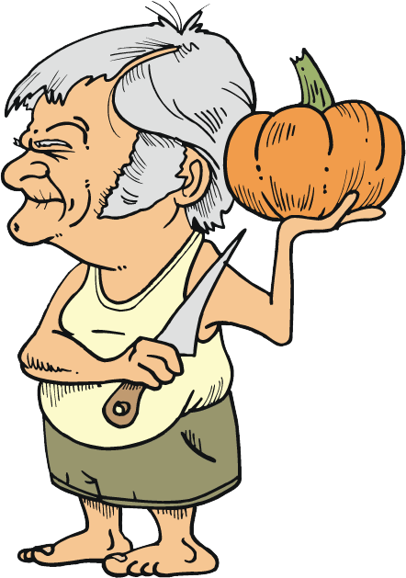
Years passed by , three of the sons remained engaged in their works. Dhilu died and left them to their fates. One brother became a green grocer, the other one became carpenter ,their earnings were meagre. The eldest son continued his study through open School and in meantime got degrees. He became a college lecturer and had a respectable place in society. People sought his advice in all matters whereas his younger brothers were looked down upon.

Slide 4
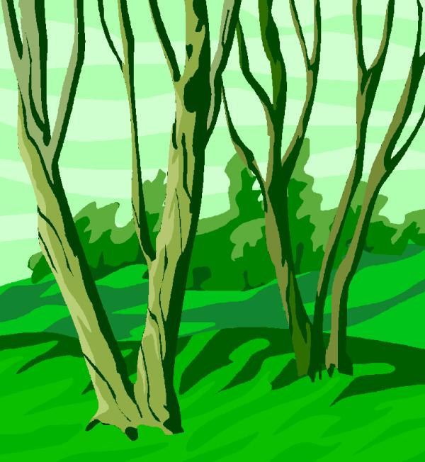
All children are not lucky to be born in well to do families. A few are unlucky and from the childhood they are compelled to work in fields, shops, restaurants, factories etc. Even their basic needs are not fulfilled. Their lives are hell and they make no efforts to drag themselves out of filthy mud. If a person determines to change his life and makes efforts too , he would ultimately be successful in life like the eldest brother. Child labourers can also bring a considerable change in their lives by educating themselves. Government provides free of cost Education to primary classes’ students. Even they can attend night schools or appear in Exams through open School. Opportunities are many but one has to look for them and utilize them for one’s betterment.
Karoni
IX-A JNV Bhiwani

