Slide 1
THE RANSOM OF RED CHIEF
Writing a different ending to a well-known story.

Slide 2
Writing a different ending
Choose a story that everyone knows.
Would you like to change the end ?
Write your own end of the story!

Slide 3
What is the story about?
This is a humorous story by O. Henry about two tramps who wanted to get money by kidnapping the son of rich parents and demanding a ransom for him. The boy was so naughty that the tramps were eager to get rid of him.
At last they wrote a letter to his father about the ransom.

Slide 4
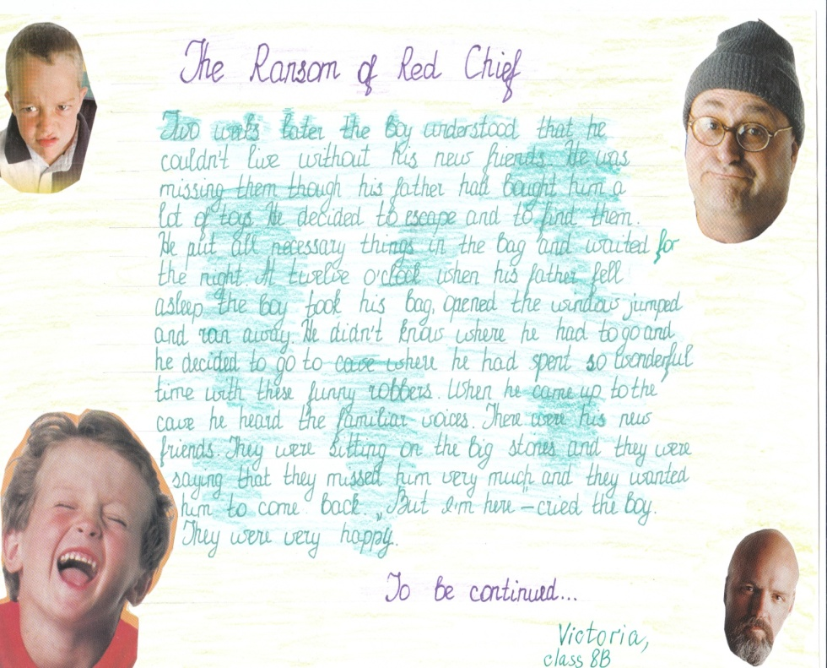
The ransom of red chief
Two weeks later the boy understood that he couldn’t live without his new friends. He was missing them though his father had bought him a lot of toys. He decided to escape and to find them. He put all the necessary things in the bag and waited for the night.
At twelve o’clock when his father fell asleep the boy took his bag, opened the window and ran away. He didn’t know where he had to go and he decided to go to the cave where he had spent such a wonderful time with these funny robbers.
When he came up to the cave he heard the familiar voices. There were his new friends. They were sitting on big stones and they were saying that they missed him very much and they wanted him to come back.
“But I’m here!” – cried the boy. They were very happy.
To be continued…
Victoria, class 8B.

Slide 5
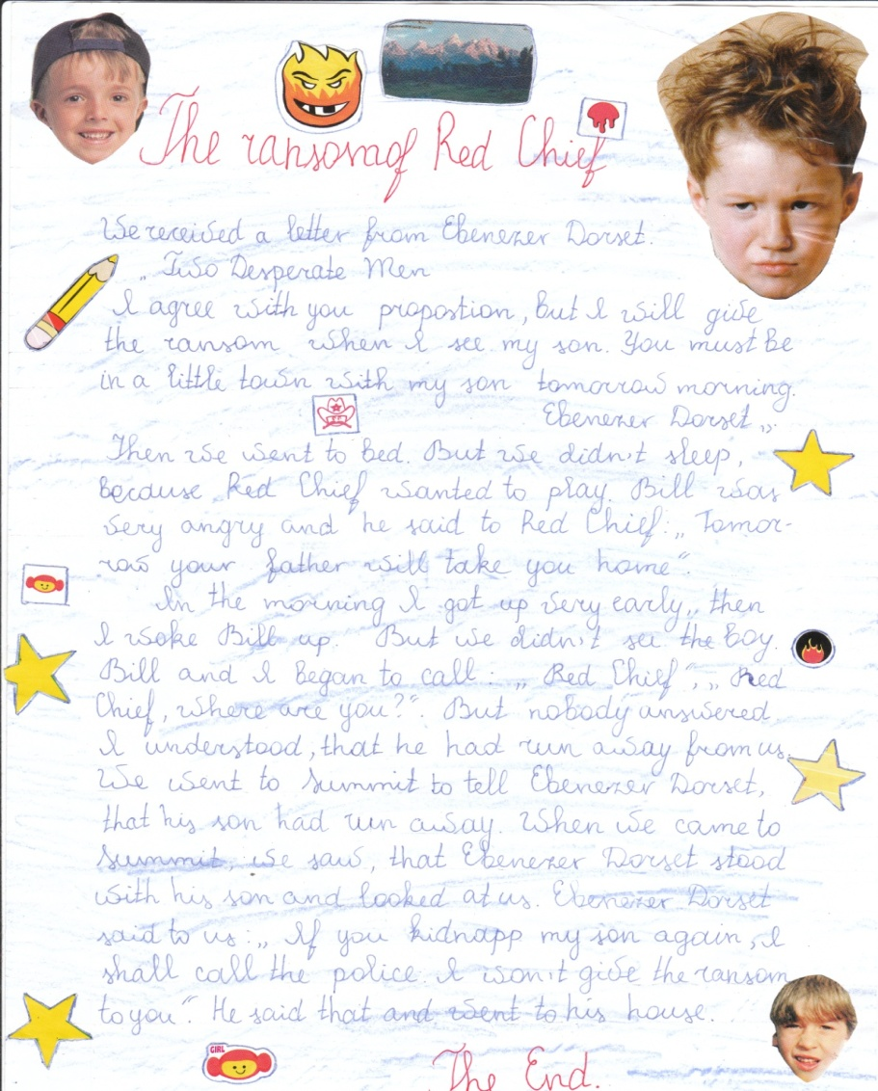
The Ransom of Red Chief
We received a letter from Ebenezer Dorset:
“Two Desperate Men,
I agree with your proposition, but I will give the ransom when I see my son. You must be in town with my son tomorrow morning.
Ebenezer Dorset”
Then we went to bed, but we didn’t sleep, because Red Chief wanted to play. Bill was very angry, he said to Red Chief, “Tomorrow your father will take you home.”
In the morning I got up very early, then I woke Bill up, but we didn’t see the boy. Bill and I began to call, ‘Red Chief, Red Chief, where are you?’ But nobody answered. I understood that he had run away from us. We went to Summit to tell Ebenezer Dorset that his son had run away.
When we came to Summit we saw that Ebenezer Dorset stood with his son and looked at us. Ebenezer Dorset said to us, “If you kidnap my son again, I shall call the police. I won’t give the ransom to you.” He said that and went to his house.
Alina, class 8B.

Slide 6
red chief
When I came back Bill and the boy were not there. They were playing the Black Scout. So I made our dinner. Then my friend and the boy came back to the cave.
I told Bill about the letter. After that I went to the village. I took the parcel and hurried back to the cave. We opened the parcel and found a note which said:
“Two Desperate Men!
Gentlemen, I have received your letter in which you demand a ransom for the return of my son. But I think you demand too much. I don’t want to pay two thousand dollars for this abnormal boy. So, if you want the boy will stay with you. If you don’t, pay me fifteen hundred dollars and I’ll take him back.”
I didn’t understand Bill’s reaction. He was very happy. He told me that he wanted to take the boy with him. I was shocked. Did Bill go mad? Only yesterday he wanted to send the boy home… I agreed with him.
We left this forest. I came back home and worked on the farm. Bill and the boy bought a house not far from mine. Bill worked on the farm too and the boy went to school. His character changed very much. Now he is a pupil of the fifth form. He goes to the same class as my son. But he is a very good boy. I like him very much.
Nastia, class 8B.
(The original – slide 7)

Slide 7
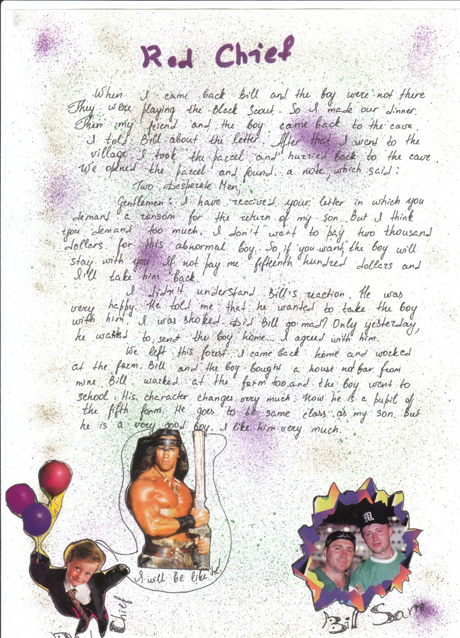

Slide 8
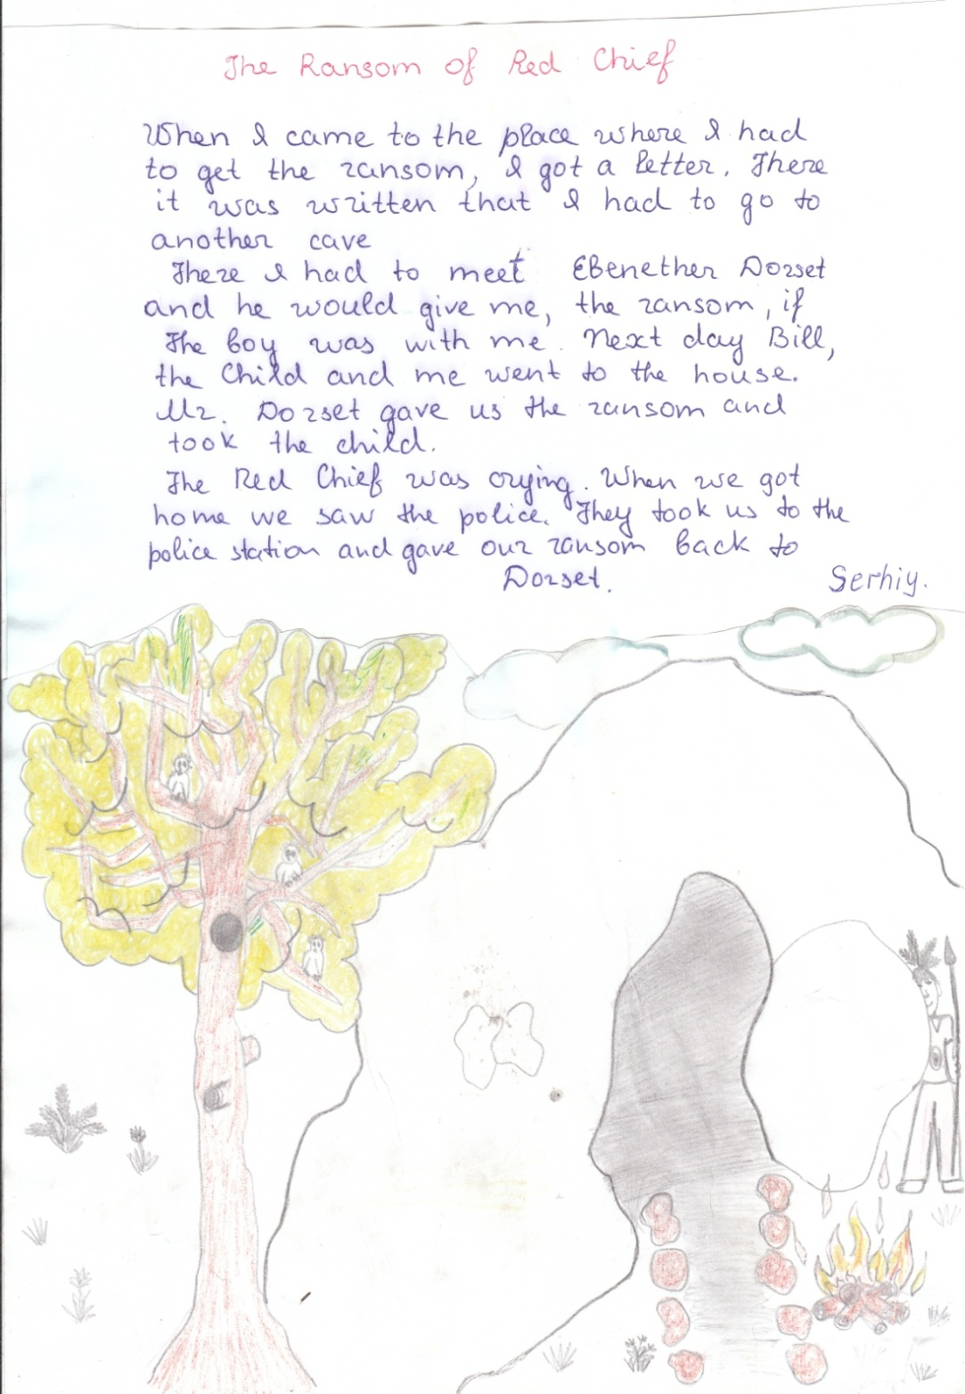
The Ransom of Red Chief
When I came to the place where I had to get the ransom I got a letter. There it was written that I had to go to another cave.
There I had to meet Ebenezer Dorset and he would give me the ransom if the boy was with me.
The next day Bill, the child and me went to the house. Mr. Dorset gave us the ransom and took the child.
Red Chief was crying. When we got home we saw the police. They took us to the police station and gave our ransom back to Dorset.
Serhiy, class 8B.

Slide 9
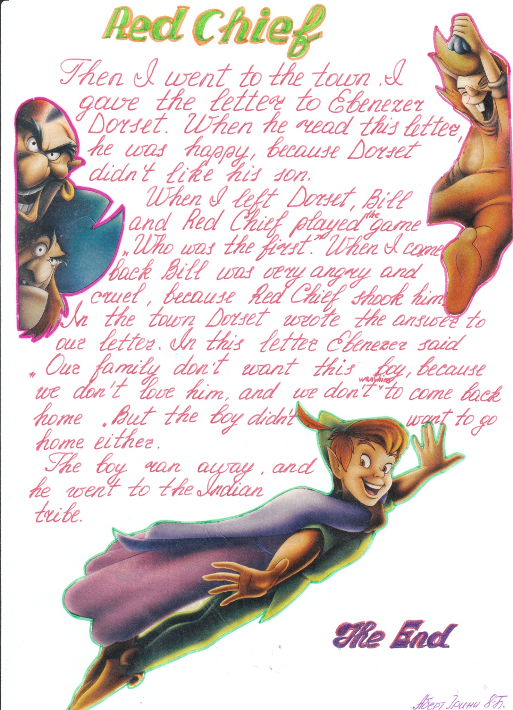

Slide 10
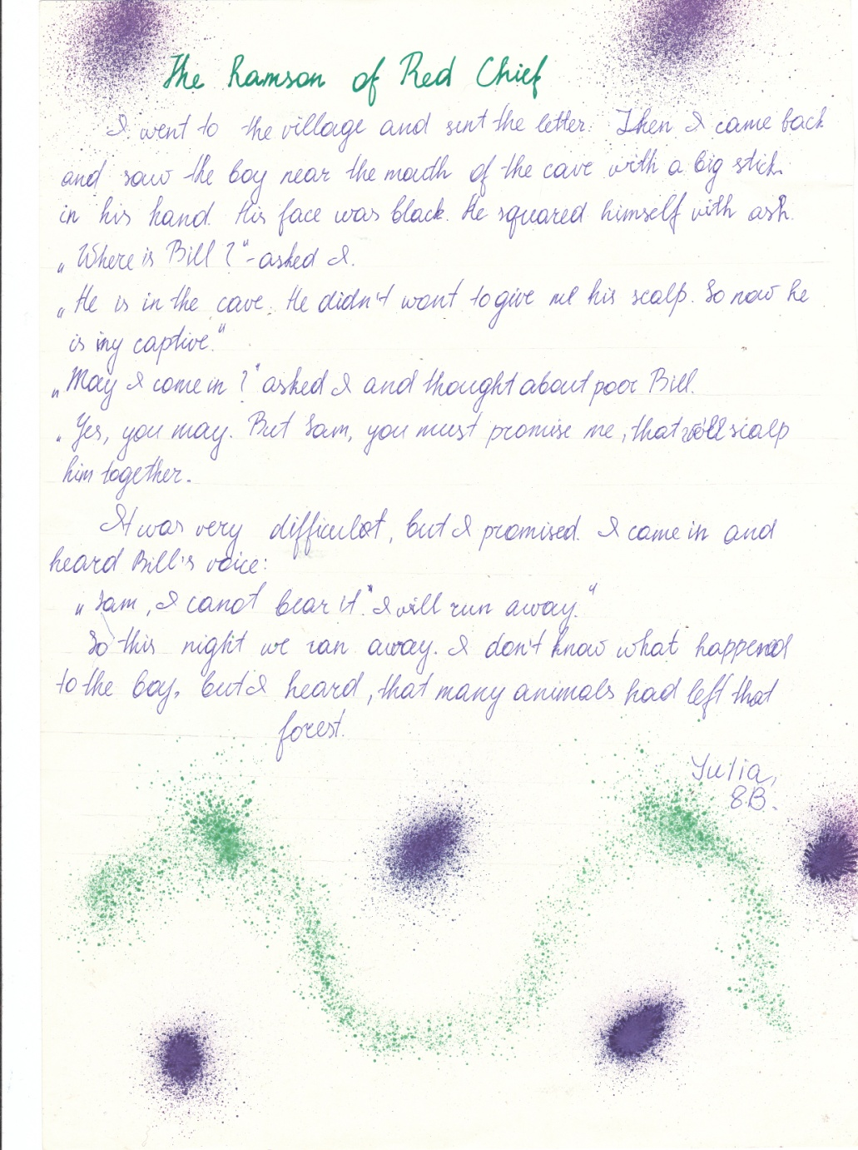
The ransom of red chief
I went to the village and sent the letter. Then I came back and saw the boy near the mouth of the cave with a big stick in his hand. His face was black with ash.
“Where is Bill?” asked I.
“He is in the cave. He didn’t want to give me his scalp, so now he is my captive.”
“May I come in?’ I asked and thought about poor Bill.
“Yes, you may. But Sam, you must promise me, that we’ll scalp him together.”
It was very difficult, but I promised. I came in and heard Bill’s voice, “Sam, I cannot bear it. I will run away.”
So, this night we ran away. I don’t know what happened to the boy, but I heard that many animals had left that forest.
Yulia, class 8B.

