Slide 1
THE MYSTERIOUS PLANET
Students were given the beginning of the story and had to use their imagination to complete it. (The activity is based on the coursebook Project II by Tom Hutchinson)
The endings were written by year8 students from Chernivtsi school #6, Ukraine.

Slide 2
The plot of the story
The spaceship Star 2 was damaged and the astronauts had to land on an unknown planet.
They found many strange creatures on that planet. Soon their tools disappeared and they could not repair the spaceship.
They are trying to find the way to come back to Earth.

Slide 3
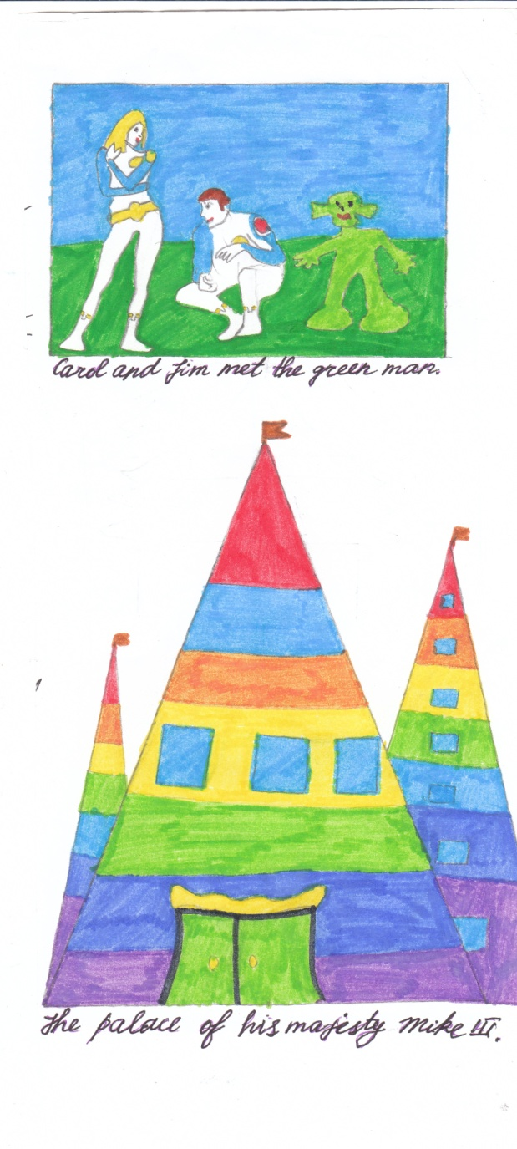
THE MYSTERIOUS PLANET
Carol, Jim and Steve saw little green people. The people came to them and began to speak their language. The astronauts asked the people if there was any way to leave the planet. The green people answered that they would take the astronauts to their ruler Mike III, who was the cleverest person on the planet.
When the travelers came to the castle of Mike III he said that there was the only way to leave the planet. He said he would show it to Steve, Carol and Jim if they promised not to tell anyone about that planet. He also said that that way (a hole in the force field) appeared only once in two weeks, so they would have enough time to repair their spaceship.
Two weeks passed quickly. Steve repaired the ship and the astronauts were ready to leave. When they took off and were on some distance from the planet Carol said, “Oh, boys, I am happy that everything is OK now and we are on our way to Earth.”
Written by Julia

Slide 4
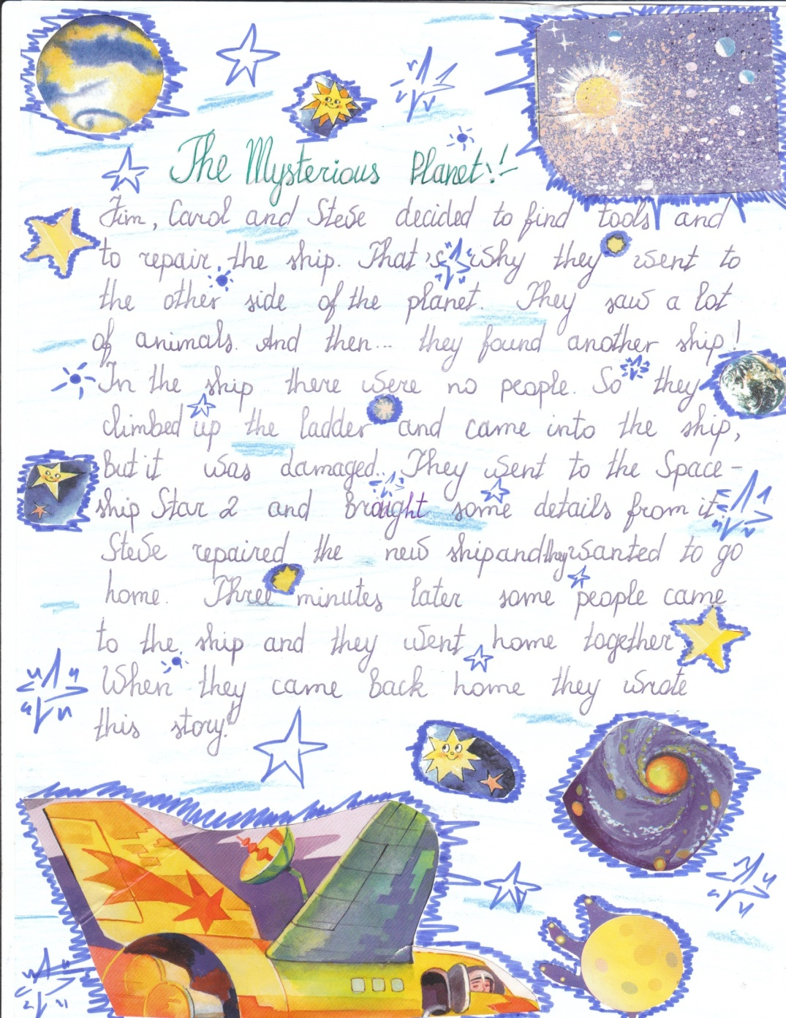
THE MYSTERIOUS PLANET
Jim, Carol and Steve decided to find tools and to repair the ship. That’s why they went to the other side of the planet. They saw a lot of animals. And then… they found another ship!
In the ship there were no people. So they climbed up the ladder and came into the ship, but it was damaged… They went to the Spaceship Star 2 and brought some details from it.
Steve repaired the new ship and they wanted to go home Three minutes later some people came to the ship and they went home together.
When they came back home they wrote this story.
Written by Tania

Slide 5
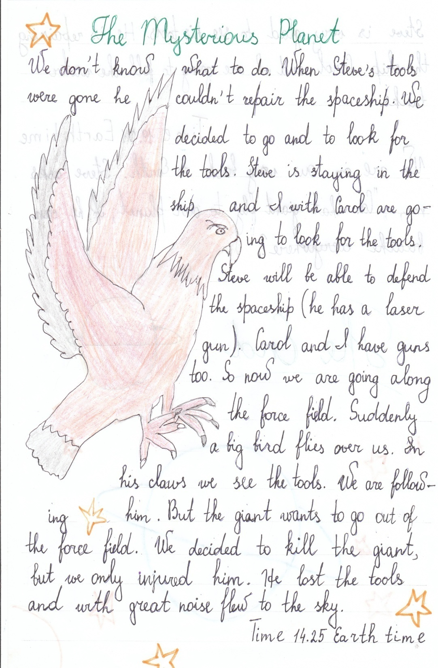
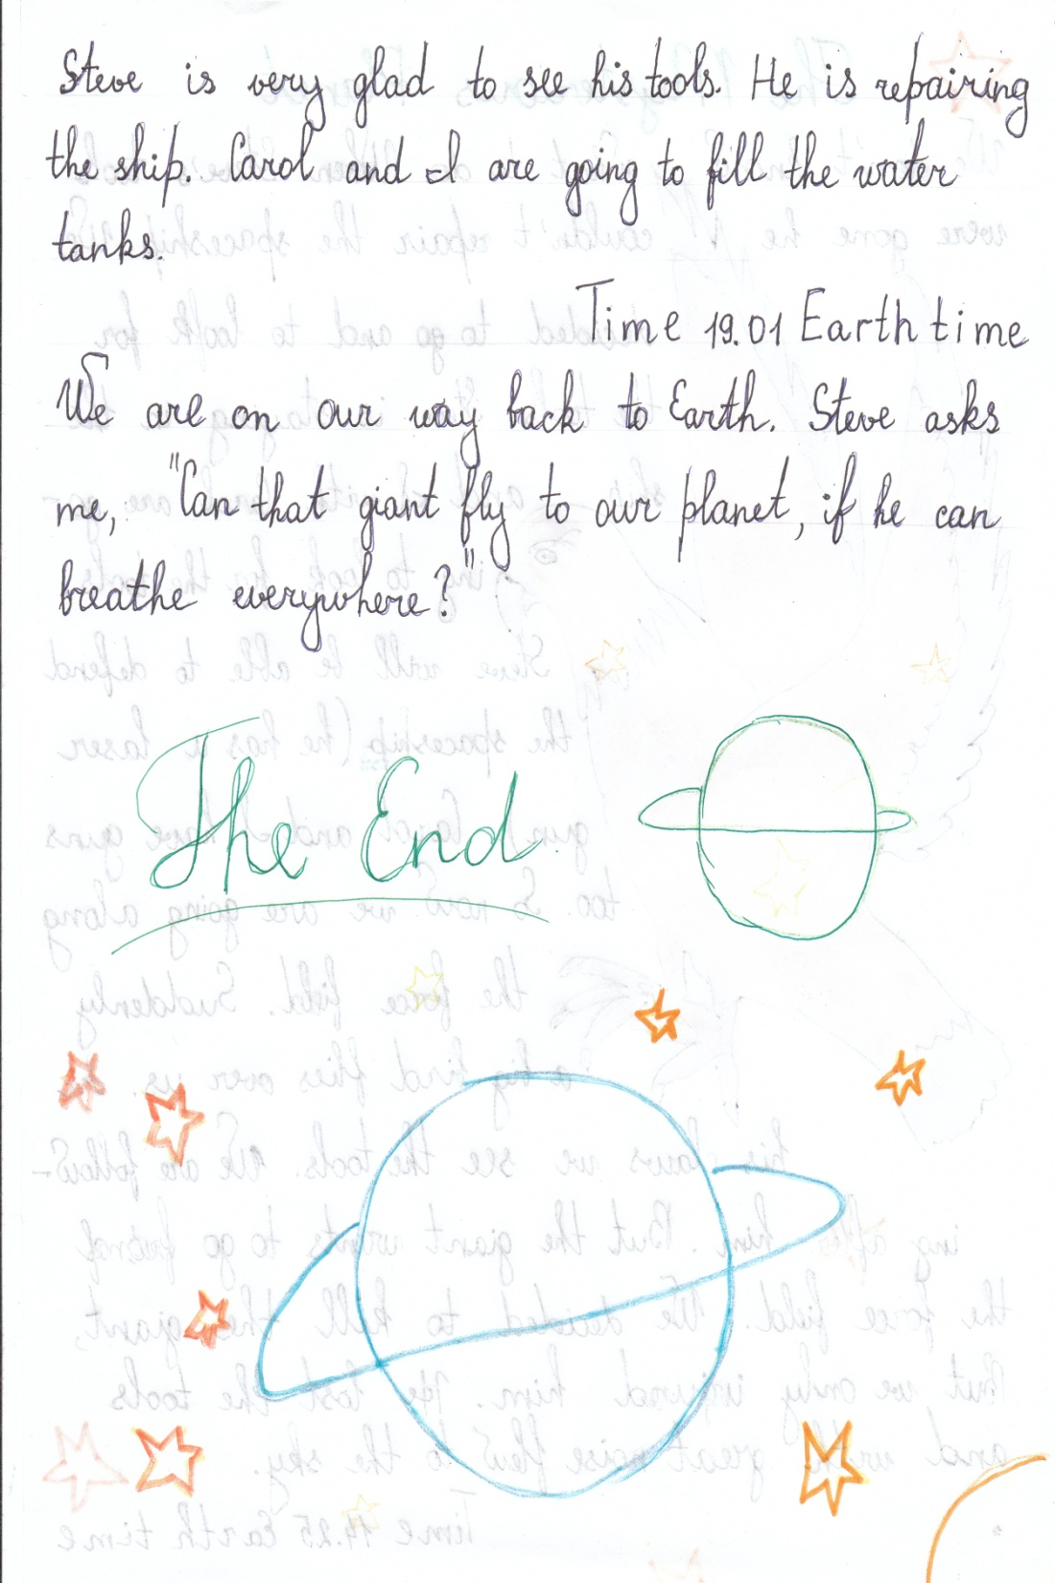

Slide 6
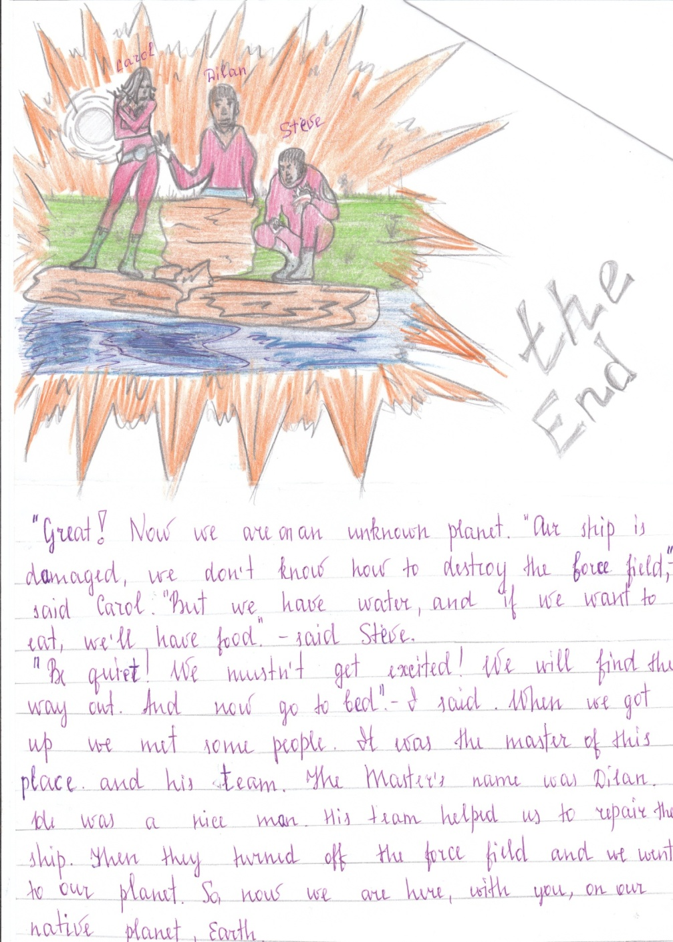
THE MYSTERIOUS PLANET
“Great! Now we are on an unknown planet. Our ship is damaged, we don’t know how to destroy the force field” – said Carol.
“But we have water, and if we want to eat we’ll have food” – said Steve.
“Be quiet! We mustn’t get excited! We will find the way out. And now go to bed.” – I said.
When we got up, we met some people. It was the master of that place and his team. The master’s name was Dilan. He was a nice man. His team helped us to repair the ship. Then they turned off the force field and we went to our planet.
So, now we are here with you, on our native planet Earth.
Written by Liuba
and Sasha

Slide 7
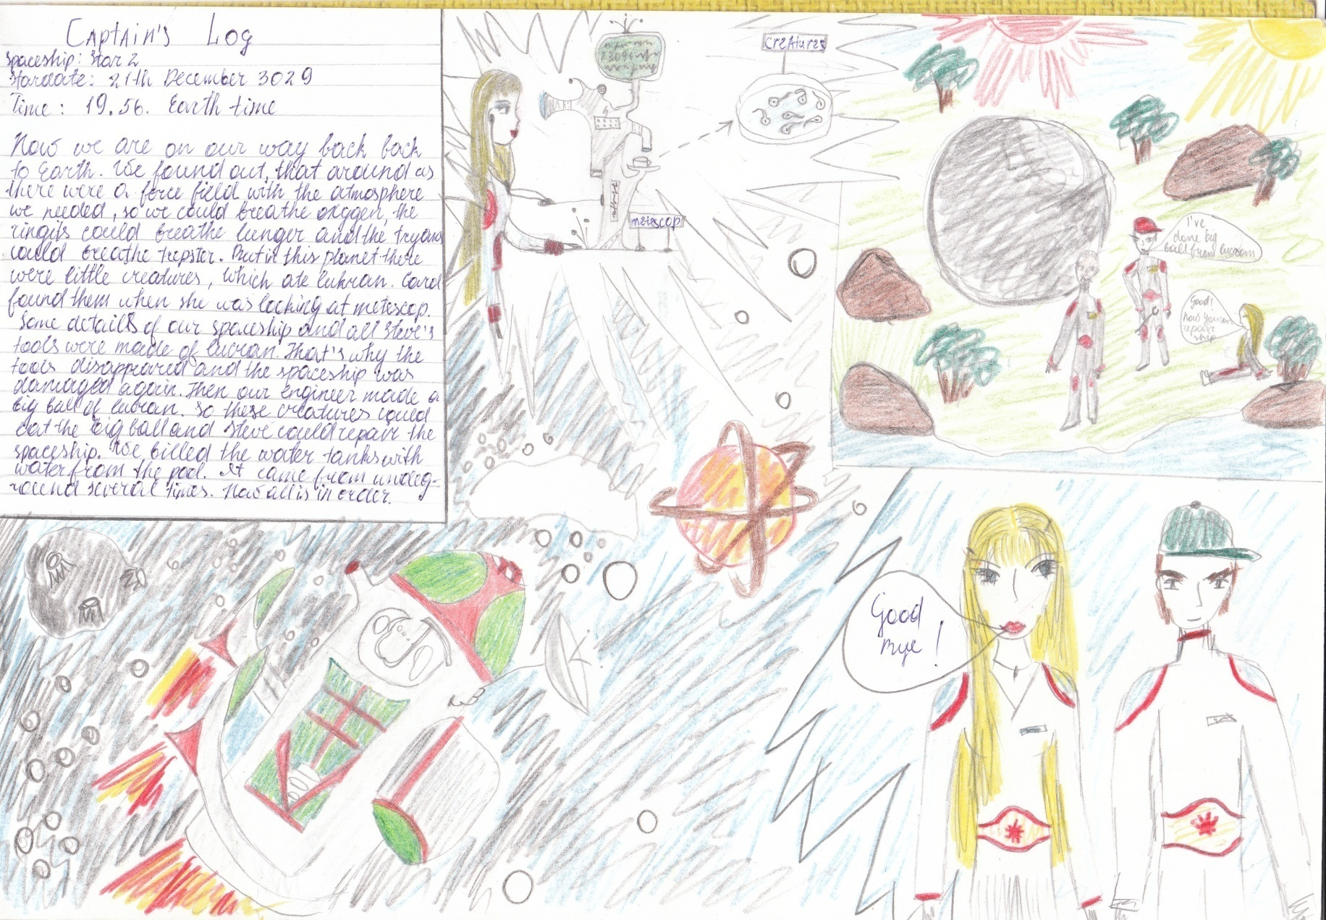
THE MYSTERIOUS PLANET

Slide 8
CAPTAIN’S LOG
(The original – slide 7.)
Spaceship: STAR 2
Star date: 21 December 3029
Time: 19.56 Earth time
Now we are on our way back to Earth. We found out that around us there was a force field with the atmosphere we needed, so we could breathe oxygen. The ringits could breathe lunger and the tryans could breathe trepster.
But on this planet there were little creatures which ate lukran. Carol found them when she was looking at metescop.
Some details of our spaceship and all Steve’s tools were made of lukran. That’s why the tools disappeared and the spaceship was damaged again. Then our engineer made a big ball of lukran. So these creatures could eat the big ball and Steve could repair the spaceship. We filled the water tanks with water from the pool. Now all is in order.
(Ringits, tryans , etc. are made up words for fantastic things.)
Written by Olena

