Slide 1

Famous people from Manchester.
By Ryan O'Rourke

Slide 2
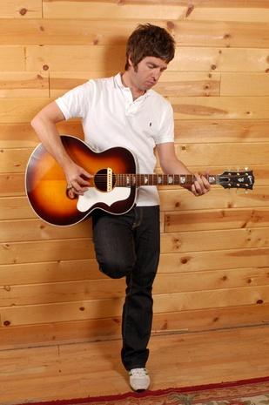
Noel Gallagher
Facts about Noel Gallagher
Noel Thomas David Gallagher (born 29 May 1967 in MANCHESTER, England) is the principal songwriter, lead guitarist, and occasional vocalist of English rock band OASIS. Raised with younger brother LIAM GALLAGER in Burnage, Manchester, Gallagher began to get guitar lessons from Dayle Robertson at the age of thirteen during a period of probation. After a series of odd jobs in construction, Gallagher joined local Manchester band Inspiral Carpetsas a roadie in 1988. In 1991, he became a member of brother Liam's band Oasis, quickly asserting his dominance over the group

Slide 3
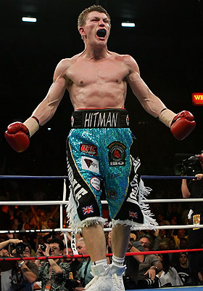
Ricky Hatton
Facts about Ricky Hatton
Richard John Hatton MBE, more commonly known as Ricky "the Hitman" Hatton, (born 6 October 1978, in Stockport, Greater Manchester, England), is a British professional boxer is a two-time IBF and IBO light welterweight champion, having relinquished the IBF belt, only to step back down to the weight class and beat Juan Urango.
He was the WBA Welterweight Champion, but relinquished this title on 31 August 2006. Hatton is also the former WBU, WBA Light Welterweight Champion and WBC, WBA, WBO Inter-Continental Light Welterweight Champion, and current Ring Magazine Junior Welterweight Champion.

Slide 4
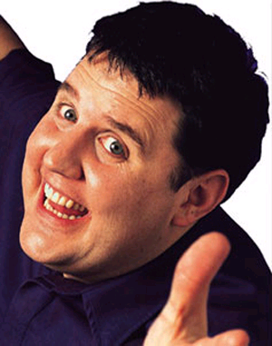
Peter Kay
Facts about Peter Kay
Peter John Kay (born 2 July, 1973) is an English comedian, writer, producer, director and actor. His work includes That Peter Kay Thing (2000), Phoenix Nights (2001), Max and Paddy's Road to Nowhere (2004), Britain's Got the Pop Factor...(2008) and other independent productions.

Slide 5
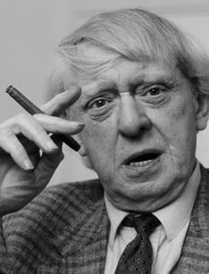
John Burgess
Information about john burgess
John Burgess Wilson (pseudonym Anthony Burgess) (25 February 1917 – 22 November 1993) was an English author, poet, playwright, composer, linguist, translator and critic.
His dystopian satire A Clockwork Orange, widely considered to be his magnum opus, is by far his most famous novel, and was adapted into a famous, if highly controversial, 1971 film by Stanley Kubrick. However, the author later dismissed it as one of his lesser works]. Burgess produced numerous other novels, including the much loved Enderby quartet. He was also a prominent critic, authoring acclaimed studies of classic writers such as William Shakespeare, James Joyce, D. H. Lawrence and Ernest Hemingway.

Slide 6
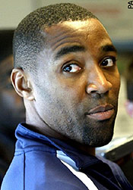
Darren Campbell
Darren Andrew Campbell (born 12 September 1973 in Moss Side, Manchester, England is a retired English sprint athlete. He competed in the 100 metres and 200 metres, as well as the 4 x 100 metres relay. Campbell is the European record holder in the relay event with 37.73 seconds.
Campbell has won two Olympic medals: a gold for the 4 × 100 m relay in 2004 and a silver in 2000 for the 200 m. He was the 1998 European Champion in the 100 m and won silver at the following 2002 European Championships. He was the 2003 World Championships bronze medallist in the 100 m. He has a personal best of 10.04 s in the 100 metres and 20.13 s in the 200 m—placing him among the top six fastest British sprinters.

Slide 7
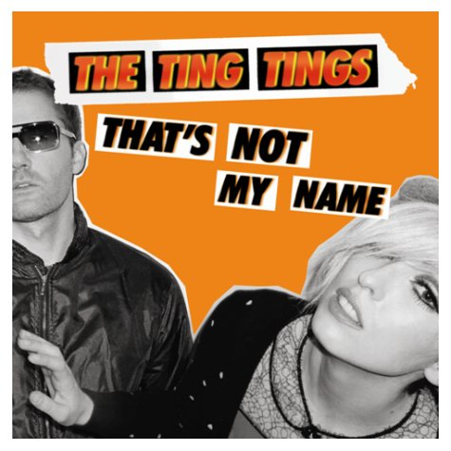
THE TING TINGS
Facts about THE TING TINGS
The Ting Tings is an English rock duo of Jules De Martino (drums, guitar, vocals, piano) and Katie White (born 1983 (vocals, guitar, bass drum). Originally from Leigh, Greater Manchester, they formed in December 2007 while based at Islington Mill, Artist Studios in Salford. They have released four singles on their current label Columbia Records UK, including the single "That's Not My Name" which charted straight at Number 1 in the UK Singles Chart on 18 May 2008. The album We Started Nothing was released on 19 May 2008 and also charted at Number 1 in the UK.

Slide 8
Hope you enjoyed it
☺

