Slide 1

Famous people from Manchester
By Faith Brett

Slide 2
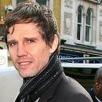
Jason Orange
His birth name is Jason Thomas Orange.
He was born the 10th July 1970.
He is in a band called take that and he plays guitar and vocals.

Slide 3



L.S Lowry
L.S Lowry is a famous artist who started as a amateur artist.
He was born on the 1st of November 1887. and died on the 23rd of February 1976.

Slide 4

Oasis !!!
Oasis is a English rock band that formed in Manchester in 1991.
In the band oasis is Liam Gallagher , Noel Gallagher , and jay Darlington are the members of oasis.

Slide 5
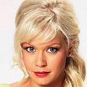
Suzanne Shaw
Suzanne Shaw is a professional ice skater. She performed on dancing on ice and won in 2007. also her Birth date is 29th September 1981.

Slide 6
Famous people from Manchester
By Faith Brett xx

