Slide 1
早晨好
Good Morning!

Slide 2

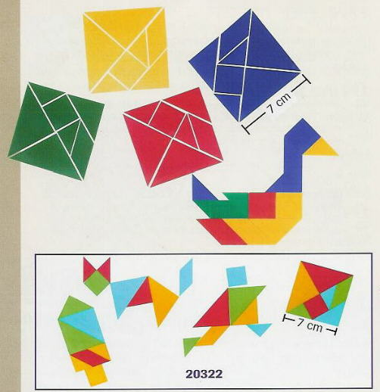
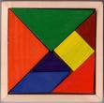
汉语 七巧板 难题

Slide 3
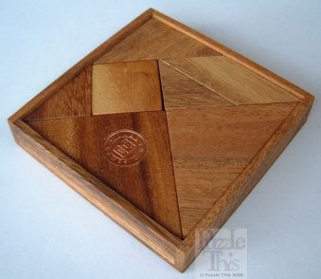

Slide 4
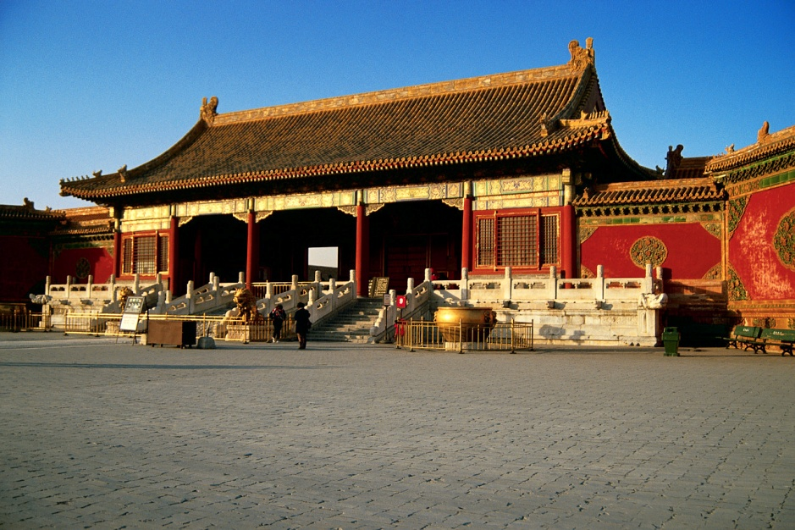
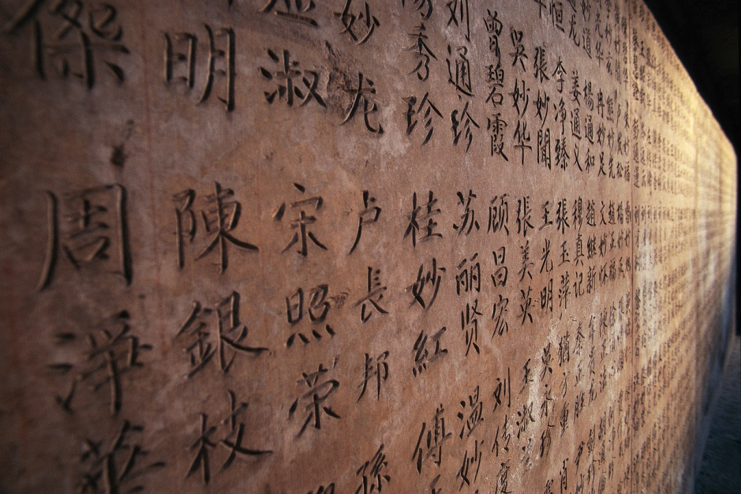
Chinese 汉语
The invention of the tangram puzzle is unrecorded in history. The earliest known Chinese book is dated 1813 but the puzzle was very old by then.

Slide 5
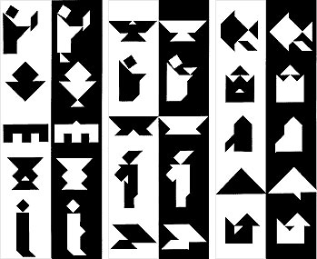
Tangram七巧板
Tangrams continue to entertain and frustrate now days. The puzzle attracts people on a number of levels. It's simplicity makes it accessible to a broad spectrum of people. The figures spark visually inclined people though their form, liveliness and striking simplicity. Many of the designs are adaptable to quilting, applique and many other artistic or craft projects. Storytellers can weave a tale with many characters and objects using only the seven tans.

Slide 6
七巧板

Slide 7
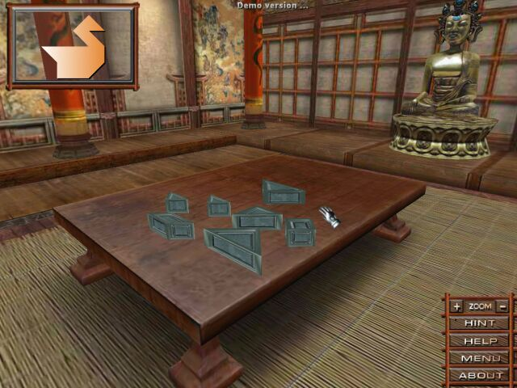
Puzzles 难题
It is one of the classic puzzles, appealing to young and old, the serious and the carefree. Go make one and enjoy it.

Slide 8


Slide 9
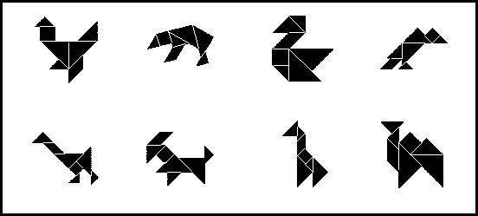

Slide 10


Slide 11
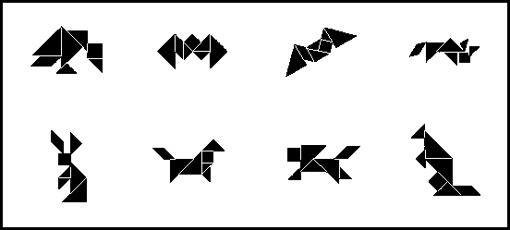

Slide 12


Slide 13
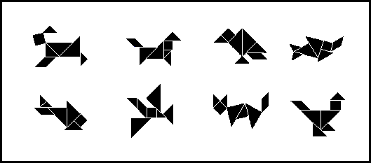

Slide 14
You will need
MDF/Plywood base 120x120x6
Plywood for the Tangram 100x100x4
Batten surround 10x15x500
Perspex template
Tenon saw
Coping saw
Files
Glass paper
Paint
Varnish
Wood glue

