Slide 1
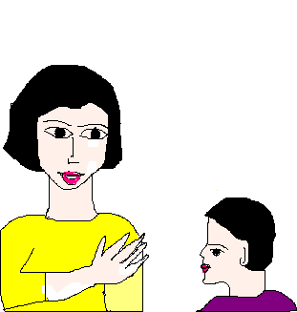
Let’s go ahead
Armed with rights, come child,
I will take you to the heights
on the wings of fancies wild,
soaring high like the kites.
Hold my finger tight,
put your step forward,
gather all your might,
Don’t be a coward.
A world you will see,
full of many pleasures,
your rights are the key,
to all hidden treasures.
Leave all your fears,
have trust in me,
wipe away your tears,
have a clear vision to see.
I am your friend &guide,
for leading you to rights,
and opening your eyes wide,
to cast aside your frights.

