Slide 1
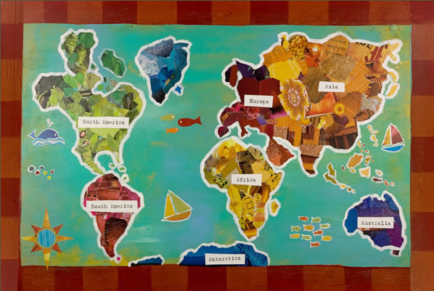
How to Reduce your carbon footprint.
By Jaiya Smith and Sophie Rollin.

Slide 2

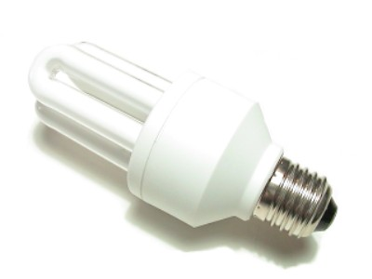
Reduce Your Light Bulb
To
Energy Saving Light Bulb
Normal Light Bulb
If You Turn Off The Lights When You have Finished With It You Save So Much Power In Your Home.

Slide 3


Reduce Your TV
To
A On TV
A Off TV
Turn Off Your TV Don’t Leave It On Stand By. It Wastes Power . TURN OFF YOUR TV!

Slide 4

Reduce, Reuse, Recycle
1. You Can Recycle Card, Paper, Tins, Cans, Leaves, Grass Cuttings .

