Slide 1
Tanks of Aden
ADEN YEMEN WATER TANKS

Slide 2
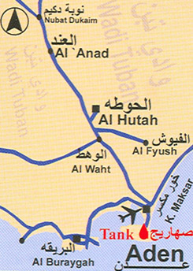
Tanks of Aden Map

Slide 3
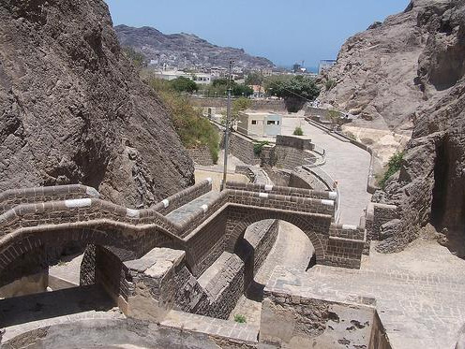
Built in the 1st century AD, the Aden tanks were rediscovered in 1854 and subsequently refurbished.

Slide 4
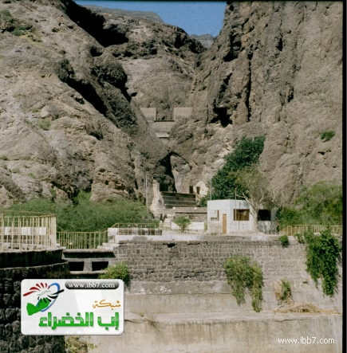
The tanks of Aden are considered one of the most prominent archaeological and tourist sites in Aden city because of their advanced technological system and their position as an icon of an ancient civilization.

Slide 5
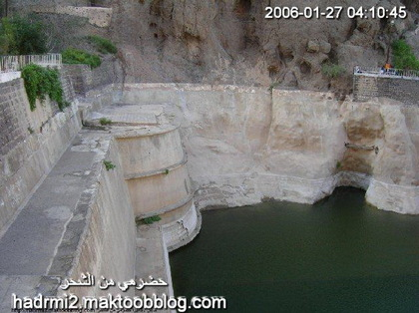
The Capacity of the total tanks is about 20 million gallons.

Slide 6
The tanks in Aden have a prominent status among the world's seacoast tanks. They are thought to be the first tanks to be built in the whole of Arabia that made use of rainwater to overcome the problem of scarcity of fresh water.

Slide 7
As time passed, the tanks were buried by torrents. They were later unearthed by the British occupation authorities in Aden who restored the tanks and added to them a huge tank called the Tank of Coglan

Slide 8
The British attempted to modify them in the mid-19th century to supply water, however their efforts were unsuccessful. Of the 53 tanks originally to be found on the site, only 13 remain.

Slide 9
The tanks are an important historical and tourist site in Aden. Visitors who see the tanks that survived the years are surprised at the creativity of those who built them. These tanks played an important role as a source of fresh water in times of drought. and provided a reliable water resource for ships sailing from the port to the Indian Ocean.

Slide 10
