Slide 1
Water Crisis in Yemen

Slide 2
Yemen is among the world’s poorest countries in terms of water resources, with average rainfall of 200 millimeters a year and no year-round rivers or lakes.
In mountainous regions they relied on rain water collection cisterns and in lower regions on shallow wells to cover their domestic needs, and in both regions the dry toilet was common.

Slide 3
Reasons of the Crisis
Rapidly expanding population
Accelerating urbanization
The ravages of climate change.
Qat (a leafy stimulant that is chewed by 70 percent of Yemeni males daily)
The crop consumes an estimated 30 per cent of the country's groundwater resources

Slide 4
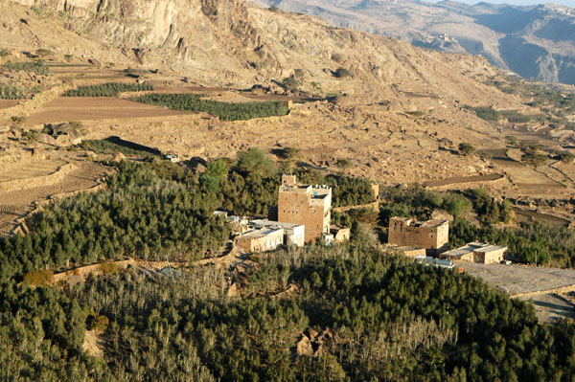
Qat Farm

Slide 5
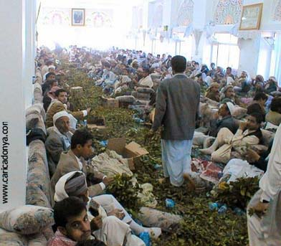
People chewing qat in a wedding party

Slide 6
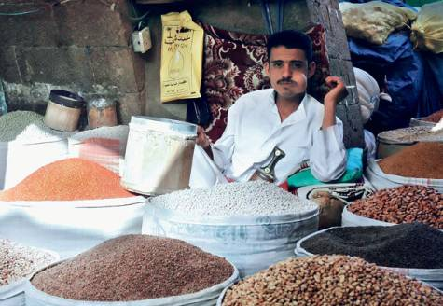
a tennis ball-sized wad of qat in one cheek, looking at first glance like he desperately needs a dentist

Slide 7
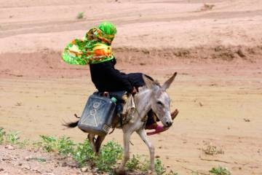
A woman rides a donkey towards a well to fill her jerry cans with water near al-Qanawes town of the western province of Mahweet, August 29, 2009.

Slide 9
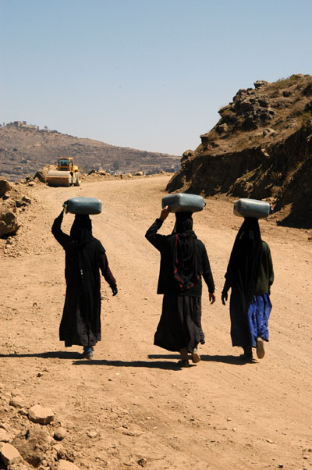
3 young women carrying water near Manakha – Sana’a

Slide 10
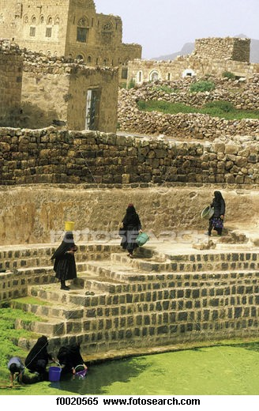

Slide 11
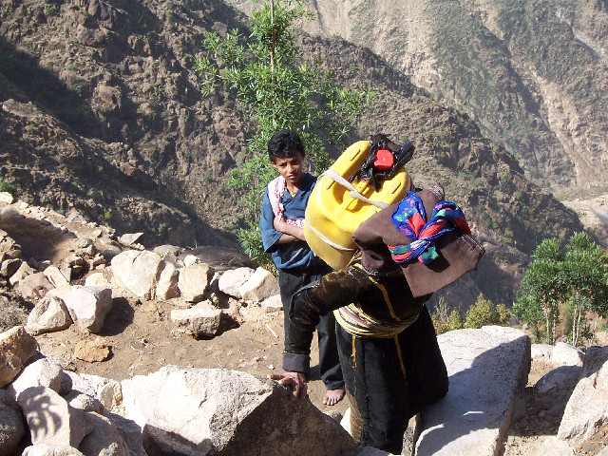
An old woman carrying a jar of water from a distance

Slide 12
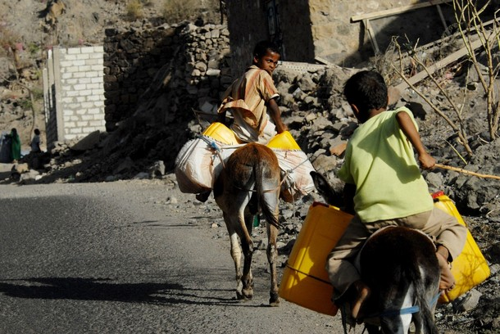
Donkeys loaded with water jerry cans cross a road near al-Qanawes town of the western province of Mahweet, August 29, 2009.

Slide 13
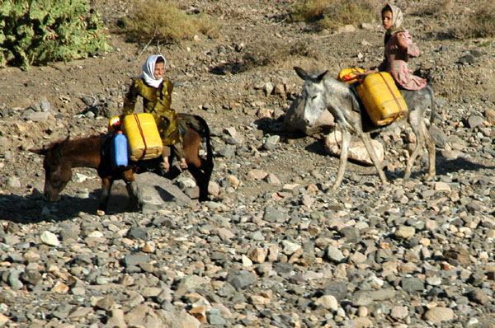

Slide 14
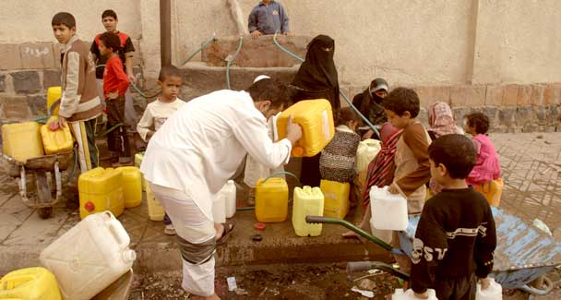
People fill up their a jerry cans with water from a public tap in Sanaa, August 27, 2009

Slide 15
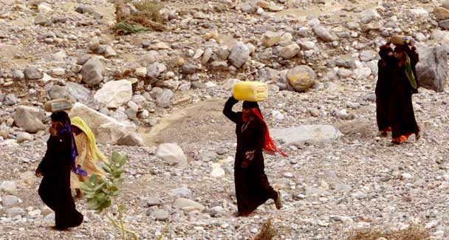

Slide 16
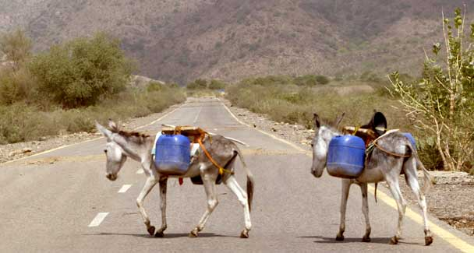

Slide 17
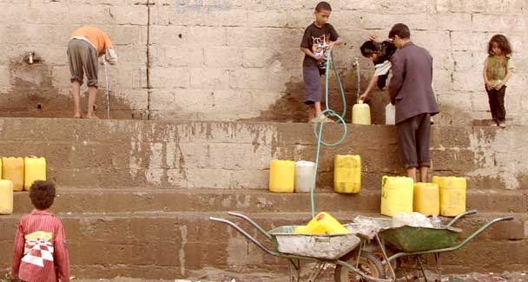

Slide 18
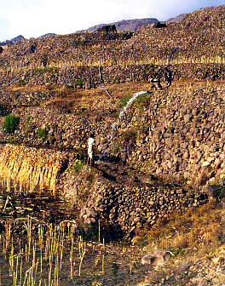
watering

Slide 19
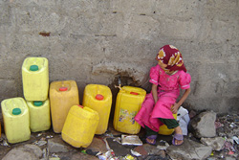

Slide 20
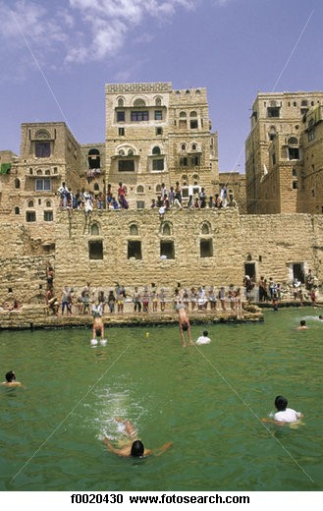
Hababa - People swim in drinking water

Slide 21
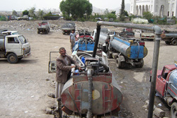
Water tanks to supply those who are in need of water

