Slide 1

Students Opinions about School Counselor
Results of The Questionnaire
among Students
By Luluk Zakiyah
Senior High School KHADIJAH Surabaya Indonesia

Slide 2

NO!
I DON’T WANNA TELL
MY PROBLEMS
TO YOU.
BECAUSE......

Slide 3

Because...
That’s my privacy
I’m afraid that my problems will told to another
Who are you? We don’t know each other
I have no time to share with you
I’m afraid if I meet you, my friends will percept that I have bad problems
I’m afraid you will tell to my parents.
Etc.

Slide 4

Yes!
I wanna tell you about my problems.
Because....

Slide 5

Because....
I’m confuse now
I need someone to share
I need someone to solve my problems
i don’t have another person to trust except you
I believe that you can help me
Etc.

Slide 6

I WISH
MY COUNSELOR
WILL BE ....

Slide 7

A person who is
Smart
Wise
Many Ideas
Patient
Friendly
Funny
Keep on Smile
Happy
Enjoyable
Trustable
Easy going
Etc.

Slide 8
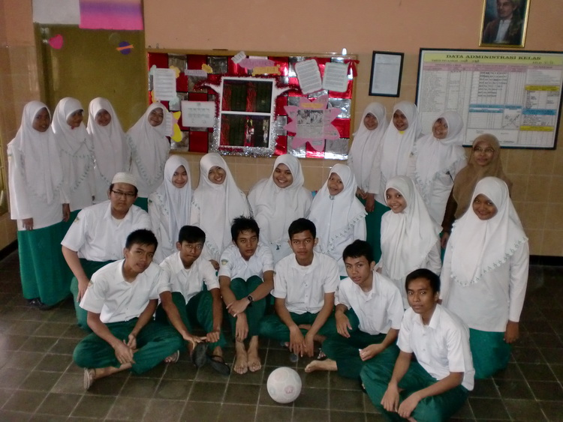
Many Thanks.

