Slide 1

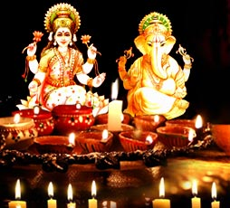
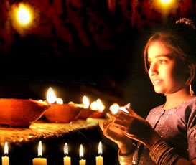
Diwali
recipe

Slide 2

Wheat Laddu
Ingredients:
1 cup Wheat Flour
1/4 cup Gram Flour
11/2 cup Sugar Powder
1/4 cup Grated Coconut
1/4 cup Dry Fruit almonds, raisins, kaju etc
1 cup Ghee
Preparation:
1. Heat the ghee.
2. Put both the flours in the heated ghee.
3. When nearly roasted put coconut and sliced dry fruit in the mixture.
4. Now put the ground sugar in the mixture and stir thoroughly.
5. Take off from the heat quickly and make laddus. You may also put the mixture in an oil based thali & make small pieces.

Slide 3
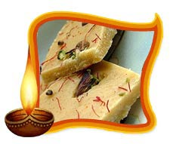
Besan ki Barfi
Ingredients :
Besan 1 kg
Sugar 1 kg
Water 1/2 liter
Ghee 1 kg
For garnishing: Pistas, Almonds
Preparation :
1. Fry besan in ghee on low flame for about 30 mins till it becomes pink and ghee separates.
2. Mix sugar and water into a syrup.
3. Add this syrup to the besan and mix well.
4. Pour this mixture into a greased tray.
5. When it cools cut into cubes and garnish with pistas and almonds.

Slide 4
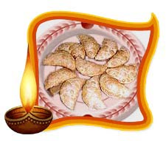
Karanji
Ingredients :
For Filling:
1 cup grated Dry Coconut
1 cup Powdered Sugar
1 pinch Nutmeg Powder
1 pinch dry Ginger Powder
4 Elaichi
2 tsp Maida
2 tsp Poppy Seeds
2 tbsp Mixed Dry fruit pieces
For Dough:
1 cup maida
1 tsp Ghee
Salt to taste
Warm milk to prepare dough
Preparation :
1. Roast Dry coconut.
2. Roast maida in ghee.
3. Roast poppy seeds.
4. Mix all the above ingredients & grind them.
For Dough:
Mix all the dough ingredients & prepare dough (a little hard).
For Karanji:
1. Make small oval shaped puris from dough.
2. Fill the prepared stuffing inside.
3. Apply some water or milk so that it will seal properly (don't apply too much of water as it will not seal properly).
4. Deep fry it till it becomes brownish colour.
5. Serve it hot or cold.
6. Karanjis can be stored for weeks.

Slide 5
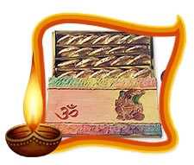
GUJIA
Ingredients :
Flour 250 grams
Khoya 500 grams
Raisins a few
Almonds 100 grams (finely chopped)
Cooking oil 3 tablespoon
Water 100 ml
Sugar 250 grams
Preparation :
Mix the oil and flour properly to form a binding consistency of breadcrumbs. Add some water and knead lightly the entire mixture. Make it soft dough and set it aside with a damp cloth covering it. Fry the khoya in cooking oil till it becomes light brown and then mix the sugar in it properly. Add the almonds and raisins, and fry for a few more minutes. Remove from fire and let it cool. Make small thick chapattis out of that kneaded dough. Fill half of the chapatti with the khoya mixture and, rolling it, seal the sides of the chapatti keeping the khoya inside it. Make the sealing look decorated by giving a look of hemming. Deep-fry these gujias until it becomes light golden brown, keeping the flame at low. Take out the gujias on a newspaper and let the oil get soaked. Serve hot or store it in an airtight container for using it on that special day.

Slide 6
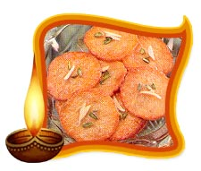
MALPUA
Ingredients :
1 cup sugar
1-1/2 cups wheat flour
4 tbsp yogurt or curd
10-15 whole peppercorns
Milk
Water
Preparation :
Make a batter of all of these dry ingredients and the dahi, using 1/2 milk and 1/2 water till it is thick and of pouring consistency, similar to pancake or dosa batter. And whip till smooth. Add the 10 peppercorns. Keep aside and allow it to rise for about two hours.
Heat oil on a medium flame. Drop large ladlefuls into the oil to form circles of 6-8 inches. Typically the dough will sink and line the bottom of the karhai and rise up in the shape of a disc. Fry till golden. Drain and pat off the oil. Serve with cream or garnished with pista. Serves five.

Slide 7
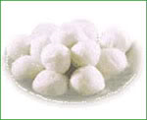
Rosgulla
Ingredients for Rosgulla (diwali recipes):
Milk one litre
Vinegar 2 tablespoons
Sugar 1 teaspoon
To make syrup:
Water five cups
Sugar one and half cups
Rose essence few drops
Method for preparation for Rosgulla (diwali recipes):
Boil milk and add vinegar. Once the watery part of the milk is separated, strain and wash thoroughly. Tie the mixture using a muslin cloth. Squeeze it to remove water. Add a spoon of sugar and start kneading. Take this mixture and make into small balls. Keep them aside. Add sugar and water and heat over a low flame to make syrup. When the syrup starts to boil, start adding the balls. Let it cook for 10 minutes. Remove it and let it cool.

Slide 8
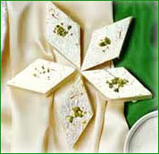
Ingredients for Kaju Barfi recipes (Diwali mithai recipe):
Cashew nuts (powdered)- one cup
Sugar - one cup
Milk - half a cup
Ghee - one cup
A silver foil
Method of preparation for Kaju Barfi recipe (Diwali mithai recipe):
Heat a pan, and then add milk with sugar. After a syrup is formed, add the powdered cashew nut and mix well to avoid any lumps from being formed. Heat on a low flame. Stir well by adding 2 teaspoons of ghee frequently. When the mixture thaws and starts bubbling, remove the pan. Pour the mixture into a greased plate coated with silver foil. Let the mixture warm. Then cut it into pieces and wait for it to cool. It is ready to eat!

Slide 9
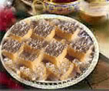
Kalakand (diwali recipe)
Time to prepare : five minutes
Cooking Time : five minutes
Ingredients for Kalakand (diwali recipe):
Cream milk 1 tin
Milk powder four teaspoons
Ghee two teaspoons
Clingfilm
Method of preparation for Kalakand (diwali recipe)
Empty contents of the creamed milk and add ghee and milk powder to it in a pan. Mix them well with a spoon. Using a clingfilm cover the mixture and keep it on high lame for around two and half minutes. When it starts boiling, put off the flame for 5 seconds and repeat the process again. After the second time, remove it and let it cool...

Slide 10
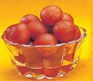
2. Gulab Jamun:
Required things:
1 cup Carnation Milk Powder
1/2 cup Bisquick – Pancake mix (Instead of Bisquick Pancake mix, use 1/2 cup all purpose flour and 1/2 tsp baking soda)
2 tablespoons butter -melted
Whole milk just enough to make the dough
2 cups Sugar
1 cup water
Oil for frying
How to Preparation:
Mix the khoya, flour and paneer together and form the mixture into 12 small balls.
Wrap a piece of cashewnut in each piece of mixture.
Make a one string syrup by dissolving sugar in the water.
Heat the ghee in the kadhai. Fry the balls until golden all over.
Drain the balls on absorbent kitchen paper then immerse them in the syrup.
Leave for about 10 minutes before eating.
Sprinkle with rose water before serving.

Slide 11

Rasmalai:
Ingredients:
2 lbs Cows Milk or Ricotta cheese
1/2 cup sugar
32 oz half & half milk
A pinch of saffron
1/4 tsp crushed cardamom seeds
1/2 cup blanched almonds
2 tbsp crushed green pistachios
Method:
Mix the cheese with sugar and little cardamom powder and spread out on a baking tray.
Bake at 350 degrees for 35 minutes or until it sets. It should not get brown.
Remove from oven, cool at room temperature and cut into 2″ squares. Place them in a dessert bowl.
Mix the other ingredients, except the pistachios well in a separate dish and pour over the squares.
Decorate with pistachios, chill for 2-3 hours and then serve.

Slide 12

JALEBI
Ingredients :
White gram dal – 500gm
Water – 1litre
Sugar – 1kg
Coconut oil or refined oil – 1kg
Jalebi colour (orange) – 5 drops
Salt – to taste
Preparation :
Lightly crush the white gram dal with little water. Mix salt in it and make a smooth batter of semi-thick consistency. In a pan, heat sugar and add water into it. Add the jalebi colour and when it thickens, remove from the fire.
Heat oil in a thick bottom vessel. Squeeze the prepared batter into the oil through a thin layered cloth. While squeezing the batter, first make three rounds and a flower shape on top. When it is done (don’t fry), remove from oil. Allow oil to drain. Put the jalebis into the warm sugar syrup. Take out after they soak in the syrup for about 15 minutes. Make jalebi’s with the whole batter.

