Slide 1
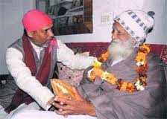
one of the legend man of our state Dr Anil Joshi story of Padmashree Dr. Anil Joshi,
Dr. Anil Joshi was born in 1955 in Kotdwara – a small town on the edge of Uttrakhand, at the foothills of the Shivalik range of the Himalayas.

Slide 2
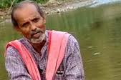
A bright student, he did well through school and college and after completing his PhD. in environmental science he eventually joined the Kotdwara government college as a lecturer

Slide 3
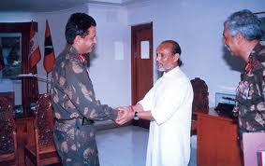
To the people of the hills in the upper reaches of India he is no less than a messiah and what he has achieved is no less than a miracle.
Padmashree Dr. Anil Joshi, or “Sir” as the local populace refers to him, has made it his life’s mission to make the villagers in the hills more self reliant – by promoting the local economy through local means and by upgrading generational hand-me-down wisdom.

Slide 4
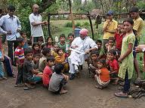
A bright student, he did well through school and college and after completing his PhD. in environmental science he eventually joined the Kotdwara government college as a lecturer

Slide 5
TO BE ONE OF THEM
That was the initial thought with which he tried to break ice with the locals, telling them that he was a social worker. But most of the villagers he first approached shunned him, telling him that since he was not staying with them, he would not know enough to help! When he remarked he was a social worker – they asked why he didn’t think of roads or schools. But he remained patient and slowly worked on building his relationship with the hill community. It’s a relationship which has prospered in the intervening 29 years and brought about a silent revolution in the way these communities exist today.

Slide 6

decided to give a more formal name and face to his approach, and thus Himalayan Environmental Studies and Conservation Organization or HESCO was formed in 1981.

Slide 7
the hills were overrun with ‘Kurri’ a wild shrub which was identified by the HESCO team as a weed
The sticks were strong enough to be used for furniture, the flowers and leaves could be used for incense sticks and the leftovers as fodder for goats! This has provided employment as well as monetization.

Slide 8
HESCO has also worked on upgrading the local water mill used to grind grain or the ‘gharat’ – to make it an effective tool for power generation and provided indigenous electricity to these villages. According to Dr. Joshi, if all the traditional ‘gharats’ are modernized in the same way, local employment can mushroom while at the same time the hills can produce up to 2500MW of power for the country at practically no cost!

Slide 9
Stopping landslides and soil erosion using biological methods; creating a social platform for women to generate employment and marketing opportunities; advocating forest fire prevention and disaster management methods; circulating a local children’s newspaper; using local development as a tool to wean away youth from anti social activities in border states – these are just some of the activities that HESCO and Dr. Joshi have been tirelessly working on to bring about a change.

Slide 10
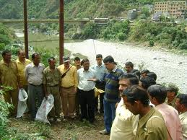
Dr. Joshi was awarded the Padamshree in 2006 and HESCO works closely with government organizations like the Department of Science and Technology, Department of Bio-Technology, BSF, ITBP, CRPF, the Social Security Board – to name a few.

Slide 11

I was born in a forest, I loved the trees and the entire atmosphere. My subject was botany and most of my papers were on forests. I wanted to do something more than research,” says Joshi. “Something that will help society.”

Slide 12
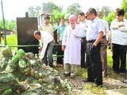
Joshi thought of controlling the weed by using it. “Bamboo was one of the worst weeds more than two centuries ago,” he says. “When people began using it, it disappeared. So we decided to find ways of using lantana.”

Slide 13
Impressed by the various development programmes for women, the Union department of science and technology has set up one of India’s four Women Technology Parks under HESCO at village Mehuwala near Dehradun. Says Dr Kiran Rawat, coordinator of the park: “There are at least 35 species of fibre-yielding plants in the mountains. We taught the women to use the fibre to make things that are generally made of coir.” It also offers a two-week training to make pickles, chutneys, jams and squashes using local fruits and vegetables.

Slide 14
HESCO has got village elders to identify medicinal plants and herbs, and now they are grown in nurseries in many homes. It has also identified 65 plants whose leaves, barks, flowers, fruit and root can yield dyes. Women are taught to use the dye and make marketable items like pouches, file covers and spectacle cases. All the women trained in the Women Technology Park later become members of Women’s Initiative for Self-Employment (WISE) network to promote and market their produce.

Slide 15
Joshi’s sensitivity to the needs of the mountain people goes far beyond their earnings. “As a child, I was pained by the drudgery of the people, particularly women. They had to walk long distances to bring water. And they had to leave home at an unearthly hour to go into the forests to ease themselves,” he remembers. Today many villages around Guar-Chauki have water harvesting tanks and Indian – style toilets with septic tanks for each house. HESCO has even devised a multipurpose kit named Kalyani, comprising a tiny screwdriver, cutter and copper tweezer instead of the crude gadgets women carried around to trim nails, clean their ears and remove thorns that hurt as they trudged through the forests.

Slide 16
Joshi drew inspiration from Mahatma Gandhi. “I learnt from Gandhiji that to work for the people, you have to be very simple,” says Joshi. “We don’t have a vehicle, it is because the people we work for don’t have one.”

Slide 17
Joshi is an Ashoka Fellow, and last year, he won the Nehru Award and the Ram Washeshwar Devi Bhatia award. His colleague Kiran Rawat received a Rs 1 lakh award from the government. The cash component of these awards has been spent on the welfare of the villagers. But Joshi has no time to rejoice: as his theme song suggests, his path is long and his destination far.

