Slide 1
RECYCLE CLUB
Activities done by the pupils in
Grade 4 - 6

Slide 2
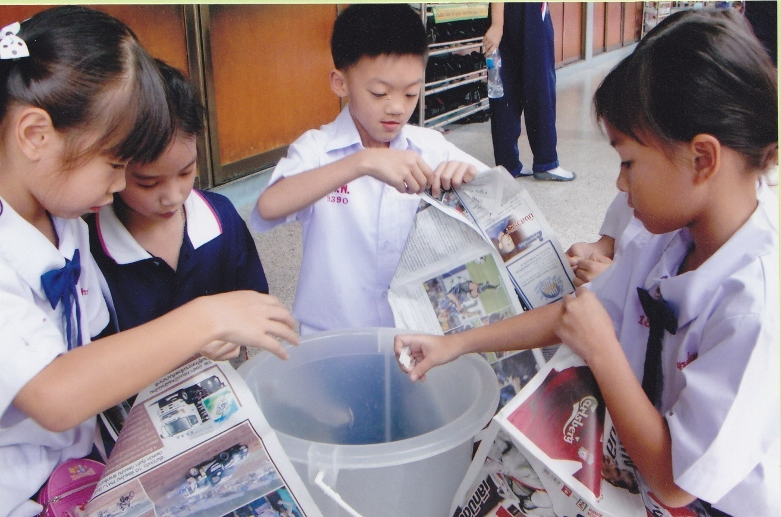
Step 1: Tearing used papers into small pieces and soak in water for 2 days.

Slide 3
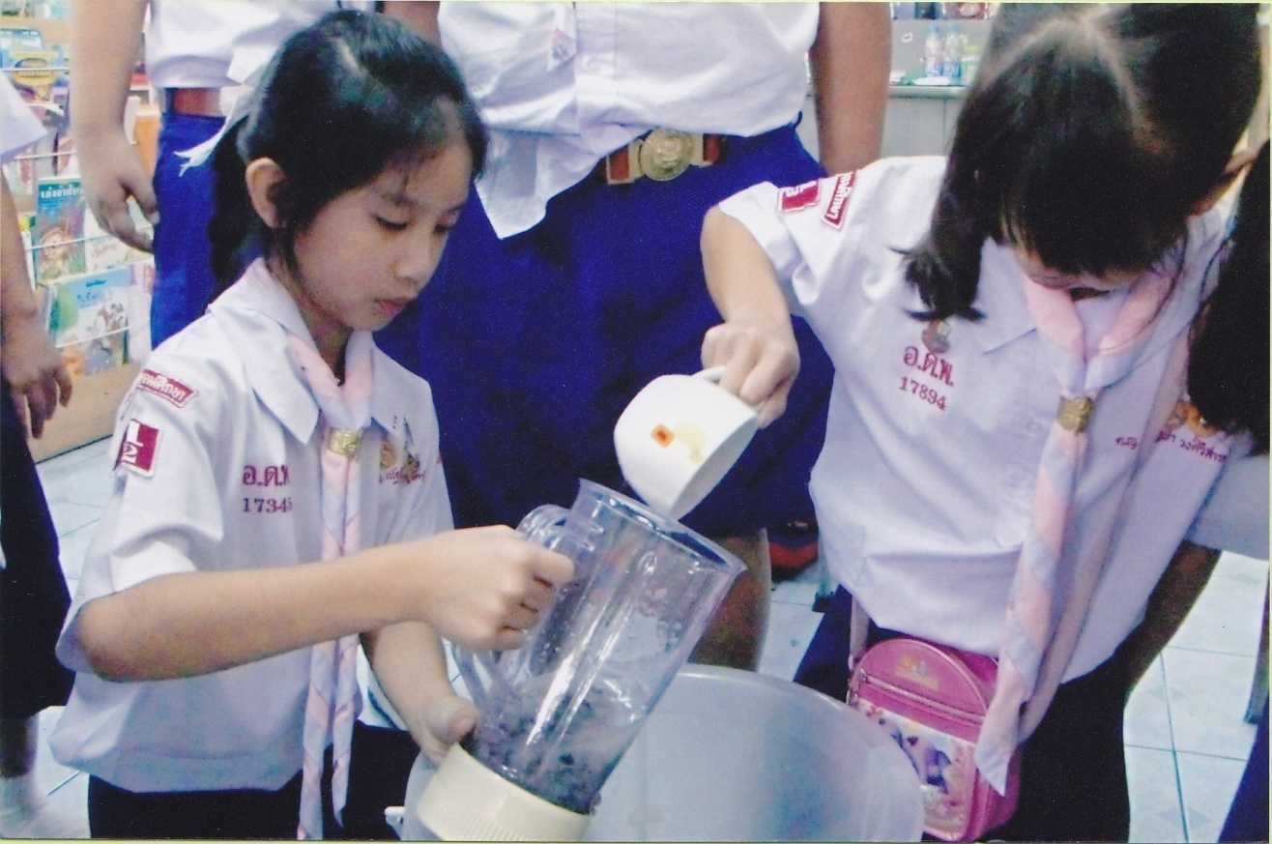
Step 2: Filling the grinder with the soaked pieces of used papers.

Slide 4
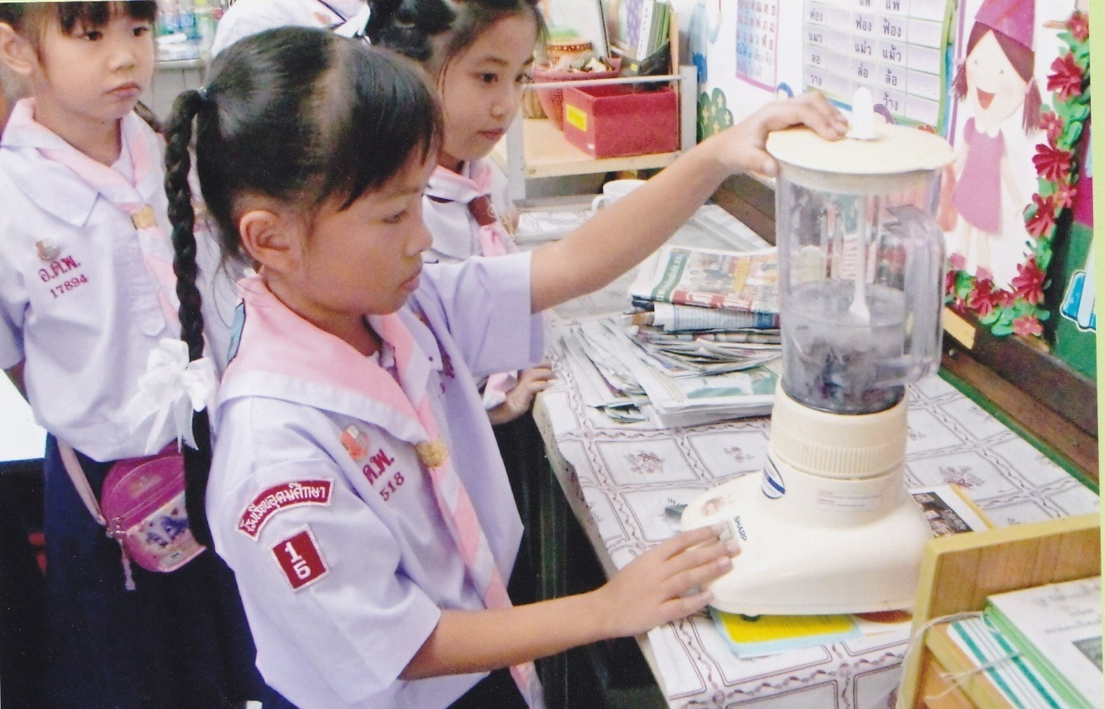
Step 3: Grinding to make the pieces of papers more fine.

Slide 5
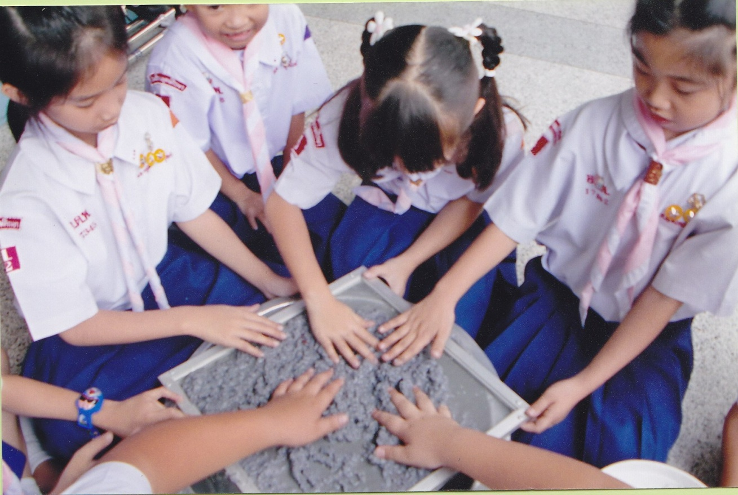
Step 4: Putting the grinded papers on a framed screen for drying.

Slide 6
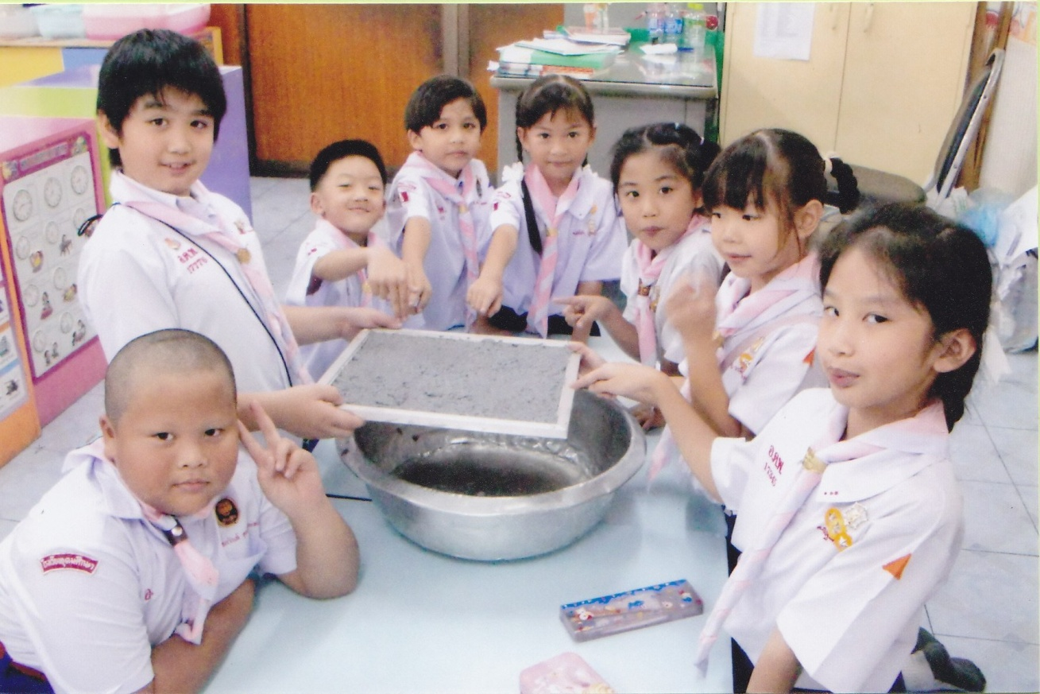
Step 5: Dried used papers formed into hard sheets and can be used to make useful projects. Ex. Picture frame

