Slide 1
ENVIRONMENT CLUB
Activities done by the Grade 4 – 6 pupils during their Environment Club classes.

Slide 2
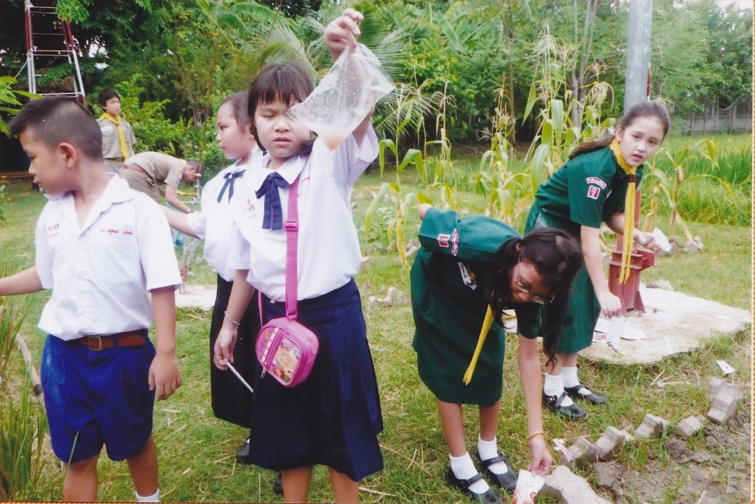
Activity 1: Collecting garbage around the school campus.

Slide 3
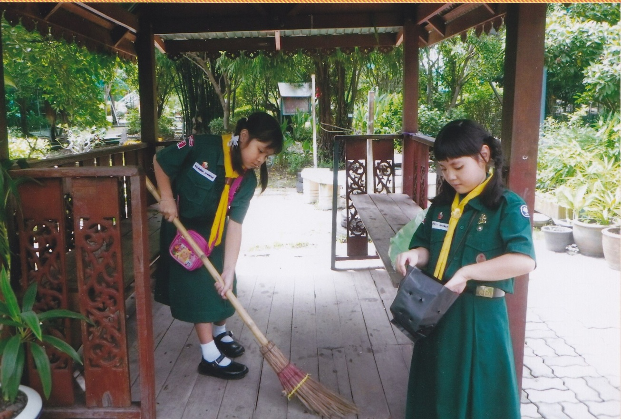
Activity 2: Sweeping the dirty areas.

Slide 4
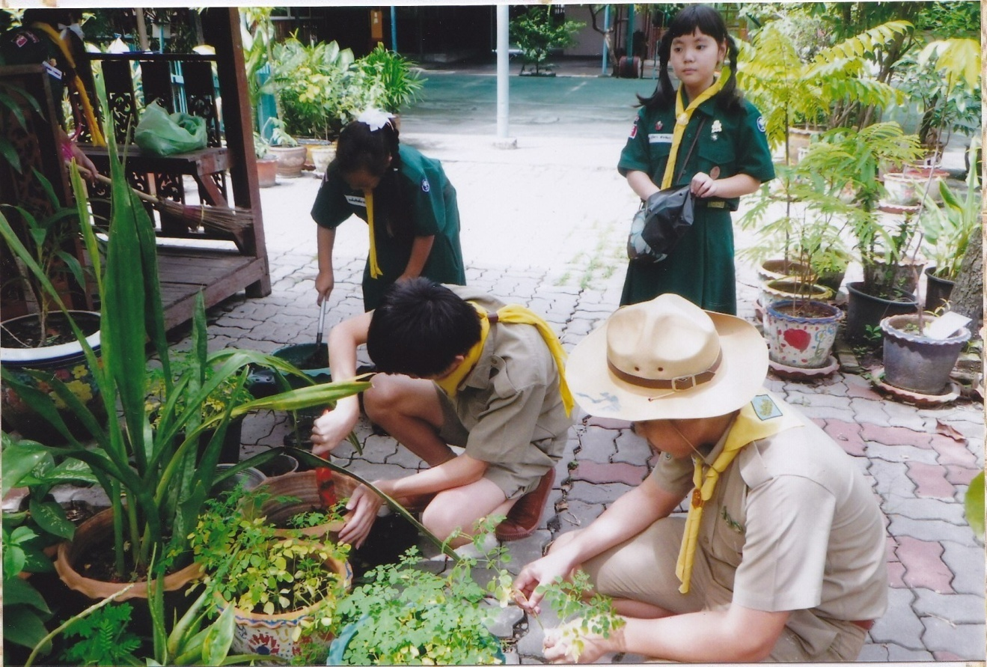
Activity 3: Getting rid off the enemies of plants.

Slide 5
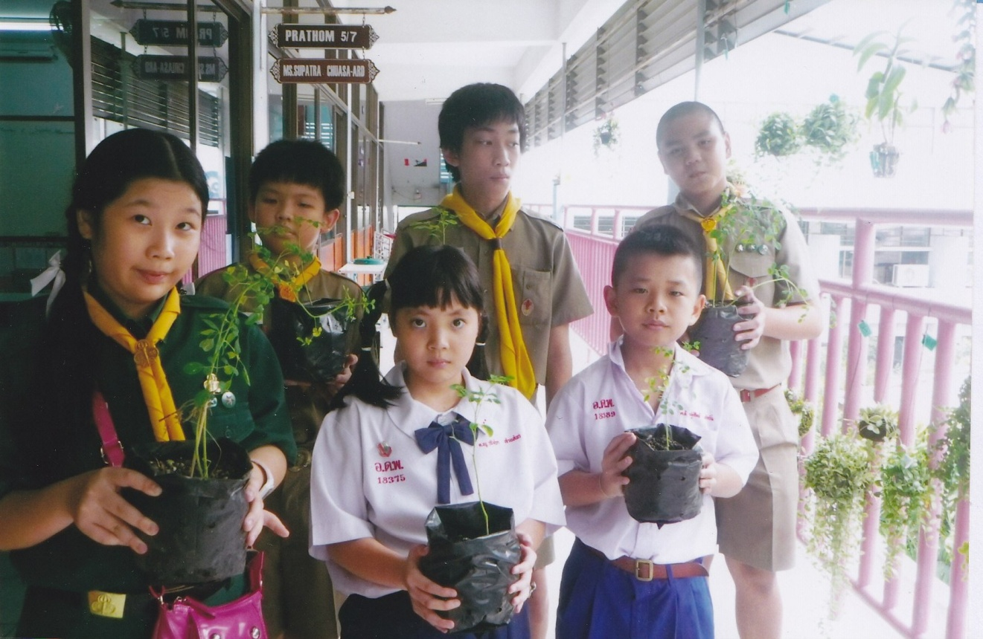
Step 4: Planting seedlings to increase the number of plants planted in the school.

Slide 6
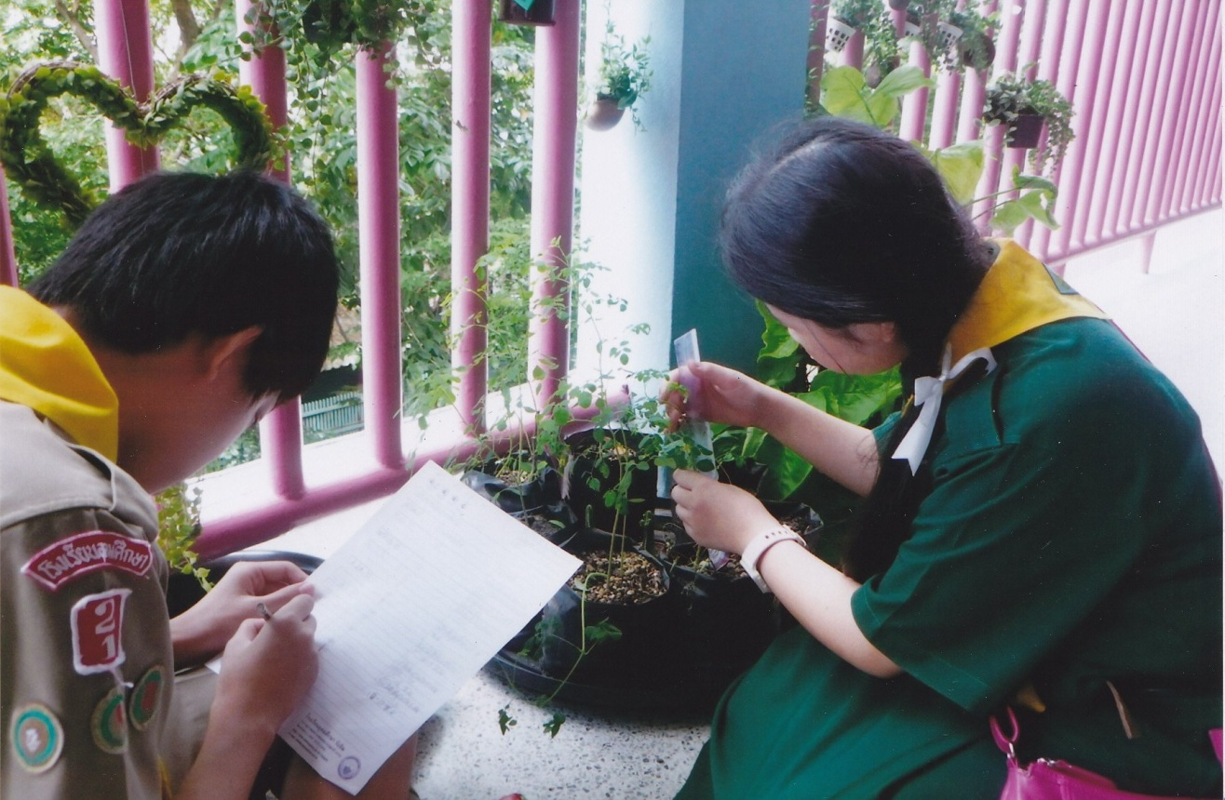
Step 5: Taking care of the plants and recording its growth.

