Slide 1


Beautiful Earth Untouched
By Mankind.

Slide 2
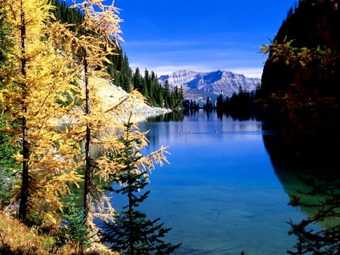
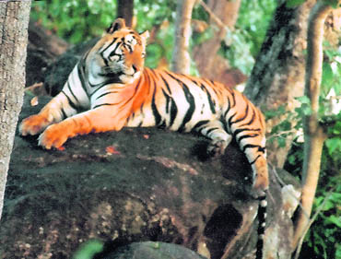
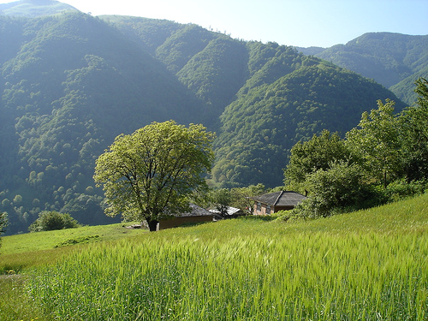
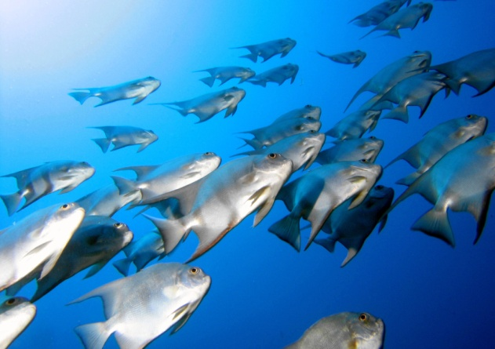
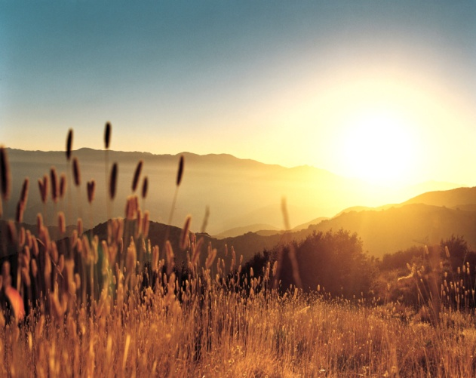
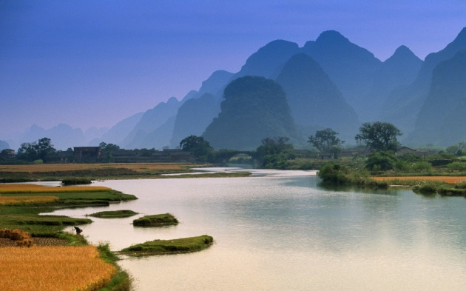
Serene Water Bodies
Beautiful Rivers
Landscapes
Forests
Wildlife
Oceans

Slide 3
Where have they all
gone now?

Slide 4


Is this the same Place as before?
Well ,Sadly It is.

Slide 5

Seeing is……….

Slide 6
Not Enough………

Slide 7
SAVE PLANET EARTH
“Our environmental problems originate in the hubris of imagining ourselves as the central nervous system or the brain of nature. We're not the brain, we are a cancer on nature”

Slide 8
we will now a meet someone from the
2070
A REALITY

Slide 9
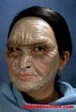
This is the year 2070
I have just turned 50, but I my appearance is of somebody of 85.
I suffer from serious kidney problems, because I do not drink enough water.
I'm afraid I do not have much time left to live.
I am one of the oldest people in this society.

Slide 10

I remember when I was a child of 5.
Everything was very different then.
There were lots of trees in the parks, houses with beautiful gardens,
and I could enjoy having a shower for half an hour.
Nowadays we use towels with mineral oil to clean our skin.
The average life expectancy is 35 years

Slide 11
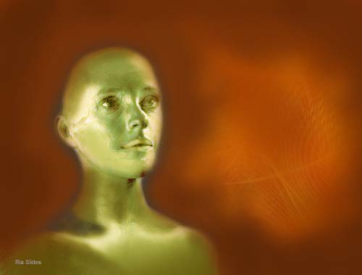
Before, women had beautiful hair.
Now, we have to shave our heads to keep them clean without the use of water.
Then, my father washed his car with water coming out of a hosepipe.
Now, my son does not believe that water could be wasted that way.

Slide 12

I remember there were
SAVE WATER
warnings on outside posters, radio and TV, but nobody paid attention. We thought that water
was to last forever.
Now, all the rivers, lakes, dams and underground water beds are either dry or contaminated.

Slide 13
Industries came virtually to a standstill and unemployment reached dramatic proportions.
Desalination plants are the main source of employment and workers receive part of their salary in drinkable water.

Slide 14

Assaults at gun point on the streets for a jerry-can of water are very common. Food is 80% synthetic. Government makes us pay for the air we breathe, 137 m3 per day per adult person.

Slide 15

Before, the recommended quantity of water to drink
for an adult was 8 glasses a day.
Nowadays, I am only allowed half a glass.
We now have to wear disposable clothing,
and this increases the amount of litter.
We are using now septic tanks,
because the sewerage system does not work for lack of water.

Slide 16
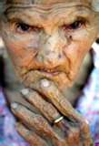
The outside appearance of the population is horrible: wrinkled, emaciated bodies, due to dehydration, full of sores caused by ultra violet radiation,
now stronger without the protective shield of the ozone layer.
Skin cancer, gastrointestinal infections are the main causes of death.

Slide 17

Due to the excessive drying of the skin young people of 20 look like 40.
Scientists investigate, but there's no solution to the problem.
Water cannot be produced, oxygen is also degraded due to the lack of trees and vegetation, and the intellectual capacity of the new generations is severely impaired.

Slide 18
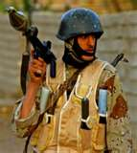
Water became a very coveted treasure, more precious
than gold and diamonds.
In some countries, where there are still some green zones crossed by rivers, these are guarded by heavy armed soldiers.

Slide 19

Where I live, there are no trees, because it seldom rains.
When it happens to register some precipitation, it is of acid rain.
The seasons have been severely affected by the atomic tests and by contamination from the 20th century polluting industries.
We were warned to look after the environment, but nobody cared.

Slide 20

He asks: “Mommy! Why there is no water?”
Then, I feel a lump in my throat!

Slide 21
When my son asks me to talk about my youth, I tell him about the green fields,
the beauty of the flowers, the rain, how pleasant was to swim and fish in the rivers and dams, to drink all the water we could, and how healthy people were.

Slide 22
I cannot help feeling guilty, because
I belong to the generation who contributed to the destruction of the environment or simply did not take into account all the warning signs.

Slide 23
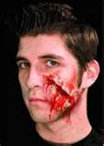
Now our children
pay a very high price!

Slide 24
I sincerely believe that within a short time life on earth will not be possible, as the destruction of nature reached now an irreversible stage

Slide 25
How I would like to go back and make mankind understand…
..that we still had time to save our Planet Earth.

Slide 26
Do You Know What's The PATH
To the extreme destruction which will take place in the 2070(future)????
LETS TAKE A LOOK…..

Slide 27
on
Global Warming
Its defined as the increase of the average temperature on the earth. As the earth is getting hotter, disasters like hurricanes, floods and droughts are getting more frequent. This is led by the pollution.
Pollution
It’s the introduction of contaminants into an environment that causes instability, disorder, harm or discomfort to the eco-system.
We’ve really got to fight these foes of the earth...

Slide 28
Deforestation
Is the clearance of the natural occurring forest by the process of logging or burning of trees. This is brought about by the destructors of the environment-human beings

Slide 29
Ozone layer depletion
Slow steady decline of about 4% per decade in the total volume of ozone since the late 1970s,and a much larger, but seasonal, decrease I in the stratospheric ozone over the earth’s polar regions.
Water Crisis
Describes an environment in which demands for water for domestic, agriculture and industry purposes exceed its availability.
Its high time we start paying heed to all these environmental concerns to make the future generation’s 2070 better.

Slide 30
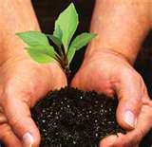
“The struggle to save the global environment is in one way much more difficult than the struggle to vanquish Hitler, for this time the war is with ourselves. We are the enemy, just as we have only ourselves as allies.”
“We do not inherit the Earth from our Ancestors, ..we borrow it from our Children

Slide 31

“The activist is not the man who says the river is dirty. The activist is the man who cleans up the river.”
“Our modern industrial economy takes a mountain covered with trees, lakes, running streams and transforms it into a mountain of junk, garbage, slime pits, and debris.”

Slide 32
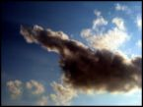
We’re clearly heading into the wrong direction…..
Here are some measures you can take to improve these situations

Slide 33
Turn off lights and appliances when you leave a room.
Use public transportation or better walk.
Choose wood that doesn’t originate from endangered forests.
Plant a tree.
Verify your home is leak free.

Slide 34
Reduce the amount of time you spend on a shower.
Buy recycled paper.
Prefer fluorescent lights.
Turn off electronics in stand by
They’re energy vampires.
Use solar power to warm water.
RECYCLE
And remember what chief SEATTLE once said……..
“The earth does not belong to man, man belongs to the earth.”

Slide 35
THE WORLD NEEDS A HERO…
And the hero is you!!!

Slide 36


Slide 37


