Slide 1
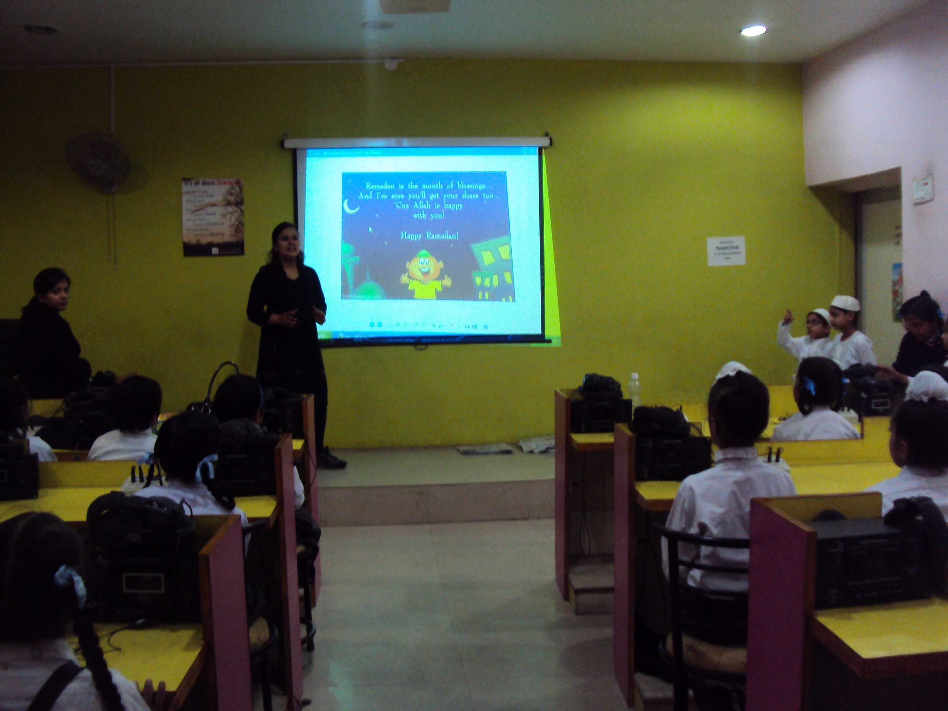



Slide 2


Slide 3
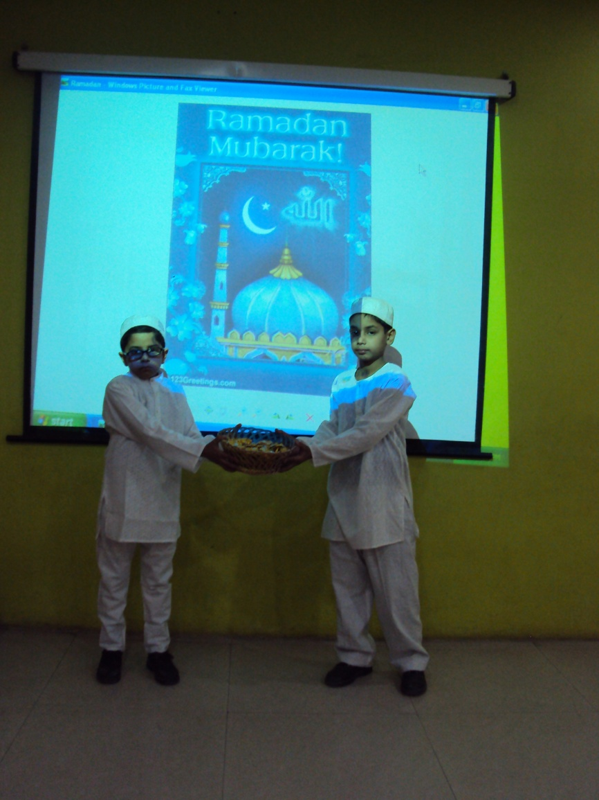

Slide 4
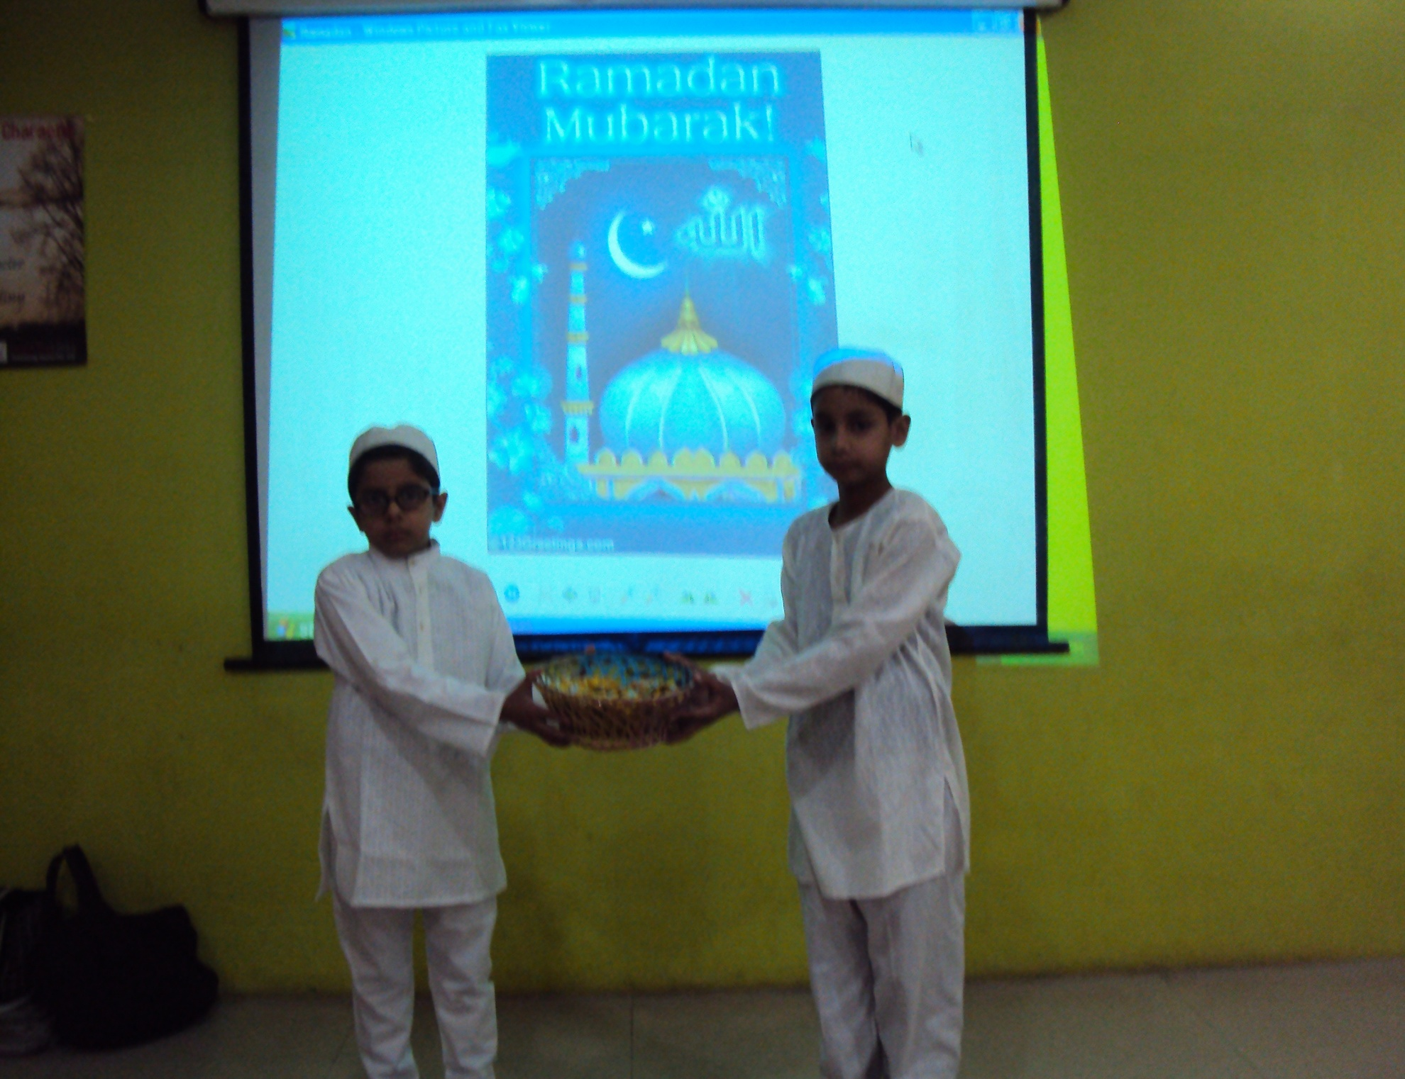

Slide 5

DRV DAV Centenary public School, Phillaur, India.

