Slide 1

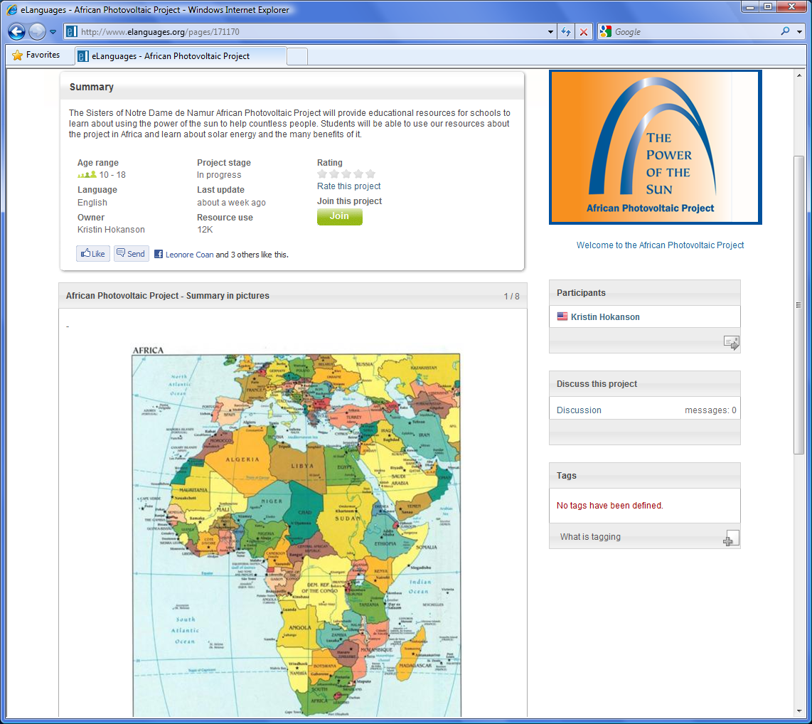
NOTRE DAME VIRTUAL SCHOOL
  ‘Power of the Sun’
  Photovoltaic Project in
  Congo and Nigeria
  Global Impact Through Technology
  Sister Kristin Hokanson
Notes:
Welcome

Slide 2
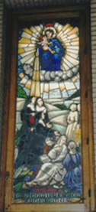
NOTRE DAME VIRTUAL SCHOOL
  December 11
  In the schools teach whatever is necessary to equip the students for life.
  St. Julie Billiart
We value the focus on education in our congregational tradition and give special attention to the educational dimension of our mission …
Constitutions of the Sisters of Notre Dame de Namur

Slide 3

NOTRE DAME VIRTUAL SCHOOL
Mission Statement
  The Notre Dame Virtual School supports the mission of the Sisters of Notre Dame. The school uses technology to expand teaching and learning by connecting Notre Dame schools and sponsored ministries around the world.

Slide 4
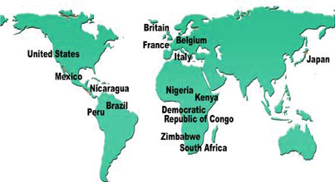
NOTRE DAME VIRTUAL SCHOOL
NDVS enables schools to
  Supplement their curriculum
  Provide alternative learning opportunities
  Collaborate with other Notre Dame schools
  Teach their students to use the latest technology
  Provide their faculty with opportunities to learn and practice the techniques of online learning
  Experience the diversity of the global community

Slide 5
Special Projects
Millennium Development
Goals
FlashMeeting
Skype
Online Courses Learning Webs/Units
Blogs/ Newsletters
United Nations
Justice & Peace
NDVS Global
Network
Social Media
eLanguages
FirstClass Intranet System
Organizational memberships

Slide 6
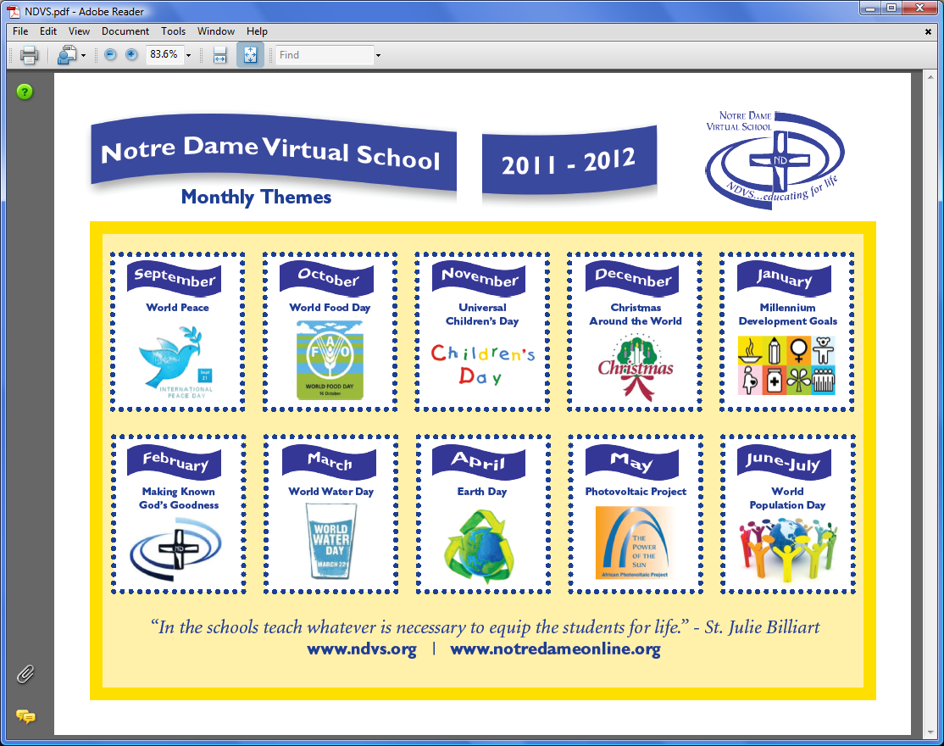

Slide 7
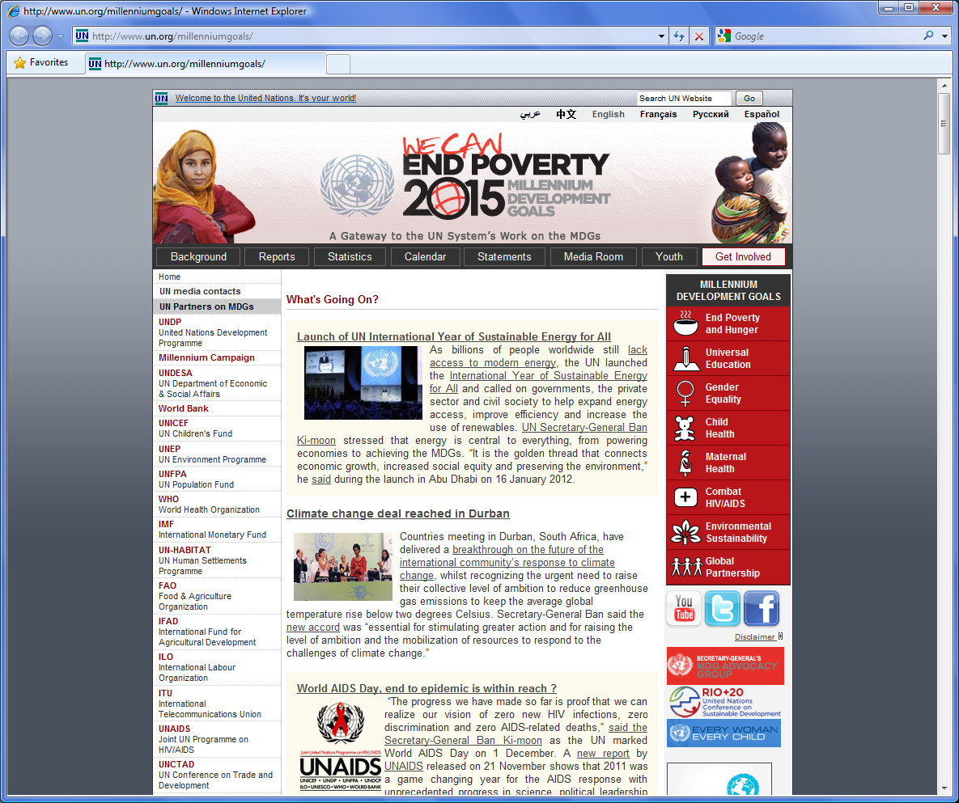

Slide 8

Why is Photovoltaic Technology a Better Method?
Photovoltaic energy is affordable, renewable,
highly reliable, and improves quality of life.
Notes:
PowerPoint lesson done by a graduate student for the project

Slide 9
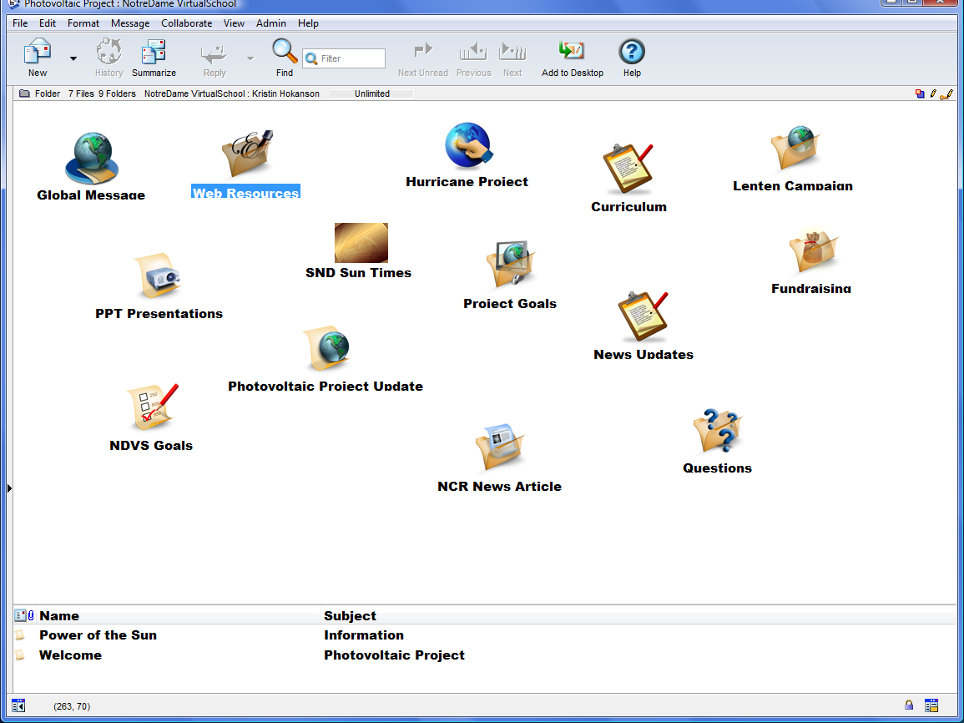

Slide 10
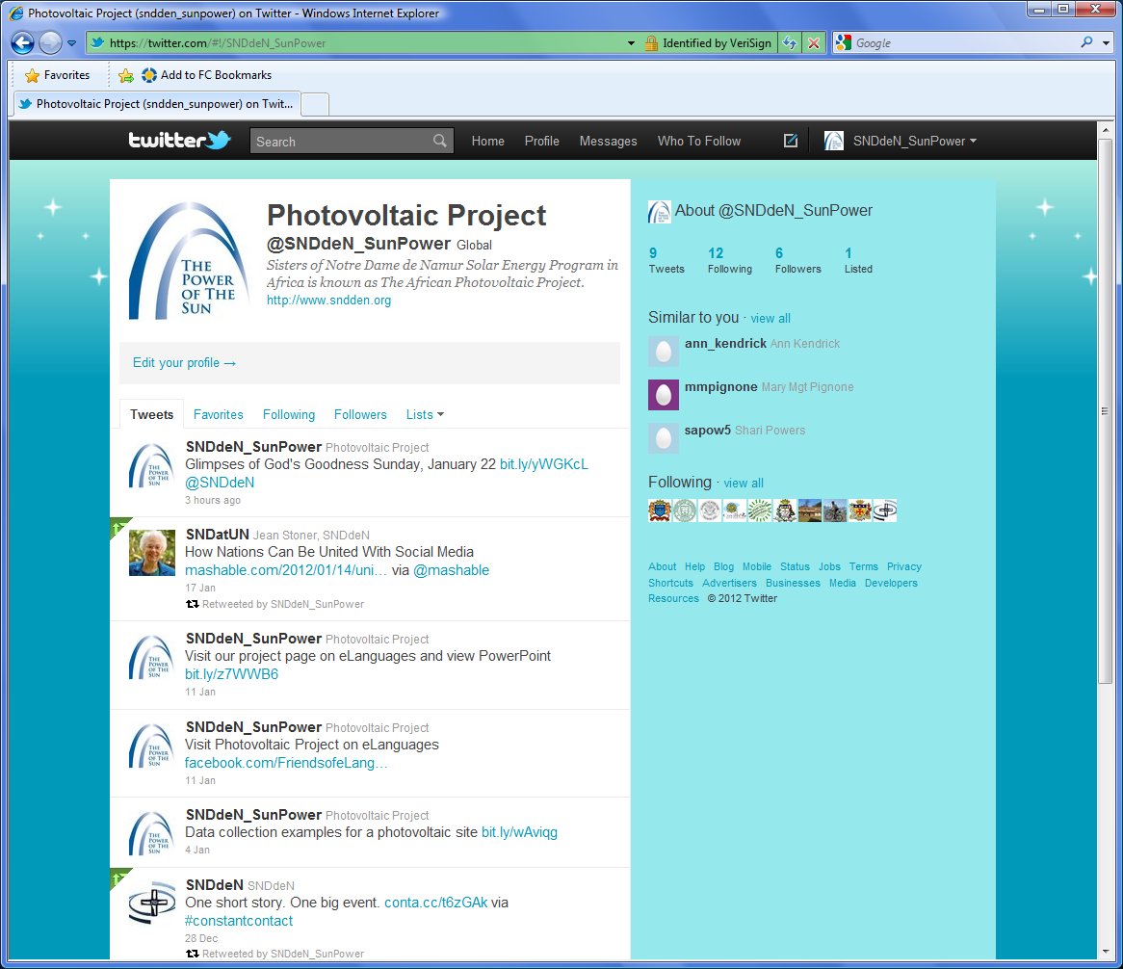

Slide 12
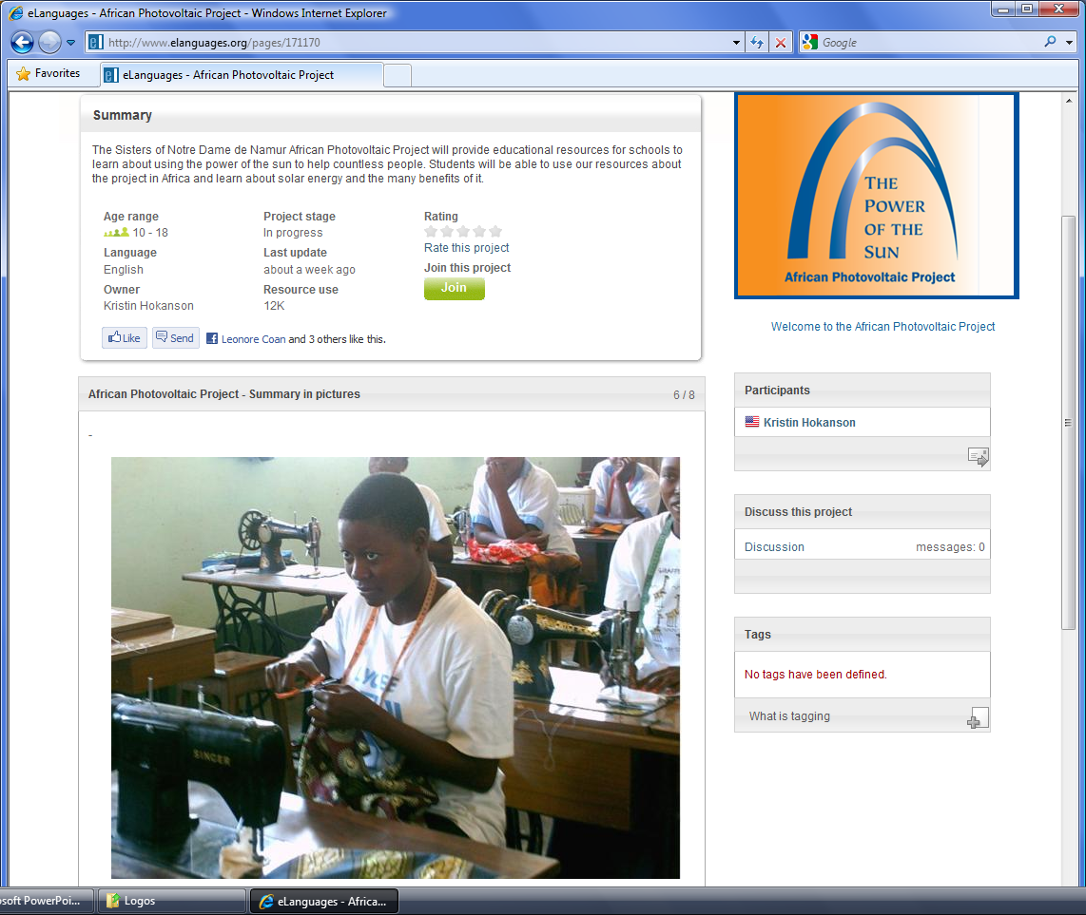

Slide 13
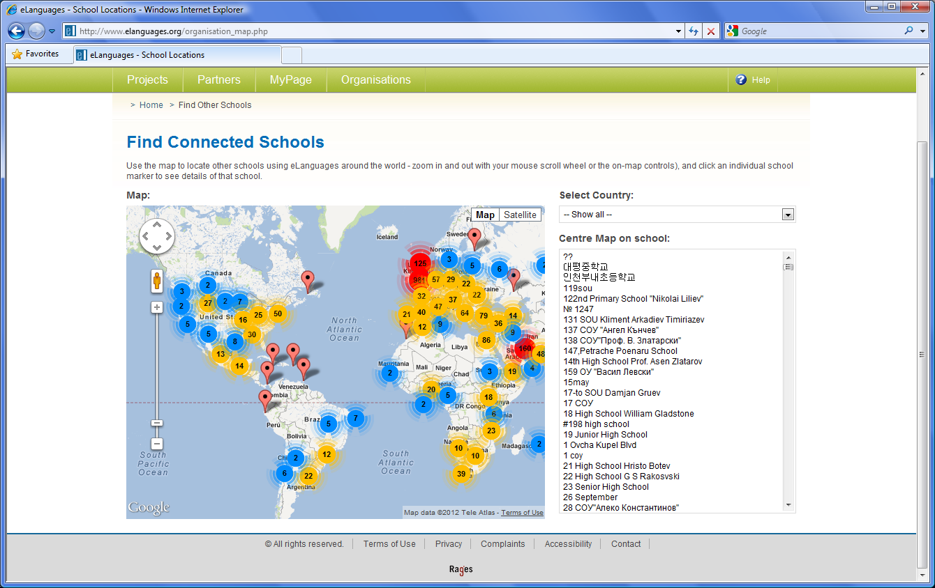

Slide 14
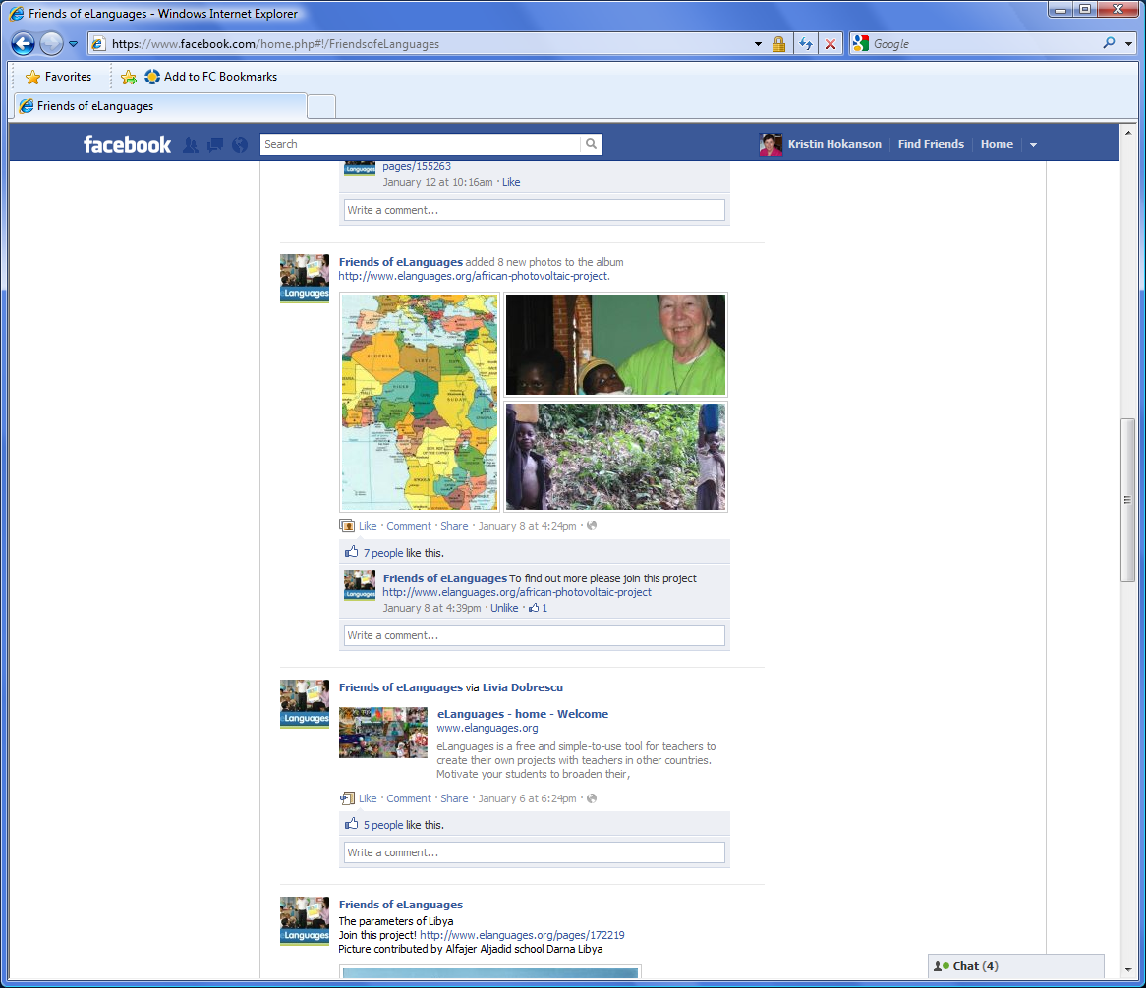

Slide 15
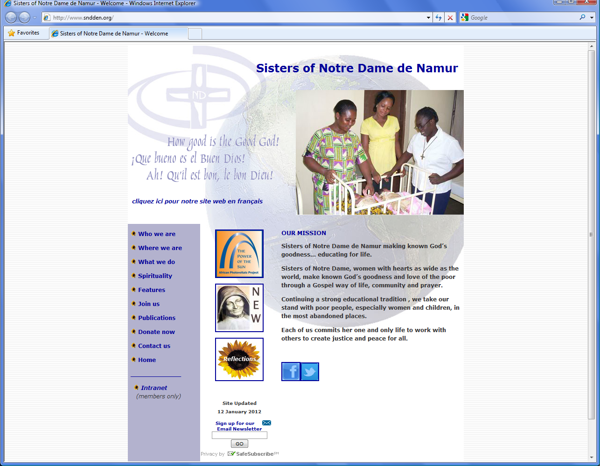

Slide 16
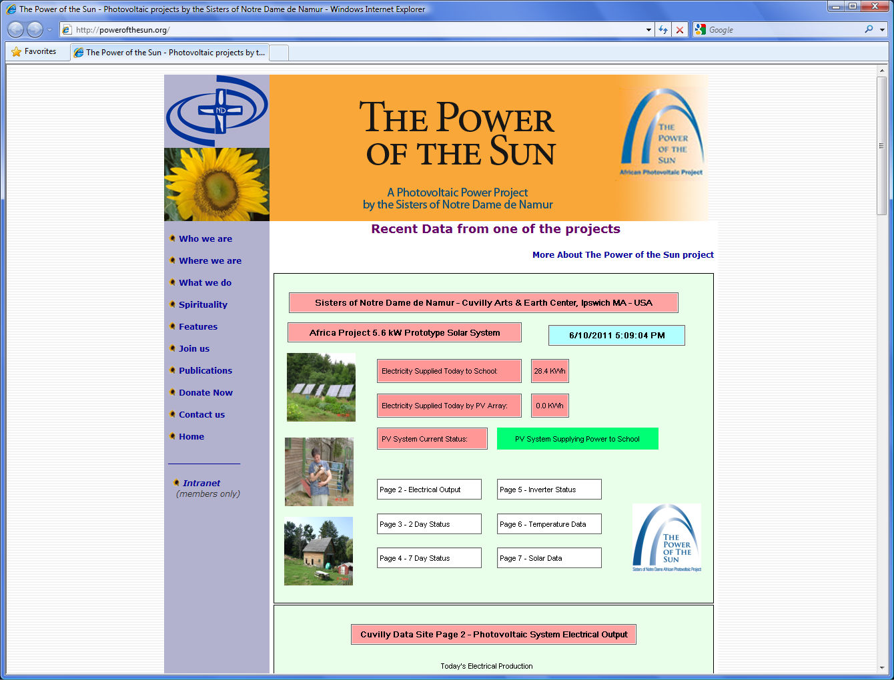

Slide 17
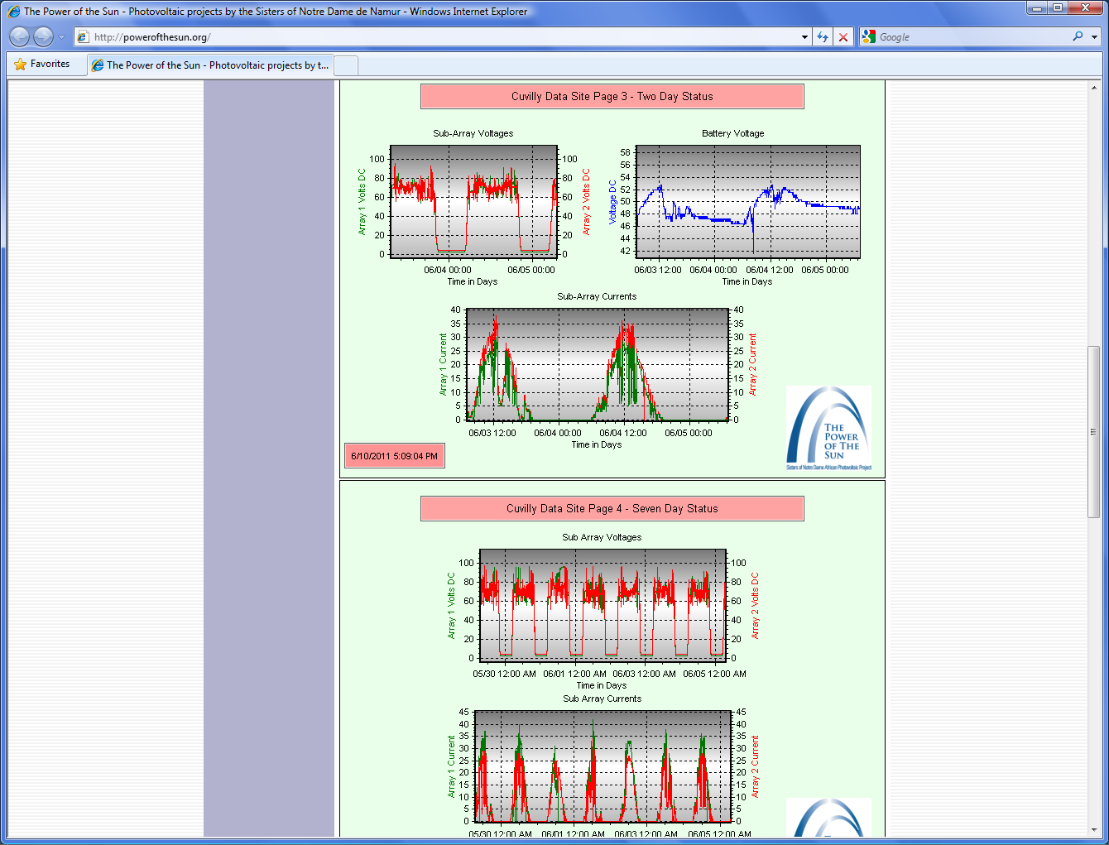

Slide 18
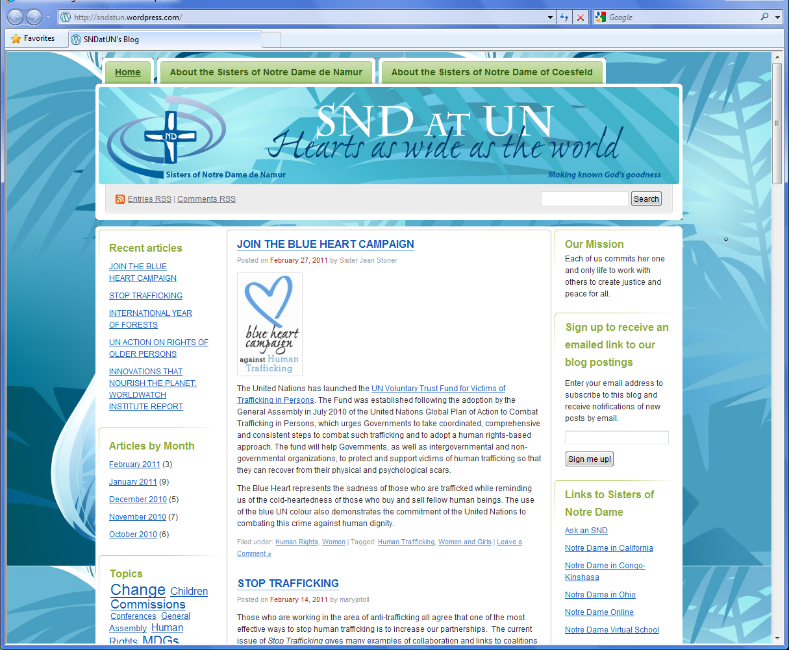
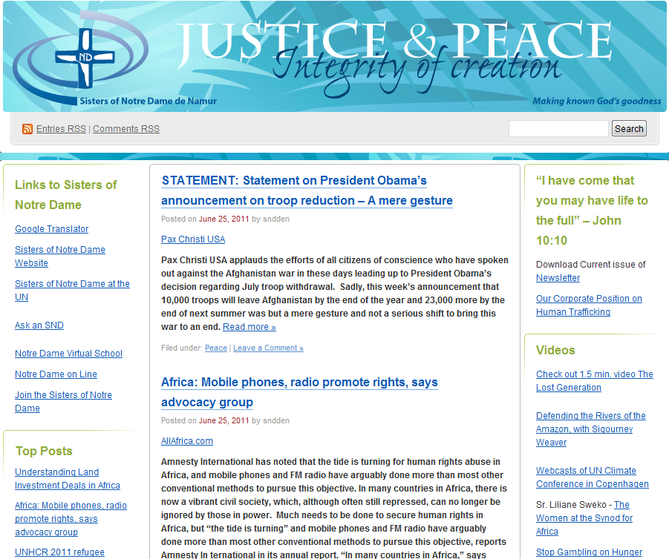
News updates from
Sister Jean Stoner
United Nations NGO
and from Sister Maura Browne
Justice and Peace Coordinator

Slide 19
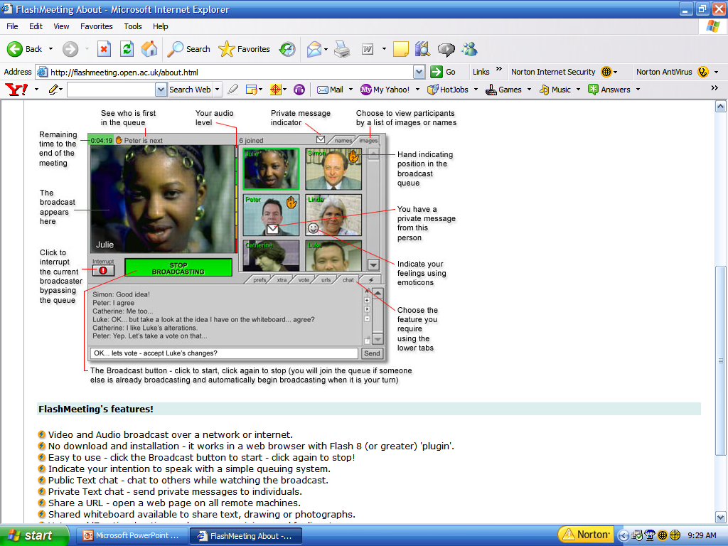

Slide 20
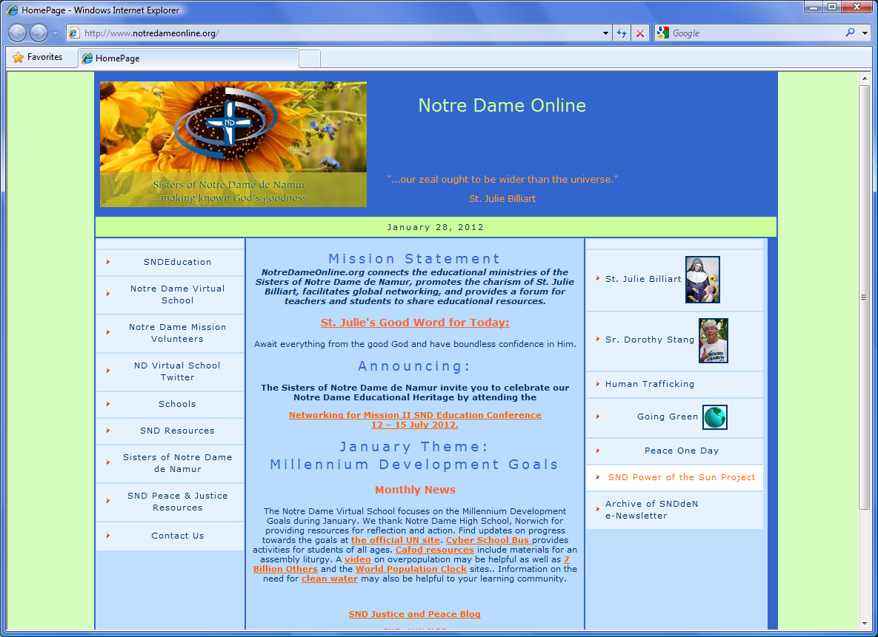

Slide 21

NOTRE DAME VIRTUAL SCHOOL
Next Steps
  New website
  Direct link to Photovoltaic educational resources
  Involve Notre Dame schools through social media – blogs, Twitter, Facebook
  eLanguages
Notes:
Mention the Academy in Tyngsboro
Language at Worcester
Sheffield; Norwich

Slide 22

“I think that soon you and I shall see things we should never have thought possible.”
SNDdeN Congregational Leadership Team
www.ndvs.org

