Slide 1
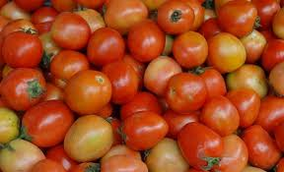
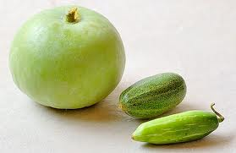
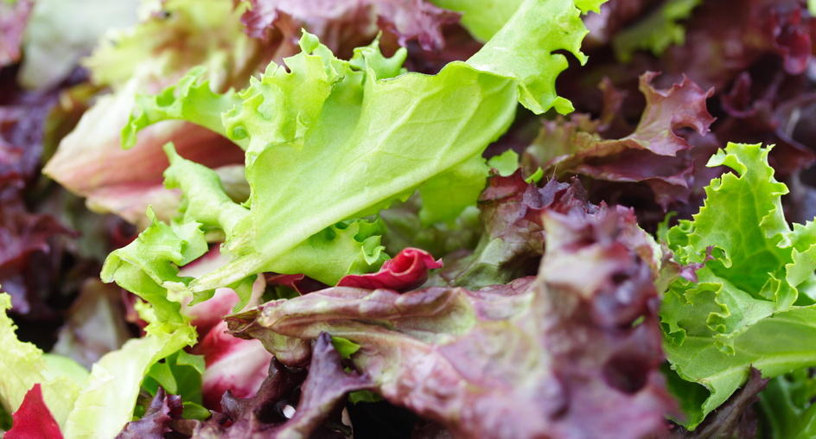
Indigenous Indian
Food………

Slide 2
1ST QUESTION:
WHAT KNOWLEDGE DO YOU HAVE ABOUT INDIA AND INDIANS?
WHEN DID YOU LAST VISIT OR HAVE HEARD ABOUT THIS COUNTRY ?
5TH QUESTION :
CAN YOU THINK OF ANY RECIPE FROM THESE ?
4TH OUESTION :
CAN YOU NAME SOME FRUITS OR VEGETABLES ORIGINATING FROM INDIA ?
CAN YOU GIVE THEM A NAME FROM YOUR SIDE ?
3RD QUESTION:
DO YOU KNOW ANY INDIGENOUS FOOD FROM INDIA ?
WHAT IS THE CLIMATIC CONDITION REQUIRED FOR THE INDEGENIOUS FRUITS AND VEGETABLES OF INDIA ?
2ND QUESTION:
WHO ARE THE INDIGENOUS INDIANS?
DO YOU KNOW ABOUT THEIR WAY OF LIVING ?

Slide 3

CAN YOU GUESS IT ???
1.THIS IS A VEGETABLE NATIVE TO INDIA.CAN YOU GUESS ITS NAME?
2.WHAT KIND OF ADJECTIVES DO YOU THINK OF WHEN YOU SEE THIS VEGETABLE?
3.THE SHAPE AND STRUCTURE OF THE VEGETABLE HAS A LOT OF REASON BEHIND ITS NAME.NOW CAN YOU GUESS IT ?
4.INDIANS CALL IT LOCALLY AS ‘BRINJAL’.WHAT DO YOU NOW THINK ITS NAME WOULD BE?
5. MANY PEOPLE ARE ALLERGIC TO IT ,BECAUSE OF ITS HIGH ORAL ALLERGIC SYNDROME. CAN U GUESS IT NOW ?

Slide 4

THE VEGETABLE IS KNOWN AS
“EGGPLANT /AUBERGINE/MELONGENE”

Slide 5
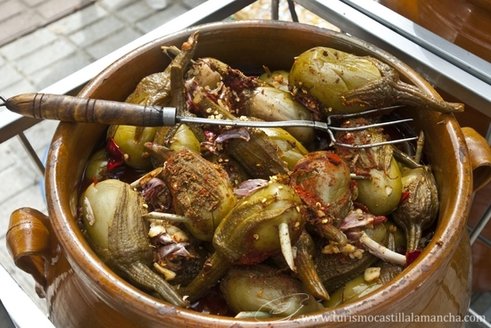
WHY IS THE EGGPLANT FAMOUS ????
As a native plant, it is widely used in Indian cuisine, for example in Sāmbhar, dalma (a dal preparation with vegetables, native to Orissa), chutney, curries, and achaar. Owing to its versatile nature and wide use in both everyday and festive Indian food, it is often described (under the name brinjal) as the 'King of Vegetables'. In one dish, brinjal is stuffed with ground coconut, peanuts, and masala, and then cooked in oil.
BERENJENAS ALMAGRO

Slide 6
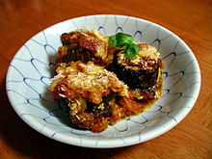
The plant is used in cuisines from Japan to Spain. It is often stewed, as in the French ratatouille, the Italian parmigiana di melanzane, the Turkish musakka, andMiddle-Eastern and South Asian dishes. Eggplants can also be battered before deep-frying and served with a sauce made of tahini and tamarind. In Iranian cuisine, it can be blended with whey as kashk e-bademjan, tomatoes asmirza ghasemi or made into stew as khoresh-e-bademjan. It can be sliced and deep-fried, then served with plainyoghurt, (optionally) topped with a tomato and garlic sauce, such as in the Turkish dish patlıcan kızartması or without yoghurt as in patlıcan şakşuka. However, arguably the most famous Turkish eggplant dish is İmam bayıldı.
PARMIGIANA DI
MELANZANE

Slide 7
HOW IS IT NUTRIONAL ?
Studies of the Institute of Biology of São Paulo State University, Brazil, have shown eggplant is effective in the treatment of high blood cholesterol. Another study from Heart Institute of the University of São Paulo found no effects at all and does not recommend eggplant as a replacement to statins.
It helps to block the formation of free radicals and is also a source of folic acid and potassium.
Eggplant is richer in nicotine than any other edible plant, with a concentration of 100 ng/g (or 0.01 mg/100g). However, the amount of nicotine from eggplant or any other food is negligible compared to passive smoking. On average, 20 lbs (9 kg) of eggplant contains about the same amount of nicotine as a cigarette.

Slide 8
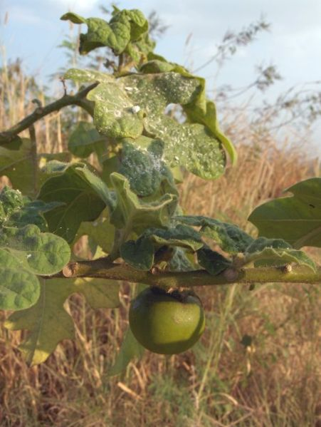
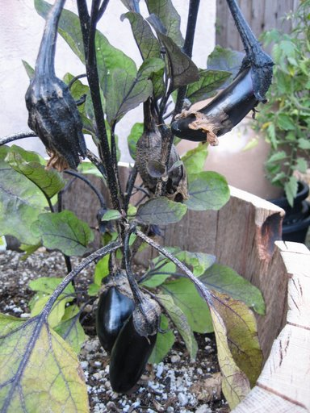
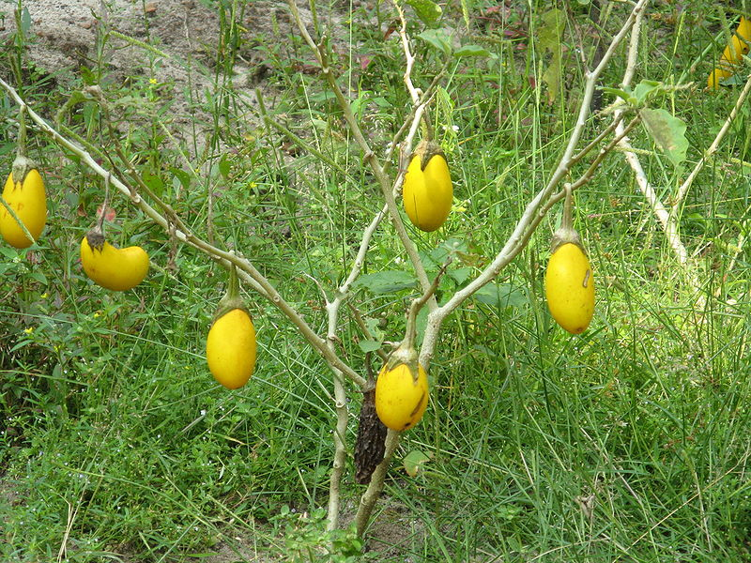
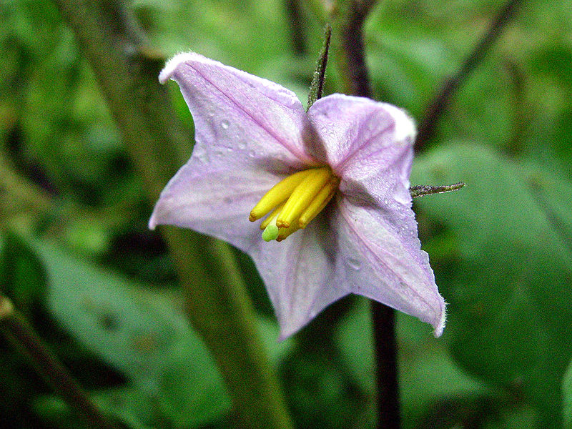
GALLERY ….

