Slide 1
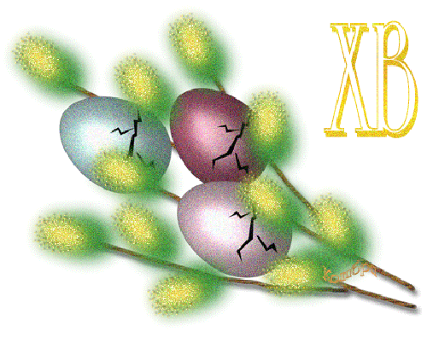
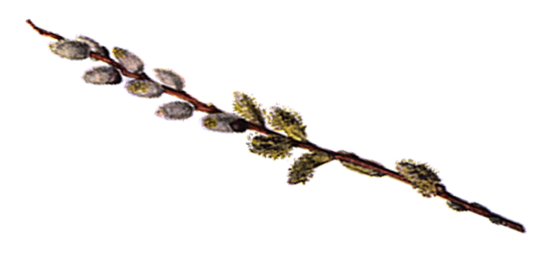
EASTER IN UKRAINE
Monastyrysche, School # 5

Slide 2
Contents
Easter and Easter Symbols
Willow Sunday
The White Week
Paska
Pysanka
Easter Basket
The Holy Sunday
Provody
Lingua-Cultural Vocabulary
NOTE. While reading click the underlined words to get their explanation in the Lingua-Cultural Vocabulary. Click the return button to get back to the text.

Slide 3
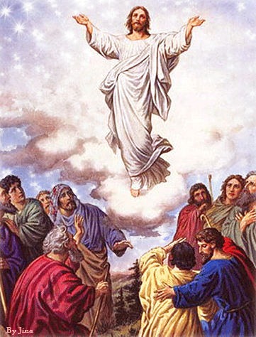
Easter is the
principal festival of the Christian church year which celebrates the of Jesus Christ . It is the festival of the joy that celebrates life.
Resurrection

Slide 4
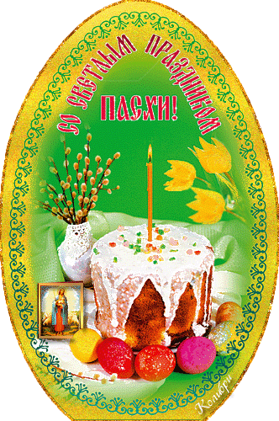
Easter is celebrated according to the Moon calendar on the first Sunday after the first spring full Moon. The Orthodox and Greek-Catholic Churches use the Julian calendar, so Easter in Ukraine does not coincide with Easter in the countries with other Christian churches. It is on a Sunday between the 4th of April and 8th of May.

Slide 5
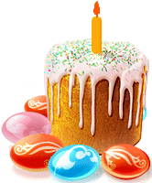
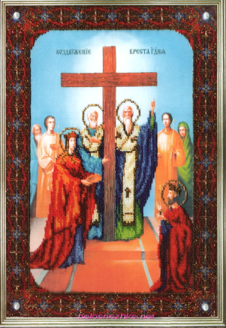
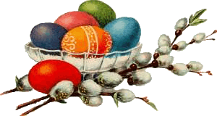
Easter Symbols
The cross
The candle
The egg
Willow branches
Easter bread

Slide 6
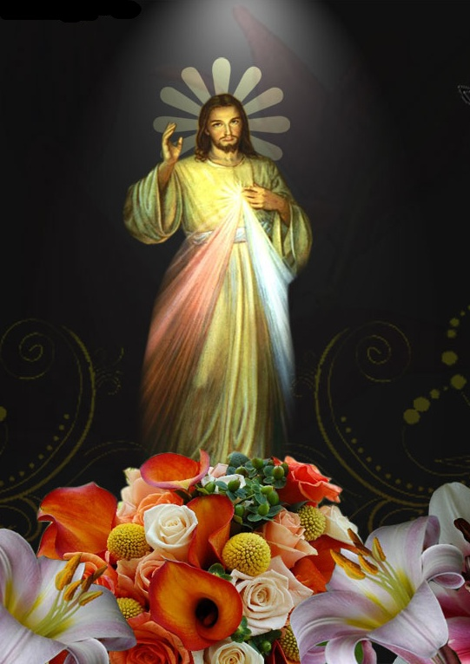
The candle gives light in darkness and symbolizes Jesus, “the light of the world.”

Slide 7
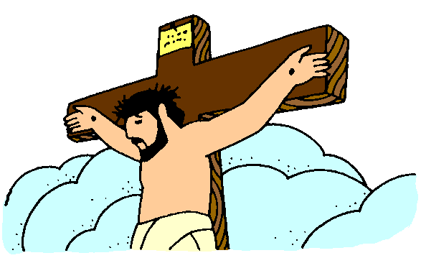
The cross reminds people of
the of Jesus Christ and symbolizes His victory over death.
Crucifixion

Slide 8
The egg
is a symbol of the rock tomb out of which Jesus Christ emerged when he arose again.

Slide 9
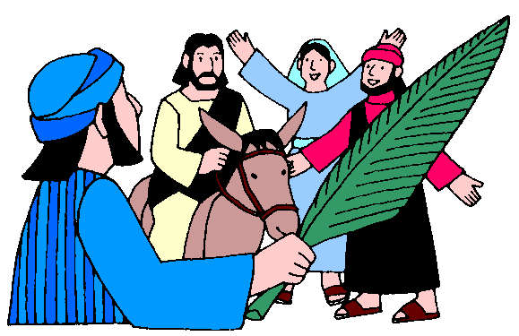
Willow branches
palm branches representing when Jesus arrived in Jerusalem and people waved them welcoming him.
substitute

Slide 10
UKRAINIAN TRADITIONS
In Ukraine Easter has been celebrated over a long period of history and has had many rich traditions.

Slide 11
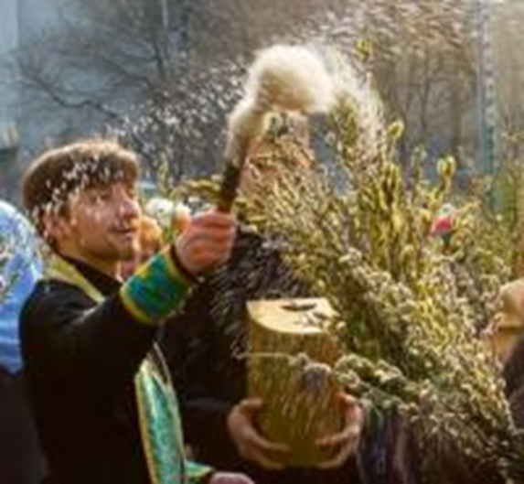
WILLOW SUNDAY
The last Sunday before Easter is called Willow Sunday
( ).
On this day pussy-willow branches
are blessed in the church.
Verbna nedilia
Palms were apparently hard to get in Ukraine in days of old, so willow branches were substituted.

Slide 12
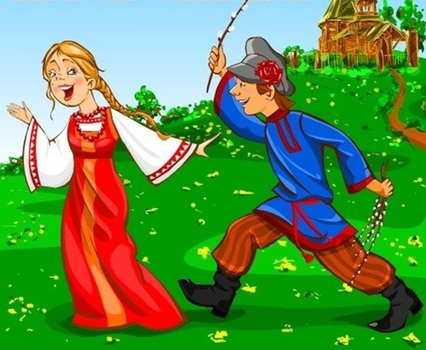
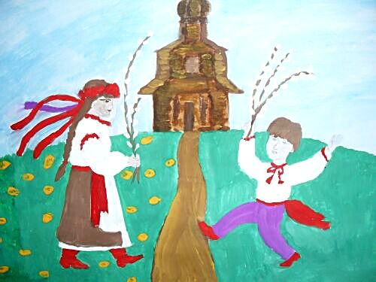
WILLOW TAPPING
On Willow Sunday people traditionally tap one another with willow branches, repeating the wish :
‘Be as tall as the willow. As healthy as the water.
As rich as the earth. Not I’m tapping.
The willow is tapping. Easter is in a week’.

Slide 13
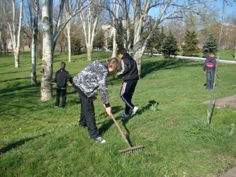
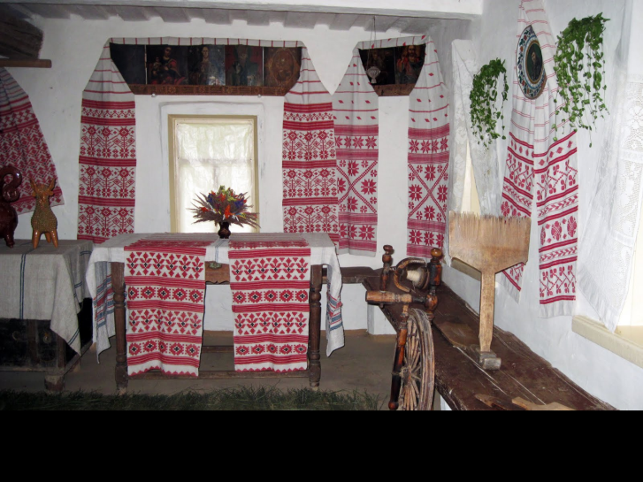
The White Week
The week before Easter, the Great (Velykyi) Week (Holy Week), is called the White (Bilyi) or Pure (Chystyi) Week. During this time an effort is made to finish all field work before Thursday, since from Thursday on work is forbidden.
is connected with ritual of clarification by water. It is traditional with Ukrainians to prepare body for Easter, to wash carefully, as it is believed that on this day water protects you washing away all diseases.
Pure Thursday

Slide 14
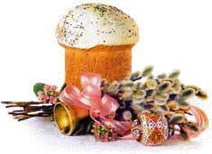
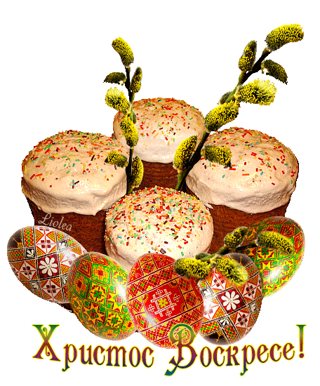
Ukrainian Paska
Paska
has great symbolic significance in Ukraine. The baker of the paska must keep her thoughts pure and the household must remain quiet for the bread to retain its fluffy texture while in the oven.
Traditionally to bake the paska is a strictly family affair; neighbours or strangers are not permitted to enter the house while the paska is being prepared. In ancient times, the man of the house would stand guard at the door while the paska loaf was being made to prevent any intruders from casting the “evil eye” onto the bread and thus threatening the family’s prosperity for the coming year.

Slide 15
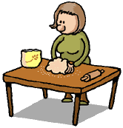
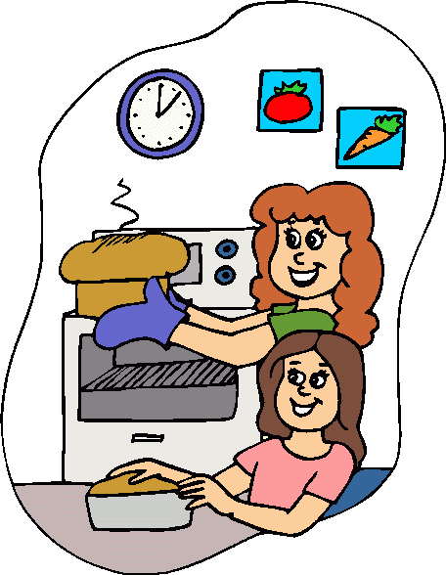
Dos and Don’ts for a Successful Paska
* When preparing paska dough don't make any sudden noises while the paska is rising or while it is in the oven baking. Also, don't sit down while the paska is in the oven or it will become flat.
* While placing the paska into the oven say: "Holy paska, be as grand and beautiful as the sun, because we are baking you for the sun. Let all members of our family be healthy. Let our children grow up as quickly as you grow. "Come out as beautiful as you go in!“
* If you carefully follow all of the above instructions, the paska will be light, airy and tasty.
* If not - the paska will come out hard and dense. Then the people will say: "Even thunder and lightning will not break this paska".

Slide 16
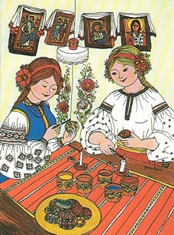
PYSANKA
Pysanky were made by the women of the house, during . They gathered eggs, and saved the best ones for making pysanky. On the chosen evening, women gathered, said a prayer, and then talked and sang while decorating their eggs.
Lent
In a large family, by Holy Thursday, 60 eggs could have been completed. This was done in secrecy, away from the men, and away from the prying eyes of other villagers.
Each family had their own dyes and their own patterns, and guarded them.

Slide 17
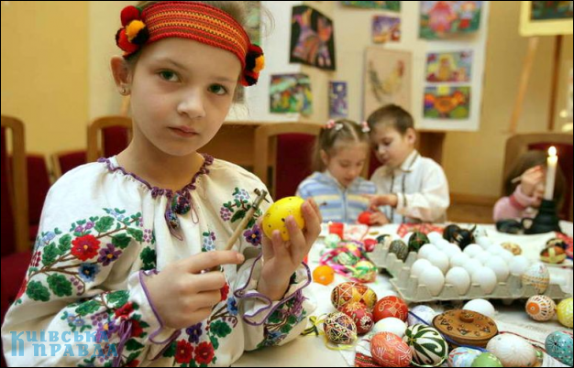
The art of Ukrainian egg painting worries the imagination of lots of people nowadays inspiring them to create real masterpieces.

Slide 18
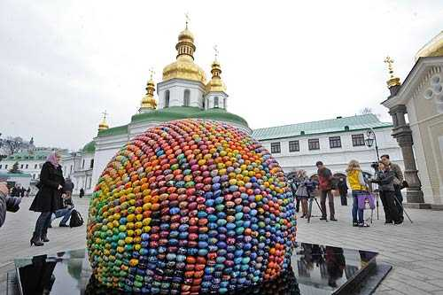
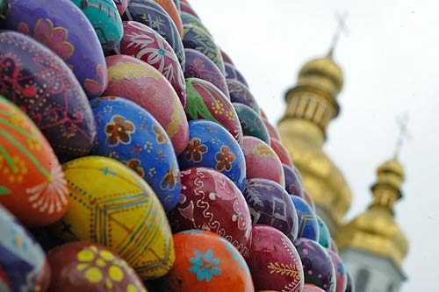
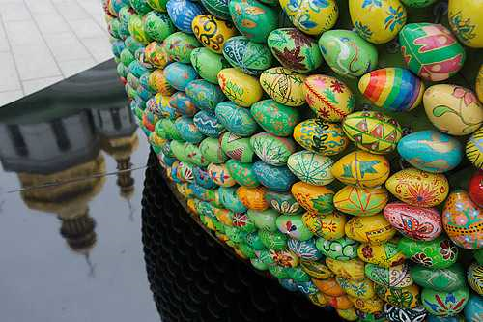
This semi-sphere sculpture is made of more than 3,000 pysankas. It is situated in Kyiv-Pechersk Lavra.
http://i.lb.ua/003/13/c646b3334d27.jpg

Slide 19
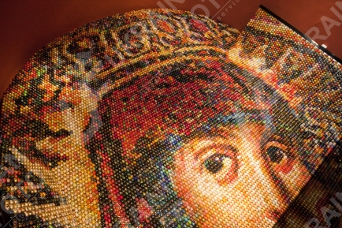
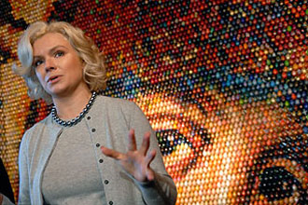
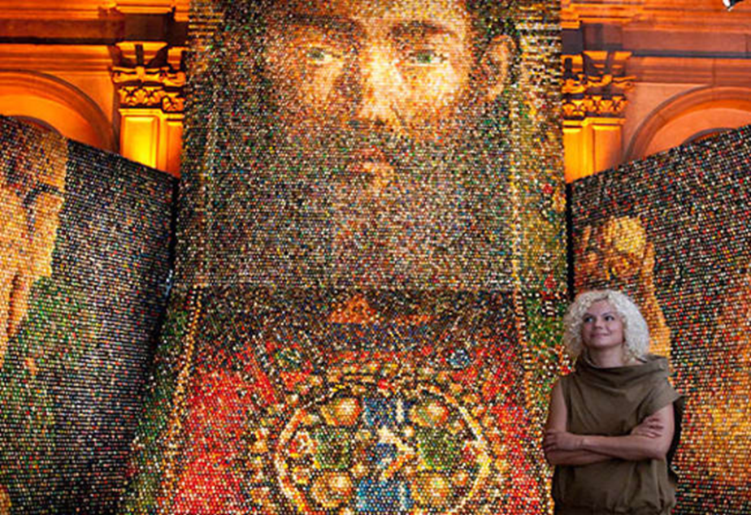
Oksana Mas, a modern artist from Odessa, creates her works with the help of Ukrainian pysankas. Her unique picture with the face of God’s Mother, laid out from 15,000 Ukrainian wooden pysankas, was presented in St.Sophia’s Cathedral in Kyiv.

Slide 20
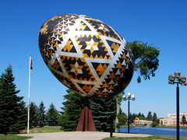
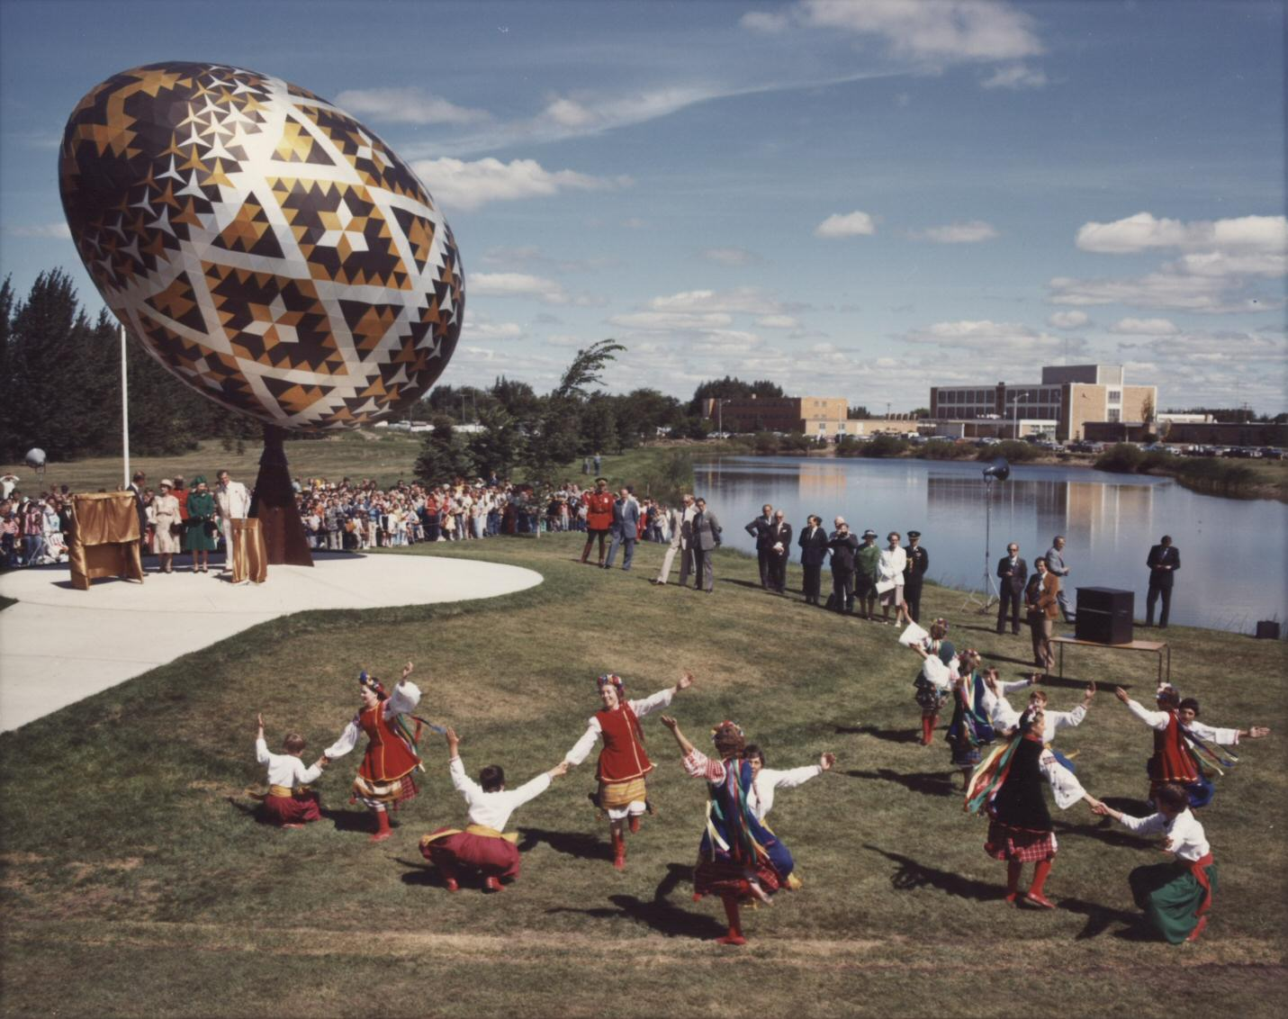
The largest in the world monument to Ukrainian pysanka is in the town of Vegreville (Canada). It is 10 meters high. Annually in July the Ukrainian festival of pysanka is held in this town.

Slide 21
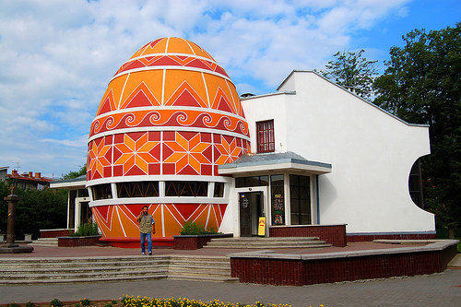
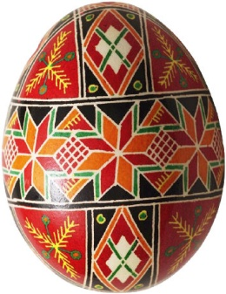
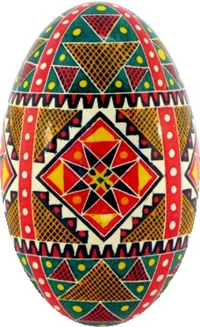
Here is Ukrainian Easter Egg in the town of Kolomyya (Ivano-Frankivsk region, Western Ukraine).It is the central part of the building of the only Museum of Pysanka in the world.
Kolomyya's Pysanka Museum was built in 2000. Hundreds of Easter Eggs from different regions of Ukraine are represented here. Kolomyya's Big Pysanka is 13 meters high!

Slide 22
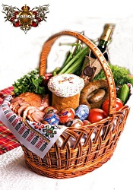
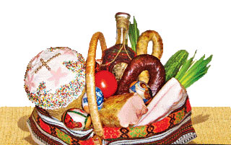
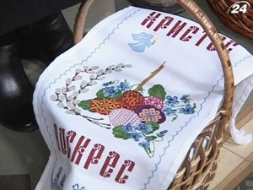
Easter Basket
The Easter basket is the pride and joy of the family. People judge the mistress of the house according to the way her Easter basket looks, what it contains, and how it is decorated.
The basket should be lined with a newly embroidered serviette or with a white napkin. An embroidered serviette should be used to cover the basket. Very ambitious housewives have two embroidered serviettes - one for lining the basket and one for covering it.
Remember, the basket should contain only a sampling of the foods .

Slide 23
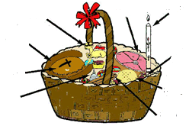
EASTER BASKET
Butter
Ham
Candle
Sausage
Eggs
Easter Bread
Cheese
Salt
Bacon

Slide 24
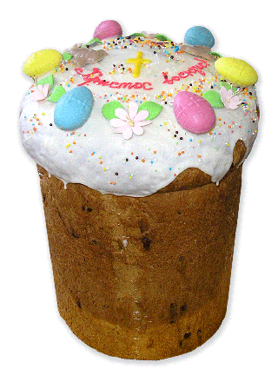
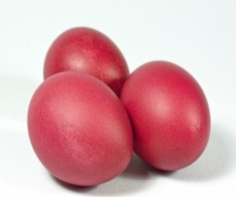
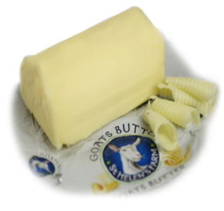
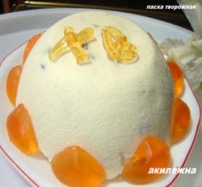
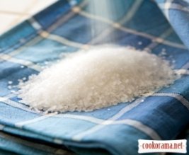
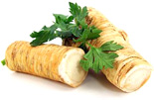
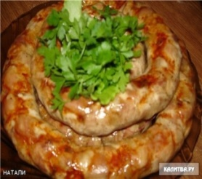
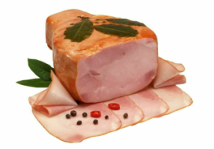
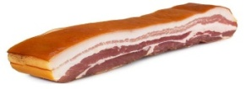
PASKA Place a candle into the center of the paska and light it when the priest begins the blessing ceremony.
KRASHANKY dyed hard boiled eggs - variety of colors, but there must be a red one.
CHEESE sweet cheese: farmer cheese with sugar, raisins, nutmeg, cinnamon. Place on a dish and on top you can place the butter.
BUTTER should be nicely shaped and decorated with whole cloves and placed on a small dish or on top of the cheese.
Put into Your Basket
SALT a small amount in a napkin.
HORSERADISH a piece of the root or prepared horseradish with beets.
SAUSAGE a small
ring.
HAM or BACON
Tie a few willow branches to the handle of the basket with a red ribbon.

Slide 25
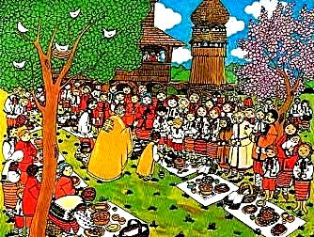
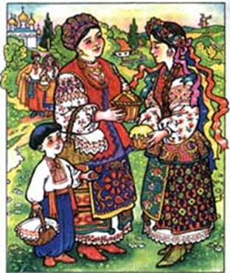
THE HOLY SUNDAY
On the way home all the people exchange Easter greetings saying: “Christ is risen!” and replying “Risen indeed” and give each other painted eggs .
On Saturday evening people go to the church for the
They stay there till the very morning when priests bless the brought food. After that people go home to celebrate Easter with their families.
Matins
and High Mass.

Slide 26
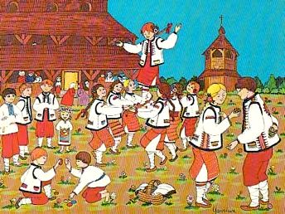
Easter is spent with family, eating, drinking, dancing and singing hayivky .With these dances and songs people greet all the good spirits of the reawakened Nature so that it would bring them good luck and wealth.

Slide 27
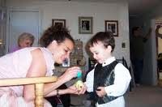
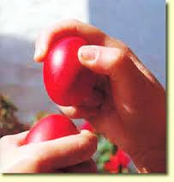
Egg Tapping
In Ukraine it is common to play a game with hard boiled eggs known as egg tapping. Each player receives one egg with which they’re supposed to try to hit other players’ eggs with their egg. The person that has the last remaining in tact egg is the winner. Losers have to eat their eggs.

Slide 28
Provody
During the Easter season the Ukrainians have
The dead are remembered during the whole week after Easter, especially on the first Sunday following Easter Sunday. People gather in the cemeteries, bringing with them a dish containing some food and wine, which they consume, leaving the rest at the graves.
Provody.

Slide 29
Vocabulary
Crucifixion death on a cross
Lent a fasting period of 40 days before Easter
Mass a celebrating church ceremony
Matins early morning or night church service
Paska Easter bread in Ukraine
Provody a kind of Ukrainian Remembrance Day
Pure Thursday the name of Maundy Thursday in Ukraine
Resurrection return to life
Substitute use instead of
Verbna nedilia the name of Palm Sunday in Ukraine

