Slide 1
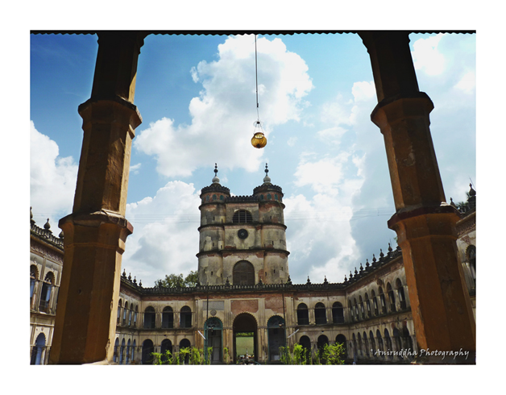
IMAMBARA

Slide 2
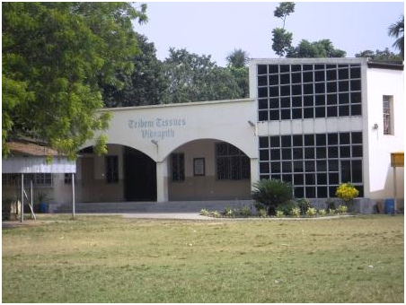
PRESENTED BY
TRIBENI TISSUES
VIDYAPITH

Slide 3
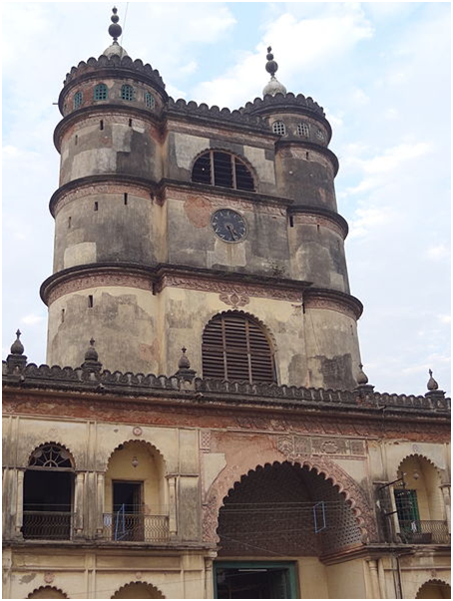
THE IMAMBARA OR SHIA MUSLIM PILGRIMAGE IS LOCATED TWO(2) KILOMETERS AWAY FROM THE BANDEL CHURCH, ON THE BANKS OF THE HOOGHLY RIVER. IT WAS BUILT BY HAZI MOHAMMAD MOHSIN IN THE YEAR 1841 AND WAS COMPLETED IN 1861 AT A COST OF TWO LAKH SEVENTY FIVE THOUSAND RUPEES(Rs. 2,75,000) . A CLOCK WAS PROCURED FROM ENGLAND AT A COST OF RS.11,721. THE 2 STORYED BUILDING CONSISTING OF RANGED ROOMS HAVING A WIDE ENTRANCE OF MAIN GATE FLANKED BY 2 GIANT TOWERS MEASURING 80 ft. TALL AND A MASSIVE CLOCK TOWER IN BETWEEN THEM.A MOSQUE, THE WALLS OF WHICH ARE DECORATED BY THE TEXTS OF HOLY KORAN AND THE INTERIOR OF THE MOSQUE IS ENRICHED WITH INLAID MARBLE AND CAREIGNS,CANDELS AND LANTERNS. THE MOSQUE IS SITUATED AT THE NORTH SIDE OF THE BUILDING. AT THE SOUTH THERE IS AN ENCLOSED COMPOUND WHERE THE GRAVES OF MD. MOHSIN AND HIS RELATIVES ARE PRESENT. MUSLIM FESTIVALS, PARTICULARLY “MUHARRAM”, ARE CELEBRATED EVERY YEAR WITH GREAT SPLENDOR.

Slide 4


Slide 5
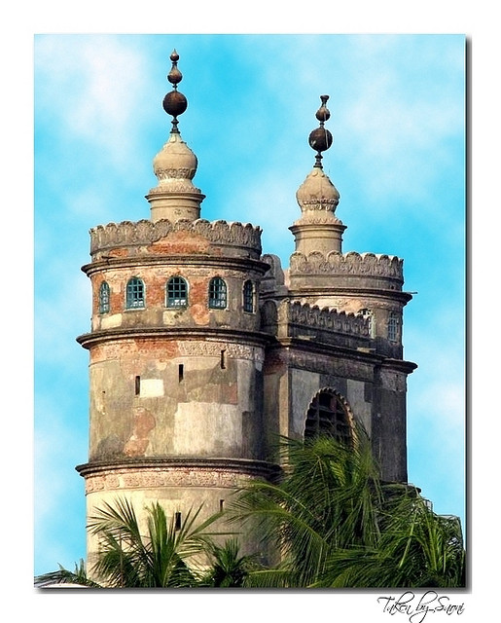
SPEACIAL FEATURES
OF
IMAMBARA,HOOGHLY

Slide 6
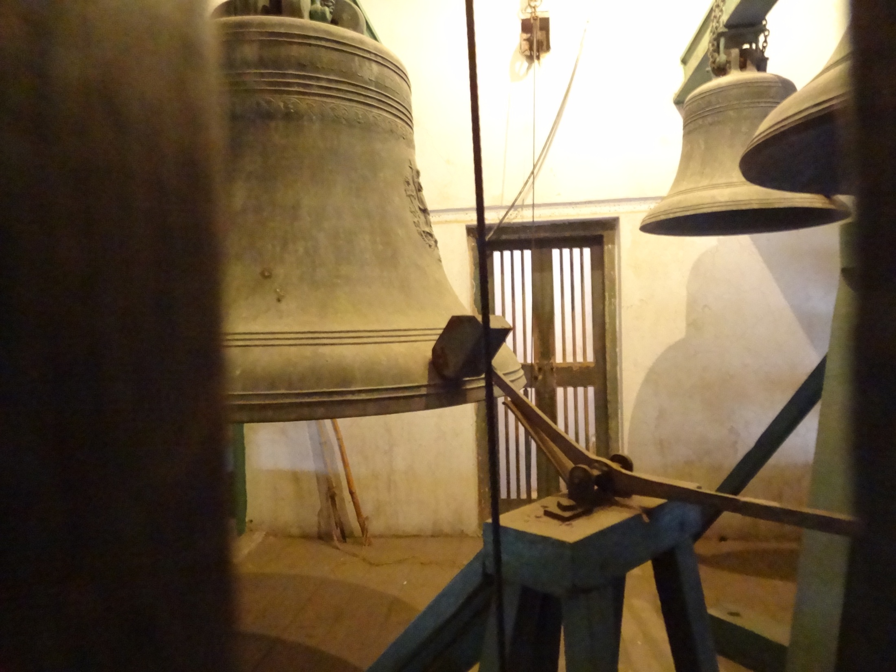
BELL

Slide 7
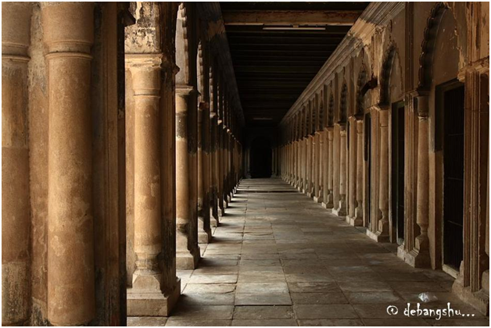
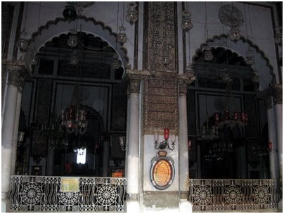
PILLERS OF IMAMBARA
TEXTS FROMHOLY KORAN WRITTEN ON THE WALLS OF THE IMAMBARA

Slide 8
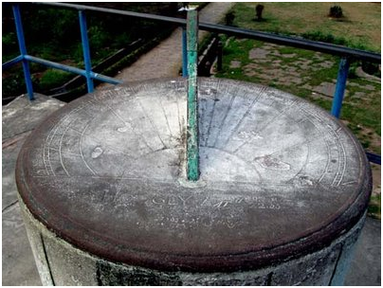
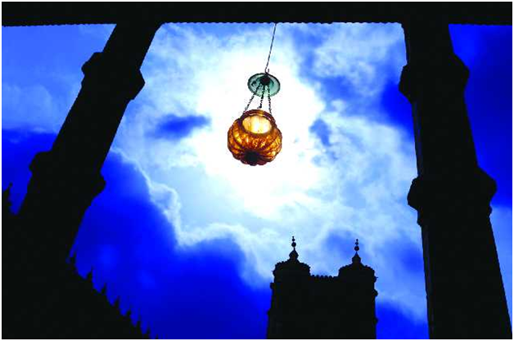
SUN BATH
LANTERN

Slide 9
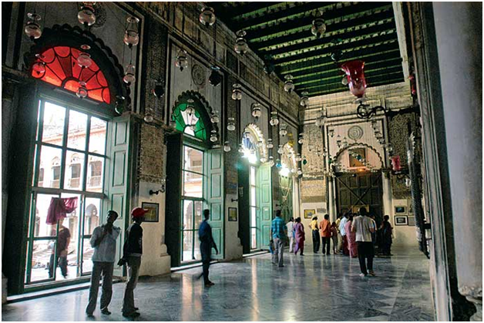
THE INTERIOR OF IMAMBARA

Slide 10
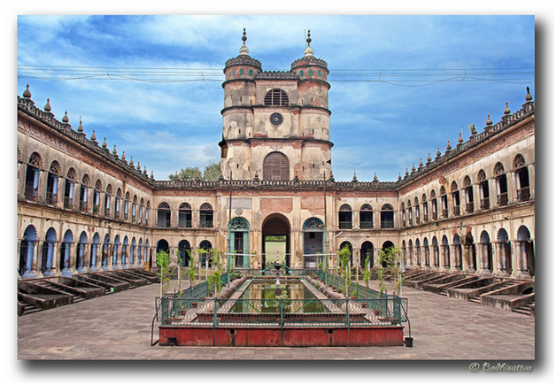
TIMINGS
DECEMBER TO JULY
AUGUST TO NOVEMBER
8:00am TO 6:00pm
8:00 am TO 5:30 pm
ENTRY FEE
Rs. 5 ONLY

Slide 11
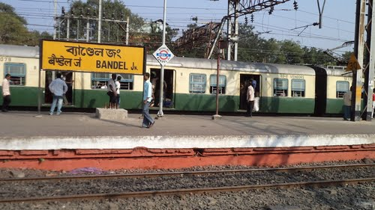
DIRECTIONS
The Imambara building having a masonry revetment is situated on the bank of river Ganges at Chinsurah. The place is nearest to the railway station "Hooghly" on the Howrah Bandel main line and from Hooghly station the rickshaw or auto rickshaw is available to reach the place.

Slide 12

PRESENTATION MADE BY
    RAJARSHI SANYAL
ROHIT CHOWHAN

Slide 13
THE END

