Slide 1
A guided learning session taken by Students of Class VII on Uses and Misuses of Groundwater
Public Water Distribution In
Singapore, U.K., and
China
ISA Programme
South City International School, India

Slide 2
What is groundwater?
Most of the rainfall will soak into the soil, which acts like a giant sponge. In the soil some of the water will be taken up by plants and, through a process called transpiration, will return to the atmosphere, but some will soak further into the ground – a process called infiltration - and trickle downwards into the rocks, becoming groundwater. The level at which the rock becomes saturated is called the water table.

Slide 3
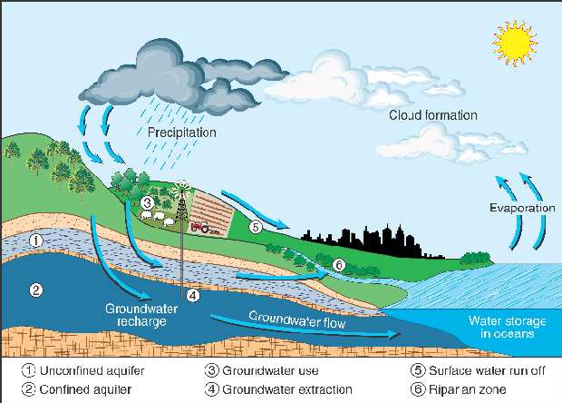

Slide 4
Importance of Groundwater
Groundwater makes up nearly 70% of all the world’s freshwater; only 0.2% is found in lakes, streams or rivers and 30% is bound up in snow and ice on mountains and in the polar regions. As rivers and lakes tend to be supported by groundwater, it is not exaggerating to say that almost all the water we use for agriculture, industry and drinking water is either groundwater or has been groundwater at some point in the water cycle.

Slide 5
In most countries, groundwater and river water is filtered and pumped and distributed through supply lines to the public.
The amount of groundwater used and measures taken to protect its amount can decide the sustainable availability of water.
We have taken the project to show how water is supplied in three countries-
Singapore
U.K.

Slide 6
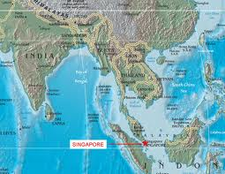
Singapore

Slide 7
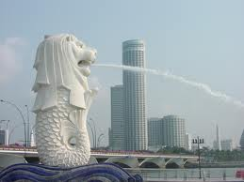
With no natural aquifers or an abundance of land, Singapore has recognised providing sustainable supply of water for its people as a vital issue in the 1960s. In the early days, we faced and overcame drought, floods and water pollution as the city grew.
Singapore has two separate systems to collect rainwater and used water. Rainwater is collected through a comprehensive network of drains, canals, rivers, storm-water collection ponds and reservoirs before it is treated for drinking water supply. This makes Singapore one of the few countries in the world to harvest urban storm-water on a large-scale for its water supply.
Singapore

Slide 8
The pillar of Singapore’s water sustainability is the use of NEWater. It is high-grade reclaimed water produced from treated used water that is further purified using advanced membrane technologies and ultra-violet disinfection, making it ultra-clean and safe to drink.
The Deep Tunnel Sewerage System, a 48-kilometer-long used water superhighway, conveys used water from the northern and eastern parts of Singapore to the centralised Changi Water Reclamation Plant for treatment before the treated used water is further purified into NEWater.
Another technology-based water source is desalinated water. Singapore has one of Asia’s largest seawater reverse-osmosis plant, which produces 30 million gallons of water a day (136,000 cubic metres) to meet about 10% of Singapore’s water needs.
Singapore

Slide 9
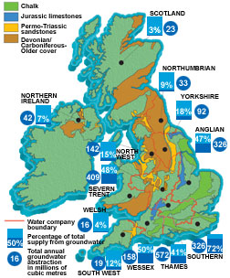
U.K.
Percentage Use of Groundwater In U.K.

Slide 10
In the South East of England the majority of public water supply is pumped from aquifers. In other areas of the UK groundwater also provides substantial proportions of water supply, even in the wettest parts of the country.
Groundwater is particularly important in East Anglia, where it is used for irrigation during dry summers, improving crop yields. Groundwater is used by industry almost everywhere in the UK, especially in large conurbations such as London, Birmingham, Liverpool and Manchester.
Protection of Groundwater in U.K.
In the UK, groundwater can generally be freely used for purely domestic purposes, with the quality checked by local Environmental Health Officers. In most of England and Wales abstracting groundwater for non-domestic use requires a license to be issued by the Environment Agency, who will check that the proposed pumping will not harm the environment or cause other users’ boreholes to dry. In Scotland and Northern Ireland similar controls are being introduced.

Slide 11
CHINA
Health problems caused by the lack of safe water are exacerbated by poor sanitary conditions, especially in rural China.
The Chinese government, the World Bank and the Washington-based Worldwatch Institute all have warned recently that increased water consumption in China's growing towns, coupled with reckless industrial and agricultural use, are rapidly exhausting the nation's already-strained water resources.
Chinese industries are water wasters, with an efficiency rate just one- tenth of that of developed countries.

Slide 12
CHINA
Groundwater is the main source for water supply in the People's Republic of China, especially in the North where groundwater supply is more than 52% of the total water supply.
Intensive groundwater exploitation in last decades has caused serious decline of water tables. Moreover, groundwater is also vulnerable to pollution from various sources. In particular, in urban and industrial areas groundwater has been polluted in the past decades due to the rapid development of the economy and urbanization.

Slide 13
CHINA
A primary groundwater level monitoring network has been operated by the China Institute for Geo-environmental Monitoring (CIGEM) in cooperation with 31 provincial Geo-environmental Monitoring Stations.
The monitoring network covers all provincial capital cities and important agricultural production plains and basins.

