Slide 1
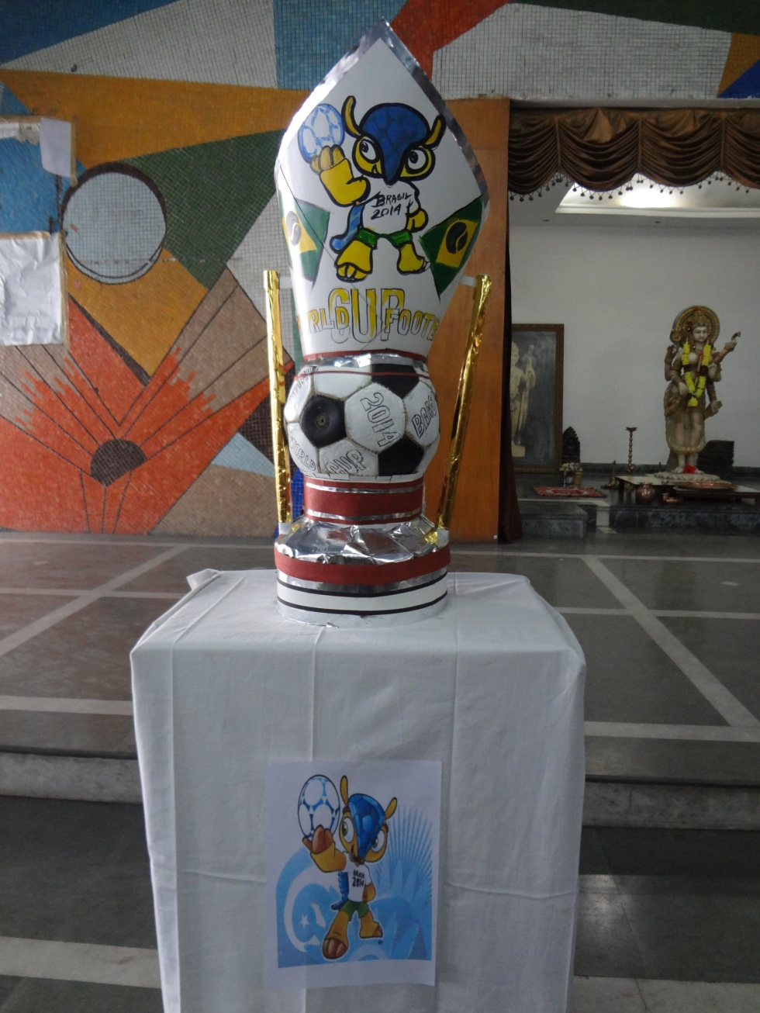

World Cup 2014
draw at
Birla
High
School

Slide 2
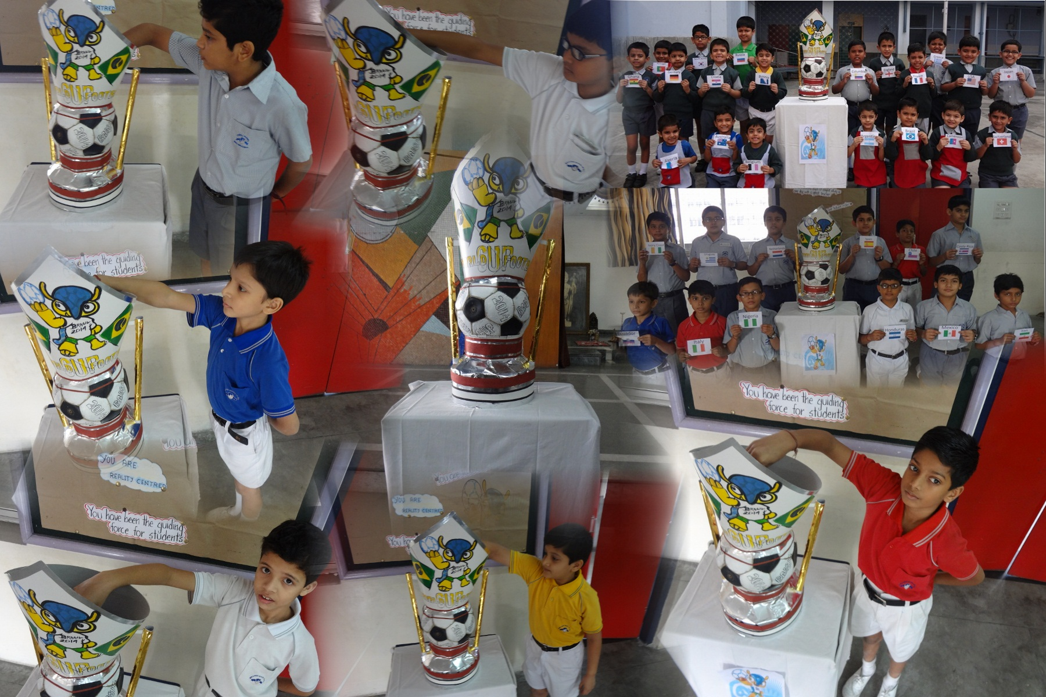
Our Pot
of Draw

Slide 3
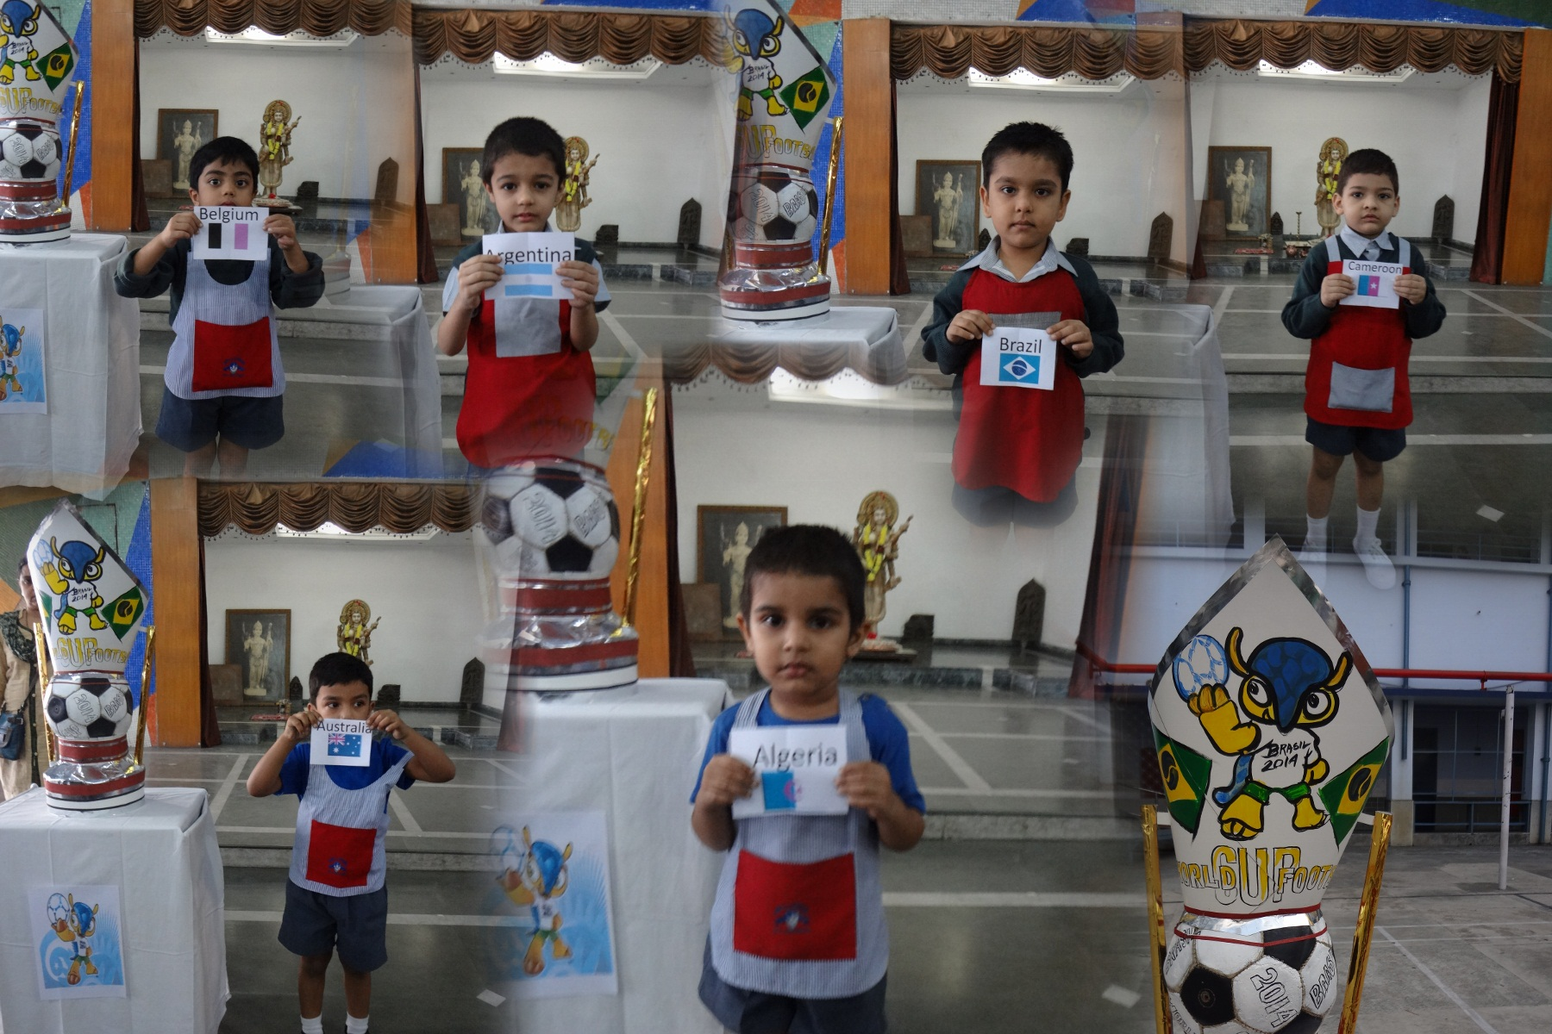
Our reps from
Nursery and Kg
Nursery A—Belgium
Nursery B—Australia
Nursery C--Algeria
KG A—Argentina
KG B—Brazil
KG C--Cameroon

Slide 4
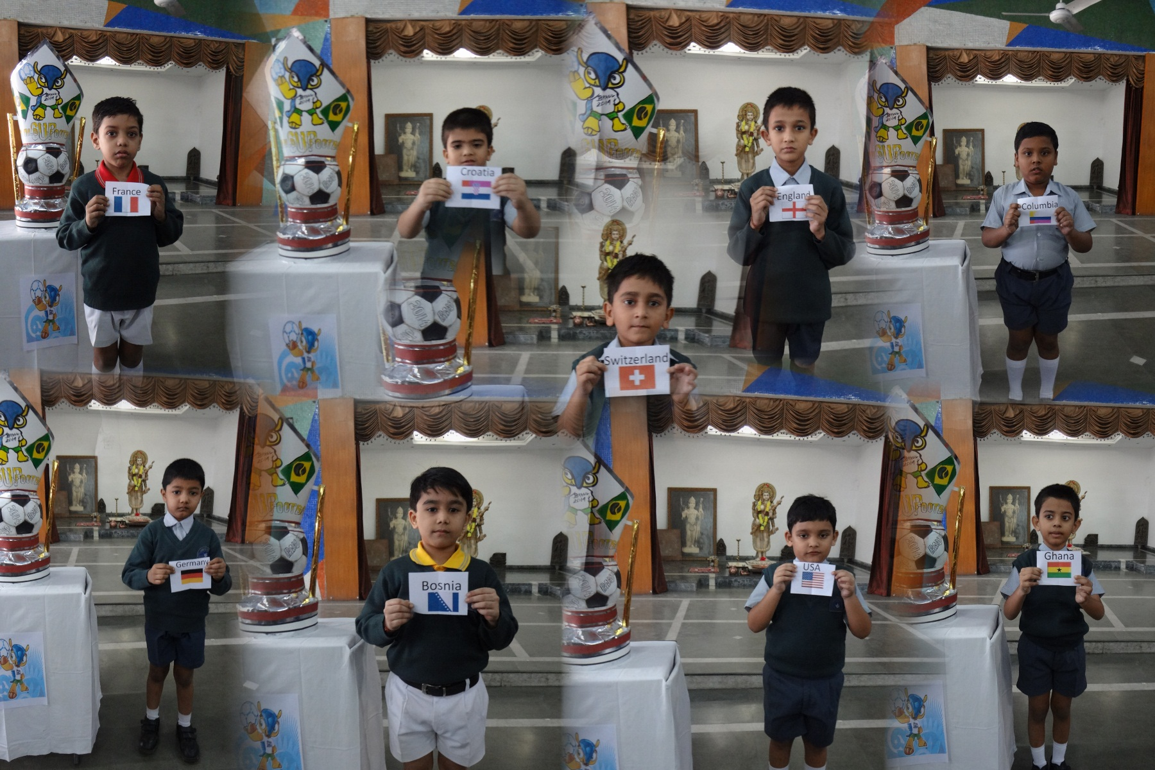
Our reps from
Classes I & II
II A—Columbia
II B—France
II C—England
II D– USA
II E-- Switzerland
I A—Croatia
I B—Bosnia
I C—Germany
ID-- Ghana

Slide 5
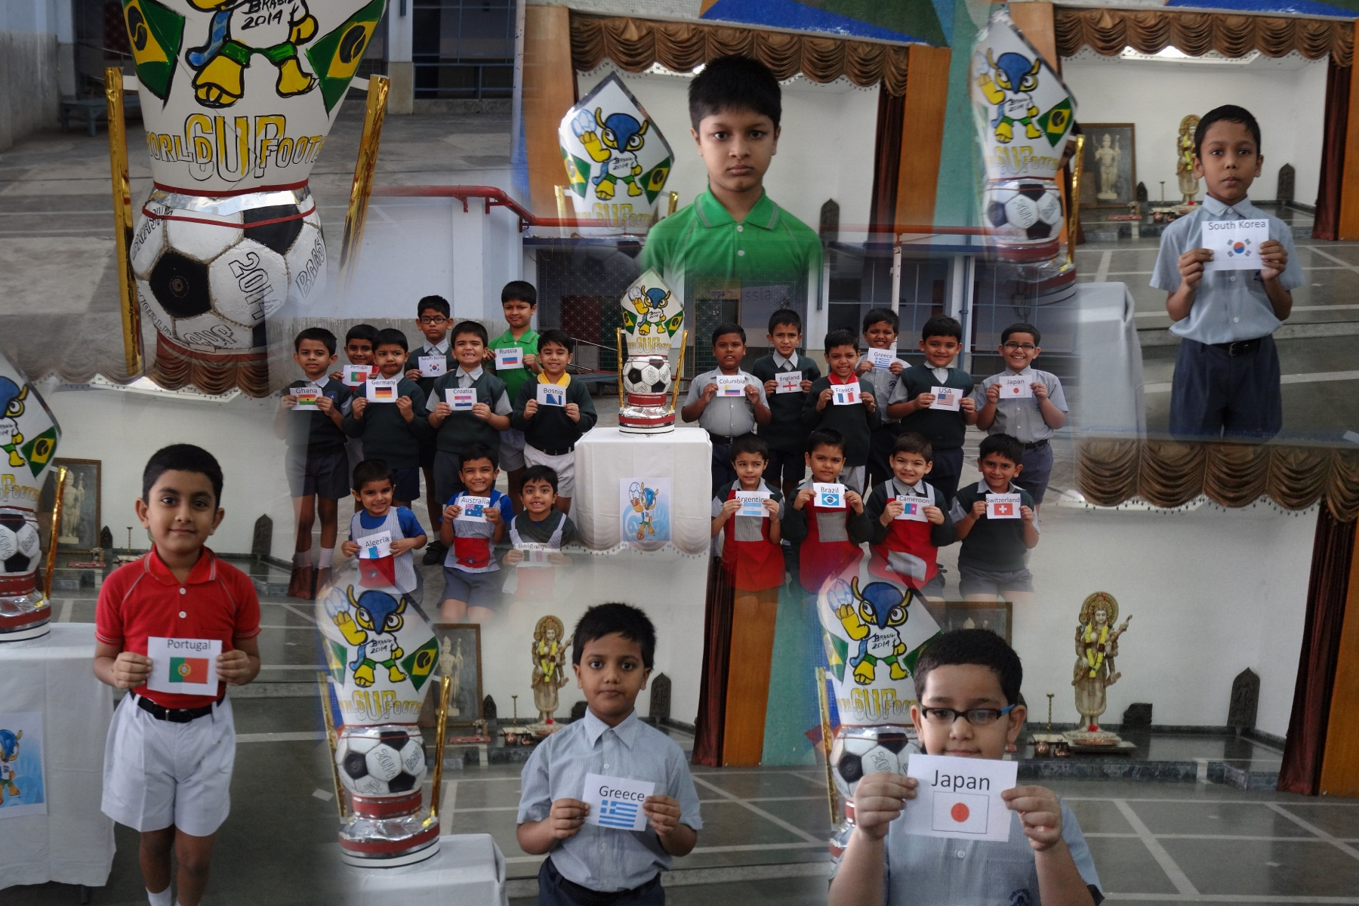
Our reps from
Class III
III A—Russia
III B—Japan
III C—Portugal
IIID– South Korea
III E-- Greece

Slide 6
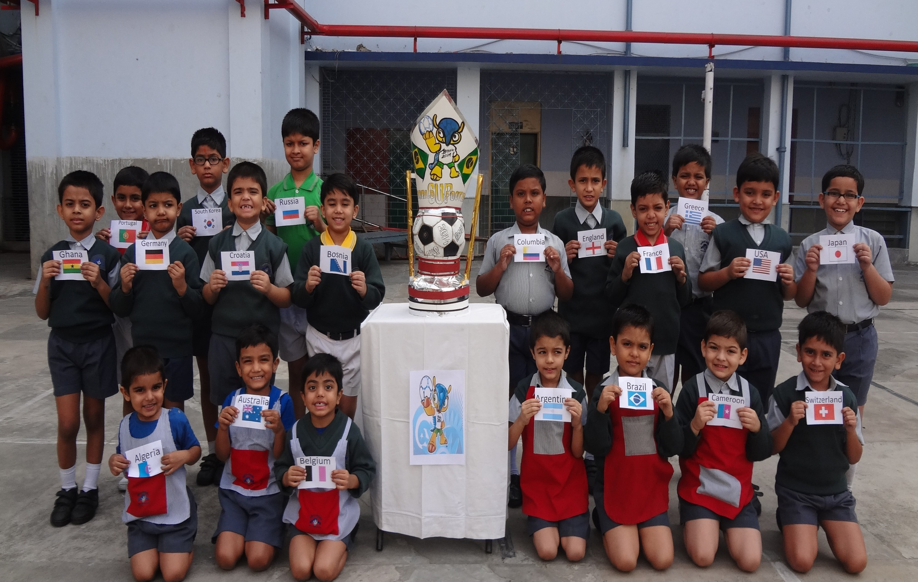
20 countries represented by
Classes Nursery--III

Slide 7
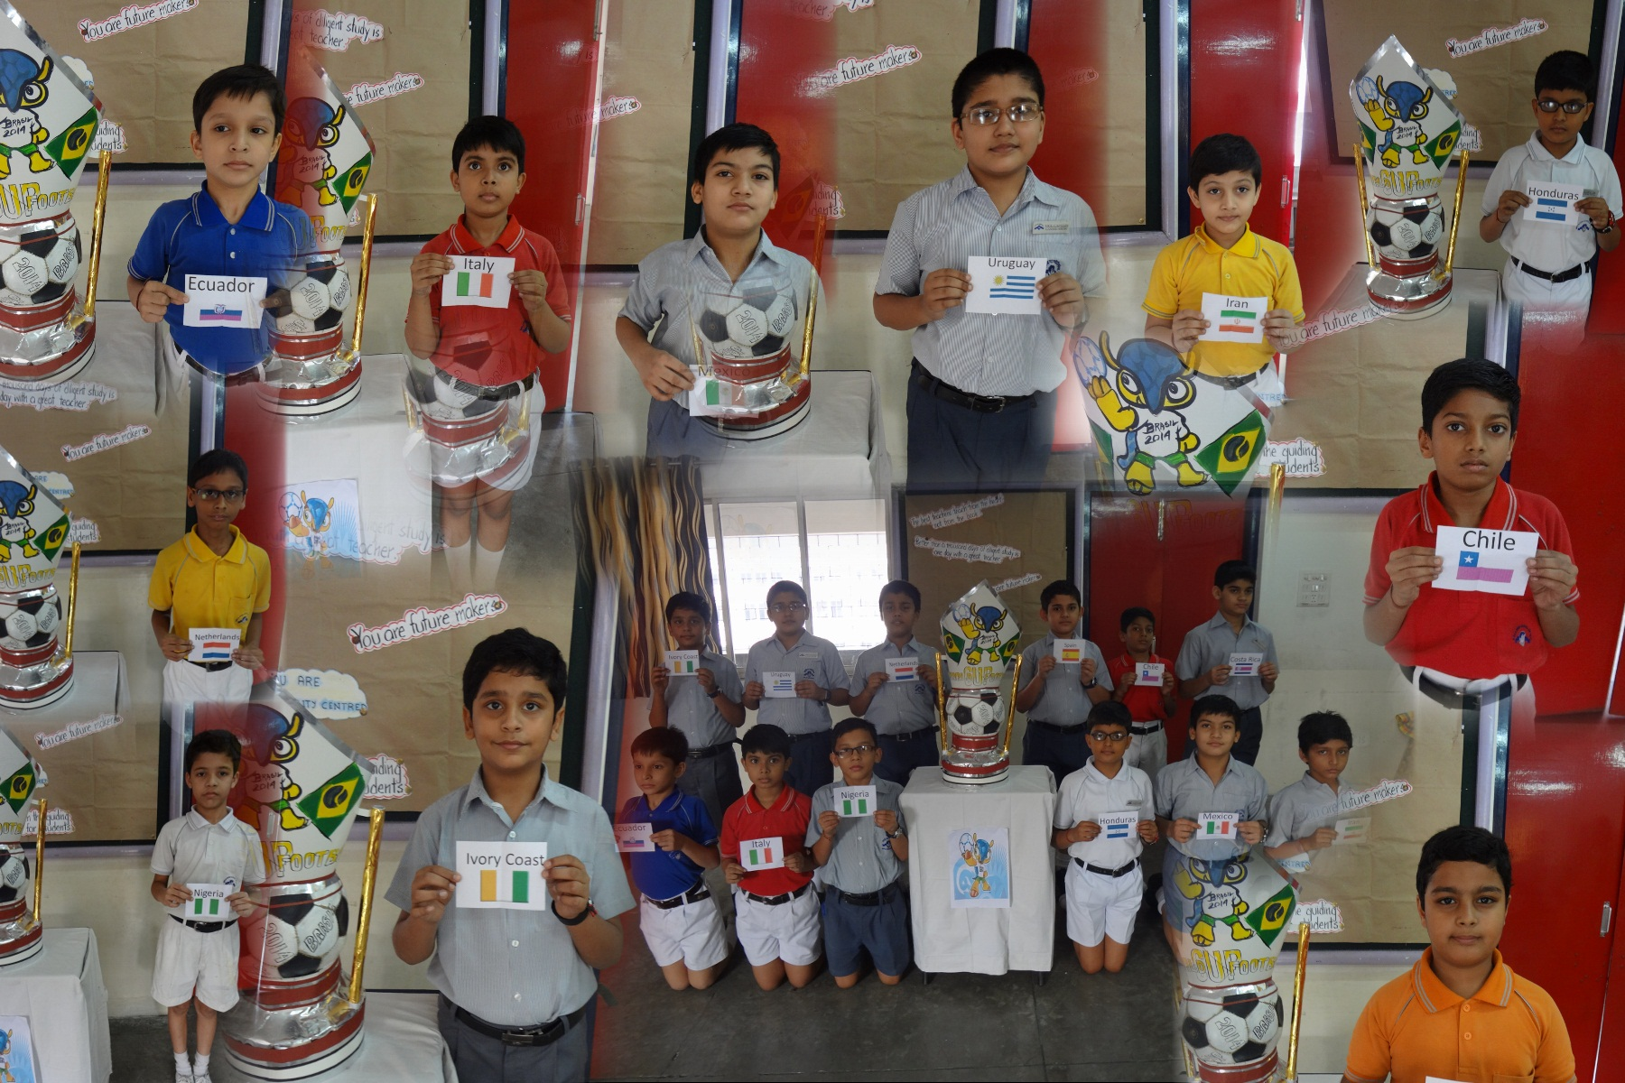
Our reps from
Classes IV & V
IV A—Nigeria
IV B _{1—}Italy
IV B₂ -- Chile
IV C—Iran
IVD– Spain
IV E -- Netherlands
V A—Costa Rica
V B—Honduras
V C—Mexico
V D– Ecuador
V E₁– Uruguay
V E₂ --- Ivory Coast

Slide 8
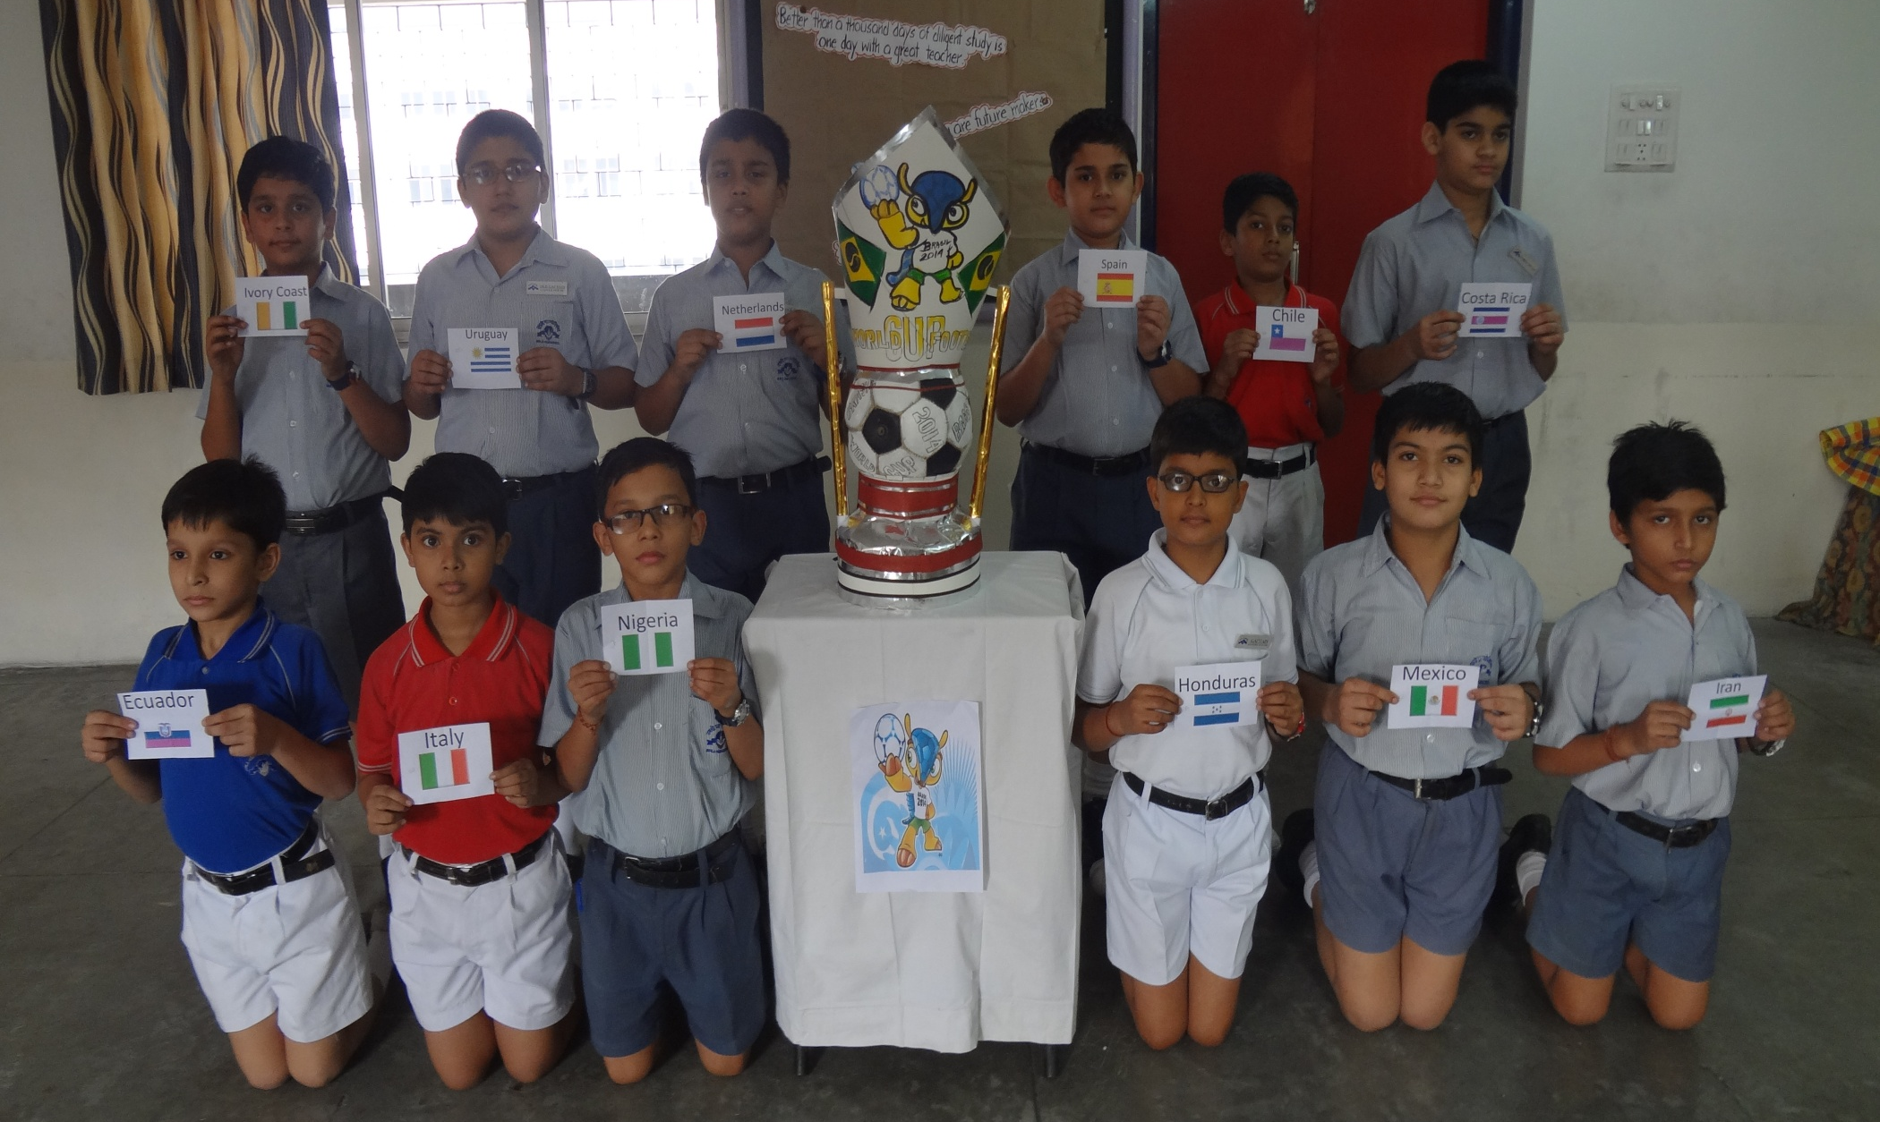
12 countries represented by
Classes IV & V

Slide 9
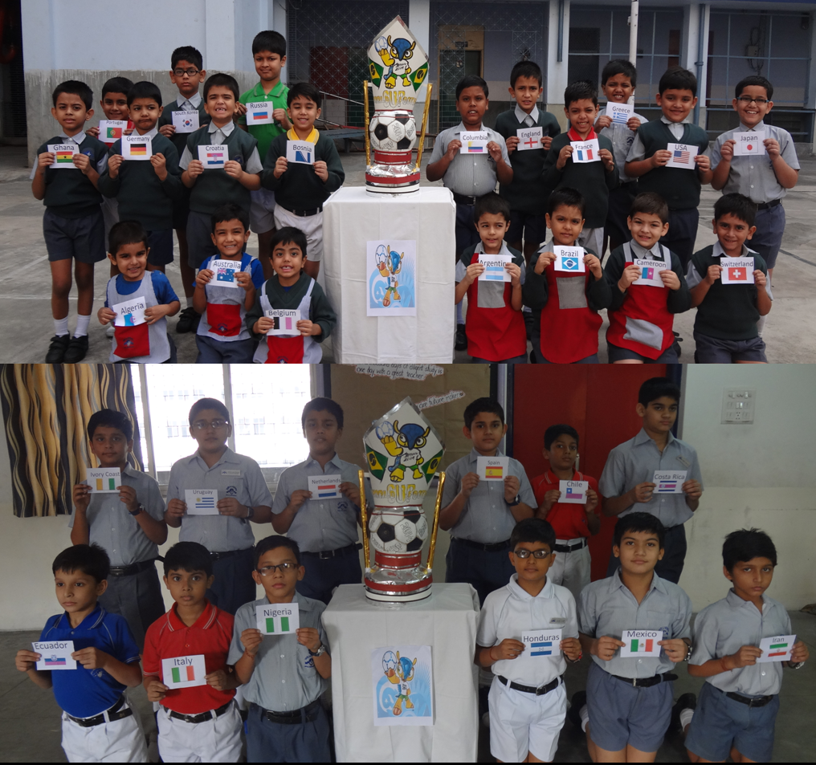
32 classes
adopted
32
countries
of FIFA
World Cup 2014

