Slide 1
Easter is coming!
Primary School in Bydgoszcz,
POLAND

Slide 2
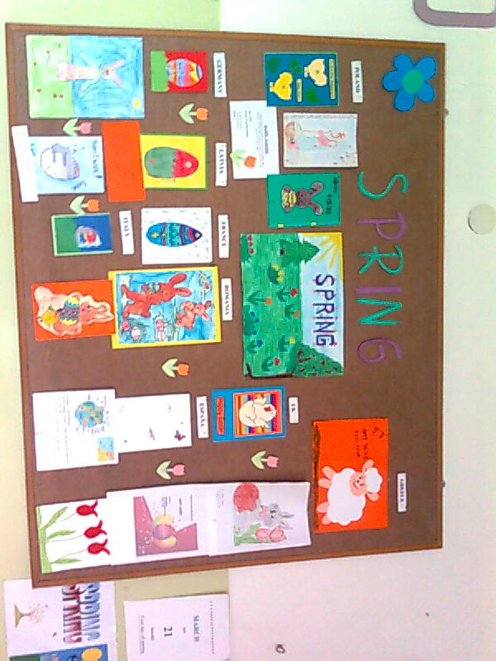
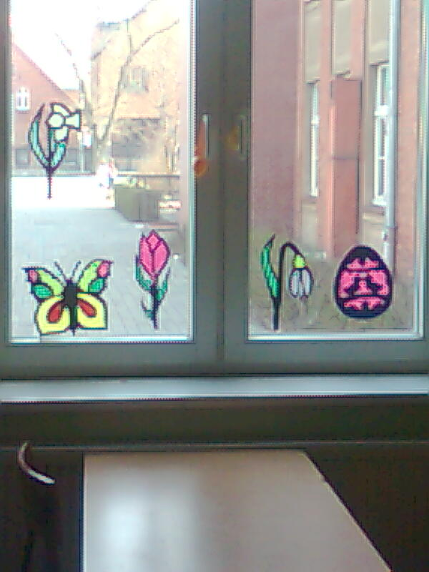
Waiting for Easter

Slide 3
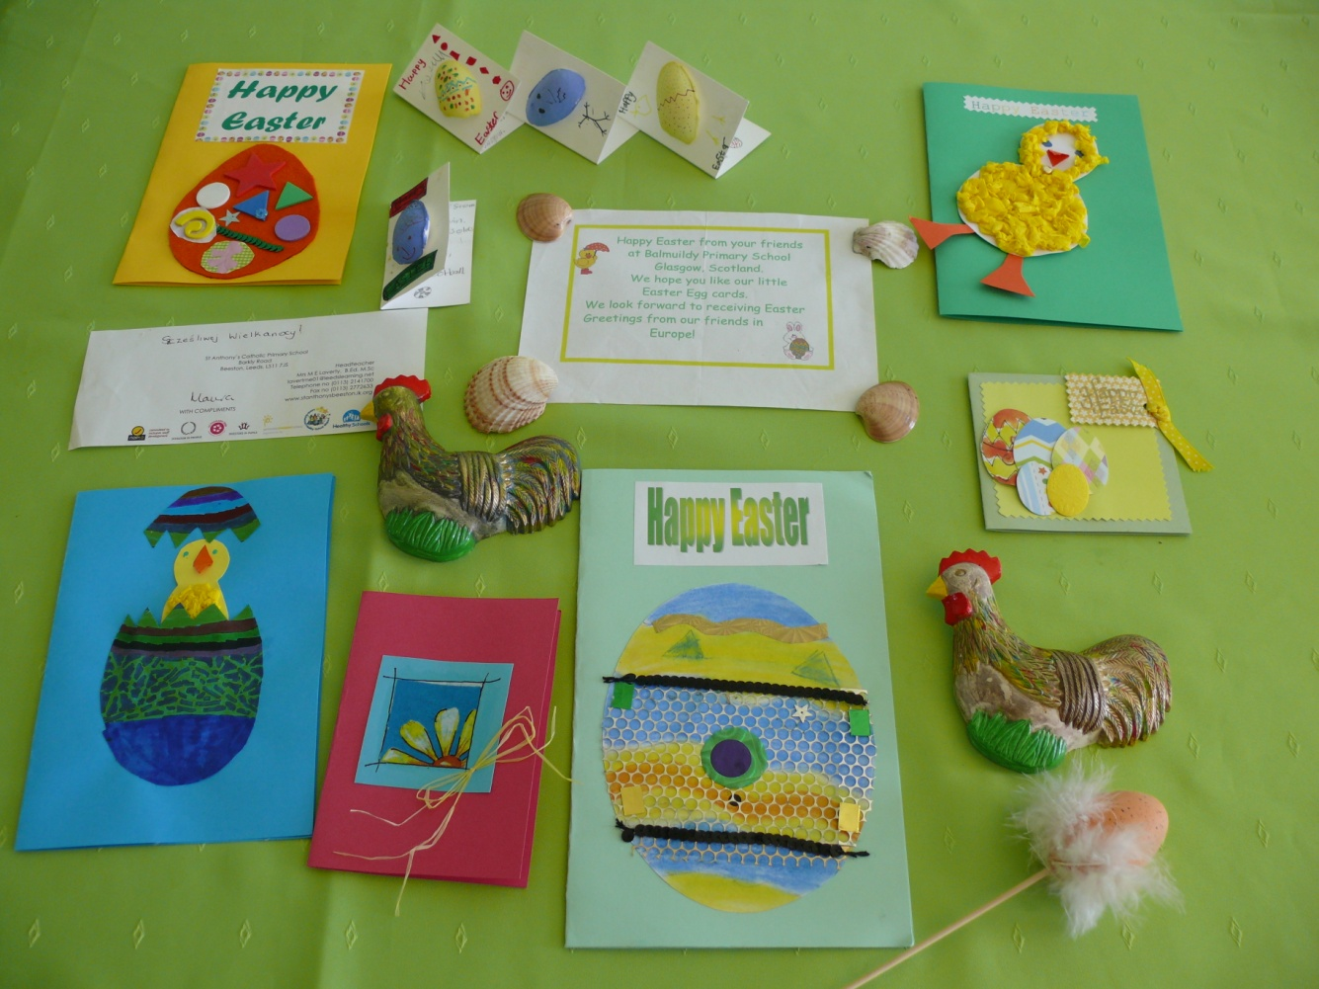
Easter cards from our British Friends

Slide 4
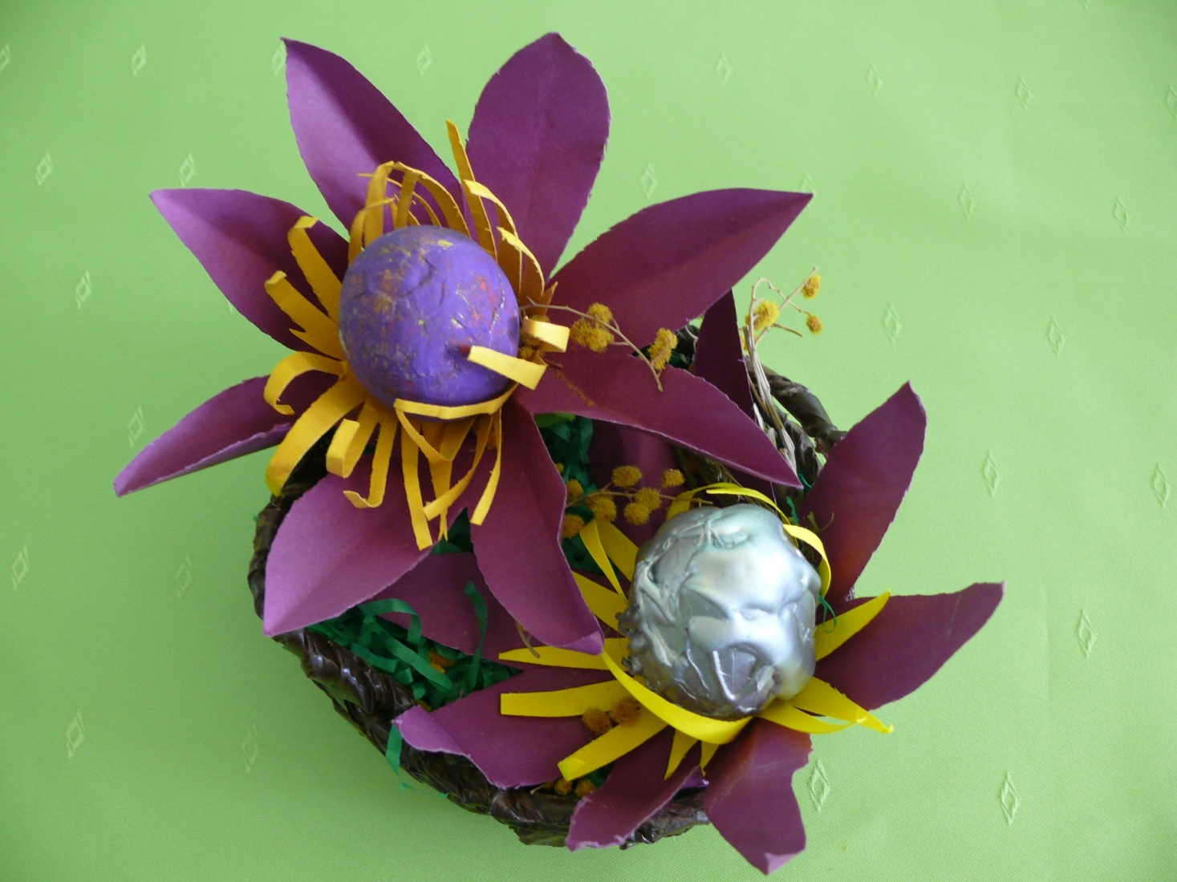
Easter basket from Croatia

Slide 5
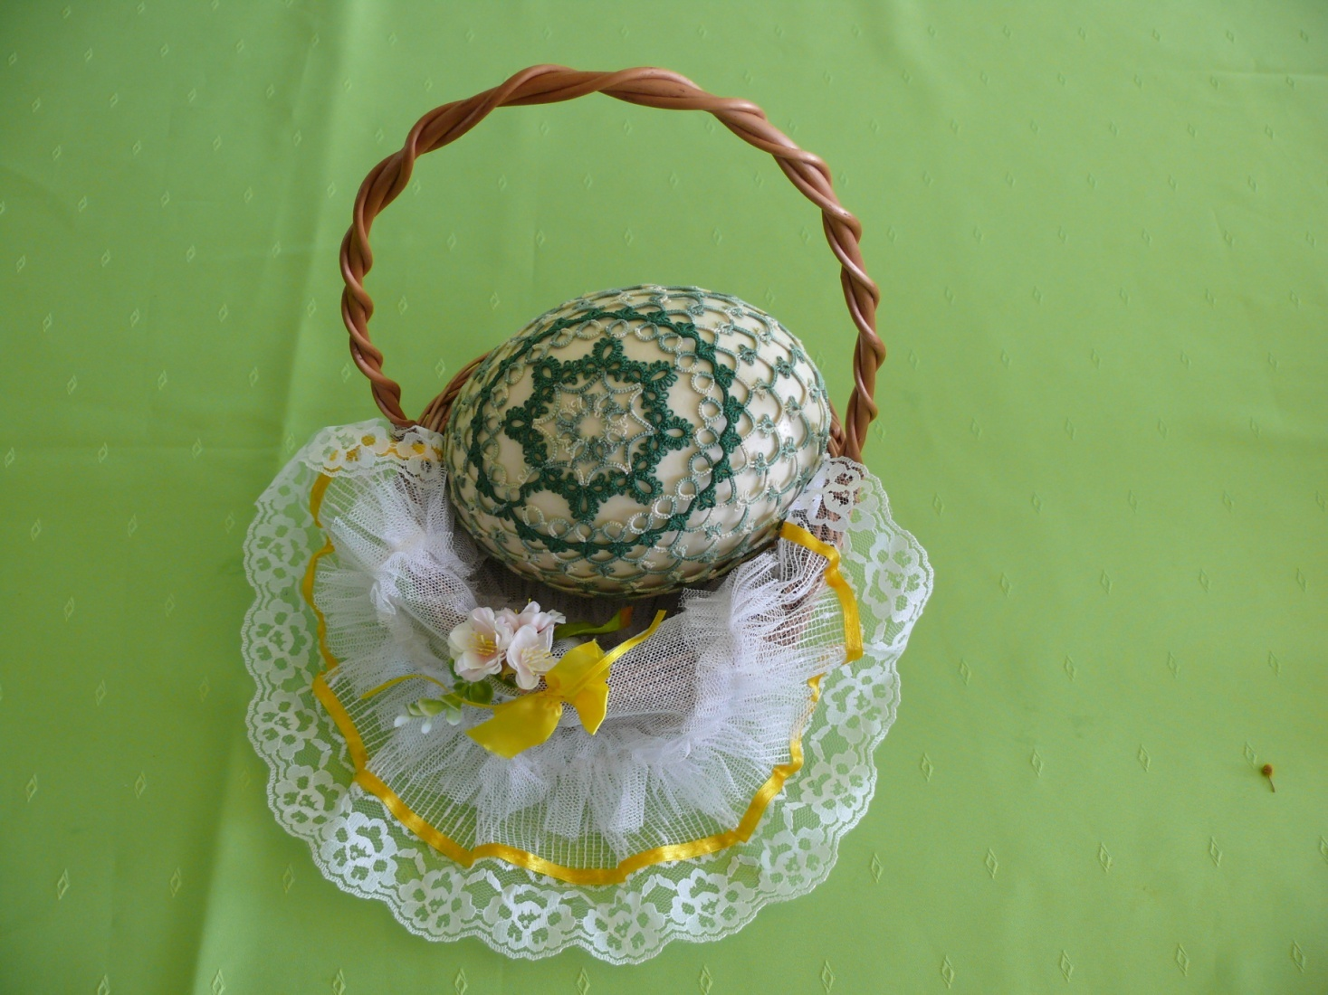
Ostrich Easter Egg

Slide 6
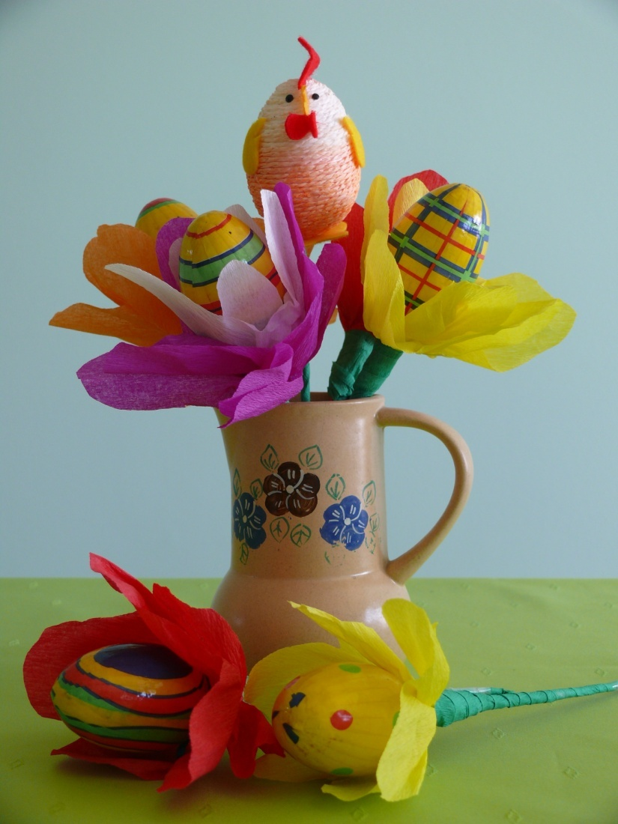
Flowers and a chick
(made of eggs and paper)

Slide 7
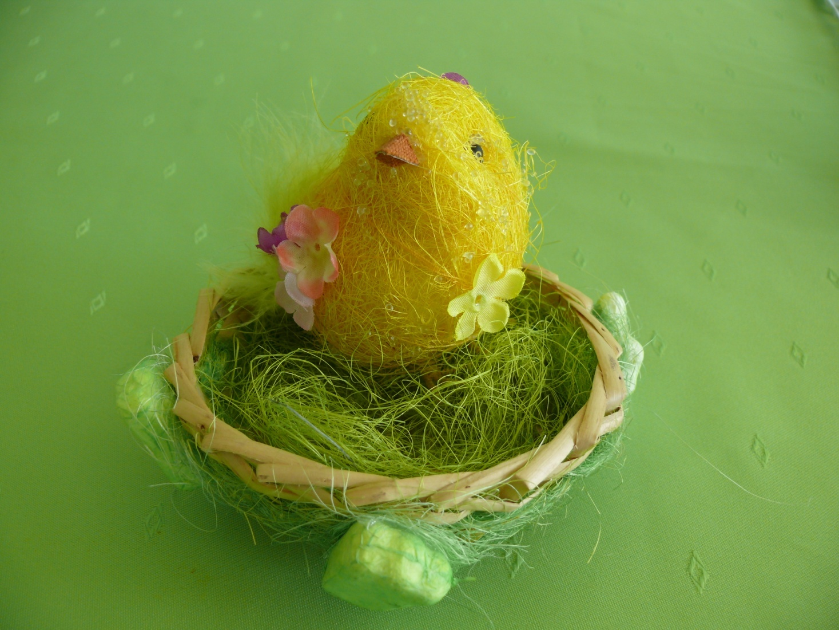
A chick made of thread and paper

Slide 8
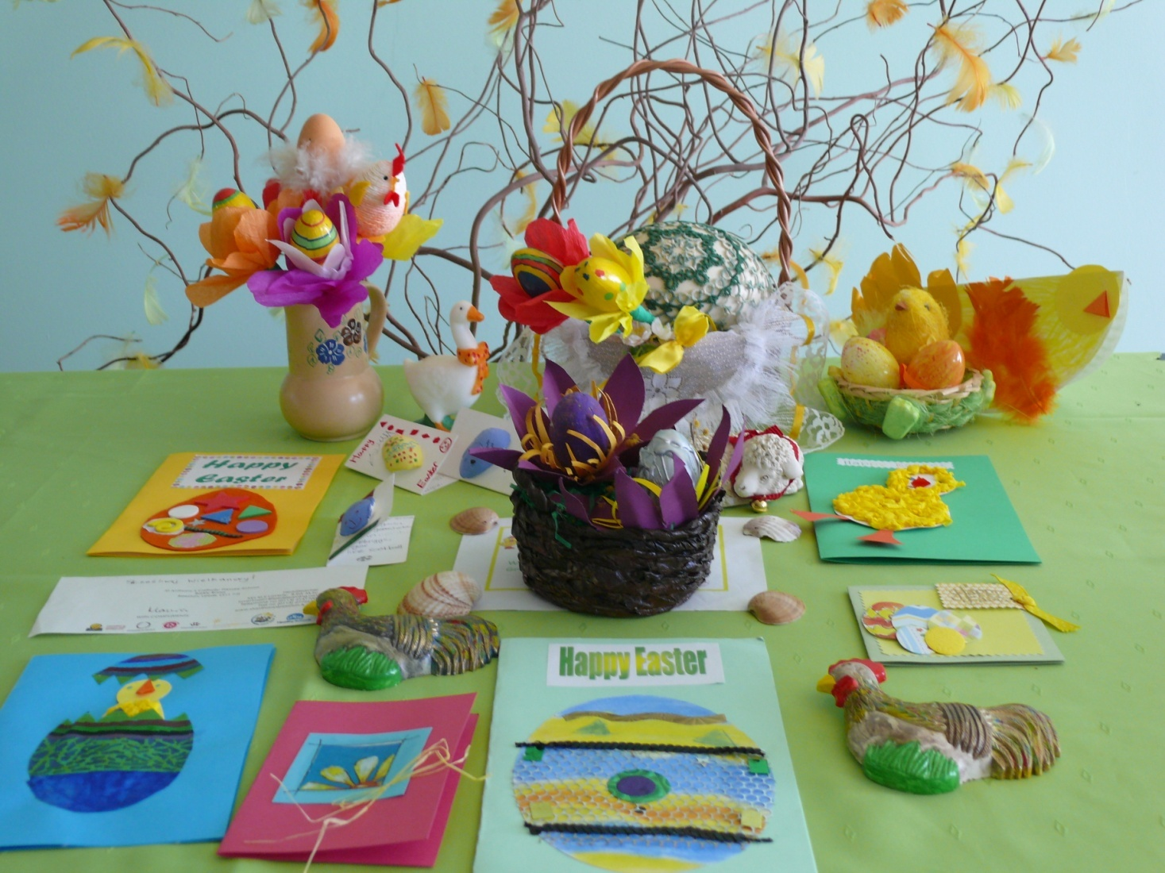
Easter decoration in our school

Slide 9
Dear Friends!
We would like to thank you very much for your Easter wishes, beautifully made Easter cards and the basket.
We wish you all the best,
Teachers and students from Polish primary School.

