Slide 1
WHAT DO WE PLANT?
POEM BY Henry Abbey

Slide 2
What do we plant?
Year 6 students of Chernivtsi school # 6 translated the poem into Ukrainian and made their illustrations to it.
What do we plant when we plant the tree?
We plant the ship which will cross the sea.
What do we plant when we plant the tree?
We plant the houses for you and me.
What do we plant when we plant the tree?
A thousand things that we daily see.

Slide 3
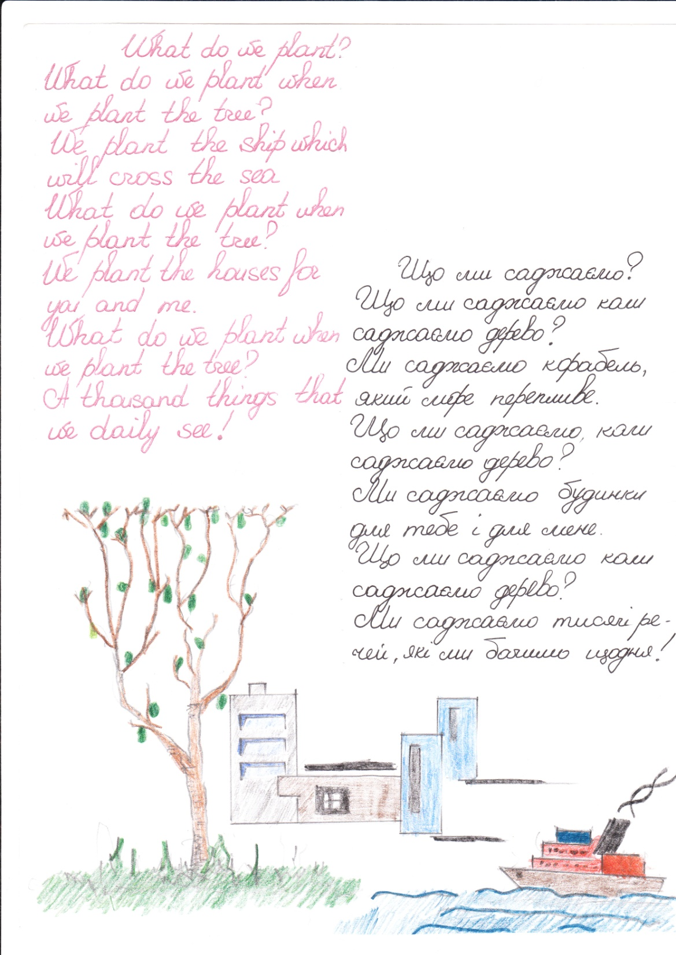

Slide 4
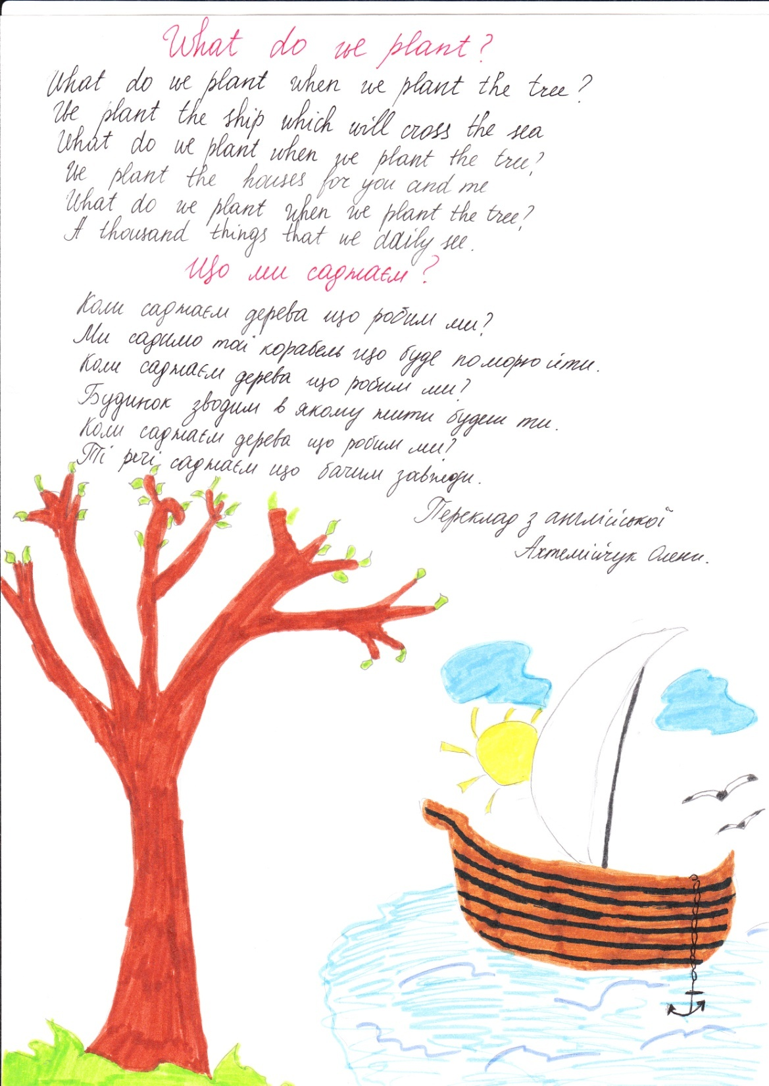

Slide 5
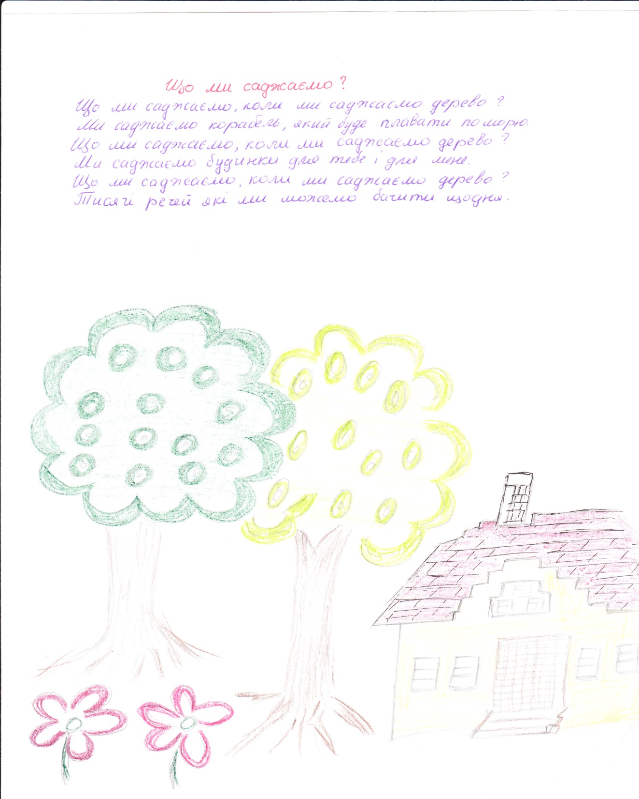

Slide 6
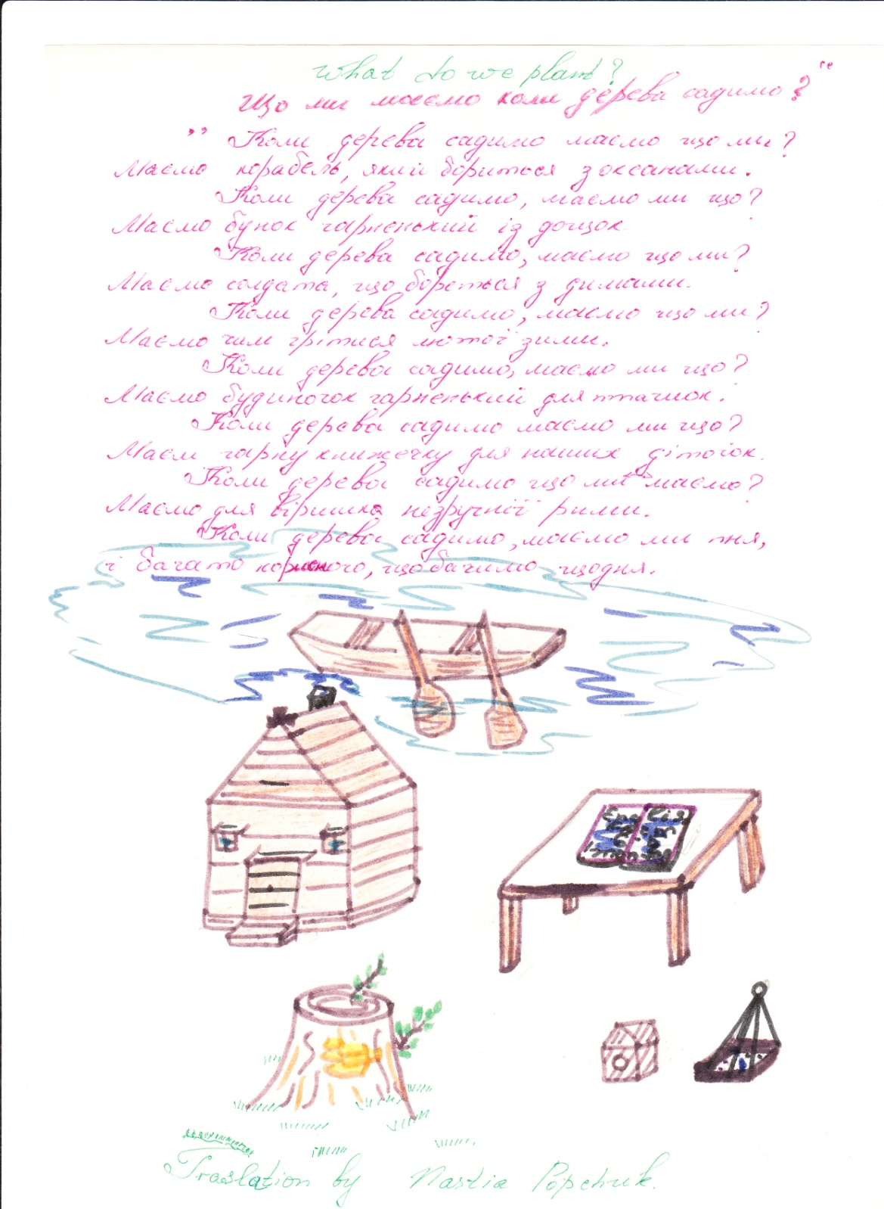

Slide 7
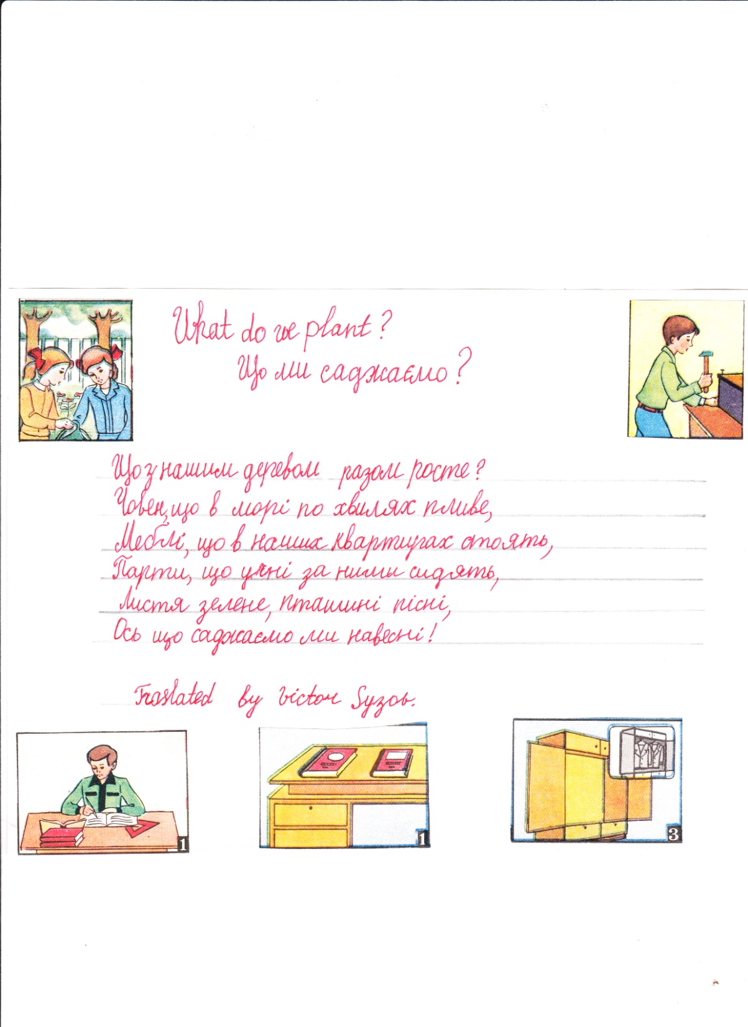

Slide 8
