Slide 1
Shahi Vegetable Cutlets
By
Tanmay Malik
class 2

Slide 2
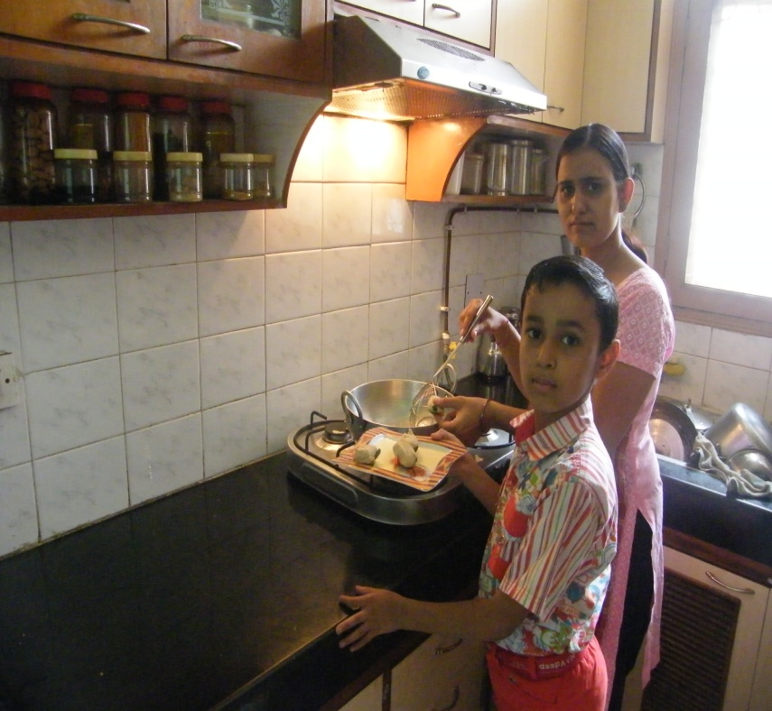
Ingredients
1 Cup Suji (semolina)
1 cup milk
50 grams raisins
50 grams cashewnuts
Mixture of grated carrot, cauliflower, capsicum, peas and coriander
1 Table spoon of ginger and garlic paste
1 tea spoon salt
½ cup oil

Slide 3
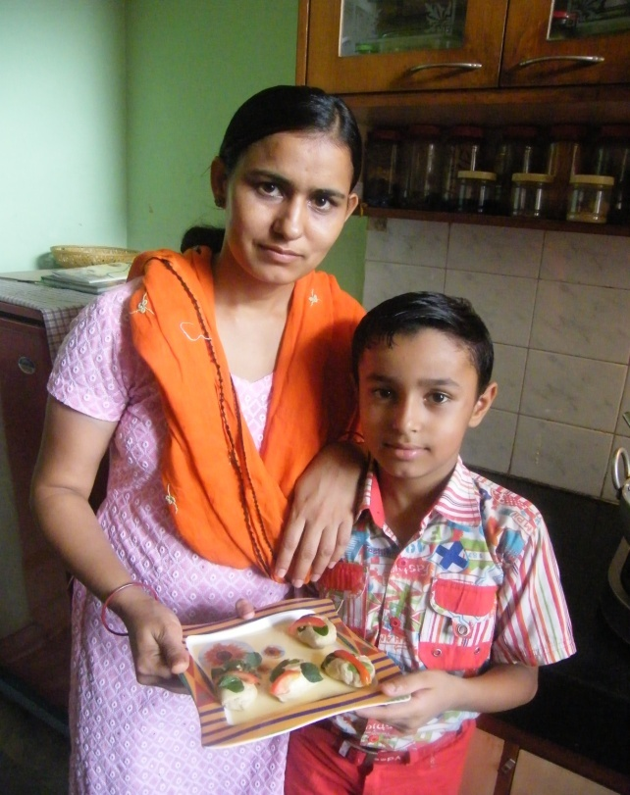
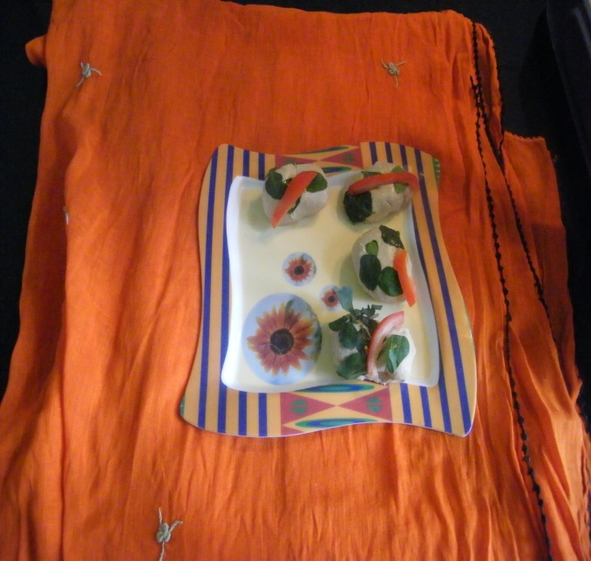
Method
Mix the semolina and milk in a pan and cook for 2-3 minutes.
2) Add all the grated vegetables, cashewnuts, raisins, garlic and ginger paste and salt in the mixture
3) Remove the pan from the flame and allow to cool for a minute. Give shape of your choice .
4) Place the pieces in a greased microwave plate for 3 to 4 minutes in the microwave or deep fry.
5) Serve hot with mint chutney and sauce.

