Slide 1
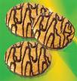
Cookies
By Diana

Slide 2

Ingredients
Two cups flour
1 teaspoon baking soda
1 teaspoon salt
100g. butter
1 teaspoon vanilla
1 cup sugar
2 eggs
1 cup nuts

Slide 3
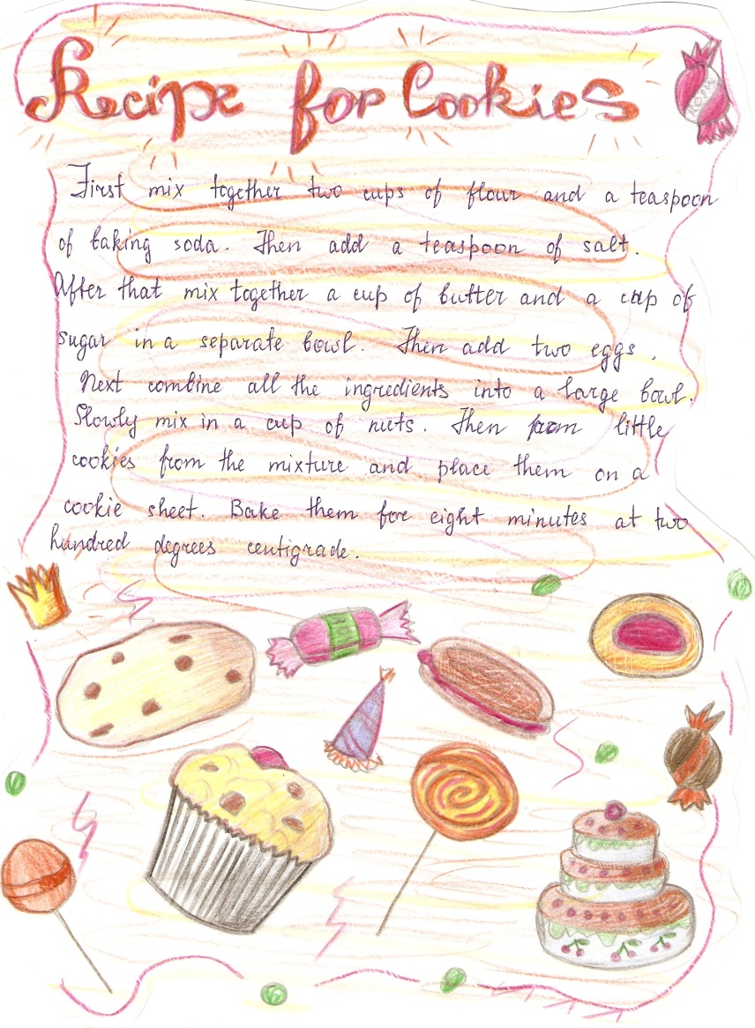
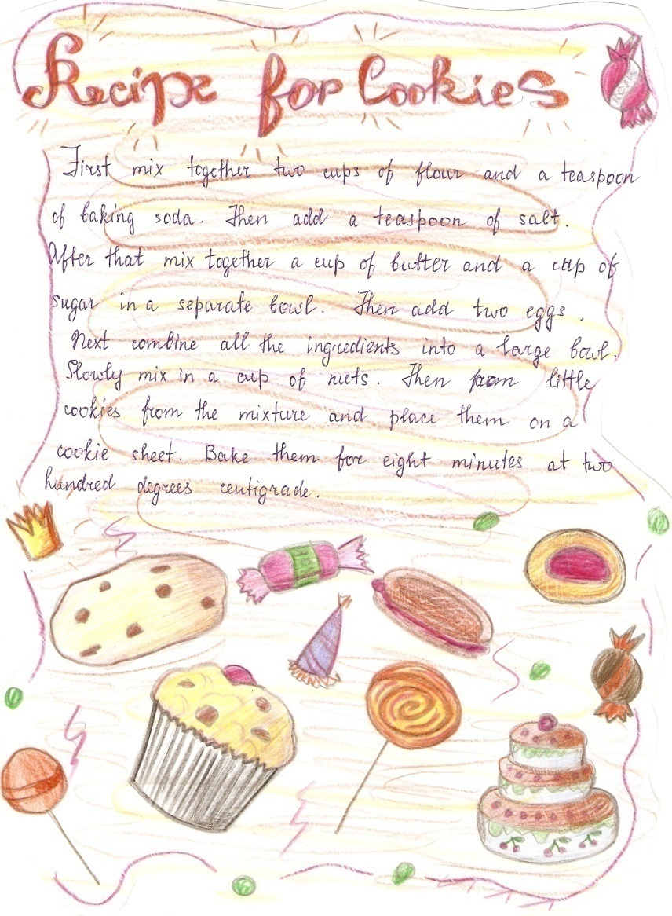
Procedure

