Slide 1
Pizza
by Kate

Slide 2
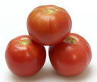

Ingredients
Sausage
Tomatoes

Slide 3
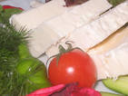
Ingredients
300 g. minced sausage
200 g. grated cheese
3 tomatoes
3 peppers
Mayonnaise
Ketchup
Mushrooms

Slide 4
Procedure
1.Pour the mayonnaise on pizza
2. Cut sausage, tomatoes, mushrooms, pepper and olives
3. Grate cheese
4. Put all the ingredients on the top of pizza
5. Add some ketchup and bake it.

Slide 5
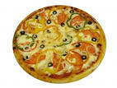
Enjoy your pizza!

