Slide 1
Delicious recipes
from Chernivtsi, Ukraine

Slide 2
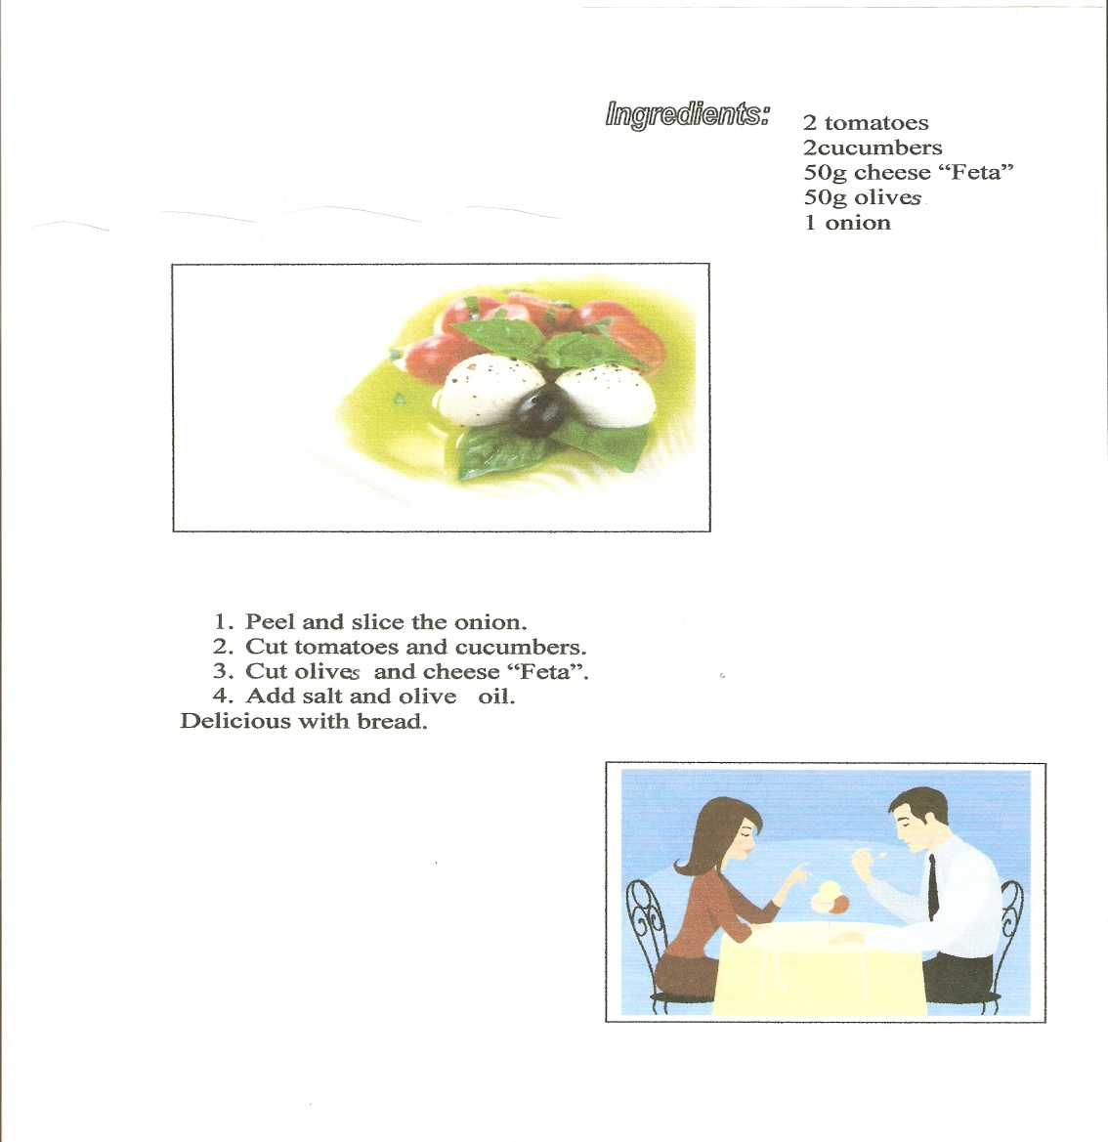
Salad “Dream”

Slide 3
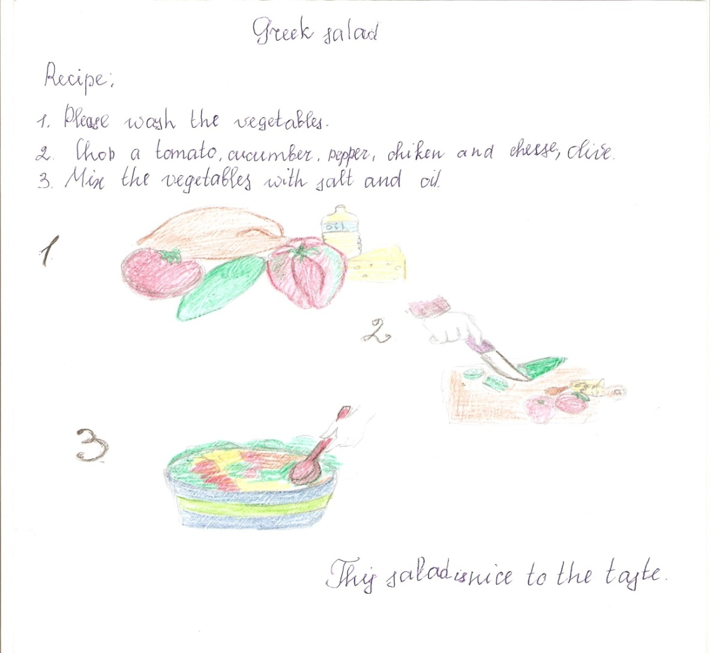
Greek salad

Slide 4
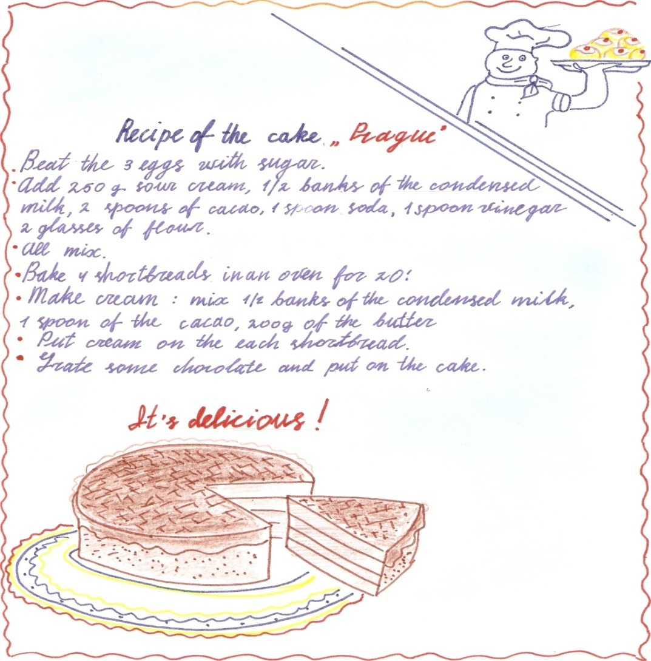
Cake

Slide 5
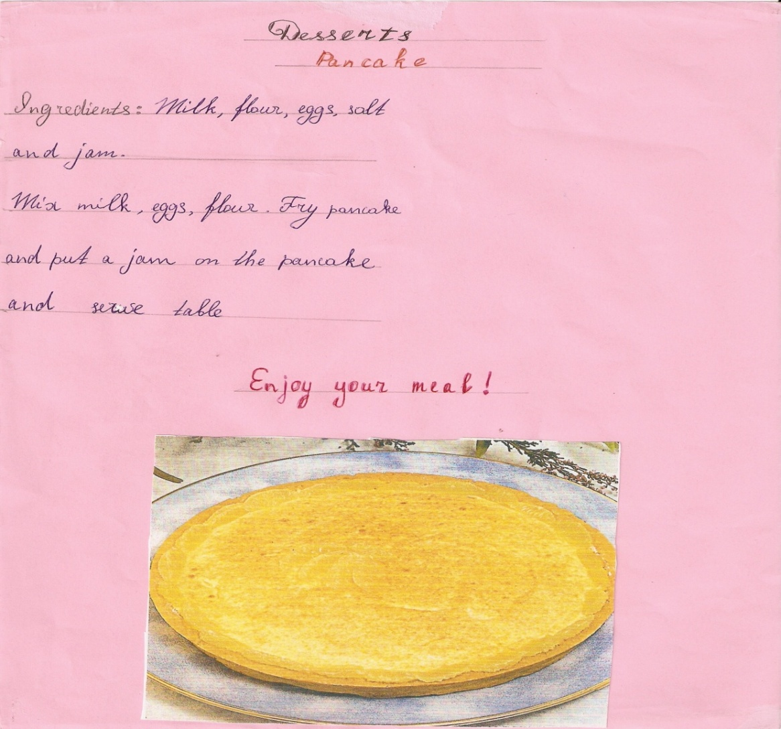
Ukrainian pancake

Slide 6
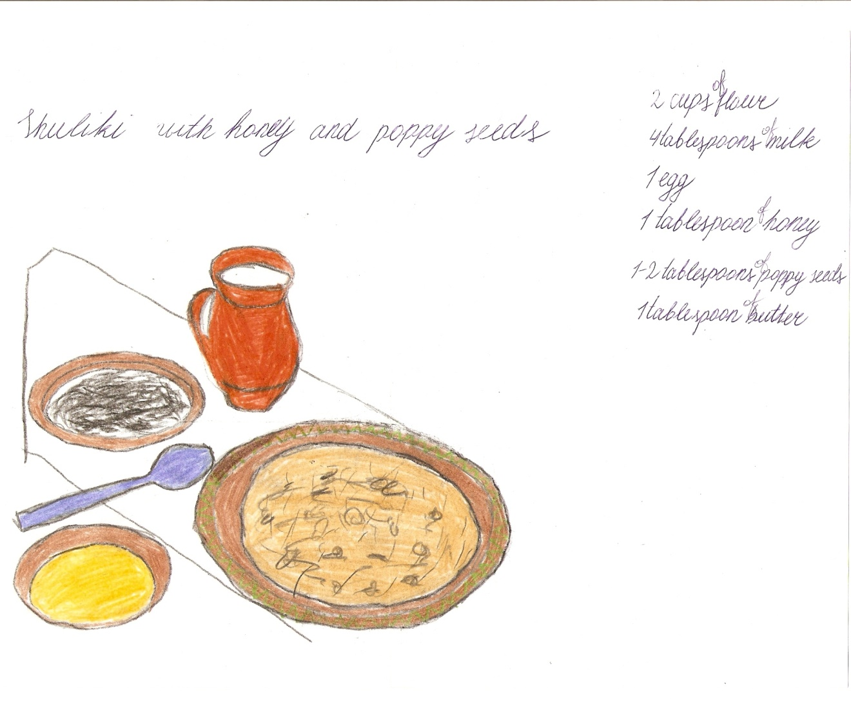
Biscuits “Shuliki”

Slide 7
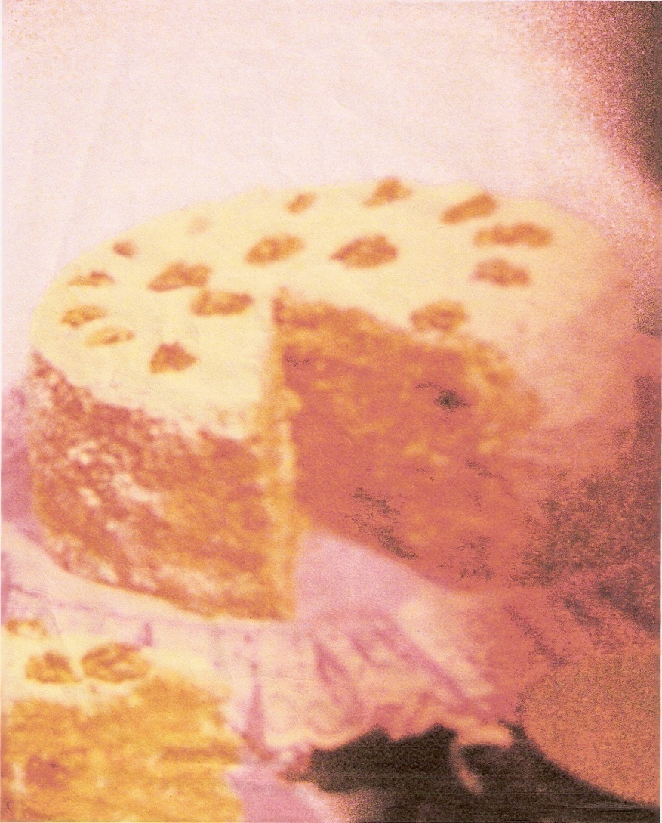
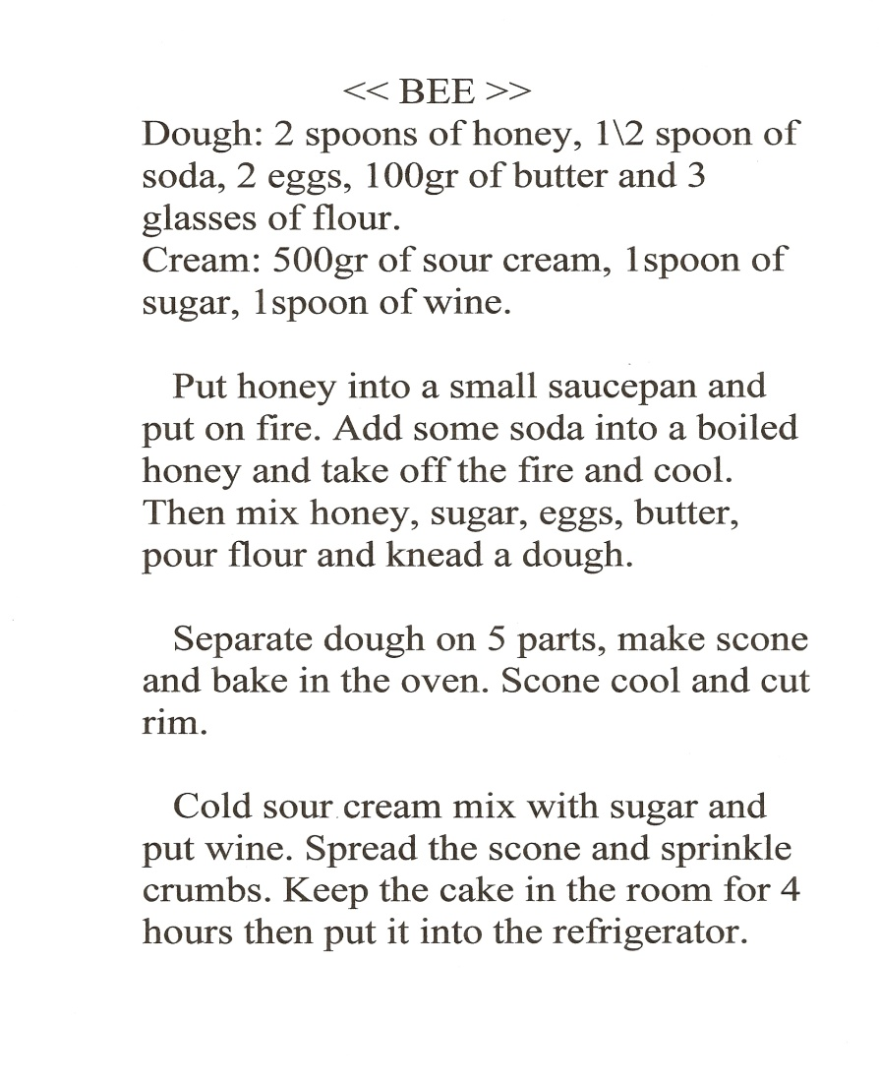
Cake “Bee”

Slide 8
Projects were made by students of the 7th and 8th forms
Chernivtsi school #6, 2009

