Slide 1
Save water
Index
1. Why water is important?
Misuse of water.(images)
3. How can we save water?
4. Why do we have to save water?

Slide 2
Why water is important?
Water is important, because without water all plants will stop growing and die.
And if there are no plants or water, all animals will lose their food and shelter, then finally humans will also die and Earth will become one lifeless planet .

Slide 3
Misuse of water
When we take shower we waste big amount of water!
Sometime we forget to turn off the tap!
Keep the tap open when we are washing dish, cups etc.

Slide 4
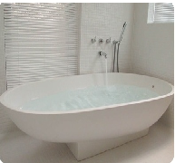
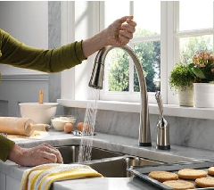
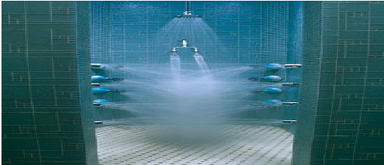
We have to cut this type of situation!!

Slide 5
How can we save water?
We can save water in the following ways:-
We can use rooftop rain water harvesting.
We can use bucket when we are taking shower.
After using water immediately turn off the tap.

Slide 6
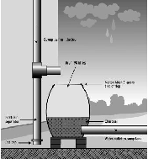
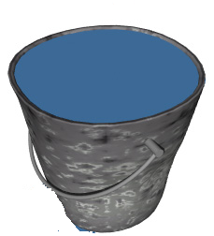
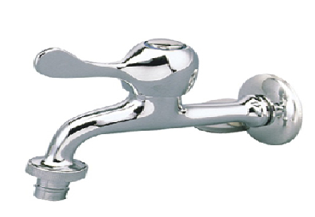
This is the example of saving water.
1. Rooftop rain water harvesting.
2. Use bucket when we are taking shower.
3. After using water immediately
turn off the tap

Slide 7
The story of waste and save …
Save
Waste
Now it is 2059, only salty water is left on the Earth.
Life is going less and less, finally there are only 100 people in the world.
Even people who are alive are hungry and poor. Soon there will be no people on the Earth.
So friends its high time that we started thinking about this life saving resource!!!
Now it is 2059, our drink able water is more than salty water. We tried to make the Earth peaceful and now our dream has come true! Now people do not have to worry about their drinking water. And we will pass on this situation to our new generations.
HURRAY!! We have done it

Slide 8
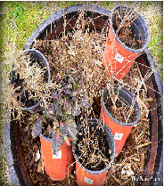
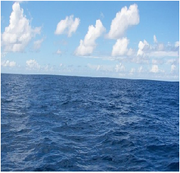
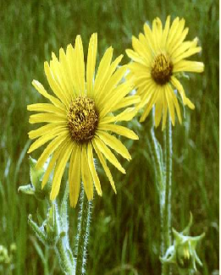
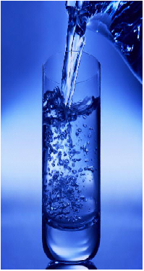
Waste
save

Slide 9
Thank you for watch ing my
Power point presentation.
---- Hyeon Jo lee

