Slide 1

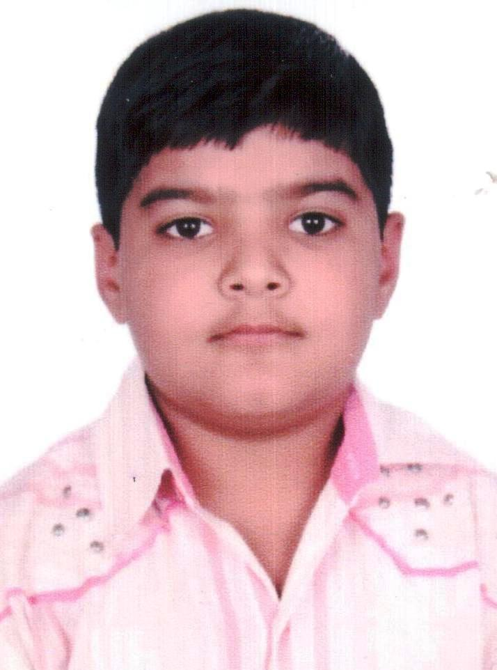
Hi friends !
I am Mehul from The Indian Heights School, Dwarka
See what I feel about this precious life-saving resource

Slide 2

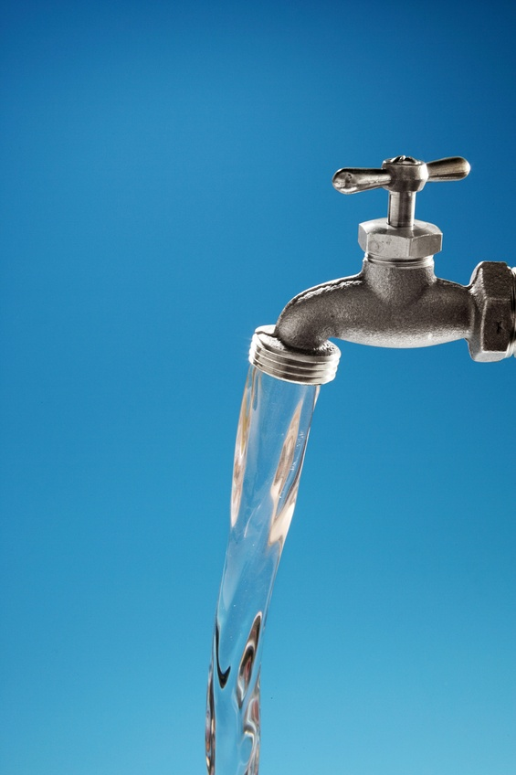
We are wasting water!

Slide 3


Save save water
I think we are not doing enough to stop that drop!

Slide 4
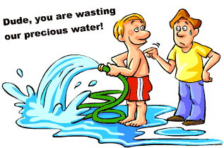
Do not wash cars and bikes with pipe

Slide 5

Use less water

Slide 6
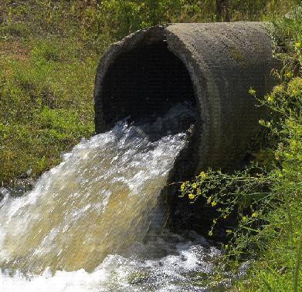
See how we are polluting water !!
Don’t you think something should be done?

